Slide 1
Evaluating the relationship between intensity of teacher professional development and student achievement in a Northern New Mexico inquiry-based science program
Dr. Emily A. Diaz, Westat
Gwen Perea Warniment, ABD, LANL Foundation
Dr. Eric Rolfhus, Westat
Notes:
Session: Fri, Nov 02, 2018 (02:15 PM - 03:15 PM) 3 presenters so about 15 minutes

Slide 2
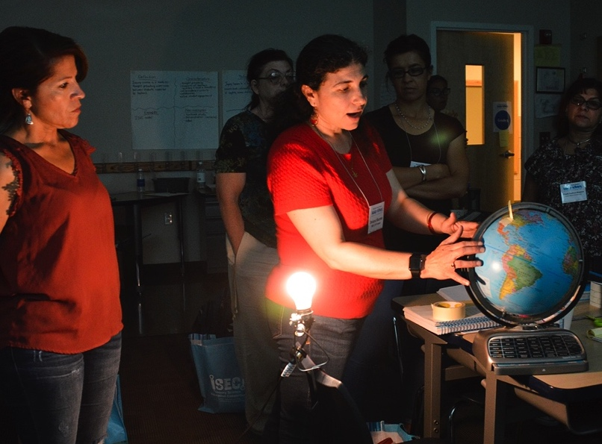
Presentation outline
What is ISEC 2.0?
What is the theory of action?
What are the goals?
Year 1 (2016/17) and Year 2 (2017/18) findings
Challenges of implementation
Lessons learned
Best practices

Slide 3
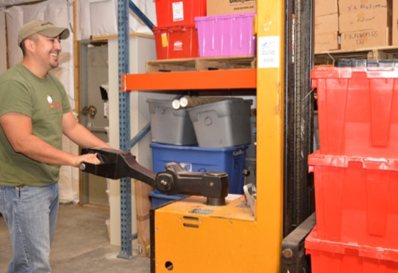
ISEC 2.0: An Inquiry-Based Science Program Focused on Intensive Teacher PD
Implemented by the Los Alamos National Laboratory (LANL) Foundation in 13 elementary schools in New Mexico
Intensive professional development
3 levels: low, medium, and high
A week long Summer Institute
Communication with site leadership
One-on-one coaching
Whole staff development
Kit replenishment system
Students in grades 3-6 were administered pre- and post- knowledge tests before and after kit instruction
Notes:
Year 1 (2016/17) and Year 2 (2017/18)
teaching specific Full Option Science System/Science and Technology for Children (FOSS/STC)

Slide 4
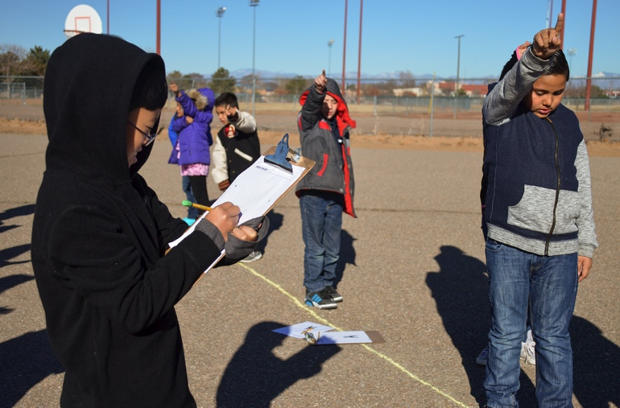
ISEC 2.0 Kits by Grade
Kit | Grade
Motion and Matter | 3
Water and Climate | 3
Energy | 4
Soil, Rocks, and Landforms | 4
Earth and Sun | 5
Mixtures and Solutions | 5
Earth History | 6
Electricity, Waves, and Information Transfer | 6

Slide 5
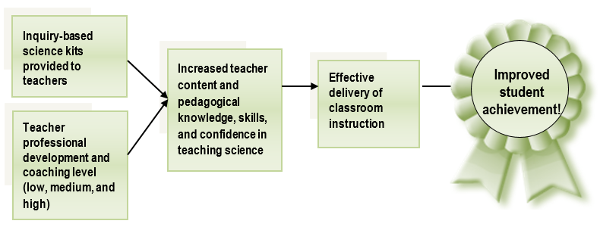
ISEC 2.0 Theory of Action

Slide 6
Map of ISEC 2.0

Slide 7
ISEC 2.0 Four Goals
Improve student achievement by increasing the number of highly effective teachers;
Increase teacher retention by building a teacher corps and teacher leadership corps;
Provide FOSS and STC science kits to teachers in all NNM districts; and
Improve leadership within the school district by producing highly effective teacher leaders.

Slide 8
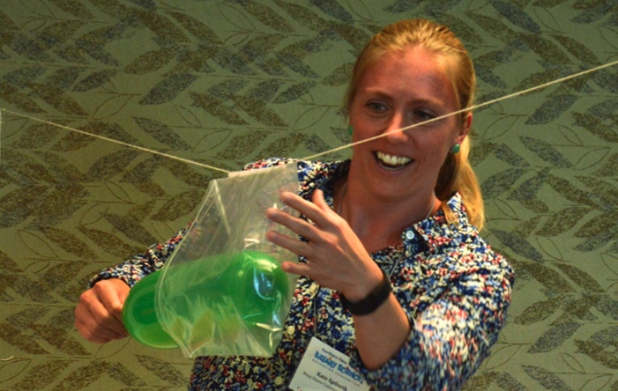
ISEC 2.0 Findings from Year 1 (2016/17) and Year 2 (2017/18)
Statistically significant gains on all of the kit assessments except for Mixtures and Solutions in Spring 2018
Generally medium or large effect sizes, regardless of PD
Large average classroom gains (20%-49%) across kits
Demonstrates successful implementation of the ISEC 2.0 theory of action.
Findings vary by intended and implemented PD dosage

Slide 9
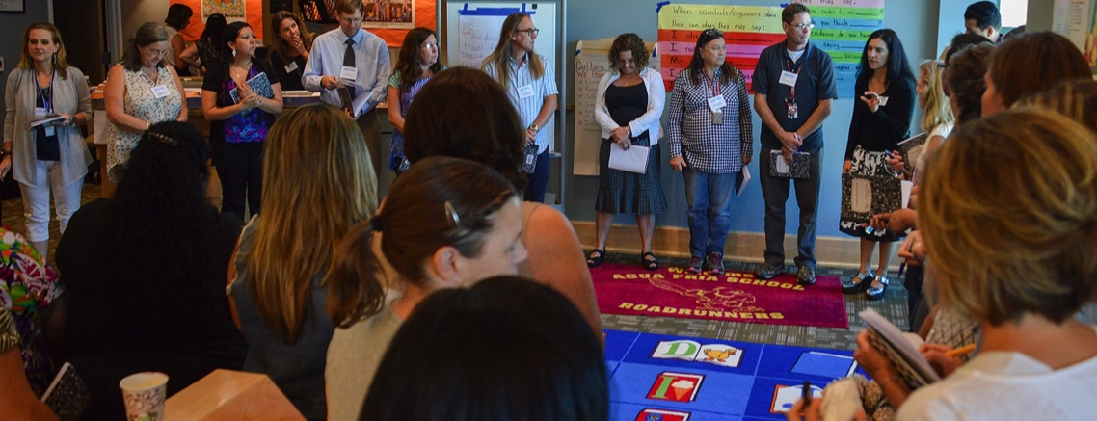
Challenges of implementation
Year 1 was the first year teaching the new FOSS/STC kits which are aligned to new standards
Rural nature of New Mexico
Difficult to visit each school and conduct PD sessions
Teacher, principal, and superintendent turnover
Teacher evaluation consists of on math and reading assessment scores so less time devoted to science
Notes:
Other barriers:
Lack of teacher candidates
Minimal connectivity of K-12 with Higher Ed
Time constraints for Professional Development
Teacher content knowledge is often limited
NGSS are complex
Politicized education system in NM

Slide 10
Lesson Learned
Formative evaluation is used to guide future PD and evaluation efforts
Depth versus breadth
The more time teachers spent on a particular investigation the less kit content they teach
The kit assessments cover all the content
No way to subset by investigation
Notes:
Other programmatic lessons:
Communication…
Leveraging infrastructure and money to serve multiple districts also demands customer service, a functional, complex database, and advanced warehouse systems
Attempting to mitigate systemic issues like turnover, implementation, and time constraints are critical, but only as successful as your partner engages

Slide 11
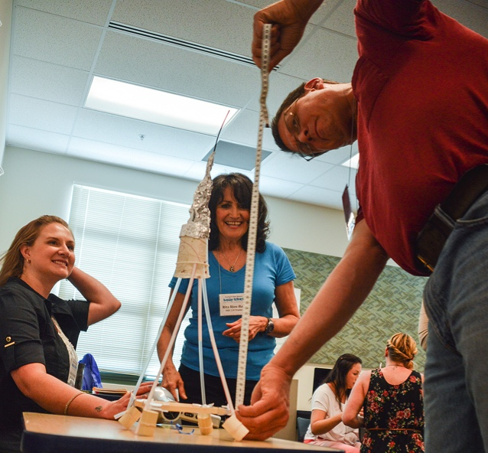
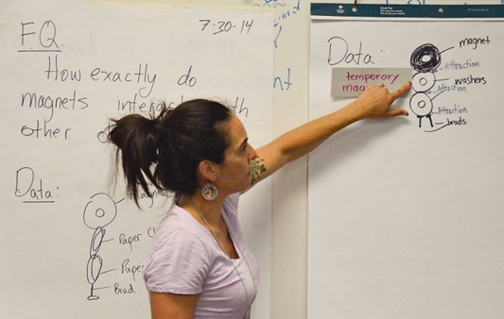
Best practices
Across Year 1 and Year 2 teachers who attended the Summer Institute had higher achievement gains that those who attended the one day make-up training

Slide 12
Thank you for your time
Emily Diaz
emilydiaz@west.com
Eric Rolfhus
ericrolfhus@westat.com
Gwen Warniment
gwen@lanlfoundation.org

