Slide 1
Sustaining an Evaluator Community of Practice
David J. Bernstein, Westat, Chair
Michael Hendricks, Evaluation Consultant
Kathryn Newcomer, The George Washington University
Mary Ann Scheirer, Scheirer Consulting
Valerie Jean Caracelli, U.S. Government Accountability Office
Brian L. Yoder, American Society for Engineering Education
+++ Current/former Washington Evaluator (WE) Board +++
+++ Washington Evaluator Members +++
+++ AEA Members and Conference Attendees +++
October 17, 2014, 1:45-3:15; Room 710, Colorado Convention Ctr.

Slide 2
Session Outline
Facilitator Introductions
Session Introduction
Reflections on an Evaluator Community of Practice: Washington Evaluators
Think Tank: Sustainable Practices for Maintaining Evaluation Communities
Sharing Learning
Washington Evaluators

Slide 3
Session Introduction
What does it take to establish and maintain an evaluation community of practice?
A Historical Example: Celebrating 30 Years of the Washington Evaluators
Exploring together: Sustainable practices that can support evaluators and the evaluation field.
Washington Evaluators

Slide 4
Celebrating 30 Years
Enjoy the Washington Evaluators 30th Anniversary slide show.
Washington Evaluators

Slide 5
WE Member Input on Communities of Practice
Networking and Social Activities
Activities that foster personal connections.
“Speed-dating” format to share ideas on topical subjects.
Evaluation-related Resources and Guidance
Website with standardized definitions and resources.
Guidance for evaluators, such as affiliate-area resources.
Case clinics to provide in-depth focus on evaluation issues.
Searchable member directory with interests, tools, etc. (WE has one, but members don’t always complete provide information).
Mentoring and Peer Support
Buddy system to pair evaluators by their interests.
Ways of integrating those new to the evaluation community (see mentoring).
Washington Evaluators

Slide 6
Think Tank Format
Per AEA, a think tank is a 90-minute session focusing on 1 issue/question.
Small Group Discussion: 20 Minutes.
Reconvene to share enhanced understanding through discussion facilitated by Chairperson: 20 Minutes.
(Concise, Specific, Operational Ideas)
Wrapping Up/Next Steps: 5 Minutes
Washington Evaluators

Slide 7
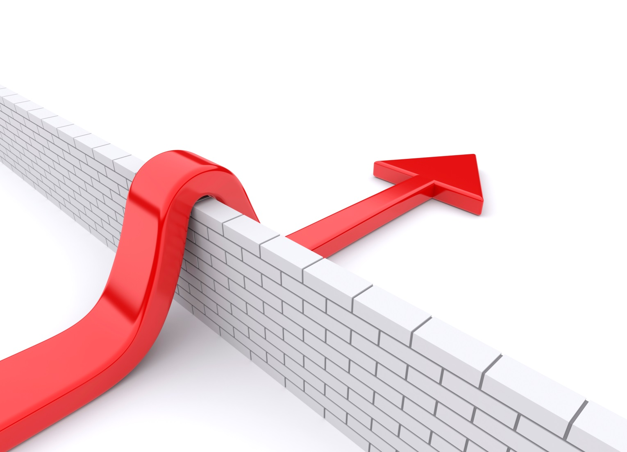
Think Tank Questions
How can evaluation communities of practice take advantage of opportunities and address challenges to sustain evaluators and the evaluation profession?
What are the opportunities?
What are the challenges?
What practices sustain evaluators?
What practices sustain the evaluation profession?
Sustainable progress.
Operational ideas for AEA affiliates.
Support for evaluators and the profession.
Washington Evaluators

Slide 8
Contact Information
Washington Evaluators
www.washingtonevaluators.org
Twitter: @washeval
LinkedIn: Search for Washington Evaluators on LinkedIn
AEA’s Local Affiliates Collaborative: http://www.lacaea.org/
Washington Evaluators

