Slide 1
“So, don't ask me no questions And I won't tell you no lies So, don't ask me about my business And I won't tell you goodbye.”
Lynyrd Skynyrd
Survey Design 101

Slide 2
Survey design
01
101
Evaluation 2013, Washington DC, Susan Kistler
Notes:
Social Media Icons free for use with commercial and noncommercial design projects
From Creative Nerds at http://creativenerds.co.uk/freebies/beautiful-letter-pressed-social-media-icons/
Note that Creative Nerds has a wealth of great free resources for design in the freebies section of their website at http://creativenerds.co.uk/category/freebies/

Slide 3
iMeasureMedia
Susan Kistler
Susan Kistler – susan@imeasuremedia.com
Notes:
I’m Susan Kistler and most of you likely know me as the Executive Director of AEA. I also have an incorporated consulting business, iMeasureMedia. For this workshop, I need to be clear that I am wearing my iMeasureMedia hat and speaking in my role as a consultant – AEA does not endorse specific products or services, but I do.
Hat Icons by Rob Sanders – Licensed for non-commercial use
Available at http://www.iconarchive.com/show/hat-icons-by-rob-sanders.html

Slide 4
WHO AM I
Susan Kistler
Executive Director Emeritus for the American Evaluation Association
Taught Survey Design at University of Minnesota
Provided Training on Survey Design
Written Hundreds of Surveys
Conducted Surveys Online, On Paper, and In Person
Taken Surveys
Asked Questions and Gotten Answers
Asked Questions and Not Gotten Answers
And you can reach me at
susan@imeasuremedia.com

Slide 5
Getting to Know You Survey
90 seconds per person max please
What is your name?
What do you do for a living?
Do you work for the federal government? (Yes or No)
How many surveys did you complete in the past year?

Slide 6
Getting to Know You Survey
Person nearest to the door, take top yellow sheet (under don’t touch this!)

Slide 7
Getting to Know You Survey
Person nearest to the door, take top yellow sheet (under don’t touch this!)
Person to her or his left take second yellow sheet
(put back the don’t touch this sign!)

Slide 8
Getting to Know You Survey
90 seconds per person max please
What is your name?

Slide 9
Getting to Know You Survey
90 seconds per person max please
What is your name? First? Last? First and Last? Other?
Notes:
Question was not clear, what exactly was being sought was not clear.

Slide 10
Getting to Know You Survey
90 seconds per person max please
2. What do you do for a living?

Slide 11
Getting to Know You Survey
90 seconds per person max please
2. What do you do for a living? Level of detail
Notes:
Open ended questions elicit varying levels of detail and length of response

Slide 12
Getting to Know You Survey
90 seconds per person max please
3. Do you work for the federal government? (Yes or No)

Slide 13
Getting to Know You Survey
90 seconds per person max please
3. Do you work for the federal government? (Yes or No) How many neither yes nor no? What if you are a contractor? Can we generalize?

Slide 14
Getting to Know You Survey
90 seconds per person max please
4. How many surveys did you complete in the past year?

Slide 15
Getting to Know You Survey
90 seconds per person max please
How many surveys did you complete in the past year? What is the highest average? Lowest? How many didn’t answer w/integer? Hard for the recorder to analyze?

Slide 16
Let’s
Dive
In
Photo Creative Commons Licensed by Scott McLean on Flickr, noncommercial attribution
Notes:
http://www.flickr.com/photos/scott_mc/262603442/sizes/o/in/photolist-pcURy-73TXEv-6KJyDA-iAiey-9VZaW9-9VZaXu-7AitRr-53NBCw-a7DyAw-2c1qXL-MCgeu-MCoh8-ubhk2-8pkGHk-8x9DYQ-8x9DUu-4Vkbwr-53e5hE-891FCt-6npbe4-zbfn3-sLWyi-8SpPSu-3qj6j-MQrWE-8A6ac6-81XMXN-5JgMV2-FmBQd-bECe7G-6eyU5u-6CK7ed-849moo-2rHj7N-7uQWtk-Bh3oY-52dkqR-4oBa2-5ytCwo-6npb48-6npaSP-6ntiPL-cfNuGf-5HuJBU-8wuvy4-f6f3Q-4QHorN-d6nHTy-76cDyx-cHeTvW-mvcZD/

Slide 18
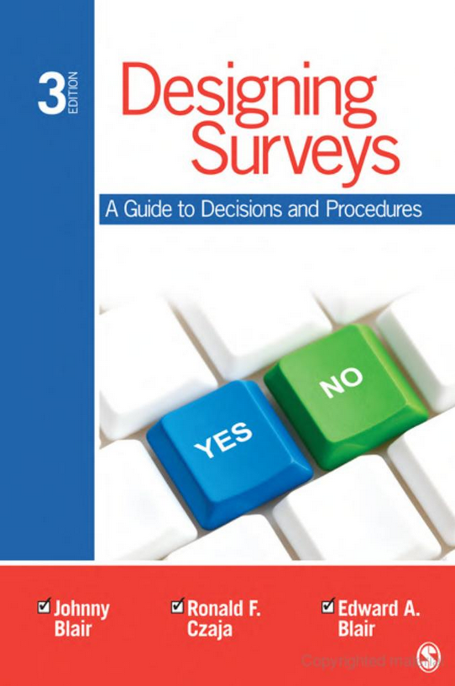

Slide 20
SITUATING SURVEY DESIGN
Program
Design
Research
Design
Survey
Design
Survey
Questions

Slide 21
Survey Process Overview
Knowledge Needs
Respondents
Statement of Purpose
Contextual Factors
Sampling
Survey Questions
Pilot / Refine
Deploy
Analyze / Report

Slide 22
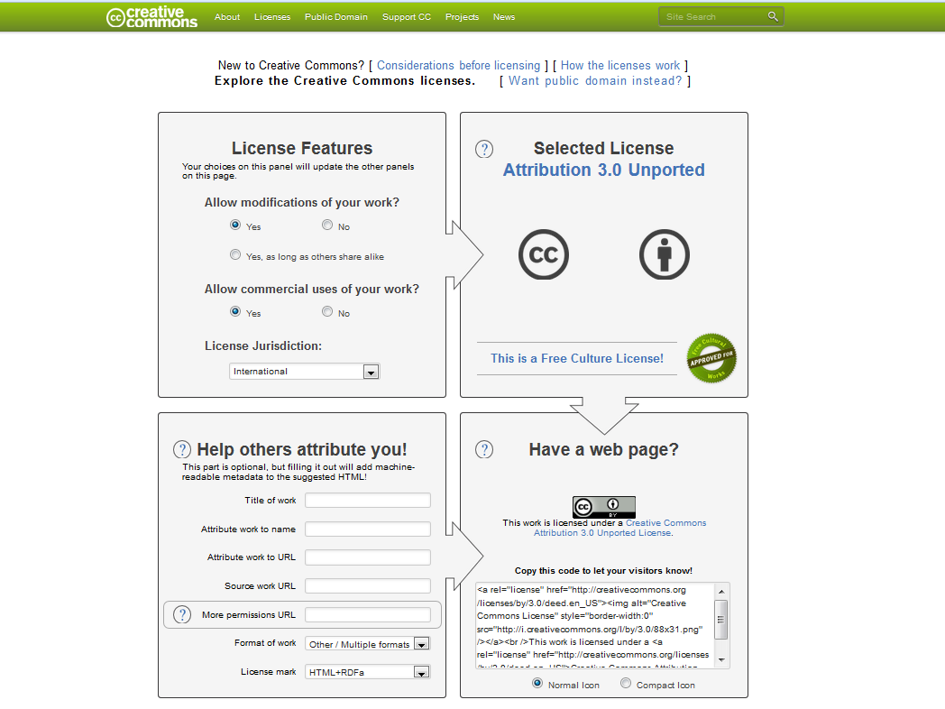
Notes:
Creative Commons Licensing
Info at http://creativecommons.org/choose/

Slide 23
Case Study
01
AEA
Evaluation 2013, Washington DC, Susan Kistler
Notes:
Social Media Icons free for use with commercial and noncommercial design projects
From Creative Nerds at http://creativenerds.co.uk/freebies/beautiful-letter-pressed-social-media-icons/
Note that Creative Nerds has a wealth of great free resources for design in the freebies section of their website at http://creativenerds.co.uk/category/freebies/

Slide 25
DRAFT STATEMENT OF PURPOSE
We are going to gather information about xxxx from yyyy in order to zzzz.
Notes:
Picture Credit: Dreamstime, image http://www.dreamstime.com/royalty-free-stock-images-overweight-image10918719

Slide 26
2011
8%
Notes:
We take a membership count on March 31 of each year. In 2011, I stood here and noted that membership growth was up over 8% with a very strong showing at the conference as we moved into Southern California.

Slide 27
CHALLENGE
RETAIN
MEMBERSHIP
THE
IS
TO
THAT

Slide 28
2012
11%

Slide 29
7933 Members
International
Notes:
As of Friday, AEA has 7933 members

Slide 30
AEA Membership by Year
Notes:
If we look at where the current membership is concentrated, as a predictor of future membership, I feel confident that growth next year should at a minimum be comparable to this year. Although federal regulations against paying for membership mean that many conference attendees do not become members, the value proposition of AEA is a strong one and thus many people join on their own and of course there is considerable representation among non-federal employees within the DC region. One strategy for increasing membership is offering nonmember registrants a rebate on registration, for instance offering them half-price registration post-conference, if you are financially strong and wish to increase the federal government representation among AEA’s membership.

Slide 31
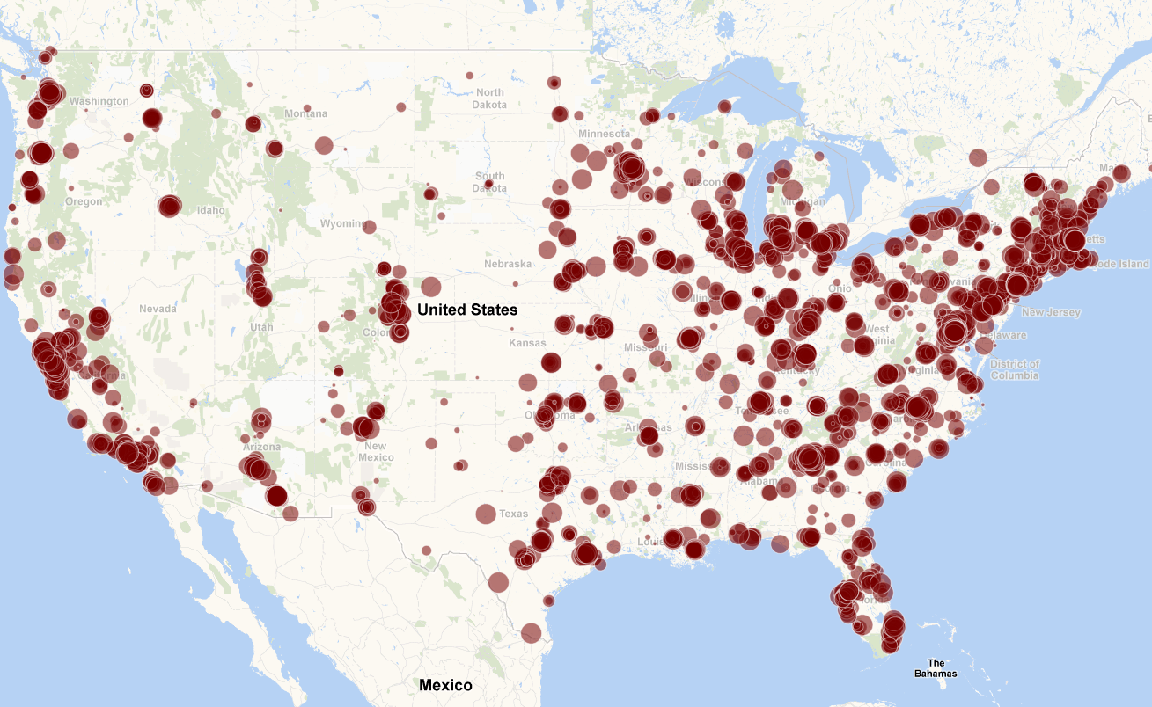
Members in the Continental US
Notes:
If we look at where the current membership is concentrated, as a predictor of future membership, I feel confident that growth next year should at a minimum be comparable to this year. Although federal regulations against paying for membership mean that many conference attendees do not become members, the value proposition of AEA is a strong one and thus many people join on their own and of course there is considerable representation among non-federal employees within the DC region. One strategy for increasing membership is offering nonmember registrants a rebate on membership, for instance offering them half-price membership post-conference, if you are financially strong and wish to increase the federal government representation among AEA’s membership.

Slide 32
DRAFT STATEMENT OF PURPOSE
3 minutes: Silently! Develop a draft statement of purpose
Prompt: We are going to gather information about xxxx from yyyy in order to zzzz.
Notes:
Picture Credit: Dreamstime, image http://www.dreamstime.com/royalty-free-stock-images-overweight-image10918719

Slide 33
DRAFT STATEMENT OF PURPOSE
10 minutes: In groups of 3, share your drafts, work together to refine one of the statements. Write it on a flipchart page. Any further info needs?
Prompt: We are going to gather information about xxxx from yyyy in order to zzzz.
Notes:
Picture Credit: Dreamstime, image http://www.dreamstime.com/royalty-free-stock-images-overweight-image10918719

Slide 34
DRAFT STATEMENT OF PURPOSE
Share Examples
Get Buy-in From Decision-Maker
Notes:
Picture Credit: Dreamstime, image http://www.dreamstime.com/royalty-free-stock-images-overweight-image10918719

Slide 35
EXAMPLE STATEMENT OF PURPOSE
We are going to gather information about program/
service use and quality and its impact on membership renewal from current and former AEA members who did and did not renew in the past year in order to contribute to decisions about programs to be retained as is, altered, or phased out.
Notes:
Picture Credit: Dreamstime, image http://www.dreamstime.com/royalty-free-stock-images-overweight-image10918719

Slide 36
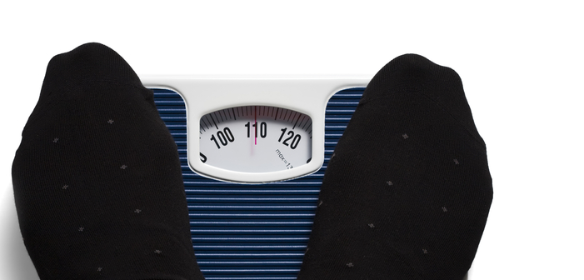
DEFINITIONS
Reliability: Measures consistently – same weight every time
Validity: Measures accurately – measures true weight
Notes:
Picture Credit: Dreamstime, image http://www.dreamstime.com/royalty-free-stock-images-overweight-image10918719

Slide 37
WHAT WE KNOW
Voluntary response rates are dropping
Notes:
See for instance
Public Opinion Quarterly, Volume 70 Issue 5 2006 Special Issue: Nonresponse Bias in Household Surveys

Slide 38
WHAT WE KNOW
Higher response
rates increase
reliability only if
representative
Notes:
See for instance
Public Opinion Quarterly, Volume 70 Issue 5 2006 Special Issue: Nonresponse Bias in Household Surveys

Slide 39
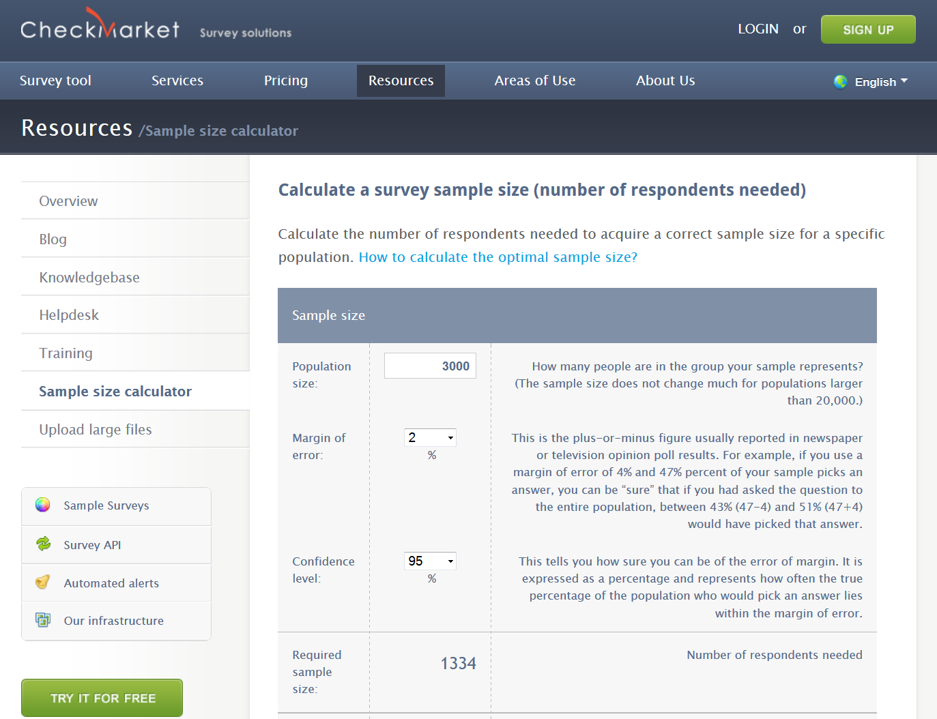
Notes:
Macorr Sample Size and Confidence Interval Calculator
http://www.macorr.com/sample-size-calculator.htm
Recommended by HRSA on this page
http://bphc.hrsa.gov/policiesregulations/performancemeasures/patientsurvey/calculating.html

Slide 41
SURVEY QUESTION TYPES

Slide 42
SURVEY QUESTION TYPE PRACTICE
I need to know how the respondents feel about public speaking and, if feeling negatively, contributors to that anxiety.

Slide 43
Likert-type Versus Semantic Differential
EXAMPLE

Slide 44
SURVEY QUESTION TYPE PRACTICE
I need to know the respondent’s thought process in selecting a dentist for a child.

Slide 45
SURVEY QUESTION TYPE PRACTICE
I need to know about when it was that the respondent last had intercourse and whether she or he used a condom.

Slide 46
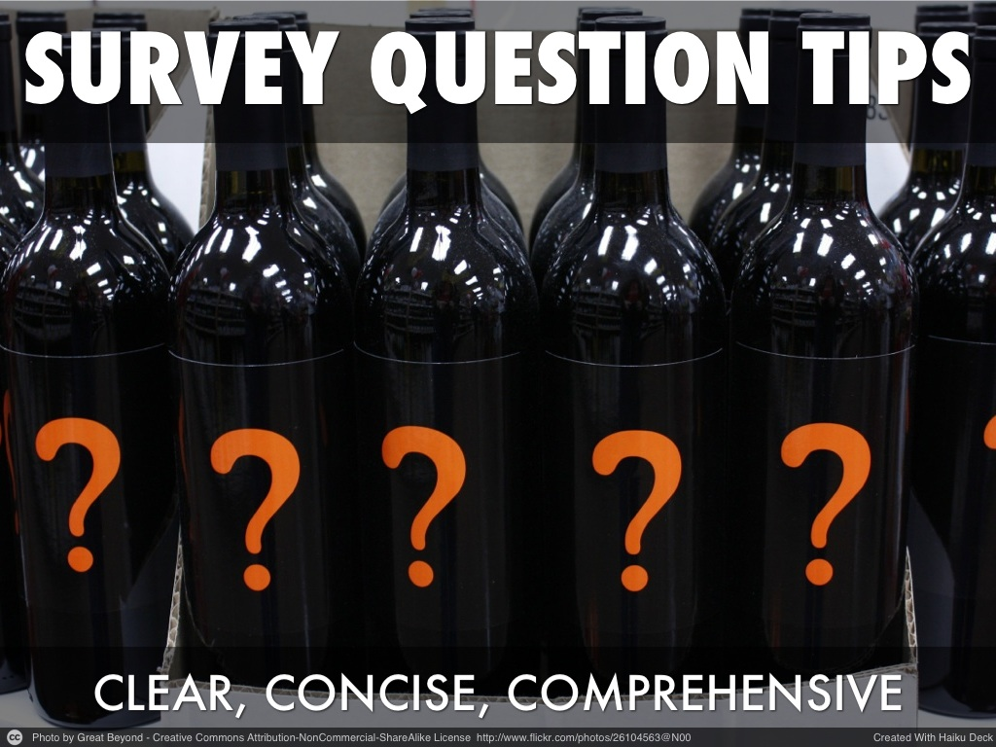

Slide 54
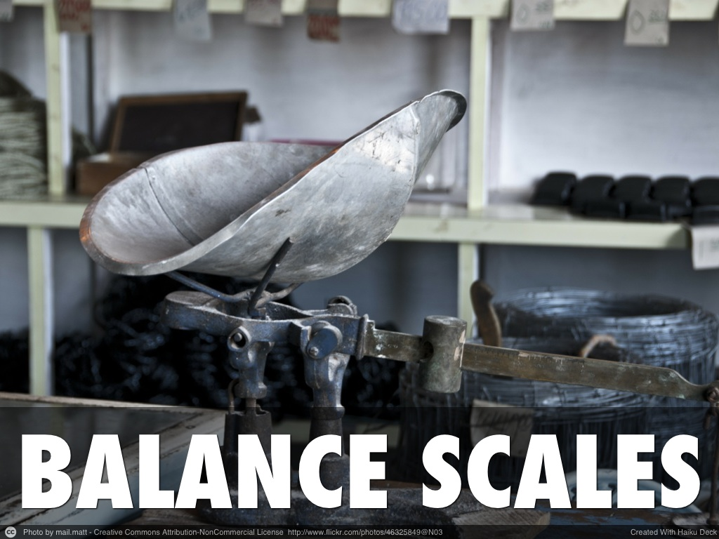

Slide 57
“It is not every question which deserves an answer.”
Publilius Syrus

Slide 58
CASE PROJECT
Design a survey for attendees at AEA’s Coffee Break Webinars with the goal of providing information to improve that program.

Slide 59
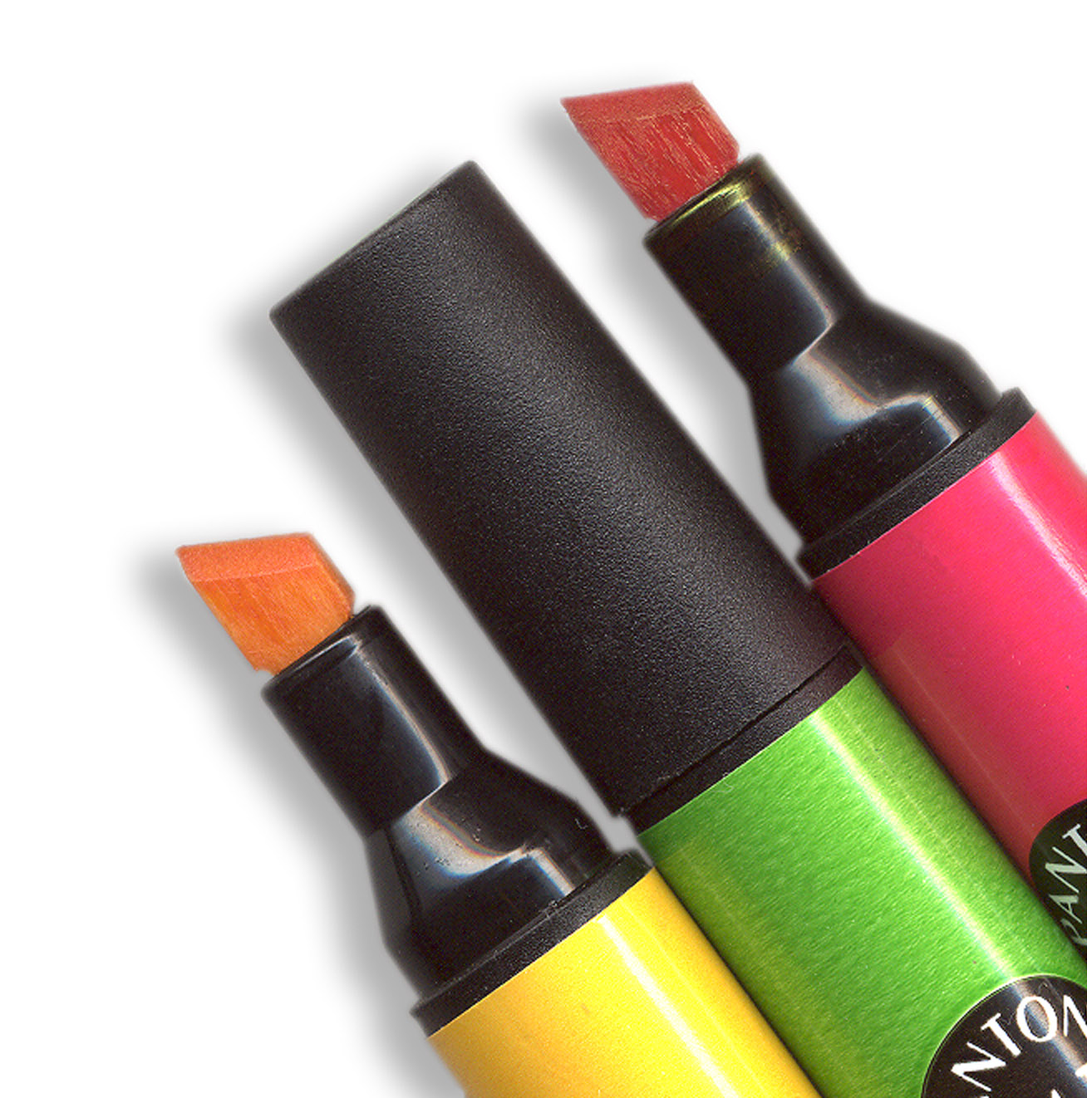
Introduce Yourself Via
Infographic
Notes:
Origin: stock.xchng http://www.sxc.hu/browse.phtml?f=download&id=18799

Slide 60
“You mustn't always believe what I say. Questions tempt you to tell lies, particularly when there is no answer.”
Pablo Picasso

Slide 61
“You mustn't always believe what I say. Questions tempt you to tell lies, particularly when there is no answer.”
Pablo Picasso

Slide 62
“You mustn't always believe what I say. Questions tempt you to tell lies, particularly when there is no answer.”
Pablo Picasso

