Slide 1
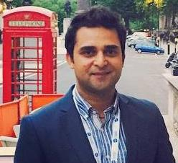
Addressing M&E Challenges in Fragility, Conflict and Violence (FCV)
Hur Hassnain
Convenor IDEAS’ TIG on EvalFCV
@EvalFCV and @hurhassnain
Notes:
Today I will talk about evaluation in the context of FCVs with a focus on 6 key principles and examples from some of the worst fragile and conflict affected contexts.

Slide 2
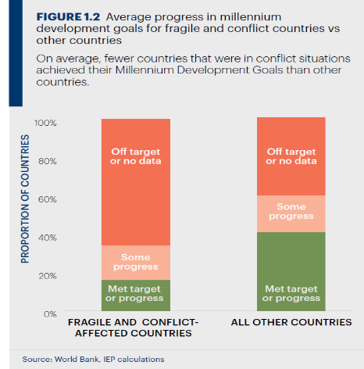
Link between FCV and Development
“Without peace there is no development, and without development there is no peace”
Jan Eliasson,
UN Deputy Secretary General
2012–2016
Notes:
The data from MDGs shows us that only 16% of the FCVs met the MDGs targets or made progress on them.
Reports have shown that:
countries that are fragile have shown lowest performance
data / m&E were not performing in such contexts

Slide 3
What is fragility?
OECD defines fragility as the combination of exposure to risk and insufficient coping capacity of the state, system and/or communities to manage, absorb or mitigate those risks. Fragility can lead to negative outcomes including violence, the breakdown of institutions, displacement, humanitarian crises or other emergencies (States of Fragility report, 2016:22).
G7+ defines “[A] state of fragility can be understood as a period of time during nationhood when sustainable socio-economic development requires greater emphasis on complementary peacebuilding and State-building activities such as building inclusive political settlements, security, justice, jobs, good management of resources, and accountable and fair service delivery”.
Notes:
Let us see what fragility is defined by different agencies:
The definitions in the sector at the moment are very broad. They don’t fit into a measurement framework easily especially if we are working in fluid, complex and volatile situations where most of the time there is no access to data, respondents and the project sites.
Just understanding fragility is not enough – we need to look at contexts – relevance, comprehensiveness and dynamic nature of the context analysis.

Slide 4
Challenges of Evaluation in FCV Contexts
Defining How Change Happens
Area of focus: Fragile states or fragile situations?
Transitional nature: countries may be fragile today not tomorrow
Measuring fragility: Tools, indicators, frameworks
Trust: No one is neutral
What standard/criteria to use
How to adapt to the changing context
Understanding and distinguishing between the nuances of fragile situations: crises, fragility and conflict
What works today may not work tomorrow

Slide 5
1- Security is paramount
Better understand the context by consulting or conducting:
Conflict analysis
Power analysis – political analysis
Gender analysis
Be conflict-sensitive in your approach
Notes:
One key principle to remember working in an insecure environment is that security of staff members, partners and beneficiaries supersedes any kind of accountability measures.
Rely on the local contextual knowledge of local partners, staff members and communities.
Only collect information that is necessary. M&E Plans and systems should be built on gender and conflict analysis with an understanding that “No one is neutral”.
As you implement keep an eye on the unintended (negative) effects and especially how your intervention is interacting with the context and vice versa.
In Pakistan we partnered with the CWSA that has XXX years of experience working in the country. As we were working on some highly sensitive topics such as gender equality, at the inception of the project and throughout its implementation we looked at the sources of tension and cohesion in the communities, drivers of conflict and triggers for violence. We worked with our partners and communities to be more gender aware and understand the needs of women, men, children and elderly and how they are affected by or affecting the context.

Slide 6
‘Unintended’ does not necessarily mean unanticipated.
In contexts affected by conflict, fragility or marginalization…. ‘unintended effects’ often worsen those dynamics.

Slide 7
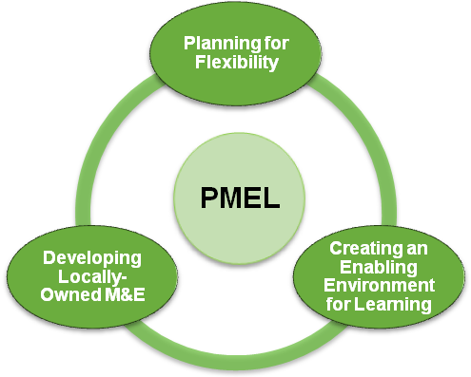
2- Introduce Adaptive MEAL
How to respond and adapt to the changing evolving environment?
Involve community in identifying change (OH) or developing indicators (EPI), local think tanks, academia and private sector
Notes:
Traditional MEAL approaches in such settings could be unrealistic as institutions may struggle to have full access to the targeted beneficiaries. In this programme it was hard for us to establish contact with local women and get their views especially on gender related issues.

Slide 8
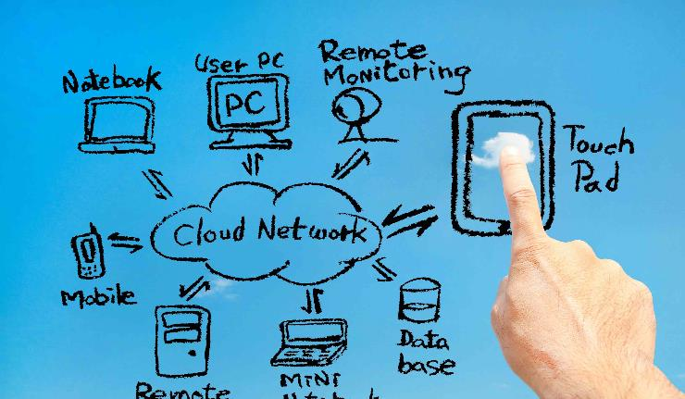
3- Use ICTs – conduct MEAL remotely
Though ICTs bring huge potential, they also carry new risks.
Invest time in creating a trusting environment before & during data collection to avoid problems or biased answers.
Notes:
Though ICTs bring huge potential, they also carry a number of new risks:
Conduct a risk assessment and think about unintended consequences. Are we creating risk for anyone? Is the potential benefit worth it?
Include community and data subjects in the process so people know why data is being gathered using technology.
Train the enumerators in conflict and gender sensitivity and make sure they understand the purpose of the data collection.
Get feedback from enumerators and partners after the data collection and involve them in the analysis of the data.
Invest time in creating a trusting environment before & during data collection to avoid problems or biased answers.
We did not use GPS in any of the work we did. You need to inform the agencies ISI and MI and take permission from the district government.
In our context, we managed to use Frontline SMS as a feedback tool but we could not use Sprockler for all our data collection. The rural women did not feel comfortable interacting with a phone/tablet. The enumerators had the questionnaires printed already and were prepared for this scenario.

Slide 9
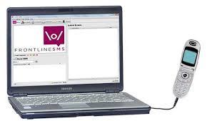
4- Seek feedback and engage local communities
Establish an effective feedback mechanism close the loop
Community-based feedback mechanisms
Notes:
Considering the complexities of the context and to overcome its unpredictability, YCI established a holistic feedback mechanism in the communities it worked it with the help of the local people. This means we asked the rural communities how would they like to provide feedback to us. This consisted of traditional feedback mechanisms such as complaint box?, Letters, Telephone calls, In-person as well as an online mobile phone based system called Frontline SMS. [Example of a Feedback received and action taken?]
The project also established community based Project Steering Committees for monitoring and providing real time feedback and solutions.
Codes which decoded in emails and on the mobile phones of selected people. Auto reply
Steering committees had three codes on Frontline SMS to visit the centre, check attendance
EXAMPLE: For one month, two of our centres would open late. The reason was the mobility/road, we tackled this issue through sorting out the issue with the logistics.
3 types of participants
Steering Groups: Example
Gender activists:
SMAs: Market Visits were then monitored through sms. Initiatlly there was a problem because they didn’t know how to use phones and in the beginning they didn’t have permission to use mobile phones. We monitored their visits to local market/exhibitions.

Slide 10
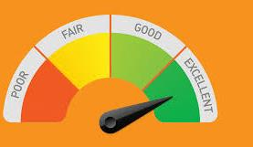
5- Choose appropriate evaluation methods
Prioritise participatory and mixed methods
Triangulate
Promote a culture of openness
Where possible use data from other sources (e.g., National Statistical Offices, other agencies, donors, academia, the UN)
Notes:
MEAL in insecure and complex contexts could be political and will require both qualitative and quantitative tools for collecting data that are capable of providing information on (un) intended effects and rigorous political analysis.
Resources vs ethical approach – rcts
Explain the three in this context.
WARNING!
Ask yourself, if this is really possible and ethical in situations of fragility?
Aim to implement the best and tested programme approaches for the community rather than experimenting.

Slide 11
Different evaluation methods
Outputs and Outcomes level | Impact level
Outcome Harvesting | Impact evaluation, Quasi and Experimental Methods
Community safety score cards | Most Significant Change
Governance diaries | Propensity Score Matching
Proxy indicators | RCTs
Likert scales
Incident logs
Media content and discourse analysis
Social Network Analysis
Remote monitoring
RTEs
PVMSC
After Action Reviews

Slide 12
6- Close the evaluation learning loop
‘This validation workshop was special, since it was the first time after a survey that the evaluation team shared the results with us’.
Online interactive Sprockler Report
Evaluation Report
Videos
Blogposts
Podcasts
Notes:
The monitoring and evaluation field of humanitarian aid has seen advancements from traditional ways to new methods, such as using drones for collecting data. However, we have not yet answered the key questions: who is really benefiting from the learning results and who is accountable?
Since the project was aimed at making people change-agents rather than just recipients of aid, the evaluation design purposely included a validation workshop to share the findings with communities, so they could learn from it and understand the importance of monitoring and evaluation to provide solid evidence of project results.
At the end of the meeting, community members were aware of what worked and what didn’t in the project, as well as the best possible ways for future improvements. One participant said, ‘this validation workshop was special, since it was the first time after a survey that the evaluation team shared the results with us’.
1- budgeting
2- Designing validation workshops
3- Identification of a suitable venue
4- Selection of relevant results to be presented
5- Involve women, young people, elderly and the poorest
6- Speak their language
7- Use appropriate technology
8- Explore impact causalities with beneficiaries – what worked and what didn’t

Slide 13
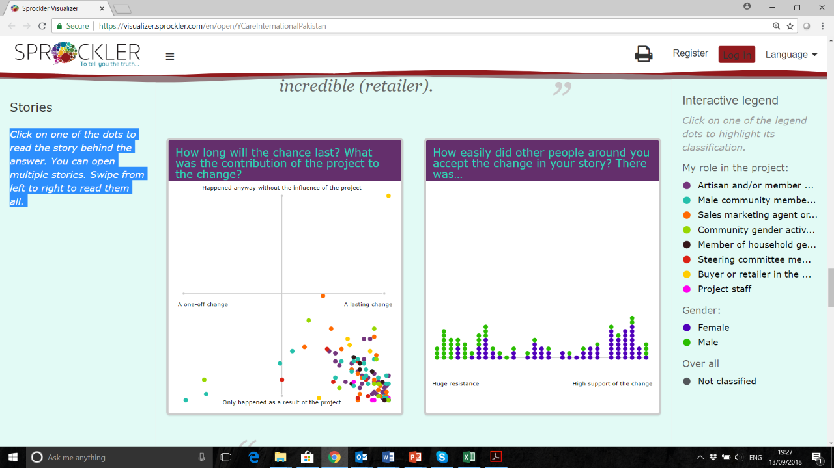
Sprockler
https://visualizer.sprockler.com/en/open/YCareInternationalPakistan
Click HERE
Notes:
Resistance:
The landlords as well as neighbouring villages were teasing men beneficiaries that their women are out of their control – mobility

Slide 14
6 Principles of evaluation in FCVs
Security is paramount!
Introduce adaptive MEAL
Use ICTs – conduct MEAL remotely (if needed)
Seek feedback and engage local communities
Choose appropriate evaluation methods
Validate and disseminate the results

Slide 15
Thank you
Please feel free to get in touch for more information hurhassnain@Hotmail.com

