Slide 1
Participatory Review and Reflection Processes (PRRPs): The Foundation for ActionAid’s Organizational Learning System
By Bevis Kapaso
Int M&E Advisor

Slide 2
About Action Aid
We are an international organisation, working with over 15 million people in 45 countries for a world free from poverty and injustice.
We advocate a Human Rights Based Approach (HRBA) approach to help people use their own power to fight poverty and injustice as we believe the people whose lives our work affects should decide how we’re run.
In 2003 ActionAid International adopted a federal model of governance and organization. This is a union comprised of self governing affiliates and associates which are members united by a central or international (“federal”) structure and by shared values, vision and mission.

Slide 3
ACCOUNTABILITY, LEARNING & PLANNING SYSTEM OF ACTIONAID INTERNATIONAL

Slide 4
ACCOUNTABILITY
ACCOUNTABITY
POWER
TRANSPARENCY
PRINCIPLES
WOMEN’S
RIGHT
EVIDENCE
LEARNING

Slide 5
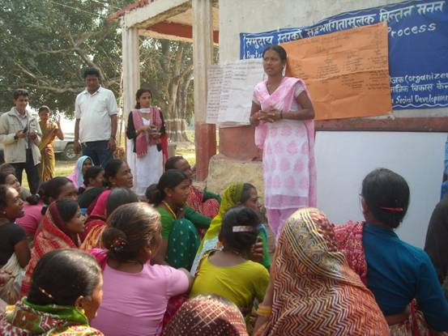
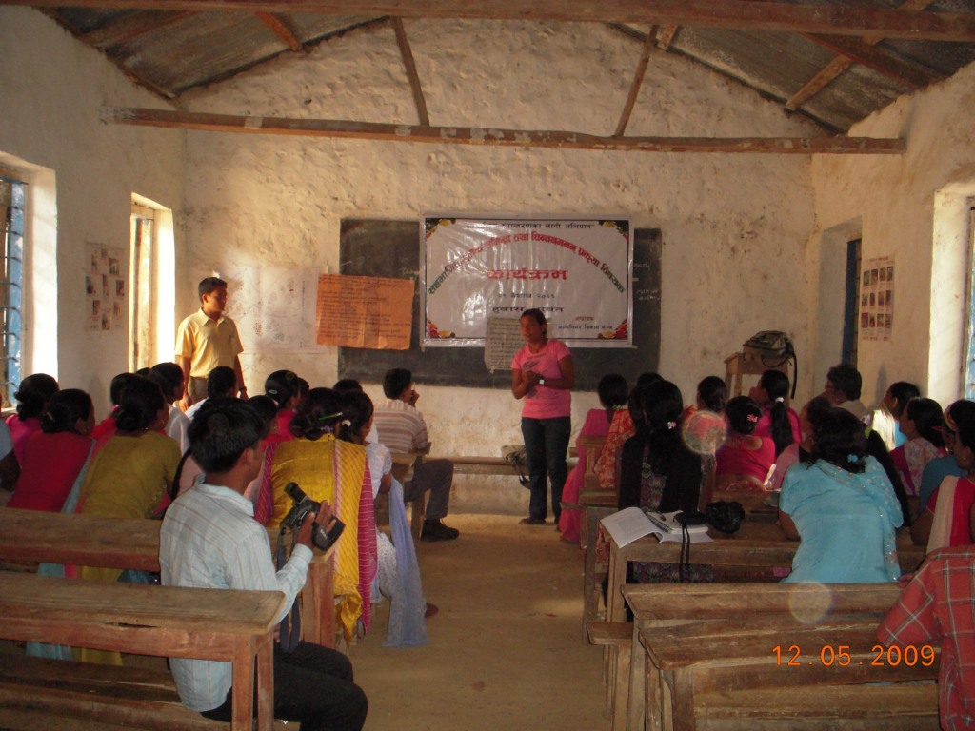
PRINCIPLE OF ACCOUNTABILTY AT WORK
A key ALPS process for monitoring, learning and accountability is
Participatory Review and Reflection Process (PRRP)

Slide 6
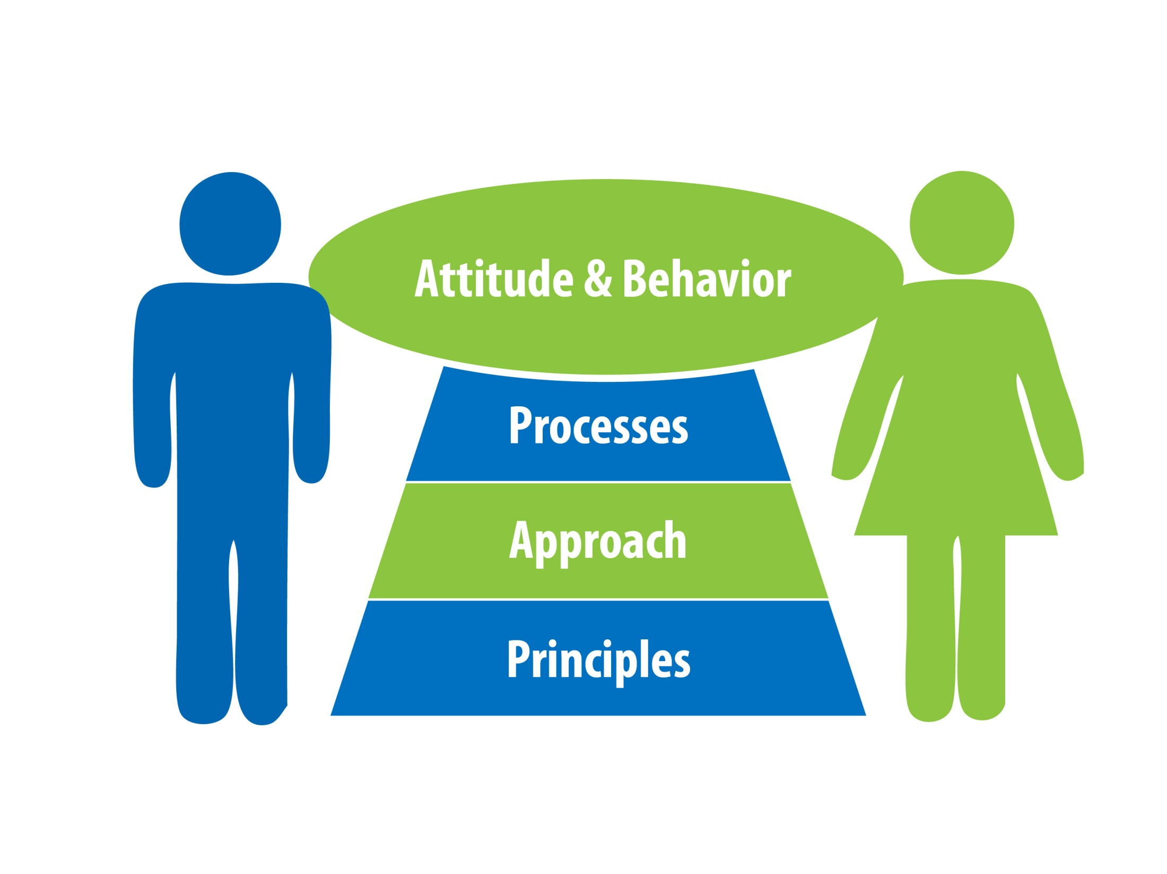
CORE ELEMENTS OF ALPS
ATTITUDE & BEHAVIOUR
PROCESSES
APPROACH
PRINCIPLES

Slide 7
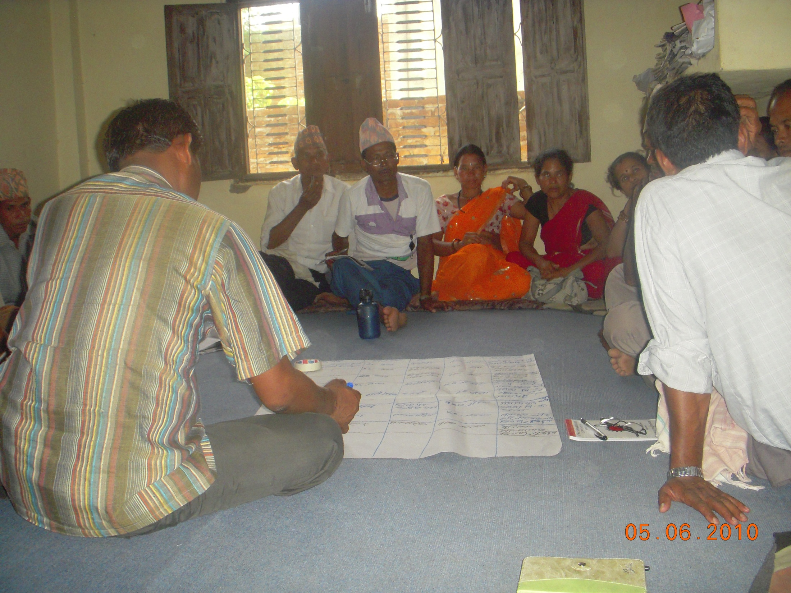
PRINCIPLE OF ACCOUNTABILTY AT WORK
Participatory planning is another ALPS process that engages and ensures stakeholders play an active role in planning and strategy development

Slide 8
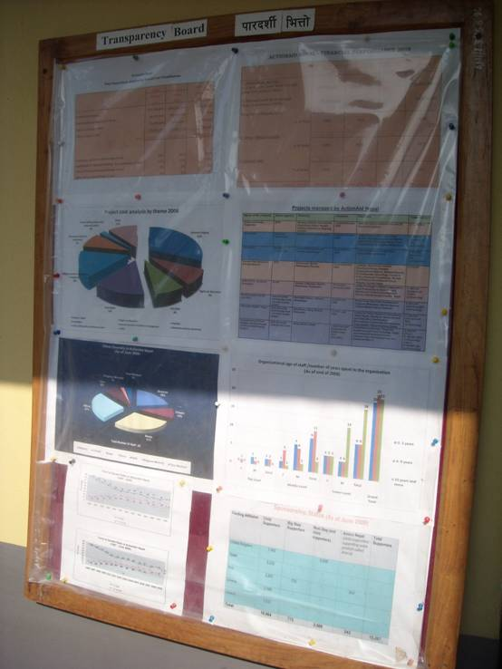
PRINCIPLE OF ACCOUNTABILTY AT WORK
PRRP and planning are
embedded in ActionAid’s organisational processes

Slide 9
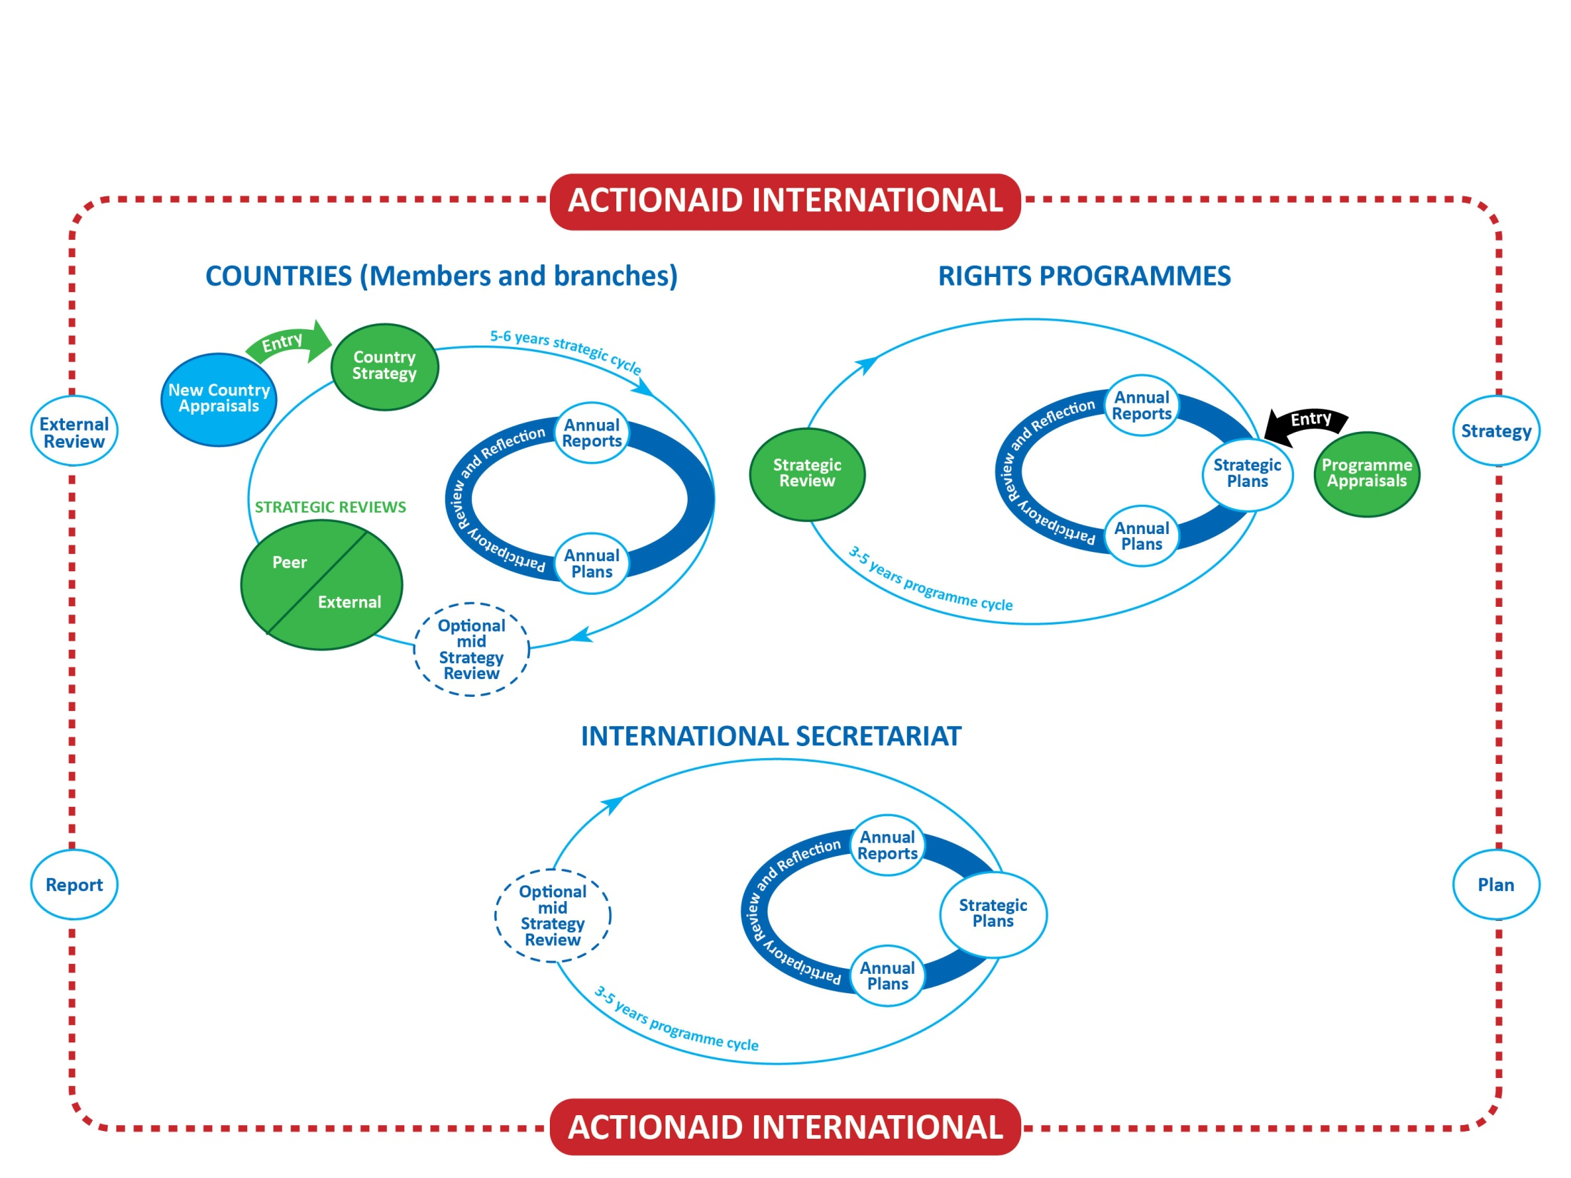
ALPS ORGANISATIONAL PROCESSES

Slide 10
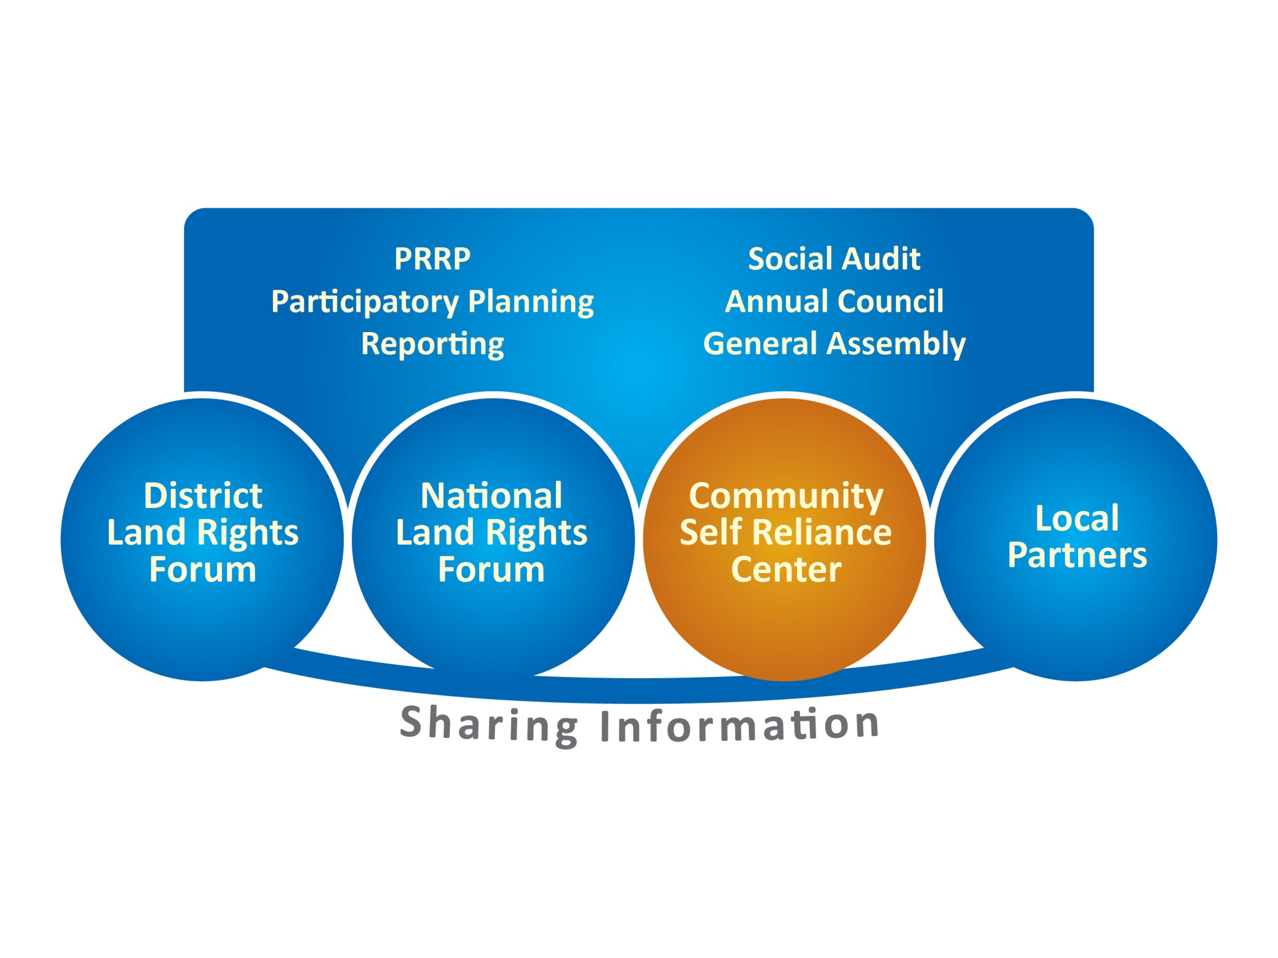
ACCOUNTABILTY MECHANISMS IN THE LAND RIGHTS MOVEMENT

Slide 11
Successes
We have gained a lot of ground, we have pushed boundaries within the NGO sector
As an NGO we have put participatory methods at the frontline of everything we do – we can’t let go off this but we need to make our PRRPs more structured, with sharper questions, and specific tools; also capacity of staff to facilitate learning processes
A key indicator of the success and value of this approach is its adoption by our partners and communities
There is a strong political dynamic supporting PRRPs. They capture the institutional ethos of putting people at the centre of change and development.
We need to continue to build upon this positive energy whilst getting more sophisticated in the data that we manage.

Slide 12
Challenges
Capacity
PRRPs have become a ritual within the organisation but the quality of data generated by is dependent upon the skills of the facilitator. There has been limited investment in building these skills amongst staff. No facilitation guidebook exists.
Organisational silos
At the national level there is good vertical integration from community to partner to national level but it has been much more challenging to integrate horizontally across countries and units limit PRRPs as coherent source of information to support decision making.
IS – country dynamic
PRRP is routinely practiced and owned by countries, the IS doesn’t really follow PRRP model

Slide 13
ActionAid is an international anti-poverty agency working in over 40 countries, taking sides with poor people to end poverty and injustice together

