Slide 1
What Constitutes Success?
A Comparison of Minority Career Trajectories
Jean H. Shin, PhD and Roberta Spalter-Roth, PhD
American Sociological Association
Presented at the 2013 American Evaluation Association Annual Conference
Washington, DC
Friday, October 18, 2013
Slide 1

Slide 2
The purpose of this evaluation is to explore whether the American Sociological Association's (ASA) now 40-year old pipeline intervention—the Minority Fellowship Program (MFP)—improves the chances of academic career success for participants compared to those minority scholars who do not participate.
We also examine the factors and relationships that lead to career success for minority men compared to minority women. Each of these factors can result in stratification within the discipline: e.g., who gets employed by research-extensive institutions and who does not.
We compare a group of PhD recipients from 1995-96 to 2008-09, who are alumni of MFP, to a group of underrepresented minority scholars who did not participate in MFP, from the same degree years.
Purpose of this Evaluation
Slide 2

Slide 3
More on the ASA Minority Fellowship Program (MFP)
MFP is a pre-doctoral training program founded in 1974 at the behest of the then-Caucus of Black Sociologists (now the Association of Black Sociologists).
MFP was founded around the same period as similar training programs in psychology, nursing, and social work (all funded by the National Institute of Mental Health (NIMH)).
The purpose of MFP was/is to address the severe underrepresentation of senior minority scholars as campuses became more diverse.
Then and still today, MFP has been inclusive of all racial/ethnic minority groups in the discipline.
Slide 3

Slide 4
Description of Dataset and Methodology
Dataset
378 non-white PhD graduates in sociology between AY 1995-1996 and AY 2008-2009 employed in the U.S. as of 2010, including universe of MFP participants (N=113) in same period.
Graduates were identified using the ASA Guide to Graduate Departments in Sociology. MFP Grant awardees were compiled from ASA databases; Control group was selected randomly but is more heavily distributed among earlier graduates.
Sample further confined to 257 graduates employed in academic/faculty positions in 2010 (82 MFP members; 175 minority "control group" members).
Faculty position: tenured/tenure-track or non-tenured teaching position.
Data analysis
P-values calculated for bivariate comparisons using Adjusted Wald test of association; differences deemed significant at the .05 level or below.
Odds ratios calculated for binary logistic regression models; robust standard errors calculated; model adjusted to account for "whether PhD was obtained from a Research I institution" (a potentially confounding variable).
Slide 4

Slide 5
How Do the Two Groups Compare?
General Characteristics for 257 Minority Sociology PhD Recipients in Faculty Positions as of 2010 (AY 1995/96-2008/09) by Group: Percent.
n=number with characteristic | Minority Fellowship Program (N=82) | All-minority Control Group (N=175) | P-Value*
Race/Ethnicity
Asian/Asian-American (n=24, 57) | 29.3 | 32.6 | .04
African-American, Black American, Black (n=36, 53) | 43.9 | 30.3 | .03
Hispanic/Latino(a) (n=18, 41) | 22.0 | 23.4 | .11
Native American or Other (n=4, 24) | 4.9 | 13.7 | .003
*Tests difference between MFP and Control Group; Adjusted Wald test of association for bivariate comparison used; significant values are bolded.
There are significant racial differences when comparing these two groups.
MFP had a significantly higher percentage of African Americans, whereas the comparison group had a significantly higher percentage of Asian Americans and Native Americans.
Slide 5

Slide 6
How Did They Vary by Race, Ethnicity, and Gender?
We examine race, ethnicity, and gender simultaneously, rather than placing men and women into one category of minorities: i.e., those who participated in MFP and those who did not. In doing so, we follow the feminist theoretical concept of intersectionality that examines how various biological, social, and cultural categories such as gender, race, ethnicity, and other markers of identity interact , contributing to systematic social inequality.
Gender and Race (n=number with characteristic) | MFP (N=82) | Minority (N=175) | P-value*
Male (n=31, 89) | 37.8 | 50.9 | <.001
Asian/Asian-American (n=7,24) | 22.6 | 27.0 | .63
African-American, Black American, Black (n=12,27) | 38.7 | 30.3 | .01
Hispanic/Latino(a) (n=11,22) | 35.5 | 24.7 | .04
Native American or Other (n=1,16) | 3.2 | 18.0 | .02
Female (n=51, 86) | 62.2 | 49.1 | .03
Asian/Asian-American (n=17,33) | 33.3 | 38.4 | .002
African-American, Black American, Black (n=24,26) | 47.1 | 30.2 | .003
Hispanic/Latino(a) (n=7,19) | 13.7 | 22.1 | .004
Native American or Other (n=3,8) | 5.9 | 9.3 | .08
*Tests difference between MFP and Control Group; Adjusted Wald test of association for bivariate comparison used; significant values are bolded.
There are significantly fewer men in the MFP group and significantly more women, compared to the control group. African American women constitute the largest share of the MFP group. Asian/Asian American women constitute the largest share of the non-MFP minority group.
Unfortunately, when we disaggregate by race, ethnicity, and gender, the numbers become very small. Thus we re-aggregate into two groups: minority men and minority women.
Slide 6

Slide 7
What Constitutes Success?
In evaluating the MFP we first need to determine what constitutes success.
We selected a variety of measures to make this concept operational. All of these are measures of social stratification within the discipline.
Is success:
Going into the academy after obtaining a PhD?
Obtaining a position at a research-extensive (or Research I) institution?
Gaining tenure and promotion within a reasonable time?
Publishing in top journals and obtaining external grants?
Doing research that is useful for minority communities?
Experiencing gender equity?
Slide 7

Slide 8
Employment at Research-Extensive (or Research I) Institutions
Employment at a Research I institution—especially among those considered in the "top 20"—is a measure of prestige in the discipline. We find significant differences between women who participated in MFP and those who did not, with women MFPs the least likely to have such positions and minority women who did not participate in MFP being the most likely of all groups (13.7% versus 38.4%). For men, there are only small differences.
General Characteristics for 257 Minority Sociology PhD Recipients in Faculty Positions as of 2010 (AY 1995/96-2008/09) by Group: Percent.
n=number with characteristic | Minority Fellowship Program Male (N=31) | All-minority Control Group Male (N=89) | P-Value* | Minority Fellowship Program Female (N=51) | All-minority Control Group Female (N=86) | P-Value*
Academic Employment Institution in 2010 is Research I (n=7,23,7,33) | 22.6 | 25.8 | .28 | 13.7 | 38.4 | <.001
Academic Employment Institution in 2010 is Non-Research I (n=24,66,44,53) | 77.4 | 74.2 | .29 | 86.3 | 61.6 | <.001
*Tests difference between MFP and Control Group; Adjusted Wald test of association for bivariate comparison used; significant values are bolded.
Slide 8

Slide 9
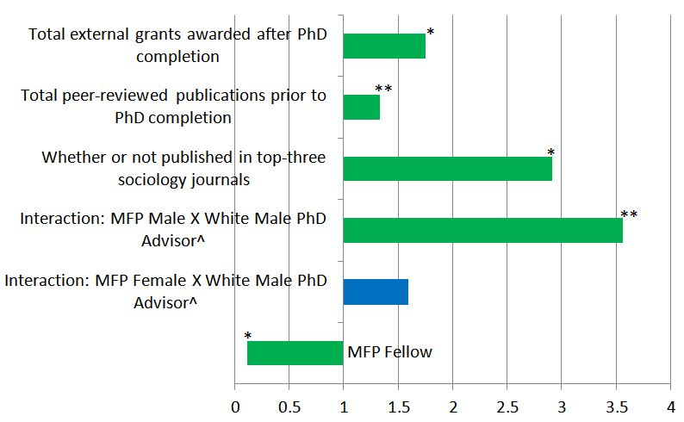
Employment at Research-Extensive (or Research I) Institutions
Odds Ratios for Logistic Regression on Employment in 2010 at a Research I Institution, for 257 Minority Sociology PhD Recipients in Faculty Positions.
^Includes control for missing race/gender of PhD advisor.
*Significant at p <.001 level; **Significant at p <.01 level.
The positive and significant characteristics associated with employment at a Research I institution include publications in top journals, total publications prior to PhD completion, and receiving external grants. But, participation in MFP had a statistically significant negative effect upon employment at a Research I, with one exception—male MFP participants were significantly more likely to be employed there IF they had a WHITE MALE dissertation advisor. This was not so for any of the other groups, including women MFPs.
Slide 9

Slide 10
Which Group is Most Successful at Gaining Tenure and Promotion?
n=number with characteristic | Minority Fellowship Program Male | All-minority Control Group Male | P-Value* | Minority Fellowship Program Female | All-minority Control Group Female | P-Value*
Received tenure by 2010 (11/51,40/51,19/59,40/59)# | 21.6 | 78.4 | <.001 | 32.2 | 67.8 | .009
*Tests difference between MFP and Control Group; Adjusted Wald test of association for bivariate comparison used.
#Calculated for 110 faculty (51 males and 59 females) who received their PhDs between (AY 1995/96-2001/2002).
We examined those individuals who received tenure within eight years after they received their PhDs. We found large and statistically significant differences between MFPs and the non-MFP minorities, regardless of gender. MFP males appear to be the least likely to have obtained tenure in the time span.
Publications in top sociology journals and awarding of external grants were significantly and positively related to tenure. Unlike obtaining a position at a Research I institution, being a participant in MFP is not negatively related to this step on the career trajectory. Once again what helps male MFPs is interacting with a white male dissertation advisor, but this is not the case for the other groups including women MFPs.
Slide 10

Slide 11
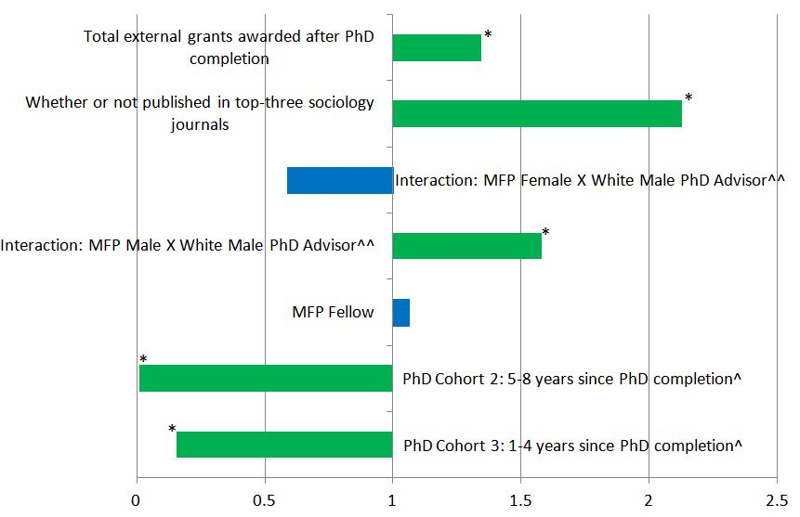
What Factors Are Significantly Associated with Tenure?
Odds Ratios for Logistic Regression on Receiving Tenure within Eight Years of PhD Completion (N=110), for Minority Sociology PhD Recipients Between 1995 and 2002.
^Base PhD cohort is 1: 9-14 years since PhD completion.
^^Includes control for missing race/gender of PhD advisor.
*Significant at p <.001 level.
Having a white male dissertation advisor has a significant and positive impact on getting tenure, but only for MFP men.
Slide 11

Slide 12
Inequities and the Effect of Intersectionality?
As we saw from the descriptive data, the differences between men and women are generally greater among MFPs, with MFP women not doing as well as MFP men (tenure appears to be an exception, although men are more likely to have employment at a Research I institution).
We see further that having a white male dissertation advisor—who can probably provide more contacts and resources than women or men of color—is not effective for MFP women.
These women are often more likely to have women of color as their dissertation advisors, who may have fewer contacts and resources within the discipline, decreasing the likelihood of the MFPs' employment at a Research I institution, although they may provide more psycho-social mentoring.
Slide 12

Slide 13
Gender Inequities and the Effect of Intersectionality?
PhD Advisor Characteristics for 257 Minority Sociology PhD Recipients by Group: Percent.
Non-MFP minority males were most likely to have white male advisors and MFP women, the least likely.
Average Number of Peer-reviewed Publications for 257 Minority Sociology PhD Recipients.
MFP and non-MFP males have approximately the same number of faculty publications. MFP females have the least number of publications.
Slide 13

Slide 14
Which Group is More Likely to Do Research
that is Useful for Minority Communities?
Does doing research that is useful for minority communities have any effects on career success? Participants in MFP were significantly more likely to write their dissertations about the intersection of race, ethnicity, gender, and health disparities, topics that are of value for minority communities.
PhD Dissertation Topic | MFP | Control Group | P-Value*
Race/Ethnicity/Minority Issues (n=52, 94) | 63.4 | 53.7 | .001
Gender (n=28, 33) | 34.1 | 18.9 | .006
Health (n=24, 22) | 29.3 | 12.6 | .001
Combination of Race, Gender, and/or Health (n=24, 24) | 29.3 | 13.7 | .003
*Tests difference between MFP and Control Group; Adjusted Wald test of association for bivariate comparison used.
MFPs were encouraged to write on these topics since the program was funded by a National Institute of Mental Health T32 training grant for many years through 2010.
Despite the potential value to minority communities, writing on these topics was negatively related to obtaining tenure in eight years.
Slide 14

Slide 15
Conclusions:
What Did We Learn and What are the Consequences Moving Forward?
Next steps in terms of research and action?
The preliminary findings here suggest that MFP, designed 40 years ago to bring more underrepresented minorities into sociology, has not always improved MFP participants' chances of career success compared to minority non-participants in terms of the following criteria.
The Positive
They were more likely than non-participants to obtain positions in the academy after completing their PhDs.
MFP participants were significantly more likely to do research that may be considered useful for minority communities.
The Negative
They were not as likely to obtain positions at Research I institutions—although male MFP participants increase their likelihood by having a white male dissertation advisor—probably the source of contacts and resources.
They were less likely to publish in top journals and obtaining external grants.
They were less successful in obtaining tenure in eight years. Having a white male dissertation advisor helped male MFP Fellows.
Slide 15

Slide 16
Conclusions:
What Did We Learn and What are the Consequences Moving Forward?
In summary:
What are the measures associated with success?
From the regression models, we saw that publishing in top journals and obtaining external grants were positively and significantly related to success (as measured by employment at a Research I institution and obtaining tenure in eight years).
But research on a combination of race, ethnicity, gender, and health was not associated with our career success measures.
Nor is gender equity associated with career success for MFP Fellows from the time period. As noted, for male MFPs, interacting with a white male advisor did increase the chances of career success. Based on these unobtrusive findings, we suggest that MFP women did not benefit as much.
Slide 15

Slide 17
What Additional Research Needs to be
Done Before Making Final Conclusions?
We are somewhat surprised by the relative lack of MFP success compared to minorities who did not participate. We want to delve deeper. Previous research (Spalter-Roth, Shin, Mayorova, and White 2013) suggests that MFP did level the playing field on several outcomes with a matched, random sample of sociologists (regardless of race). Of course, we cannot do strict control group experiments.
We are hoping to do more research to find out what kind of career people wanted—it may be that not everyone wants an academic career at a Research I institution. And, what kinds of networks do MFPs participate in, aside from their relation with their dissertation advisor? Does participation in homogeneous networks decrease scholarly productivity/disciplinary visibility, or does it increase comfort levels with other outcomes?
Finally, what about intersectionality? Do women in MFP tend to be excluded by white male advisors and therefore gravitate to minority women advisors who have fewer contacts and resources? Perhaps they are not taken seriously as scholars by white male advisors, or perhaps the interaction between white males and minority women is fraught for other reasons.
Many of these questions will require detailed survey responses rather than unobtrusive data, in addition to possible in-depth interviews or focus groups.
ANY HELP?
Slide 16

Slide 18
Thank you!
Presentation is uploaded to the AEA eLibrary and can be accessed there.
For further discussion or help, contact Dr. Roberta Spalter-Roth, PhD, at
202-383-9005 ext. 317 or by e-mail at spalter-roth@asanet.org.
For free downloads of ASA Research Briefs, visit:
www.asanet.org/research/briefs_and_articles.cfm.
Slide 17

