Slide 1
Evaluating “Trauma-Informed Care” for Veterans: Two States’ Approaches and Challenges
RHODE ISLAND
John F. Stevenson
University of Rhode Island
TEXAS
Stacey Stevens Manser
University of Texas at Austin

Slide 2
Acknowledgments
This work was funded in part by the Substance Abuse and Mental Health Services Administration (SAMHSA) grant:
RI: 1H79SMO59269
TX: 1 H79SMO59275
https://www.federalregister.gov/articles/2009/12/04/E9-28953/agency-information-collection-activities-submission-for-omb-review-comment-request
RI: Thanks to PIRE Associates Bill Zywiak, Karen Friend, and Jordan Braciszewski for their work in support of this presentation
TX: Thanks to Sam Shore, Aaron Diaz, Gilbert Gonzales, and Cruz Vallarta for their work in support of veterans and this presentation

Slide 3
JDTR Priority to Veterans – Overview
5-year SAMHSA grant to 13 states
State and Local Advisory Councils
Divert a primary population of veterans with trauma from the criminal justice system
Divert into trauma-informed systems that provide trauma specific interventions
Implement at local pilot sites and then rollout
Cross-site and local evaluation

Slide 4
13 States w/ SAMHSA JDTR Funding
Cohort 1 (2008)
Cohort 2 (2009)
Colorado
Connecticut
Georgia
Illinois
Massachusetts
Vermont
Florida
New Mexico
North Carolina
Ohio
Rhode Island
Texas
Pennsylvania (2010)

Slide 5
Sequential Intercept Model
The 13 JDTR states address a variety of intercept points
Notes:
1 pre-booking; 7 post-booking pre-adjudication; 5 post-booking post-adjudication; 2 post-booking, post-sentencing

Slide 6
What can we learn from this important national study?
What can we learn from the cross-site evaluation?
What can we learn from the separate state evaluations?
Have we made a difference in the lives of people who face incarceration for actions that may be best explained as the result of trauma in their lives?
Will our veterans with trauma gain from this study?
Can we isolate the effects of the trauma-directed interventions we have employed?

Slide 7
Evaluation: Cross-Site
Primarily examining client outcomes, with data from:
Client Interviews
Baseline
Arrest/Incarceration 6 months before baseline
6 Month
12 Month
Archival Data (12 months prior to final interview)
Service Utilization (trauma intervention, substance use, mental health, etc)
Arrest/Incarceration
Process data from individual site visits to provide context

Slide 8
Evaluation: Local
This presentation will attempt to …
Provide observations and insights regarding the nature of two JDTR state trauma specific interventions:
TAMAR in RI
Seeking Safety in TX
Examine challenges raised by:
Addressing intervention fidelity, and
Attempting to isolate effects of the “treatment” in and across the sites.
Discuss strategies to address these challenges
These issues are not unexpected but important to consider …

Slide 9
Comparison 1: Different States and Pilot Sites Rhode Island and Texas
Rhode Island
Texas
RI Population(~ 1 million, 5 counties)
~ 80,000 veterans
~ 26,000 Vietnam era
~ 12,600 Persian Gulf (*Nat’l Guard)
~ 12,500 WWII
~ 11,100 Korea
Kent County (~ 1.7 thousand)
2nd busiest court in state
Functioning court clinic
Kent Center
~ 100 Veteran clients per year
66 JDTR participants
84% veterans
17.5% female
Texas (~ 25 million, 254 counties)
~ 1.7 million veterans
10% of all active service members
15 military installations
Half of all jail detainees located in 5 counties (Bexar is one of 5)
Bexar County (~1.7 million)
6 military installations
~150,000 veteran residents
Jail diversion at each of the 5 intercept points (2002)
Center for Healthcare Services
~3,500 yearly through the Sobering Unit
~15% are veterans (525)
96 Veteran JDTR participants

Slide 10
Comparison 2: Sequential Intercept Model: RI and TX Choices
Texas:
Pre-booking Restoration Center Sobering Unit
Rhode Island:
Arraignment in Veteran’s Court
or normal docket
Notes:
1 pre-booking; 7 post-booking pre-adjudication; 5 post-booking post-adjudication; 2 post-booking, post-sentencing

Slide 11
Comparison 2: Different Intercepts/JDTR Model Rhode Island
Court Clinicians,
Case Manager
Intercept 2:
Kent County Courthouse
(referrals from police, prosecutors, public defenders)
Regular Docket
For
Women with Trauma
VETERANS’ COURT
Review Panel,
Contract
Kent Center (CMHS)
TAMAR, Case Management
VA Services
Recovery Coaches
Veteran Peer Mentors

Slide 12
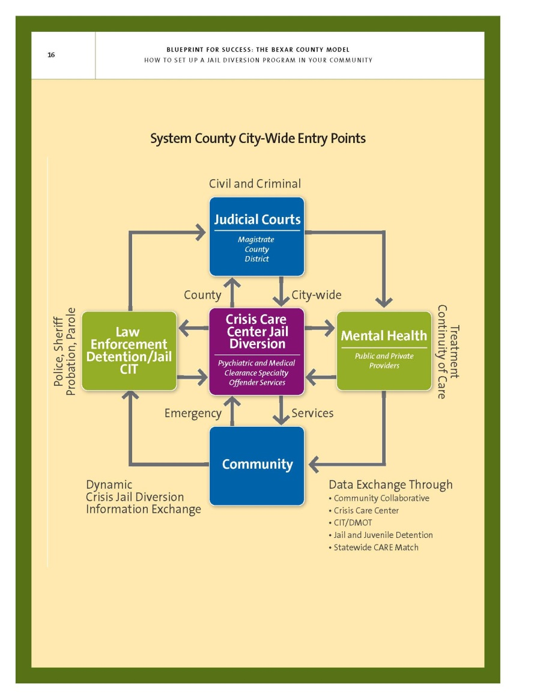
Comparison 2: Different Intercepts/JDTR Model Texas
JDTR Intercept 1:
CHCS Restoration Center - Sobering Unit
Case Management:
CHCS Recovery Specialist(s)
Haven for Hope
IHRP/housing
+ 78 partners
CHCS
CM + SA-IOP
+ MH + other
VA
Multiple sites
Seeking Safety at each location

Slide 13
Comparison 3: Client Populations Demographics/Contextual Information*
Rhode Island
Texas
 | N | % | % | N
Male | 36 | 83.3 | 89.6 | 96
Age M(SD) | 32 | 37.9 (12.41) | 48.8 (12.54) | 96
Race/Ethnicity: Black or African American American Indian White Hispanic | 36 | 8.3 5.6 86.1 8.3 | 15.6 2.1 82.3 37.9 | 96
Education: Less than High School High School/GED/Voc Tech Some college or more | 39 | 19.4 44.4 36.1 | 7.3 42.7 50.0 | 96
*reported at baseline interview

Slide 14
Comparison 3: Client Populations Demographics/Contextual Information*
Rhode Island
Texas
 | N | % | % | N
Working FT or PT = YES | 36 | 25.0 | 16.7 | 96
Income past 30 days (Median) | 32 | $1,013 | $200 | 86
Housing past 30 days: Own home Unstably housed Homeless Institution/Other | 32 | 65.6 31.3 3.1 0 | 8.3 15.6 70.8 5.2 | 96
Criminal Justice Involvement = YES Ever on probation Ever spent time in jail/prison | 36 | 52.8 40 | 62.5 83.2 | 96
*reported at baseline interview

Slide 15
Comparison 3: Client Populations Military Service*
Rhode Island
Texas
 | N | % | % | N
Civilian | 8 | 25.0 | 0 | 0
Branch Served** Army Navy Marine Corps Air Force Coast Guard | 26 | 46.9 3.1 15.6 9.4 0 | 58.9 18.9 12.6 8.4 1.1 | 95
Eras Served*** Korean up to Vietnam Vietnam Post-Vietnam Persian Gulf-Middle East Afghanistan/Iraq | 26 | 0 9.4 15.6 9.4 46.9 | 6.4 34.7 53.7 15.8 16.8 | 95
*reported at baseline interview **branch is inclusive of guard/reserve service ***some served in multiple eras
Notes:
Army is also the largest branch of the military

Slide 16
Comparison 3: Client Populations Clinical*
Rhode Island
Texas
 | N | % | % | N
PTSD diagnosis (PCL-C) | 32 | 75 | 82.1 | 95
Non-military trauma (before 18) | 32 | 81.3 | 43.2 | 95
Depression (BASIS-24 subscale) Moderate to Extreme Difficulty | 32 | 37.5 | 58.2 | 91
Alcohol (positive CAGE) | 32 | 46.9 | 76 | 96
Illegal Drug Use (past 30 days) | 32 | 46.9 | 30.5 | 95
Past MH treatment | 36 | 30.6 | 32.3 | 93
Past SUD treatment | 36 | 13.9 | 30.2 | 96
*reported at baseline interview
Notes:
PTSD Checklist – Civilian version (PCL-C) 17 items
Behavior and Symptom Identification Scale (BASIS-24) full scale score and subscale scores (Depression, Relationships, Self-Harm, Emotional Lability, Psychosis, Substance Use).
CAGE: 4-item screening for alcoholism. 2 items indicate a positive screen and need for further assessment.
Past 30 day MH and SUD OP treatment

Slide 17
Comparison 4: Trauma Intervention How is the intervention provided?
TAMAR - RI
Seeking Safety - TX
Overall:
SAMHSA Promising Practice
12 modules in original design
Psycho-educational group program
Designed for women in prison
At pilot (adapted TAMAR):
Adapted for male veterans by pilot Director/staff with VA expert clinicians
11 session version is formalized in a revised manual
RI TAMAR modules in reverse order from original; 7/11 similar; RI does not include Supplements A & B.
Overall:
SAMHSA EBP
Effective in veteran populations
25 possible topics in any order
No specific degree/experience
At pilot:
In the service continuum
Since 2009 at CHCS, in use by the VA
Group and Individual
Do not use all 25 topics (8 – 11)
1st 8, then counselor’s discretion
Change topic order based on group
Use as a “brief intervention”?

Slide 18
Comparison 4: Trauma Intervention Participation in Intervention
TAMAR - RI
Seeking Safety - TX
Run in groups:
Men: 11 completed groups
2-8 members (M=4.7)
Overall age range: 22 to 67
Group age M = 31.3 to 41.5
All veterans: now splitting combat from non-combat
Women: 4 groups
1-3 members (M=2.8)
1 female veteran
Overall age range: 22 to 53
Group age M = 22.0 to 36.0
Run in Groups (CHCS):
Separate groups for men / women
Number of groups - ?
Seeking Safety part of service array
84.1% report SS participation
Currently gathering EHR data
SS “Brief Intervention”
54 veterans (56%)
312 documented SS BIs
Range: 1 – 16; Median = 5

Slide 19
Comparison 4: Fidelity of the Intervention How is/ How can fidelity be examined?
TAMAR - RI
Seeking Safety - TX
One primary provider/trainer
Manual revision with supervisory staff and SAC participation
Manual-based checklists
Plan for post-session ratings?
Center requires initial SS training
One primary trainer on staff
Fidelity checks (no specific schedule)
SS “Brief Interventions”?
At VA, unsure …
Demonstrating significant reduction in trauma symptoms from Baseline to 12 month.

Slide 20
Comparison 5: Beyond the Primary Intervention – Use of Additional Services*
RI
TX
Psychiatric Medication | 50% | 85.4%
Peer Support/Self-Help | 33.3% | 80.7%
Case Management | 25% | 98.8%
Housing | 16.7% | 47%
Outpatient SUD Treatment | 16.7% | 86.6%
Detoxification Services | 8.3% | 89.2%
Vocational/Rehabilitation Services | 8.3% | 54.9%
Transportation | 8.3% | 92.8%
*reported at 6-month interview

Slide 21
Evaluation Challenges for Drawing Meaningful Conclusions
Variations in the:
Intercept point and JDTR models employed
Client population
Trauma specific intervention / Fidelity
Array of additional services
Ability to collect data
Drawing conclusions about:
Effectiveness of the program
Effectiveness of the trauma-specific intervention

Slide 22
Evaluation Challenges for Drawing Meaningful Conclusions: Site Variations
Characteristic
RI
TX
Intercept | 2 = arraignment | 1 = pre-booking
JDTR model | Court-based | Center-based
Client Population:
Age | 37.88 | 48.82
Race/Ethnicity | 8.3% Latino | 37.9% Latino
Education | 36.1% some college | 50.0% some college
Working full-time | 25.0% | 16.7%
Income past 30 days | $1,013 | $200
Housing past 30 days | 65.6% own home | 70.8% homeless

Slide 23
Evaluation Challenges for Drawing Meaningful Conclusions: More Site Variations
Characteristic
RI
TX
Client population continued:
Criminal Justice involved- Prison | 40.0% | 83.2%
Military: Era Served | 46.9 % Afghanistan/Iraq | 88.4% Vietnam/Post-Vietnam
Civilian | 25% | 0%
Non-Military Trauma <18 | 81.3% | 43.2%
Alcohol Problems | 46.9% | 76.0%
Past SUD Treatment | 13.9% | 30.2%

Slide 24
Evaluation Challenges for Drawing Meaningful Conclusions: Site Variations, Trauma-specific Intervention
Within-site variations
“Psycho-educational” can blur into clinical
Composition of individual groups
Clinician expertise varies (substance abuse, trauma, psycho-ed)
Works in progress, adapting to clients, settings, court requirements
Fidelity is best seen as a way to track evolution and variation
Cross-site variations
Trauma-informed vs. Trauma-specific
Different Trauma-specific interventions
Trauma-specific intervention offered at different Intercept points

Slide 25
Ability to collect data
Rhode Island:
Small state advantage: everybody knows everybody (e.g. staff musical chairs)
Part-time self-employed contract staff delivering the intervention; difficult to stay connected even with good intentions
VA relatively compliant, has helped from the beginning with treatment adaptation
Other service use, even in a small state ???.
Tracking variations in treatment (e.g. differences for women, non-combat veterans) is not easy
Finding the clients and getting them to call back at 12 months – aargh!
Texas
County/community on board with jail diversion – systems in place
More than one staff from more than one provider deliver SS = many variations in SS delivery / how SS is documented in EHR / fidelity?
Still working with VA to collect service use data (including SS) and “finding” SS in the EHR

Slide 26
Ability to draw conclusions
The independent variable is not well specified
The population is remarkably varied
from state to state
within states across implementation sites
looking at moderating effects will be difficult, as the treatment is so various and client-responsive
Everyone cares about the “priority to vets” but
What about women? How is this going for them?
Does the positive commitment to vets lead to over-promising?

Slide 27
Strategies for Overcoming the Challenges
Ideas from RI:
Don’t put all your eggs in the outcome basket
For programs like this (innovative, directed at new populations for services, highly political for implementation and likely to evolve with the political environment in the county and state) the process tracking aspect of evaluation should be central
Ideas from Texas:
Same as the above, plus:
Map service pathways at the beginning of the project and as they are added during the project (playing catch up) … another variable(s)?
Document how the trauma specific intervention is delivered and monitored by various systems
Agree on a standard method to provide SS from project start (?) and then make modifications if necessary
Establish EHR data collection process from the beginning (playing catch up)

Slide 28
What’s in Process?
Fidelity of the “treatment” but with an understanding of its role when the treatment is evolving, flexible
Transfer of the “treatment”:
Training evaluation (RI)
“Rollout” to other sites (TX)
Local (pilot site) and statewide advisory committee process over time (RI has used rating forms for this )
Qualitative data from treatment providers, clients, case manager, court clinicians – and vet peer mentors and clients where possible
Digging into the data
Making friends: VA, VISN, treatment providers, vet peers, cross-site evaluators, other state evaluators …
And thanks for coming! New friends?

Slide 29
Contact Information
John F. Stevenson
Department of Psychology
University of Rhode Island
10 Chafee Road
Kingston, RI 02881
401-874-4240
jsteve@uri.edu
Stacey Stevens Manser
University of Texas at Austin, Center for Social Work Research
1717 W. 6th Street
Austin, Texas 78703
512-289-0148
stacey.manser@austin.utexas.edu
http://www.utexas.edu/ssw/cswr/institutes/mental-health/

