Slide 1
Performance Management in Action: A National System for Measuring Early Childhood Outcomes
Kathy Hebbeler, Donna Spiker, Lauren Barton
The Early Childhood Outcomes Center at SRI International
Lynne Kahn
The Early Childhood Outcomes Center at FPG Child Development Institute at UNC-Chapel Hill
Presented at:
Annual Conference of the American Evaluation Association
Anaheim, CA - November 3, 2011
Notes:
1

Slide 2
Steps in Building the National System: Background and State Choices
Lauren Barton
SRI International

Slide 3
In this presentation…
The programs and the system they needed to build
Why?
Identifying outcomes to measure
Federal reporting requirements
Current state approaches
Notes:
What to build - What was needed – an outcomes measurement system – the missing piece in understanding and managing program performance
Why? The impetus behind developing a system

Slide 4
The programs
Early Childhood Programs under the Individuals with Disabilities Education Act (IDEA)
Age | Names
Birth to 3 years | Part C Early Intervention (EI)
3 – 5 years | Part B Preschool Early Childhood Special Education (ECSE) Section 619 Programs
Notes:
Focus of the agencies where the systems have been developed, but the children are served in many different early childhood programs. With an emphasis on supporting functioning in inclusive settings, children are in many different child care settings, head starts, community preschools, etc.

Slide 5
Initial data being gathered
Collected data on
Number, type, and settings of services provided
Family satisfaction with services
Case studies describe changes for individual children
Identify individualized outcomes to focus on and progress toward meeting those for each child/family– identified in
IFSP - Individualized Family Service Plan (0 to 3)
IEP - Individualized Educational Program (3-5)
(Different outcomes, cannot aggregate this data)

Slide 6
The need: Build an outcomes measurement system
Outcome: a benefit experienced as a result of receiving services
Goes beyond number and type of services
Is not satisfaction with services
Looking at global outcomes – the benefits we want all children in the program to experience
Different from individualized outcomes on an IEP/IFSP
Notes:
In performance management system, needed to measure child and family outcomes… benefits experienced as a result of services. A way to see the change that result across all the kids who get services… did the program make a difference? Goes beyond counting services or seeing if those who receive them were happy with the services they got…. Did the program produce the intended changes in the child’s functioning? Looking at global outcomes.. Intended difference we expect to see for all children, not just changes in specific goals identified for one child..
(outcomes - the change that resulted)

Slide 7
Why are state early intervention and preschool special education programs collecting data on child and family outcomes?

Slide 8
Why?
Accountability
Federal government (Office of Special Education Programs, U.S. Department of Education) requires that states submit data on outcomes
In some states, policymakers are asking for outcome data because states provide some funds
Program Improvement
State agencies (and local programs) want to use data on outcomes to improve services for children and families
Notes:
Including thinking about allocating TA resources

Slide 9
Federal forces
Government Performance and Results Act (GPRA)
Individuals with Disabilities Education Act (IDEA)
Program Assessment Rating Tool (PART)
Notes:
Federal forces: Impetus for collecting data on child outcomes
Three driving forces from the federal govt
GPRA – 1993, PART 2002, IDEA reauthorization – 1994.
GPRA
Requires goals and indicators be established for IDEA
Indicators and data collection for school age population included data on outcomes
Notes from OSEP’s slides: Lou
GPRA:
Passed in 1993
Applies to all federal agencies
Requires that a set of indicators be established in order to judge the effectiveness of programs meeting their goals
OSEP has established GPRA indicators for all IDEA programs, including Parts B, C, and D that are reported to Congress annually.
For the Part C indicators, OSEP has collected data on the total number of children served and the number of children served under the age of one, and on settings where services are provided to eligible children
For 619, OSEP has collected data on settings where children receive special education and related services
Thus far OSEP has not yet collected and reported data on the functional abilities of children and family outcomes

Slide 10
Individuals with Disabilities Education Act (IDEA)
SEC. 616. <<NOTE: 20 USC 1416.>> MONITORING, TECHNICAL ASSISTANCE, AND ENFORCEMENT. ``(a) Federal and State Monitoring.-…..
…..
``(2) Focused monitoring.--The primary focus of Federal and State monitoring activities described in paragraph (1) shall be on-- ``(A) improving educational results and functional outcomes for all children with disabilities;
Notes:
To focus on improving results, we need a way to know what the results are and to see if they are changing over time.

Slide 11
OSEP: PART evaluation results (2002)
130 programs examined in 2002; 50% programs had no performance data
Programs looking at inputs, not results
Part C and Section 619
No child outcome data - “results not demonstrated”
Department of Education needs to develop a strategy to collect annual performance data in a timely manner
Notes:
During the 2003 budget period, the Administration rated approximately 130 federal programs on their effectiveness using part
50% of the these programs had no performance data
Programs tend to use inputs or process data, rather than results or outcome data
Specifically for Part C and Section 619: did not do well in the area of accountability/results because there were no long-term child outcome goals; no child outcome data. The recommendation from the PART is that OSEP needs to develop a strategy to collect annual performance data (child and family outcomes) in a timely manner

Slide 12
Read more at ExpectMore.gov
Notes:
Explain PART and posting on website
Still relevant today

Slide 13
How Office of Special Education (OSEP) responded to PART
Required states to submit outcome data in their Annual Performance Report (APR)
Funded the Early Childhood Outcomes (ECO) Center in October 2003 to gather input, conduct research, make recommendations, and assist states

Slide 14
What child outcomes should the programs measure?

Slide 15
Identifying outcomes to measure
Extensive process
Stakeholder input nationwide
1½ years process, identified priorities… resulted in the 3 outcomes…
Result: widespread agreement
Overarching vision of what the program hopes to accomplish for children
3 child outcomes to measure annually in addition to other data already being collected
Notes:
Child outcomes are one indicator in a set of indicators for both of these programs…
We are only talking about one indicator… not the only one.

Slide 16
Overarching goal for EI and ECSE
“…To enable young children to be active and successful participants during the early childhood years and in the future in a variety of settings – in their homes with their families, in child care, in preschool or school programs, and in the community.”
(from Early Childhood Outcomes Center,
http://www.fpg.unc.edu/~eco/pdfs/eco_outcomes_4-13-05.pdf)
Notes:
Outcomes support these
If room, it is negotiable…

Slide 17
OSEP Reporting Requirements: Child Outcomes

Slide 18
Three Child Outcomes
Children have positive social relationships.
Children acquire and use knowledge and skills.
Children take appropriate action to meet their needs.
For examples, see outcomes step by step video:
http://www.fpg.unc.edu/~eco/pages/videos.cfm

Slide 19
OSEP reporting progress categories
Percentage of children who:
a. Did not improve functioning
b. Improved functioning, but not sufficient to move nearer to functioning comparable to same-aged peers
c. Improved functioning to a level nearer to same-aged peers but did not reach it
d. Improved functioning to reach a level comparable to same-aged peers
e. Maintained functioning at a level comparable to same-aged peers
3 outcomes x 5 “measures” = 15 numbers
Percentages in 5 categories add to 100%
Notes:
OSEP came up with these 5 categories for reporting children’s progress in the three outcome areas. (Summer 2005: OSEP announces the child and family outcomes States must report on through their SPP/APRs. Progress categories evolved to 5)

Slide 21
Summary statements
Of those children who entered the program below age expectations in each Outcome, the percent who substantially increased their rate of growth by the time they turned 3 [6] years of age or exited the program.
c + d
(a+b+c+d)
Notes:
The statements on which states set targets this year.

Slide 22
Summary statements
2. The percent of children who were functioning within age expectations in each outcome by the time they turned 3 [6] years of age or exited the program.
d + e
(a+b+c+d+e)
Notes:
Targets set for summary statements this year.

Slide 23
The concepts are easier than the words or the formulas
Summary statement 1: How many children changed growth trajectories during their time in the program?
Summary statement 2: How many children were functioning like same-aged peers when they left the program?
Notes:
Other ways to think of SS1 – how many made more than expected growth. Sometimes called ‘significant.’ SS2 – for preschoolers – ‘ready for kindergarten.’ At age level.

Slide 24
Target setting and reporting requirements
Targets
Summary statements in 2008-09 are baseline
Identify targets: Expected summary statement percentages for next 2 yrs
Public Reporting
For each of the 3 global outcomes:
Report state % in each of 5 categories of progress
Report state % in each of 2 summary statements and compare to state target
Report 2 summary statement % by local area/district/region and compare to state target
Notes:
Where performance management system… 2 indicators out of a set of multiple indicators that programs report on… stakeholder process to set, baseline, report… made it, improvement strategies…
Target setting is important, encourage to look at outcomes data in multiple ways in multiple variables.
Also reporting out by program.

Slide 25
State example: Statewide baseline and targets on summary statements in SPP
Notes:
http://hss.state.ak.us/ocs/InfantLearning/resources/publicreporting/default.htm

Slide 26
Reporting APR data in 5 progress categories
Also presented for other 2 child outcomes

Slide 27
State example: Comparing statewide
summary statements to targets in APR
Notes:
They present data for all 3 outcomes this way

Slide 28
Local reporting of actual summary statements
Targets
60%
52%
Targets
66%
46%
Targets
62%
46%

Slide 29
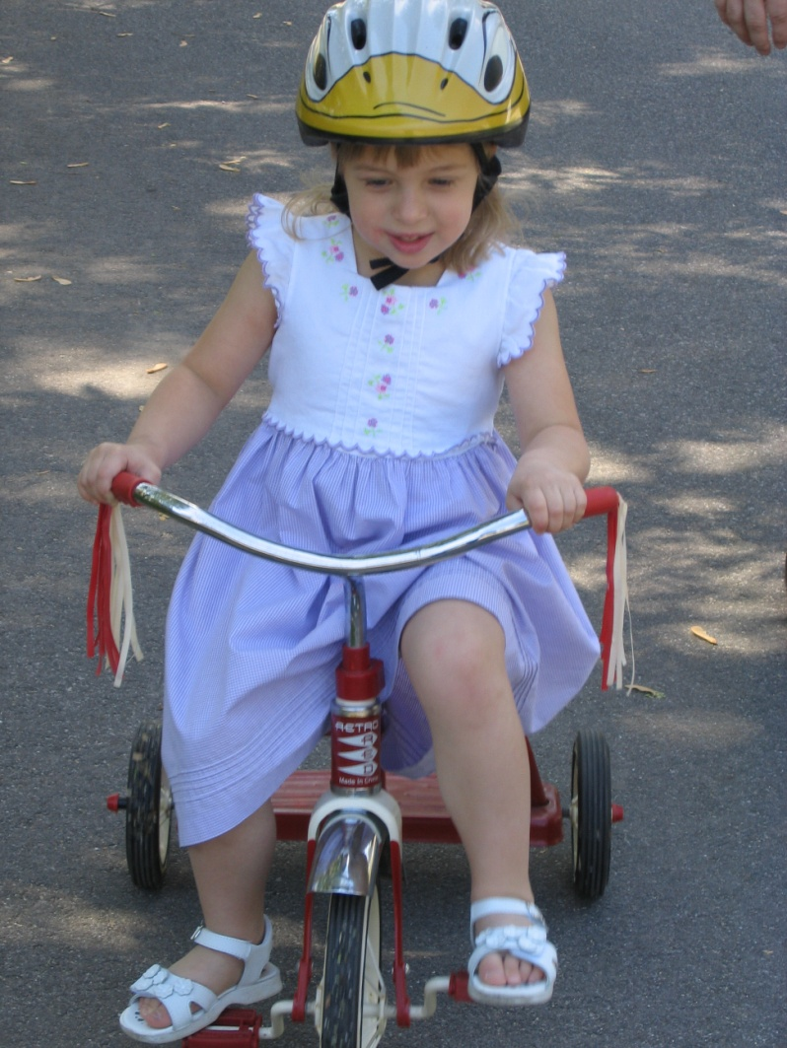
State approaches

Slide 30
State Approaches to Outcomes Data (February 2011)
Approach | Part C (56 states/jurisdictions) | Part B Preschool (59 states/jurisdictions)
COS* 7 pt. rating | 41/56 (73%) | 37/59 (63%)
One tool statewide | 7/56 (13%) | 9/59 (15%)
Publishers’ online analysis | 3/56 (5%) | 6/59 (10%)
Other | 5/56 (9%) | 7/59 (12%)
*Child Outcomes Summary Rating
Notes:
Primarily an approach called the COS rating…. Different approaches, most are using one…
Don’t explain all of the approaches.. Call attention to the difference.

Slide 31
Summary: National Picture
Shift from no data in 2003 to up to 4 years worth of data on children’s progress in 2009-2010
Part C: 54 state/territories–97,558 children
Part B Preschool: 58 states/territories–138,662 children
There are still issues with the data, but it continues to improve because of state diligence
No other national early childhood program has this kind of information
No other program in the U.S. Department of Education has this kind of information

Slide 32
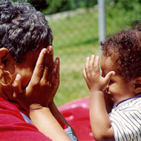
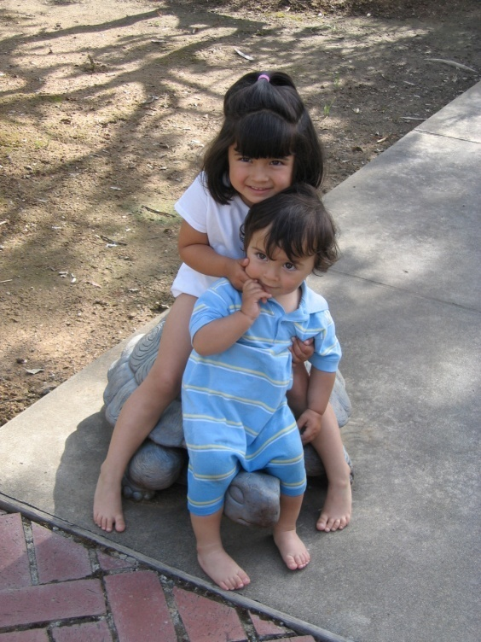
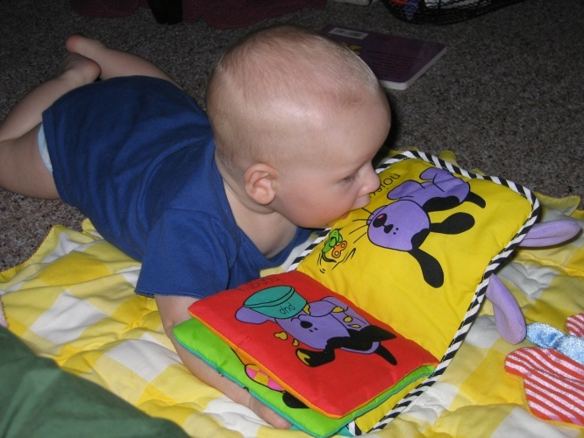
QUESTIONS??

