Slide 1
Dismounted Counter-IED Tactics Master Trainer (DCT-MT) Evaluation
Dr. Jay Brimstin, US Army-Maneuver Center of Excellence
Annie Hester, US Army-Maneuver Center of Excellence
For any questions, please contact Dr. Jay Brimstin at
jay.a.brimstin.civ@mail.mil or Annie Hester at toumnakone.hester.ctr@mail.mil

Slide 2
Video

Slide 3
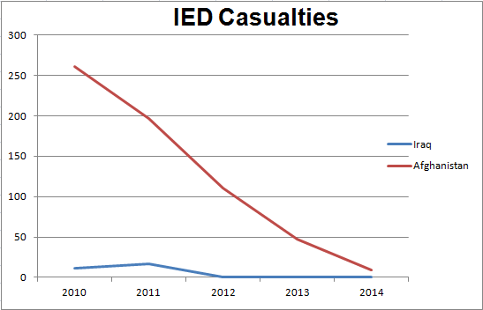
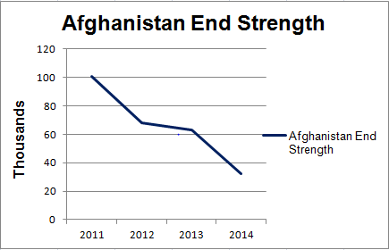
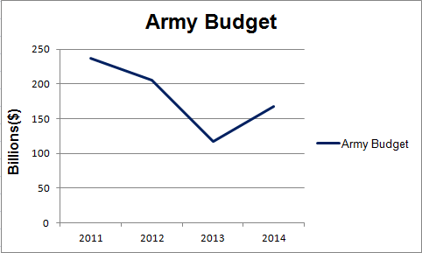
Why Evaluate?
“Soldiers did not know the limitations and capabilities of the handheld devices, how to properly use the equipment, or how to tactically employ the devices during dismounted patrols”
Training Course = Resource
Man Power
Money
Time
Notes:
JB: Why evaluate this course?
Number of functional courses—showing a downward trend
Decrease of end strength in Afghanistan and reduction in Army budget

Slide 4
Mixed Method: Kirkpatrick 4-Level Model
Purpose: Evaluate the effectiveness of the DCT-MT course and determine what impact the course has on trained units’ operational performance in theater
Organizational Improvements
What was the impact of training on unit’s operational performance?
Results
Operational Performance Measures (Variables)
1. Decrease in casualties
2. Decrease in found/cleared
3. Decrease in detonation
On-the-job-performance
Did Soldiers apply what they learned during unit training and operations?
Behavior
Work Outputs & Processes
1. Did MT conduct C-IED training?
2. Did MT advise leaders?
3. Did MT plan for employment of handheld devices?
Gain in Skills and Knowledge
Did Soldiers learn?
Learning
Knowledge and Skill Testing
1. Pre/post test comparison
* Increase of 25% or higher between pre/post tests
Attitudes and Perceptions
How did Soldiers perceive training?
Reaction
Opinion and Feedback
1. End of Course Survey
*4 or greater on Likert scale
Notes:
JB: (left side of slide)
Reactions: Attitudes and Perceptions
Learning: Gain in skills and knowledge
Behavior: On-the-job-performance
Results: Organizational improvements
AH:
Reaction: an end of course survey was used to collected data and a rating of 4 or higher on Likert scale was desired
Learning: each student completed a pre test prior to receiving any instruction and a posttest was administered on the last day of training. Pre and posttest scores were compared to determine the increase in learning. An increase of 25% or higher from pre to posttest was desired
Behavior: four different types of data collection instruments were employed during unit deployment in Afghanistan and after the unit returned home. Data collected from theater included the direct observations of units by the JET advisors and surveys were completed by unit commanders and the course graduates. After units redeployed, focus groups were conducted with the graduates and when possible, their unit commanders. The Testing and Evaluation Team also administered “The Soldier Survey.” Surveys were completed by unit leaders from the brigades and captains in the Maneuver Captains Career Course.
Results: The three variables we looked at were the numbers of casualties, IED found/cleared, and IED detonations during dismounted operations. Each of these numbers should decrease as a result of the training.

Slide 5
Demographics
Total of 525 Soldiers trained from 21 classes
19 Brigades from Aug 2012 to end of FY 2013
Target Career Management Fields: 82%
46%-Infantry
20%-Engineer
4%-Field Artillery
12%-Cavalry Scouts
Rank of Students: 89%
Sergeant-42%
Staff Sergeant-35%
Sergeant First Class-12%
92% of students have deployed, 46% of whom have deployed 24 or more months
Notes:
AH:
21 classes had been conducted between the first class in August 2012 to the end of FY 13. Included in the analysis were 19 classes. Two classes that were conducted were not for a brigade; one was for the Operations Group at the National Training Center and the other was conducted at Ft Benning for several units.
The target audience for the course were Infantry, Engineer, Field Artillery, and Calvary Scout Soldiers. The target rank were Sergeant promotable and above.
8% of the Soldiers who have not deployed are junior enlisted and officers.

Slide 6
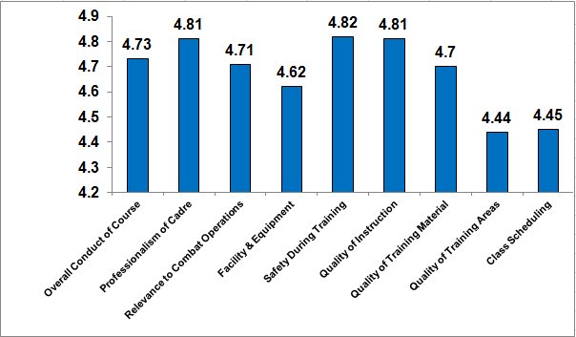
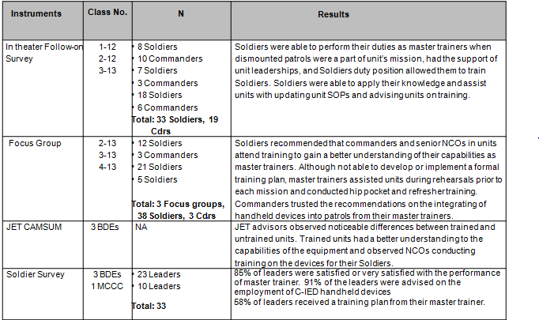
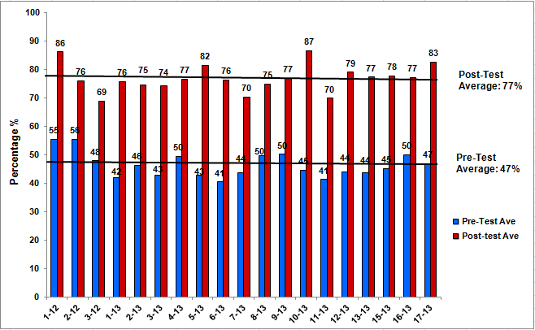
Results
Level I
Level III
Level II
Level IV
Notes:
AH:
The results for each level can be found in your handout.
Levels I and II data were collected during the training. The feedback from the end of course survey were used to continuously improve the course. The mobile training team and the design and evaluation team conduct a quarterly review of the program of instruction. The feedback from the surveys generated the recommendations for adding or deleting a lesson plan or changing how certain lessons are conducted.
JB: Transition to levels 3 and 4.

Slide 7
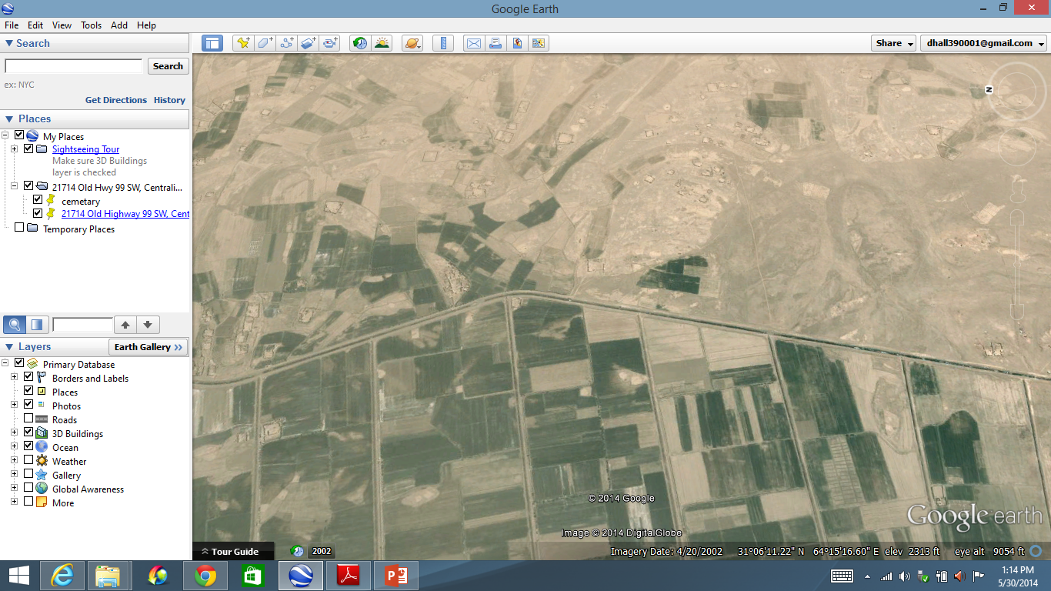
Which Route Would You Take?
N
FOB
Objective

Slide 8
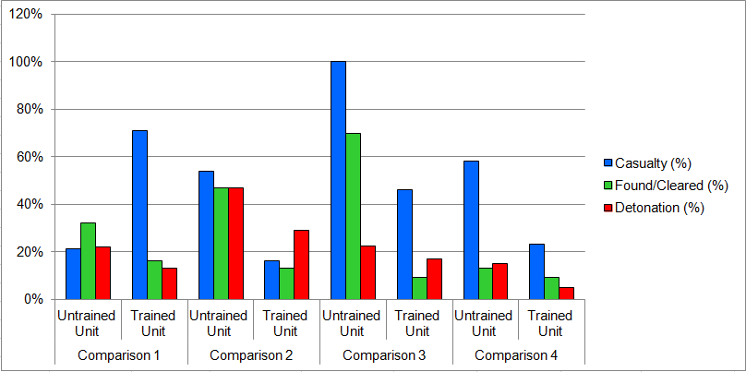
Level 4: Results
Casualty Ratio
Found/Cleared Ratio
Detonation Ratio
Level 4 Comparison
Ratio =Total No. Unit/Total No. AO
Notes:
AH:
Explain what untrained and trained units:
Untrained units: Did not receive the DCT-MT training
Trained units: Received DCT-MT training
Explain what each variable means:
Casualty Ratio: Number of injuries sustained from an IED during dismounted operations-an IED blew up and someone got hurt
Found/Cleared Ratio: IEDs that were found/cleared that did not detonate
Detonation Ratio: IEDs that exploded, not found/cleared
Ratio: calculated by dividing the units’ total number by the total number w/in the AO
Expectations from training: Expect to see all three ratios for trained units to be lowered than those of untrained units b/c Soldiers are trained to avoid vulnerable areas, which will reduce the found/cleared ratios; number of IED detonations should reduced; and with the reduction in IED detonations, the number of casualties should also reduce
Level 4 Comparison: This figure summarizes the 4 comparisons in the analysis. As expected, the found/cleared and detonation ratios for all four trained units were lower than the untrained units. The casualty ratios for three of the four comparisons were lower for the trained units. The trained unit had a higher ratio than the untrained unit in Comparison 1.
Anomaly in Casualty Ratio for Comparison 1: Unlike the other three trained units in the analysis, the trained unit in comparison 1 suffered a catastrophic event that resulted in 13 casualties in a single event. There were only 10 other casualties throughout the AO during the time for the trained unit but a total of 159 casualties for all other units in the AO during the untrained unit’s time frame in theater.
JB
Conclusion/Transition to next slide: The training had a positive effect on unit countering IED threats, however, the results are not conclusive. Some factors that could possibly have affected the results is the small sample size and the anomaly in Comparison 1.

Slide 9
Challenges To Evaluation
Lack of controlled environment
Change of mission
ANSF taking lead
Isolating dependent variables
Response rate
Generalize findings
Size of evaluation effort
Time span of evaluation
Evaluator Bias
Notes:
JB:
Lack of controlled environment
“Perfect experiment”
Couldn’t control for enemy activities (Cav Scouts injured more than IN b/ of the increase in IDF)
Didn’t control who went to course (ranks/CMF) or command emphasis
Change of Mission
Retrograde operations
ANSF taking lead
AH:
2. Isolating dependent variables-There were confounding variables that effected the dependent variables. These included the leaders’ emphasis on the value of the training, having the target audience (w/ the target CMF and rank), and compe
3. Response Rate-The response rates for the follow-on in theater surveys for the commanders and course graduates were very low. Enough data were collected from 3 bdes. Once in theater, computers and internet connections were not available at each location. We were competing with other priorities for the soldiers, such as preparing for the next mission, maintenance on equipment, or just relaxing. Completing a survey is most likely the last thing that thought about. The low response rate created a challenge in trying to generalize the findings from the surveys.
4. Size of Evaluation Effort-From start to finish, the evaluation spanned over 18 months.
Time span of evaluation-15 months is the average time span between soldiers receiving the training to the units’ redeployment. It took another 3 months for the analyst to collect data from level 4 evaluation after the units redeployed.
Because of the deployment cycle, the data collection was limited to a small number of units.
Levels I and II were conducted during the classroom and the instructors assisted with the data collection
Levels III and IV was in depth and required data from multiple sources and the collaborative efforts between several different teams and/or organizations (i.e. JET, DIAT, and T&E)
The level of effort to gather and analyze level IV data were more extensive than we realized. An analyst dedicated his time to collect, vet, and analyze the data. He spent on average of 65 man hours completing the analysis for one unit. There was another team that vetted the data to make sure all the data included in the analysis were for dismounted patrols only.
5. Evaluator Bias-The findings and recommendations provided in this evaluation are limited to the interpretation of the data by the evaluator. The evaluator has subjective biases and professional and military experiences that could affect how the qualitative data was analyzed, coded, and interpreted. In the same manner that methodological triangulation was used for Level III evaluation, investigator triangulation could be used in the future, which involves other evaluators during the data analysis phase of the evaluation.
JB
5. “I failed to realize…..size of evaluation……but did realize……..”

Slide 10
Recommendations
DCT-MT Course
Future Evaluation
Rank: SGT Promotable and above
Target career management fields
Completed prerequisite training (40 hr handheld devices training)
Deployable (will deploy with unit)
Duty positions that allowed the Soldier to perform duties as a master trainer
Conduct training at least 90 days prior to the Combat Training Center rotations or deployments
Kirkpatrick four-level model
Use Levels I and II results for course improvement
Methodological & Investigator Triangulation
Incorporate evaluation plan early
Collaboration with external teams
Collaborative team effort
Notes:
AH:
DCT-MT Course
The results of an evaluation is useful only if the results are used to improve on the course or in the process of how the course is conducted. The results of this evaluation project did both. The results from all four levels of the evaluation were used to make changes to course content based on feedback from Soldiers in the course and in Afghanistan and how the course is actually conducted. The following recommendations are made as a result of the evaluation:
1. Rank/Target career management fields-these two recommendations were based on the feedback received from the end of course surveys and test scores. Specialists and below on average scored lower on the post test, almost 10 points lower than the highest ranking Soldiers. Soldiers with CMF, other than the target CMF, also on average scored lower on the posttest. The comments from junior soldiers with non-target CMF were also different from Noncomissioned officers (NCO) with the target CMFs. For example, a Specialist who drives a truck will recommend more time spent on the operations orders, how to conduct unit training, or more time spent on IN tactics.
2. Prerequisite training-Prior to attending the course, Soldiers are required to complete a 40-hr course on C-IED handheld devices. During training, they are taught the ‘buttonology’ of each piece of equipment. When Soldiers who haven’t completed the course go to the training, they are at a disadvantage and are in danger of falling behind.
3. Deployable-This course is 80 hours long and the lessons learned are relevant and pertinent to the unit’s success in the fight against IEDs. There are units that would send a Soldier to the training and the Soldier does not deploy with the unit.
4. Duty positions-Just like units sending Soldiers to the training who won’t deploy, the unit will send Soldiers who are not in the position to conduct training for the unit. For example, sending a mail clerk to the training versus a platoon sergeant.
5. 90 days-Timing is everything. Most of the units at the end of FY 12 and FY 13 received the training w/in 30 days of deploying or their CTC rotation. During this time, Soldiers and units were preparing for the deployment or for their CTC rotation, preoccupied with packing, and taking leaving. Graduates did not have the opportunity to conduct training for their units.
Future Evaluation:
Kirkpatrick four-level model-The Kirkpatrick four-level evaluation model is designed for evaluating training. This model provides a framework to follow and streamlines the process of answering the evaluation questions. The model is adaptive and can be tailored to meet the needs of the organization. As such, this model should continue to be used for future training evaluation projects.
2. Levels I and II to improve course-Unlike most surveys administered after a training course, each survey was read and vetted. The recommendations from Soldiers were implemented and changes to the course were made to ensure Soldiers were receiving the most up to date information. Also, recommendations to the minimum requirements for rank and CMF were made base on the levels I and II data.
3. Methodological & Investigator Triangulation-When evaluating Level III or higher of other training programs, methodological and investigator triangulation should be employed, especially when conducting qualitative data analysis. Having more than one analyst analyzing the same data could provide deeper insights into the understanding of emerging themes and increase the level of confidence in the data. The interpretation of the data is also not solely dependent on one analyst.
4. Incorporate evaluation plan early-Ideally, an evaluation plan should be developed in conjunction with the process for developing the course. When an evaluation plan is not implemented until mid-way through the program, key data may not be collected. In this case, level I data were not collected for the first seven classes because the data collection instrument was not developed and administered until the 8th class of FY 13.
5. Collaboration (external)-It would have been near impossible to complete this evaluation project without the help of external teams (i.e. JET advisors, DIAT, and T&E). These resources were available and within the organization (MCoE), we should take advantage these resources when possible.
Collaborative Team Effort-The bulk of this project was completed by one member of the design and evaluation team for this course (i.e. developing the evaluation plan, data collection instruments, data entry, analysis/interpretation of data, and completing the final report). Having a team to conduct an evaluation of this magnitude would reduce the workload of that one person and builds in continuity if that person has to be replaced or leaves employment.
JB: Conclusion…….

