Slide 1
Scrum for Evaluators
Elise Garvey
King County Auditor’s office
@elisegarvey

Slide 2
King County Auditor’s Office
Performance Auditing
Independent agency of the County Council
King County biennial budget: $9 Billion

Slide 3
Examples of our audits
Strategic Climate Action Plan
Office of Law Enforcement Oversight
Transfer Station System Planning
Emergency Medical Services

Slide 4
Capital Projects
Emergency Radio System Replacement
Wastewater Treatment Plant
County Courthouse
Child and Family Justice Center

Slide 5
Project Management
What it is:
Method to achieving evaluation goals within constraints
Informs how we approach teamwork, logistics
Helps us document our process

Slide 6
Project Management
What it is not:
It is not the evaluation approach or type

Slide 7
Scrum is project management methodology that is iterative and flexible.

Slide 8
Questions for you
How many people have a defined project management approach?
What is it?
Why have a project management approach?

Slide 9
Today
Practice
Basic Scrum processes
Challenges to adapting Scrum to evaluation

Slide 10
Not today
Scrum vocabulary and history overload
Everything about Scrum
Scrum evangelism

Slide 11
What I like about Scrum
Impact is forefront
Helps keep the focus on the value to the evaluation users

Slide 12
What I like about Scrum
Visual & Communicative
Uses tools and processes to ensure team knows what is going on and can manage time

Slide 13
What I like about Scrum
Nimble
Uses information sharing with users and iterations to manage change

Slide 14
Impact
Focus is on the value to the evaluation users
Who are the evaluation users?

Slide 15
Evaluation Users

Slide 16
Framework
As a
(user)
I want
(goal)
so that .
(value)

Slide 17
Framework
As a King County Councilmember
I want to know whether Lean is improving citizens’ customer service experience with the County
so that I can decide whether to continue funding Lean efforts

Slide 18
Try it out
With the person next to you, use your worksheet to think through this framework for different types of users for your projects

Slide 19
User Stories
A user story is a statement that describes the value of the evaluation from a user’s perspective.
User stories help guide the evaluation team throughout the project.

Slide 20
General To Do List
Like a list off the top of your head

Slide 21
General To Do List
Could come from:
Terms of Reference
Evaluation Plan
Standard things you do during an evaluation

Slide 22
King County Auditor’s To Do List
Comes from:
Yellowbook Standards
Individual Project Survey Plan
Individual Project Workplan

Slide 23
Product Backlog

Slide 24
So far we have
Statements of value to stakeholders
General to-do list
Plain language
Scrum language
User Stories
Product Backlog

Slide 25
Iterations
2-4 weeks
Make a more refined to-do list with:
Big tasks
Smaller tasks
Deliverables

Slide 26
Iterations
Big tasks: Prioritized items from backlog or changes you can break down into tasks
Smaller tasks: Things you can do in under 4 hours
Deliverables: Tangible internal or external products

Slide 27
Sprint Plan

Slide 28
Sprint Planning Activity
Put together a sprint plan for the research phase of your evaluation for a project

Slide 29
Sprint Planning Activity Tips
Try to keep two-week time frame in mind, but don’t let it paralyze you
Don’t try to make your task list exhaustive
Don’t reignite the Paradigm Wars

Slide 30
Report Back
One big task
Smaller tasks under it
Deliverable

Slide 31
So far we have
Statements of value to stakeholders
General to-do list
Iteration to-do list
Plain language
Scrum language
User Stories
Product Backlog
Sprint Plan

Slide 32
Daily meetings
10-15 minutes
Framework:
“Yesterday I did”
“Today I will”
“My impediments are”

Slide 33
Stand-ups

Slide 34
Scrum process
User stories
Product Backlog
Sprint Plan
Daily stand-ups

Slide 35
Why I like Scrum
Impact is forefront
Focus is on the value to the users of the evaluation
Visual & Communicative
Uses tools and processes to ensure team knows what is going on and can manage time
Nimble
Uses information sharing with stakeholders and iterations to manage change

Slide 36
Nimble
What can happen in an evaluation that could change what or how or when you conduct your work?

Slide 37
Challenges
What seems like it might be challenging about Scrum?

Slide 38
Challenges
Time in meetings
Sticking to the purpose of meetings
Seeing the big picture

Slide 39
Agile
Crystal Clear
DSDM
Scrum
Extreme Programming
Feature Driven Development

Slide 40
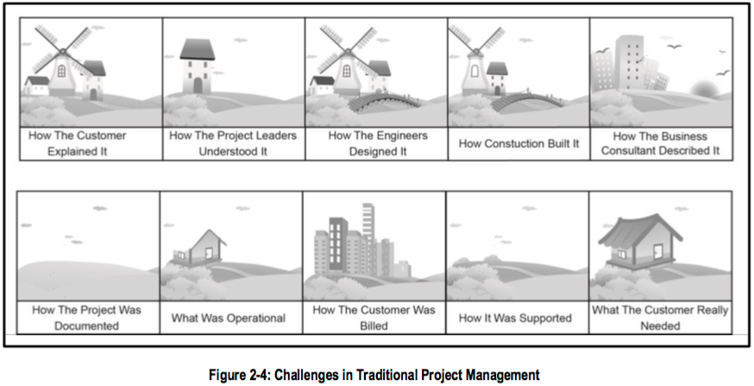
Credit: SBOK 2013

Slide 41
Scrum

Slide 42
Resources
Scrum Alliance
Scrum Book of Knowledge (SBOK)

Slide 43
Thank you!
Elise Garvey
King County Auditor’s Office
206-477-1038
elise.garvey@kingcounty.gov
@elisegarvey

