Slide 1
Purposeful Learning to Help Programs Adapt
RTI & Mercy Corps Present M&E Activities & Tools to Encourage Adaptive Management
EMILY JOY
Senior Client Success and M&E Officer, MicroMentor

Slide 2
MOLLY CHEN
Monitoring, Evaluation, Research, Learning and Adapting (MERLA) Specialist,
RTI International
mchen@rti.org
EMILY JOY
Senior Client Success & M&E Officer, MicroMentor, Mercy Corps
ejoy@mercycorps.org

Slide 3
How do we instill a learning culture?
Our Challenges
Tools & Resources
Knowledge Sharing
Q&A
Notes:
Intro & Challenges - 10 min
Tools & Resources - 20 min
Knowledge Sharing - 10 min
Q&A - 20

Slide 4
Our Challenges
Notes:
Linear thinking around program execution and design (delivered by consultant, HQ, etc.), lack of trust and confidence in field staff - not empowered to be program designers “not allowed to change” - donor requirements, country director, etc. (Soft factors were more important in enabling adaptive management).

Slide 5
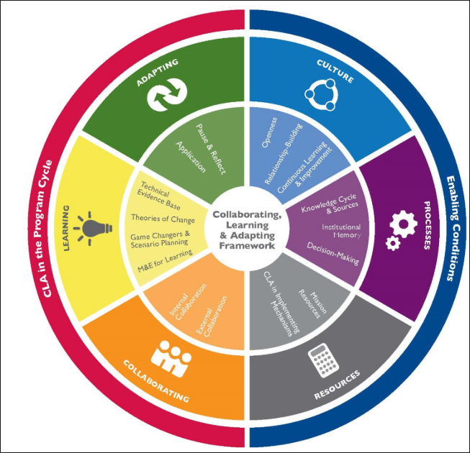
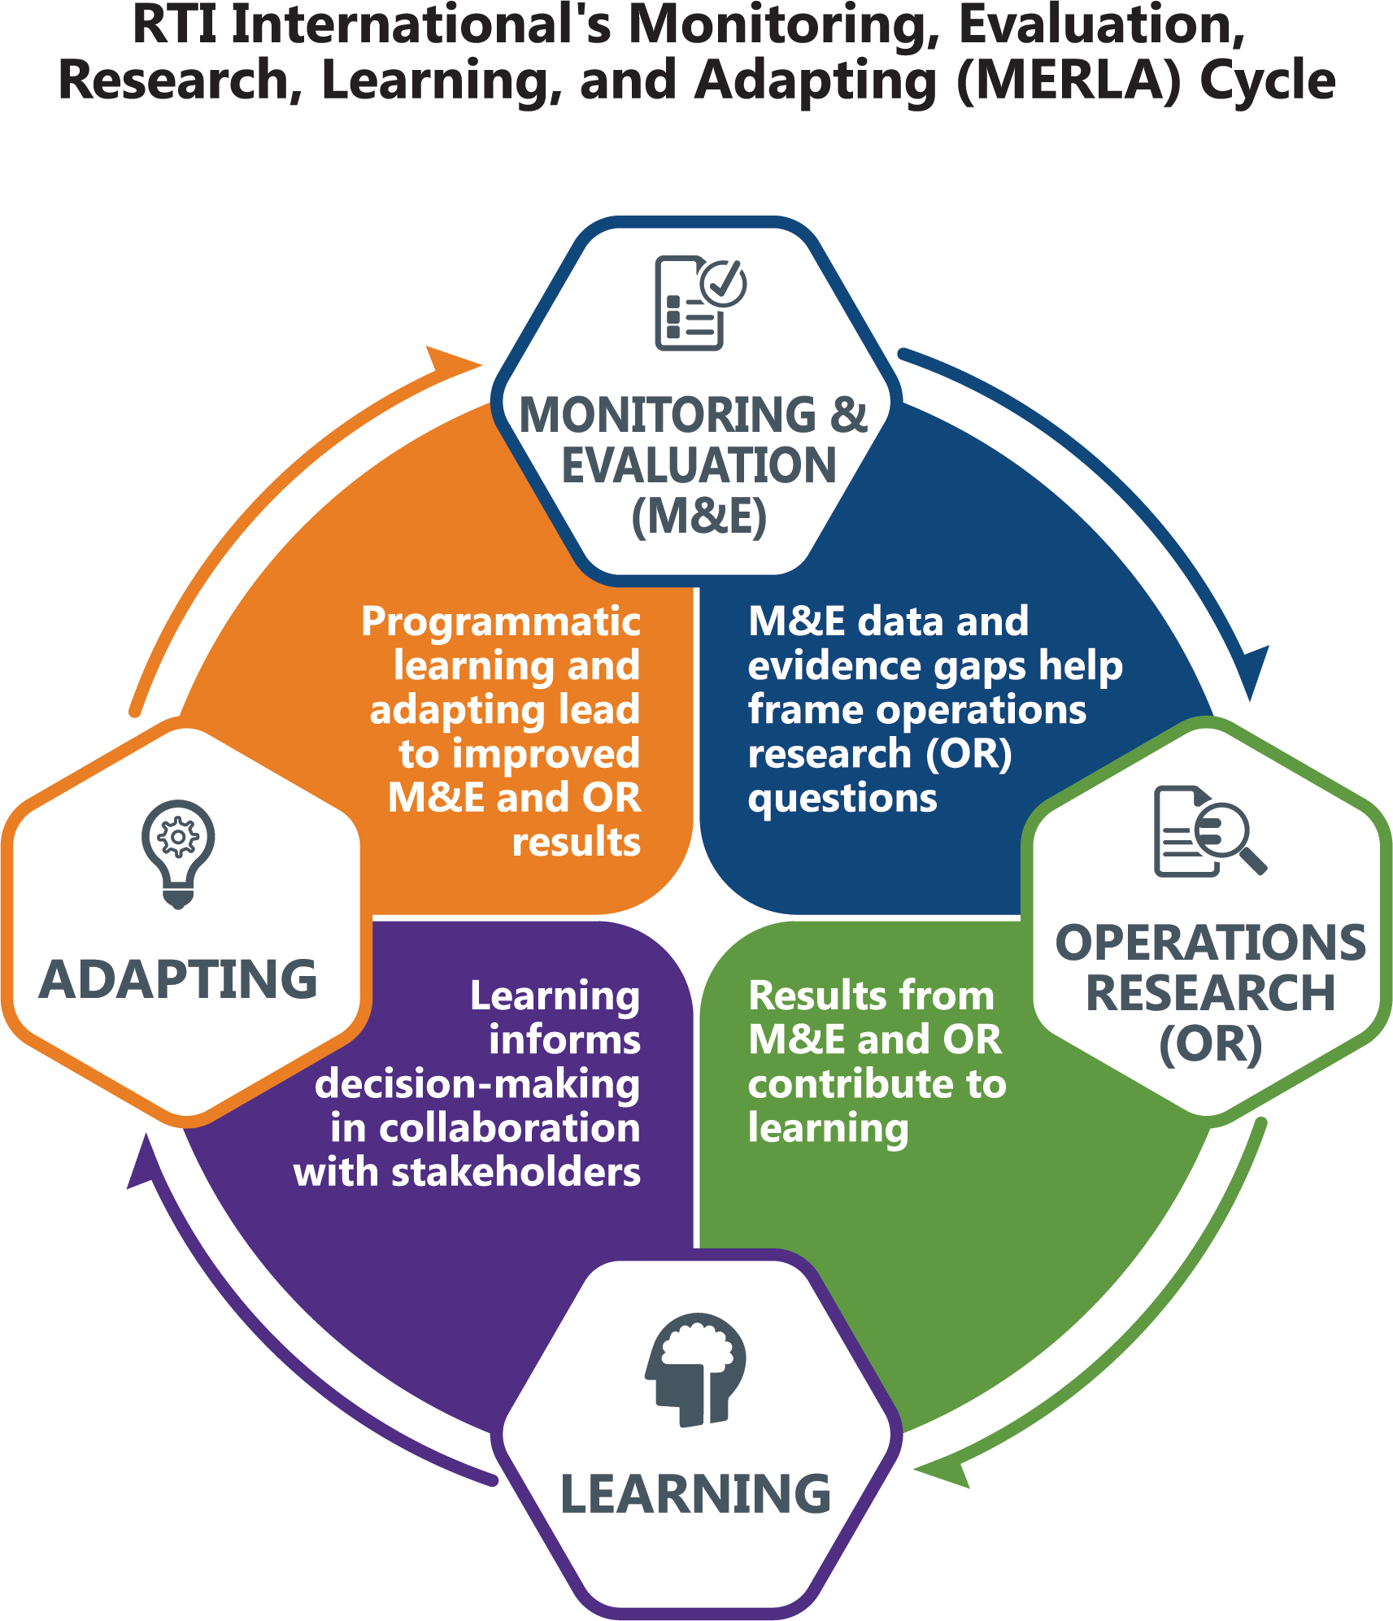
RTI’s International Development Group
Notes:
Context: Donor relations and talking about programs in context of learning (USAID CLA approach)
Insert CLA graphic-
Internally: MERLA CoP
Externally: Tools, resources, and thought leadership

Slide 6
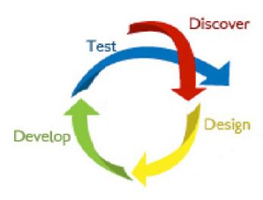
micromentor.org
Notes:
Context/Challenges:
Mercy Corps - larger context
MicroMentor - more specific case with social enterprise perspective

Slide 7
Tools & Resources

Slide 8
Pause & Reflect Sessions
A reflection section typically includes these steps:
Reflection Session Ice Breaker and Guidelines
Theory of Change Review and discussion
Review Results of each component: Planning, Implementation, Communication
Cross-Cutting Themes
Moving Forward, a focus on adaptation
Reflection sessions seek to address:
What is working well?
What can be improved?
What should be done differently?
What are some cross-cutting issues affecting the program?
What are the key activities to scale, change, or discontinue? (feeding into workplans)
Notes:
Analyze and synthesize data, evidence, studies, and stakeholder experiences
Gain understanding of which aspects of the program are achieving results and should be continued and which aspects should be modified.
Should provide clear understanding of lessons learned, best practices, and necessary work plan modifications.

Slide 9
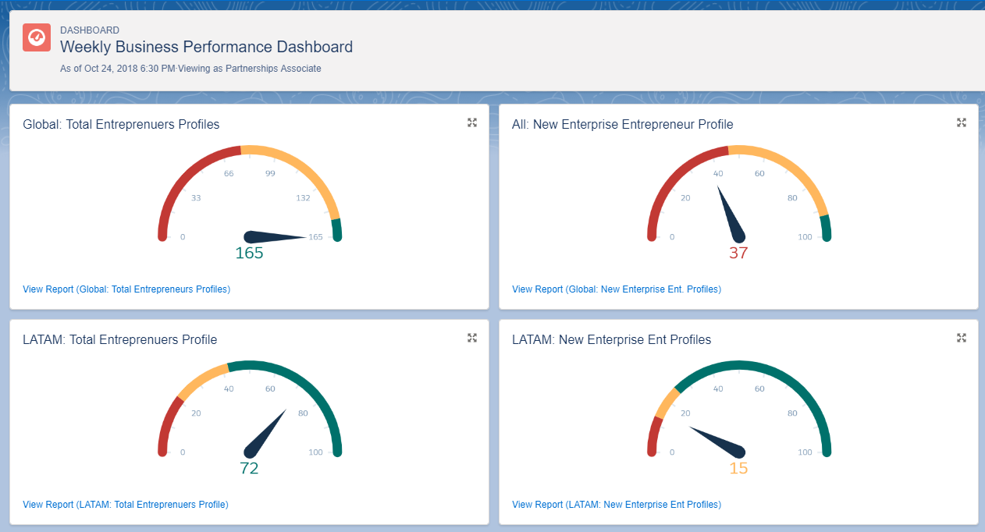
MicroMentor’s Line of Sight Metrics
Connecting theory of change to strategic goals
Indicator tracking & data visualization in real time
Notes:
Internal program management tool
Line of sight measurement looks at the theory of change from a business performance standpoint, linking the theory of change to long term strategic objectives through real-time KPIs and time-bound performance targets.
Enables an iterative learning process by making the appropriate data visible and encouraging reflective analysis that informs decisions to adapt.
Optimization of program implementation enables feedback loop from theory of change to achievement of desired outcomes and impact.

Slide 10
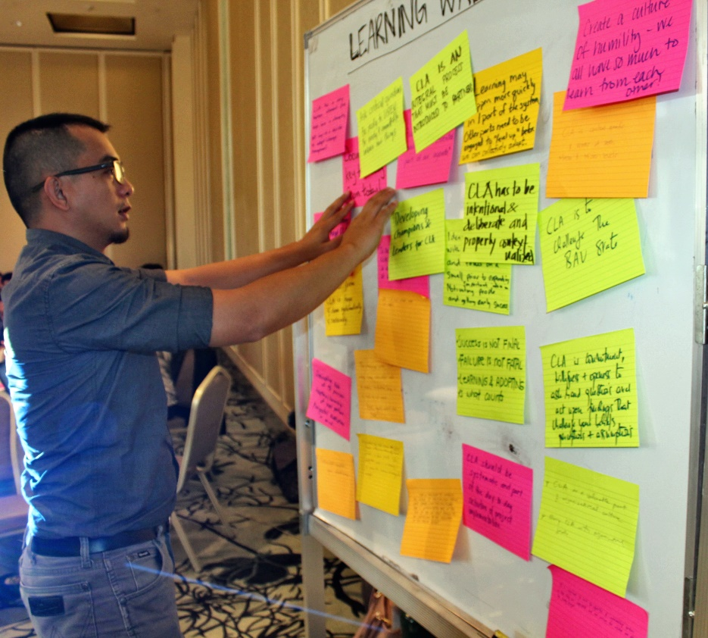
Learning Agendas
Maximize results
Reinforce the strategic direction
Adapt programs as evidence and context shifts
Remain flexible
Accommodate short and longer-term priorities
Notes:
A learning agenda is a set of broad questions directly related to the work that an agency conducts that, when answered, enables the agency to work more effectively and efficiently, particularly pertaining to evaluation, evidence, and decision-making. Once the questions are identified, a learning agenda also prioritizes and establishes a plan to answer short- and long-term questions of the highest value across relevant program and policy areas.

Slide 11
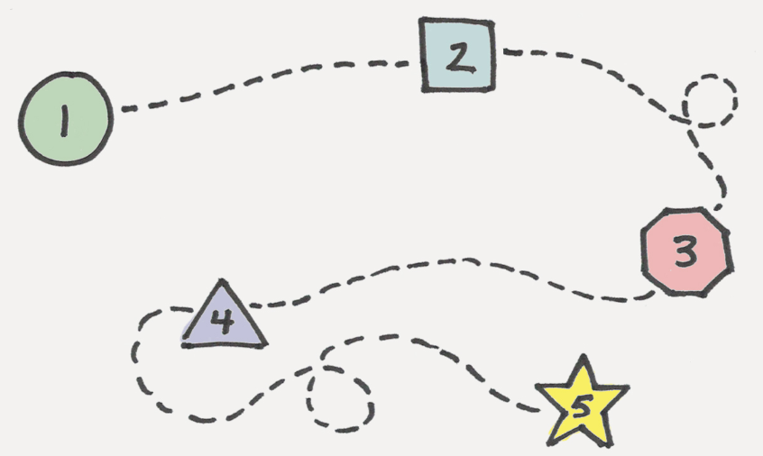
Implementing a Learning Agenda
Step 1: Gathering Stakeholders
Step 2: Identifying and Prioritizing Questions to Improve Program Performance and Effectiveness
Step 3: Develop a Plan
Step 4: Implementing Studies and Analyses
Step 5: Document findings and Rinse & Repeat
Notes:
Step 1: learning agenda should take into account the perspective of a wide variety of stakeholders- program staff, decision makers, funders, partners, beneficiaries
Step 2: This iterative approach is grounded in continuous learning: testing what works and what doesn’t, balance between short- and long-term questions of interest to be able to address policy and program issues happening right now versus those that look at longer-term outcomes. This approach also helps to build ownership of programs and overall capacity in support of stakeholder-owned agendas and processes.
Step 3: plan should state the goals and objectives of the learning agenda, outline priority questions, describe a time-frame for how to answer the questions, and determine what tools are available and what tools are needed to answer the questions of interest.
Step 4: should operationalize the process by which you and your agency have chosen to answer the questions identified and prioritized in your plan. Implementation can and should include a multitude of activities that can include program evaluations and analysis of existing data which could include administrative and performance data.
Step 5: Evaluation findings should be used for program improvement and accountability by program managers and agency leadership.

Slide 12
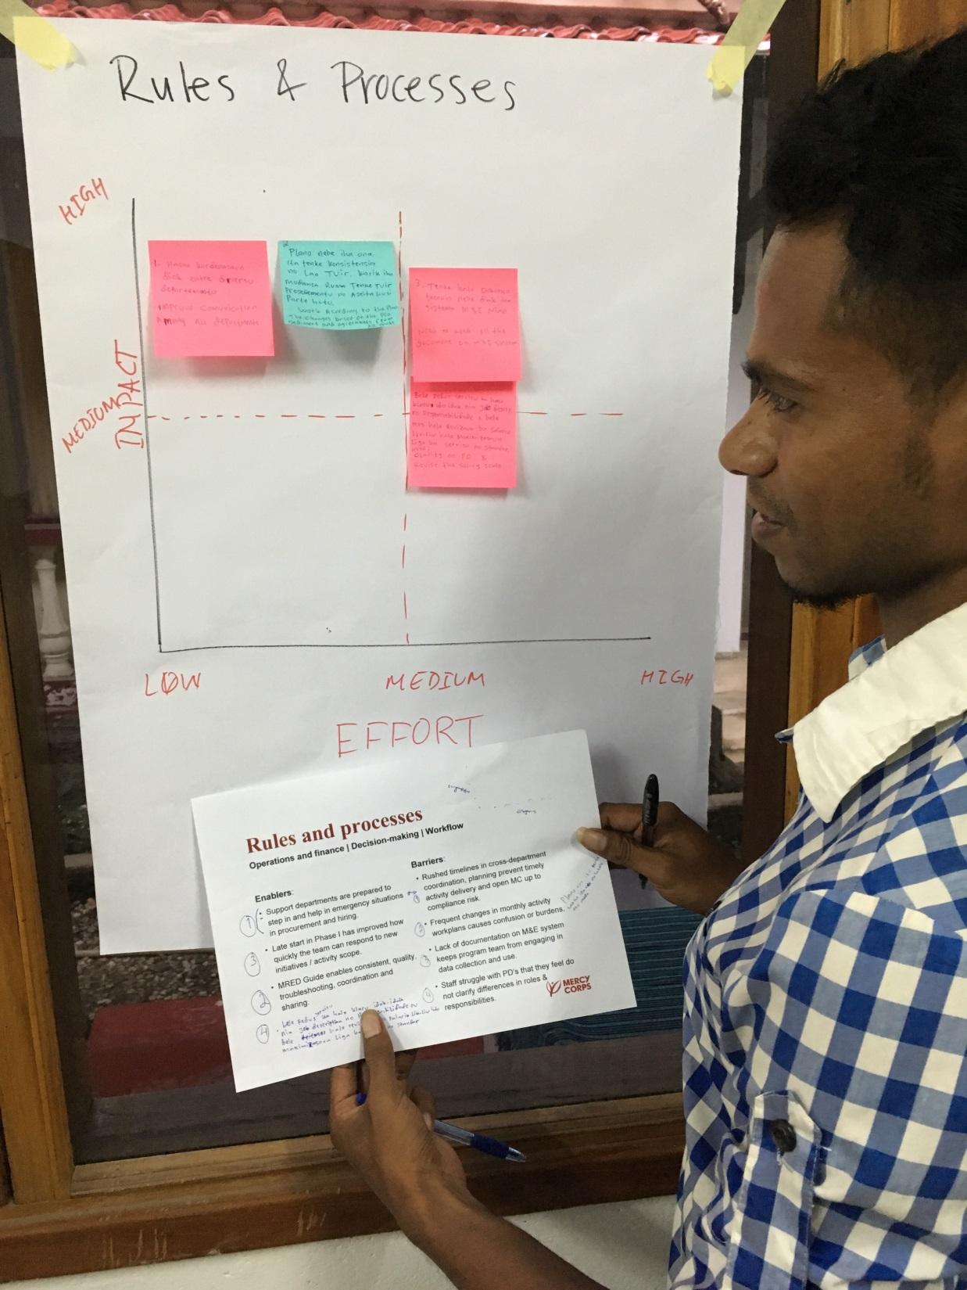
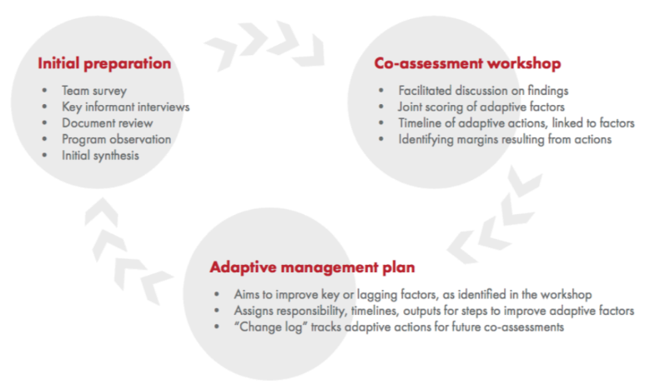
ADAPT Scan
Notes:
Research and learning grant focused on adaptive management from USAID that helped to develop this tool.
Major takeaways - Promote idea of how results can change/improve due to adaptive actions. Donor trust was a huge factor in enable program iterations or adaptations. Local political context was also a huge factor in enabiling or inhibit willingness to change. Ability to think about adaptation increases willingness to make programmatic change. Iterative model and act of developing action plan was a way to plant the seed of adaptive management. Instilling confidence in local teams -that they know their programming best, as well as process of identifying enablers and barriers then charting a course of action enabled framework for change.
Alison Hemberger oversaw this project.

Slide 13
Notes:
Field team
Factors - programmatic culture and structure as well as team culture and structure that enbled or restricted adaptations
Adaptive Actions - potential actions to improve program, decisions based on enabling factors and input/info from the community and environmental factors
Adaptive margin is tracking of change at a certain point in time vs. predictive model of program at same rate of change. (expected results w/o adaptation vs. actual results with adaptatation)

Slide 14
Knowledge Sharing
Notes:
Emily: Intro Knowledge Sharing

Slide 15
RTI’s MERLA Community of Practice
Notes:
Internal funded initiative (started in 2017)
Cross-sectoral core members, field and home office staff-- started with 15 members and grown to 60
Overall purpose: share across the institute (internal goal), increase visibility and participation in the learning community (external) and contribute to the general dialogue
Internal- meet monthly, share “notes from the field”- someone’s experience in the last month in MERLA, have a discussion, post on sharing platforms (SF, Yammer, etc)
External- participated in USAID CLA Challenge Week, regularly blog on the USAID Learning Lab website, external MERLA listserv

Slide 16
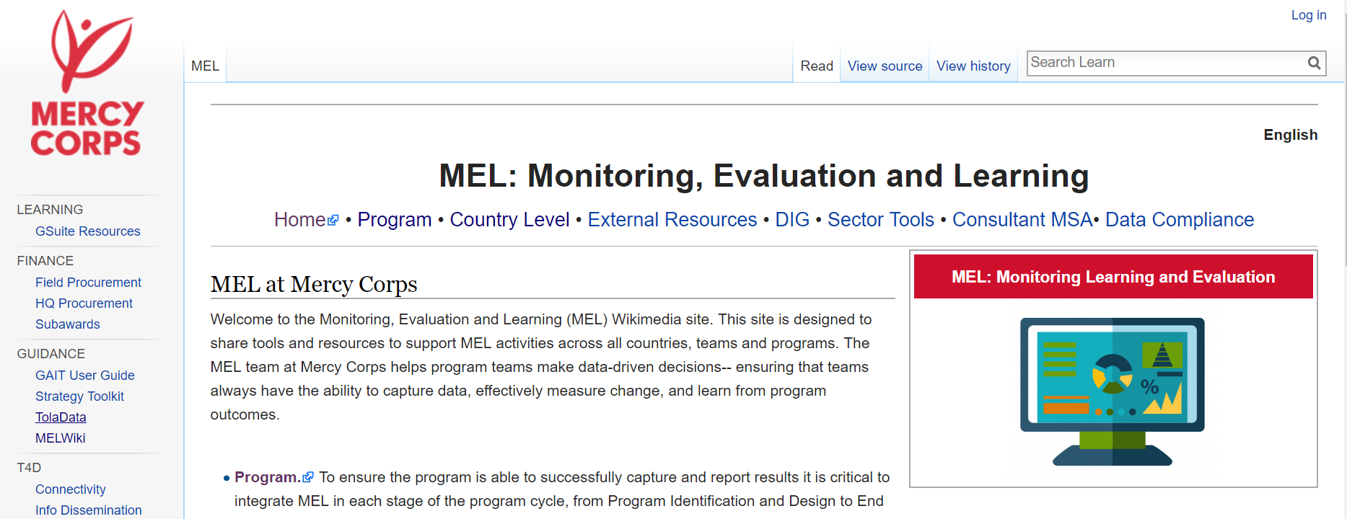
MEL Wiki
Notes:
Learning section - capacity building for field teams, with emphasis on practical application. Templates, toolkits, case studies, etc.

Slide 17
Q&A

Slide 18
Thank You!
mchen@rti.org
ejoy@mercycorps.org

