Slide 1
Evaluation Perspective from a Technology Program Office, NCI Center for Strategic Scientific Initiatives (CSSI)
American Evaluation Association, Evaluation 2016
October 27, 2016

Slide 2
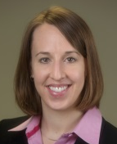
NCI Center for Strategic Scientific Initiatives (CSSI)
Director
Douglas R. Lowy, MD
Deputy Director
Jerry S.H. Lee, PhD
Associate Director
Sean E. Hanlon, PhD
Program Director
Michelle Berny-Lang, PhD
Mission
“…to create and uniquely implement exploratory programs focused on the development and integration of advanced technologies, trans-disciplinary approaches, infrastructures, and standards, to accelerate the creation and broad deployment of data, knowledge, and tools to empower the entire cancer research continuum in better understanding and leveraging knowledge of the cancer biology space for patient benefit…”
2003, 2007, 2011, 2013, 2014
2005, 2010, 2015
2008, 2013*
2011, 2014
2004, 2008, 2014
2005, 2008
2010
Dates indicate approval(s) by NCI Board of Scientific Advisors; *Program moved to NCI Division of Cancer Biology
Notes:
-Part of NCI’s Office of the Director, established in 2003…strategic focus for innovative programs that range from exploratory pilot programs to the development of national resources that serve the overall cancer research community. CSSI adheres to a basic set of principles that define each program, including extensive conversations with the extramural community; mile-stone driven plans; trans-disciplinary team science; and publically available, broadly accessible, multi-dimensional data.
-Since its inception, CSSI has undertaken a number of initiatives that have contributed to addressing major barriers and opportunities in cancer research, focused on areas such as genomics, biospecimens, and physical sciences.

Slide 3
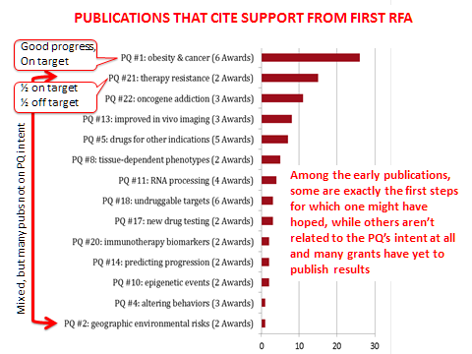
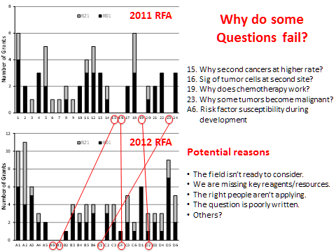
CSSI Recent Evaluations Presentations to NCI Board of Scientific Advisors
PQ
June 2014
IMAT
Dec 2014
CPTAC
June 2015

Slide 4
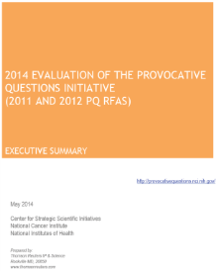
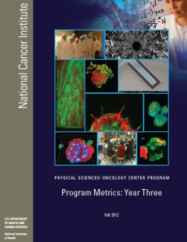
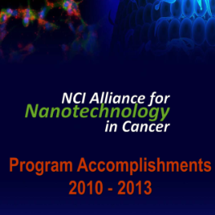
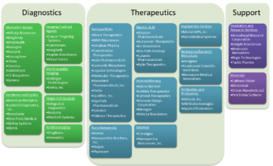
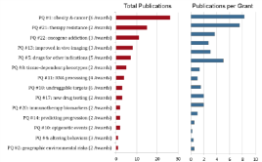
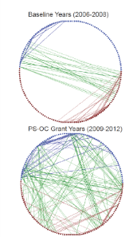
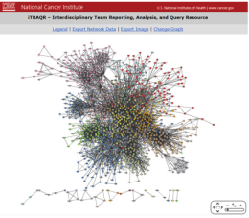
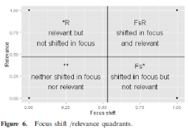
CSSI Program Evaluations and Outcomes Highlights
Phase I (May 2014)
Phase I (Fall 2012)
Phase II (March 2013)
~$30M per year for 3 years
1,500+ applications in 2 years
~150 awards overall
Enabled analysis and evaluation of applicants pre-review
$30M per year for 5 years (over $100M leveraged)
600+ trainees
500 self-reported new collaborations
5 PS-OC advances tested in clinical settings
23 patent applications
$32.7M per year for 5 years (over $100M leveraged)
70+ startup companies
17 clinical trials testing 8 Alliance therapeutics
5 diagnostic devices being tested under clinical protocol
39 patents awarded citing Phase I awards and over 100 patent applications filed during Phase II

Slide 5
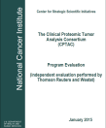
CSSI Uses External Evaluations to Enhance Programs
Phase I Launched
U54
R01
F32/F33
Program
Renewed
Phase II Launched
U54
U01
K99/R00
R25
Program
Renewed
CaNano
Plan 1
CaNano
Plan 2
U54
U01
T32
Ongoing Evaluation
Program
Eval
Program
Eval
RFA Program Launched
3 R21
3 R33
3 R21/R33
Program Renewed
3 R21 (3 year)
3 R33
Program Renewed
2 R21 (3 year)
2 R33
Program Renewed
2 R21 (3 year)
2 R33
Ongoing Evaluation
Program
Eval
Program
Eval
Program
Eval
2004
2005
2006
2007
2008
2009
2010
2011
2012
2013
2014
2015
2016
Program
Renewed
Program
Renewed
Phase I Launched
U24
R01
R21/R33
Phase II Launched
U24
Linked with TCGA
Prospective Electronic Program Evaluation
U24
U01
Program
Eval
Ongoing Evaluation
Phase I Launched
U54
Prospective Electronic Program Eval
Program
Eval
Program
Renewed**
Ongoing Evaluation
U54
U01
Program
Renewed
Phase I Launched
R01
R21
Phase II Launched
R01
R21
Pre-Review
Applicant Eval
Program
Eval
Ongoing Evaluation
*Red Denotes Program Evals and Changes to Programs

Slide 6
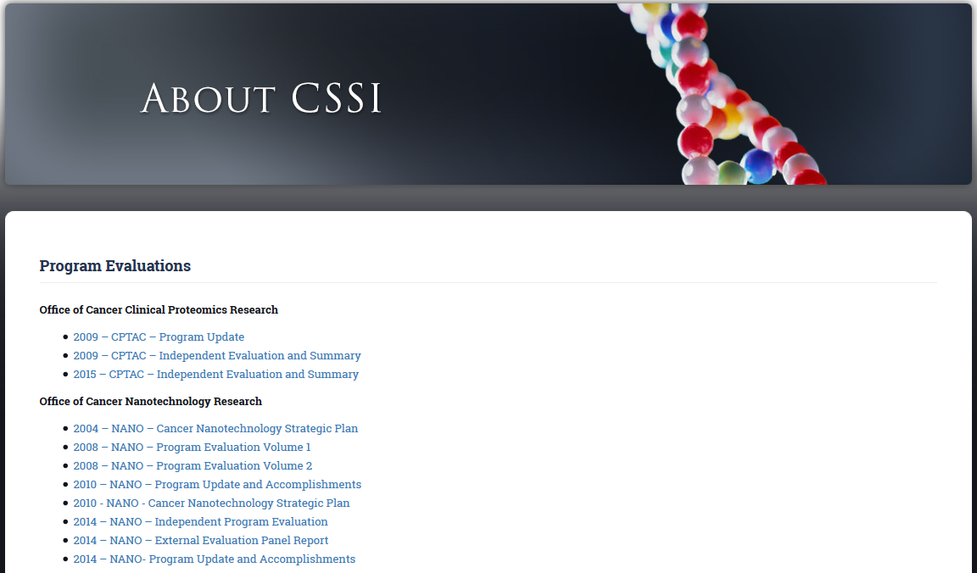
Questions? Learn More About CSSI & CSSI Evaluations….
cssi.cancer.gov
Michelle Berny-Lang, PhD
michelle.berny-lang@nih.gov
Copies of all CSSI evaluations available for download

