Slide 1
Assessment of Comprehensive Primary Care for Women Veterans
Women Veterans Health Strategic Health Care Group, Office of Patient Care Services, Veterans Health Administration (VHA)
Program Evaluation Purpose and Methodology
American Evaluation Association Conference
November 3, 2011
Anaheim, CA
Notes:
Booz Allen Hamilton Standard Colors
Colors should be used in the color pairs whenever possible. Do not mix and match colors, use pairs together as shown.
Black, White and Gray can be used with any of the other colors.
Purple Pantone 2765
R 12
G 4
B 79
Green Pantone 357
R 15
G 67
B 24
Blue Pantone 2 88
R 11
G 31
B 101
Black
Pantone Cool Gray 6
R 158
G 158
B 158
Red Pantone 485
R 252
G 5
B 14
Yellow Pantone 3965
R 232
G 244
B 4
Aqua Pantone 319
R 126
G 204
B 189
White

Slide 2
Agenda
Program Evaluation Purpose and Background
Program Evaluation Methodology Overview
Site Selection, Data Management, and Data Analysis Approach
Benefits and Next Steps
Questions

Slide 3
Program Evaluation Purpose and Background

Slide 4
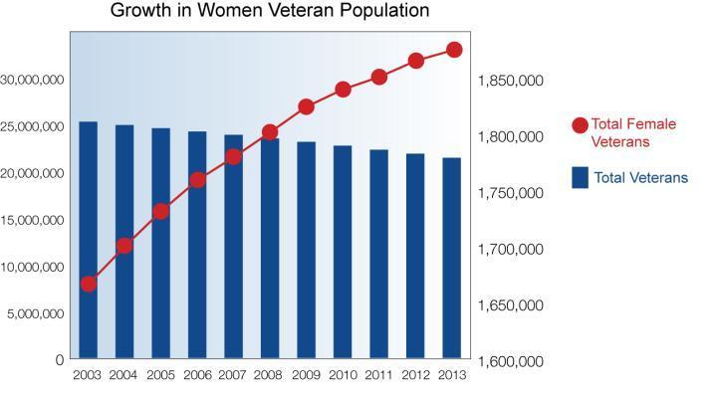
Population Explosion
Source data supplied 7/9/10 by the Office of the Actuary, Office of Policy and Planning, Department of Veterans Affairs
Notes:
3
Source data supplied 7/9/10 by the Office of the Actuary, Office of Policy and Planning, Department of Veterans Affairs
Expanding population: The number of women veterans is growing rapidly.
Because of the large number of women on active duty and entering military service, the percentage of female Veterans is projected to increase:
from 8% in 2010
to 10% in 2018
to 14.3% in 2033
Source: VetPop2007, Office of Policy and Planning, Department of Veterans Affairs

Slide 5
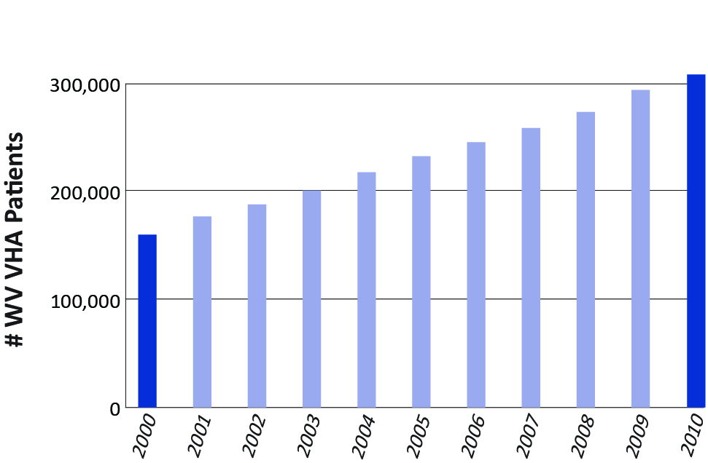
Women Users Doubled Since 2000
Number of women Veteran VHA patients in each year, FY00-FY10
Source: Women’s Health Evaluation Initiative (WHEI) and the Women Veterans Health Strategic Health Care Group; Sourcebook: Women Veterans in the Veterans Health Administration V1: Sociodemographic Characteristics and Use of VHA Care, 2011.
Notes:
The number of women Veterans using VHA has nearly doubled in the past decade, from 159,630 in FY00 to 292,921 in FY09. The rate of growth has been faster in women Veterans than in men Veterans.

Slide 6
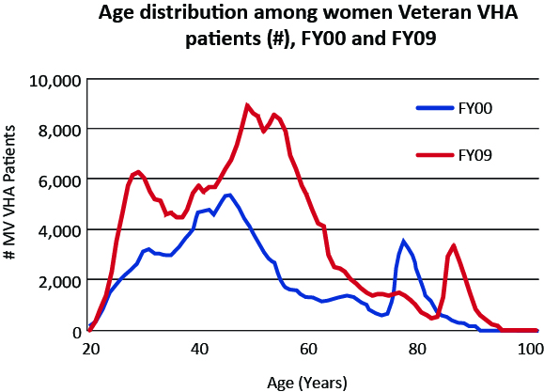
Women VA Patients: Three Peaks
Source: Women’s Health Evaluation Initiative (WHEI) and the Women Veterans Health Strategic Health Care Group; SourceBook: Women Veterans in the Veterans Health Administration V1: Sociodemographic Characteristics and Use of VHA Care, 2011.
Notes:
Shifting Age Distribution in VHA Women Veterans. In FY00, the age distribution of women showed two main peaks: The tallest peak had a maximum at age 44, and the second peak had a maximum at age 76. By FY09, this pattern had shifted. The peak that had been tallest in FY00 was even taller in FY09 and had its maximum at age 47. The second peak had its maximum at age 85. Meanwhile, a substantial new third peak had appeared, with its maximum at age 27.
The number of women Veterans using VHA has doubled in the past decade, from nearly 160,000 in FY00 to 315,000 in FY10. The rate of growth has been faster in women Veterans than in men Veterans.

Slide 7
Women Veterans Health Strategic Healthcare Group (WVHSHG) Mission
Ensure that all women Veterans receive equitable, high-quality, and comprehensive health care services in a sensitive and safe environment at all VA facilities
Be a national leader in the provision of health care for women Veterans, thereby raising the standard of care for all women

Slide 8
Overview of the Challenge
4
In 2008, The Under Secretary of Health (USH) Work Group released a report that surveyed the current state of health care delivery to women Veterans
Operation Enduring Freedom / Operation Iraqi Freedom (OEF/OIF) Veteran Population
Percentage of Veterans Who Are Women
14.3%
10%
Male
Veterans
89%
11%
Female
Veterans
89%
7.7%
2008
2018
2033
The report noted:
Gaps in the current health care delivery to women Veterans:
Delivery of primary care is fragmented
There are persistent disparities in quality
There are inconsistencies in the definition of comprehensive primary care for Women Veterans

Slide 9
Women Veterans’ Health Program Assessment – Background, Purpose, and Goals
Assessment Background
The USH Report recommended that site assessments be conducted to better understand the delivery of care to women Veterans
The Women Veterans Health Strategic Health Care Group (WVHSHG) in VHA was tasked with conducting these site assessments
In 2010, VHA published Handbook 1330.01, which describes the components of a Women Veterans’ Comprehensive Primary Care Program
Purpose and Goals of the Assessment
Assess implementation of the Women’s Health Program (WHP)
Identify areas where improvements are needed to ensure the delivery of comprehensive care delivery to women Veterans
Identify best (or promising) approaches that can be disseminated across VHA
Aggregate data at the regional and/or national level to identify trends and systemic opportunities for improvement

Slide 10
Program Evaluation Methodology Overview

Slide 11
Assessment Methodology and Tool Development Process
Identified
Essential Components and Critical
Capabilities
Developed Suite
of Assessment
Tools
Conducted
Pilot Site
Visits
Refined Suite
of Assessment
Tools
Conducted
Site
Visits
Collaborated with a panel of subject matter experts from VA and DoD, and a steering committee comprised of senior VA officials, to identify four essential components and 39 critical capabilities that should be present in a developed Women’s Health Program (WHP)
Developed a methodology and suite of tools—to include a pre-survey, site visit agenda, interview guides and scoring tool
Conducted two pilot site visits in FY2010; feedback gathered from all participants; all tools and processes refined
Conducted four additional validation site visits in FY2010; data collected entered into an Excel database
Completed 21 site assessment visits in FY2011; data added to the data from the previous year
Notes:
10

Slide 12
Protocol Assessment Tool Design
Essential Components
Program
Health Care Services
Outreach, Communication, and Collaboration
Patient Centered Care (PCC) / Patient Aligned Care Team (PACT)
39 Capabilities across the four components
Numerous assessment criteria with critical success factors
Each capability is measured using a four-level scale
Highly Developed
Developed
Being Developed
Needs Development
Notes:
Transition slide

Slide 13
Sample Capability, Assessment Criteria, and Assessment Levels
Capability Statement 1.1.1. The organizational structure (including VHA, Veterans Integrated Service Network (VISN), and local facility level staff) is well defined and clearly supports the strategy and operations of the WHP.
Assessment Criteria
An organization chart for the WHP is developed and shared across the facility and with the VISN. The organization identifies WHP leaders and their respective roles and responsibilities. The WHP organizational structure is integrated with other components of the facility, as evidenced by the inclusion of WHP staff in Medical Center governance and committees at appropriate levels. Appropriate clinical and administrative staff are available to support and sustain the WHP. A full-time WVPM is designated and assigned to execute comprehensive planning for Women’s Health (1330.01 pg 4). Key staff from the VISN and VAMC work together to support the WHP. Key positions are assigned and filled at the VISN, and the local facility/facilities, to support the WHP.
Capability Assessment Levels
□ |  | Highly Developed | All assessment criteria are met.
□ |  | Developed | The organization identifies WHP leaders and their respective roles and responsibilities. A full-time WVPM is designated and assigned to execute comprehensive planning for Women’s Health.
□ |  | Being Developed | One or more of the following is not met: The organization identifies WHP leaders and their respective roles and responsibilities. A full-time WVPM is designated and assigned to execute comprehensive planning for Women’s Health.
□ |  | Needs Development | The roles and responsibilities of facility leaders for the WHP have not been defined. There are no ongoing plans to recruit a full-time WVPM.
 |  | Comment / Rationale

Slide 14
Overview of Data Gathering Process
Each site assessment visit is conducted over a 2-day period
Information is obtained via the site assessment and its associated tools, including:
A pre-survey
Interviews
Document reviews
Facility tours
Case studies
Tools and data gathered are used to assign each critical capability a rating on a four-point Likert scale (Highly Developed, Developed, Being Developed, Needs Development), based on presence of critical success factors and other assessment criteria
Debriefs of the programs’ relative strengths and opportunities for improvement are provided to facility leadership at the conclusion of the site assessment visit
Data from site assessments were recorded in an Excel database, and reviewed to identify trends and recommendations across all sites

Slide 15
Site Visit Agenda and Scheduled Interviews/ Activities
{Date Day One}
Opening Conference
Tour of Facility
WVPM
Associate Chief of Staff (ACOS)/ Primary Care Services
Women Veterans Health Care Committee
Quality Improvement (QI) Management Staff
Outreach/Public Information Officer (PIO)/Volunteer Services
Chief Financial Officer (CFO)/Fee Basis Coordinator/Clinical Approver of Fee Care
VISN Lead
{Date Day Two}
Telephone Advice Staff
Director/Associate Director
Chief of Staff
Associate Director Patient Care Services (PCS) /Director of Nursing
Women Veteran (WV) Medical Director
Case Based Discussion
Director of Mental Health
Director of Pharmacy
Chief Information Officer (CIO) and Clinical Applications Coordinator (CAC) / Health Information Management System (HIMS)
Education and Training Staff (Nursing Ed, Associate Chief of Staff for Education (ACOSE), Human Resource (HR), Ed Staff)
Community Based Outpatient Clinic (CBOC) Coordinator/Medical Director
{Date Day Three}
Closing Conference

Slide 16
Methodology Overview
Data gathered through pre-survey, document reviews, interviews, case studies, and observations during the assessments provide valuable insights regarding development of capabilities at each facility visited and emerging trends across the system
Assessment teams applied a standard framework to ensure uniform use of the tools and interpretation of data collected. Each assessment produced a variety of qualitative and quantitative data, and involved a thoughtful exchange of insights between facility staff and Assessment Teams
The methodology and related assessment processes encourage and provide an increase in an understanding of program requirements across the sites at all organizational levels

Slide 17
Site Selection, Data Management, and Data Analysis Approach

Slide 18
Site Selection – Background
Total of 152 VA Medical Centers (VAMCs)
FY2010: 4 sites (plus 2 pilot sites)
FY2011: 21 site assessment visits completed
FY2012: 21 site assessment visits to be completed
End of FY2012: 46 of 152 VAMCs (30%) will have been evaluated

Slide 19
Site Selection – Sampling Methodology
60 sites blindly selected based on the following criteria:
Location
Veterans Integrated Service Network (VISN) (n = 23)
Complexity Level
Categories: 1a, 1b, 1c, 2, 3 (1a = most complex, 3 = least complex)
Variables: 1) Veterans Equitable Resource Allocation (VERA) Pro-Rated Person (PRP); 2) Level of Intensive Care Unit; 3) Patient Risk; 4) Total Resident Slots; 5) Revised Herfindahl-Hirschman Index (HHI) Resident Slots; 6) VERA Research per PRP; 7) Complex Clinical Programs
Census category
Urbanized area (UA) = metropolitan area with more than 50,000 people
Urban Cluster (UC) = metropolitan area with between 2,500 and 50,000 people
Rural = area with less than 2,500 people by census bureau definition
Randomly selected 21 sites from the 60 blindly selected sites based on VISN and State

Slide 20
Data Management – Considerations
The end goal of the use of the data (both display/reporting and future use of the data)
What data is available
How the data relate to each other and can be analyzed to meet the objectives of the study
End-user capabilities and access to software
The most suitable means of housing the data, i.e., software and their respective capabilities

Slide 21
Data Management – Women Veteran Health Program Evaluation Data Types
Self-Reported Data
The Women’s Assessment Tool for Comprehensive Health (WATCH Data)
Pre-Survey data (Demographics, Health Care Services, Models of Care)
Self-Assessment Data (across 4 components, 39 capabilities and associated assessment criteria, including critical success factors)
Site Assessment Visit Data
4 Components
39 Capabilities
Assessment Criteria
Critical Success Factors
Models of Care
Staffing: Women’s Health Providers and Team
Potential Best Practices

Slide 22
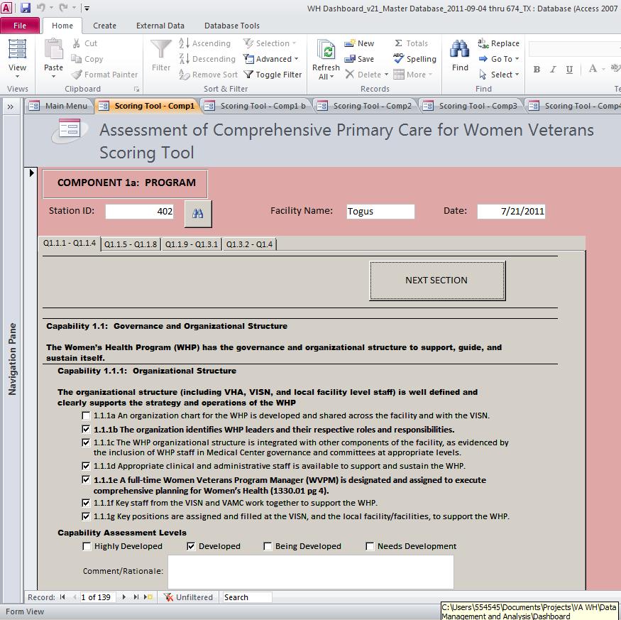
Data Management – Site Assessment Visit Data Entry
MS Access
Mirrors Protocol Assessment Tool

Slide 23
Data Analysis – Methods
Cumulative Proportions Analysis
Statistical Outlier Analysis

Slide 24
Cumulative Proportions
SAMPLE: THIS IS NOT ACTUAL DATA

Slide 25
Determination of Thresholds by Percentage Example
Define: “High Performance” as a Capability that receives consistently high scores across facilities.
Define: “Needs Attention” as a Capability that receives consistently low scores across facilities.
To identify these areas, thresholds for each are determined.
This method can be applied to and analysis of Capabilities, Components, Facilities, and VISNs.

Slide 26
Determination of Thresholds by Percentage Example
If the number of Capabilities Needing Development ≥ 10% AND the number of Being Developed Capabilities is ≥ 25%, then flag the facility as one that “Needs Attention.”
If the number of Highly Developed Capabilities is ≥ 40%, then flag the facility as an example of “High Performance.”
SAMPLE: THIS IS NOT ACTUAL DATA
Three facilities
(A, C, and E)
that meet the
“Needs Attention” criteria
One facility (D)
meets the
“High Performance” criteria

Slide 27
Determination of Thresholds by Statistical Percentile
To address areas of “High Performance” and areas that “Need Attention” previously defined, a measure based on statistical measures and the Normal Distribution can be used.
If the test statistic is in the top 10th percentile, it is labeled as an area of “High Performance”, if it is in the bottom 10th percentile, it is labeled “Needs Attention”.
This method can be applied to analysis of Capabilities, Components, Facilities, and VISNs.
Notes:
Get feedback on preferences for thresholds

Slide 28
Calculation of Percentiles
Capability Score
Aggregate Metric
for a capability
across all facilities
We use the sum of capability scores as our unit of measure. We can take the sums of capabilities across components, facilities, and VISN’s, similar to how one may calculate an average score. This produces an aggregate metric we will use for analysis.
We then standardize the metric to perform well known statistical analysis.
The standardized statistic can now be viewed as coming from a Standard Normal distribution. We can then compute the percentile of this score which will determine if the capability is an example of “High Performance” or if it “Needs Attention”.
First Facility
3
.
.
.
Σ
56
Last Facility
2

Slide 29
Percentiles – Across and By Components
COMPONENT | Percentile
(1) Program | 21st
(2) Health Care Services | 89th
(3) Outreach, Communication, and Collaboration | 43rd
(4) PCC/PACT | 8th
Summary
High Performance: Component 2 was the sole “High Performance” component. This component had two capabilities that were also “High Performance.”
Needs Attention: Component 4 was the sole “Needs Attention” component. Capability 4.2 was indicated as “Needs Attention.”
Notes:
Currently we have more capabilities that are indicated as “High Performance” than are indicated as “Needs Attention.”
Component 1: Program | Percentile
(1.1) Governance and Organizational Structure | 23rd
(1.2) Human Resource and Talent Management | 5th
(1.3) Non-VA Provider Mgmt | 91st
(1.4) Organizational Learning | 17th
(1.5) Culture | 43rd
(1.6) VISN | 85th
Component 2: Health Care Services | Percentile
(2.1) Comprehensive Primary Care | 56th
(2.2) 24/7 Health Advice | 92nd
(2.3) Urgent Care | 85th
(2.4) Emergency Care | 98th
(2.5) CBOC/PACT | 18th
SAMPLE: THIS IS NOT ACTUAL DATA
Component 3: Outreach, Communication, and Collaboration | Percentile
(3.1) Veteran Outreach | 98th
(3.2) External Partnerships | 12th
(3.3) Academic Affiliates | 52nd
(3.4) VSO Collaboration | 28th
Component 4: PCC/PACT | Percentile
(4.1) Coordination of Care | 15th
(4.2) Continuity of Care | 1st
(4.3) Patient Centered Care | 11th
Key
Green Fill | High Performance
Red Fill | Needs Attention

Slide 30
Percentiles – Across Capabilities
Summary
High Performance: Component 1 (Program) has 4 capabilities in the “High Performance” category.
Needs Attention: Only 3 capabilities ranked in the “Needs Attention” category.
Notes: More capabilities ranked in the “High Performance” category as than the “Needs Attention” category. This is a positive sign.
Capabilities Scoring in the “High Performance” Category
 | Facility
 | A | B | C | D | E | F | G
Capability |  |  |  |  |  |  |  | Percentile
(1.1.1) Organizational Structure | 4 | 2 | 2 | 4 | 4 | 3 | 4 | 96th
(1.1.3) WVHC | 4 | 4 | 2 | 4 | 4 | 4 | 4 | 99th
(1.1.8) Information Technology | 2 | 4 | 2 | 4 | 4 | 3 | 4 | 96th
(1.3.2) Fee Basis Providers | 4 | 4 | 1 | 3 | 4 | 4 | 4 | 98th
(2.2) 24/7 Health Advice | 4 | 4 | 2 | 4 | 3 | 3 | 2 | 92nd
SAMPLE: THIS IS NOT ACTUAL DATA
Capabilities Scoring in the “Needs Attention” Category
 | Facility
 | H | I | J | K | L | M | N
Capability |  |  |  |  |  |  |  | Percentile
(1.1.5) Collaboration with VA Entities | 1 | 2 | 1 | 2 | 2 | 2 | 3 | 2nd
(2.1.6) Pharmacy | 2 | 2 | 1 | 2 | 2 | 1 | 1 | 1st
(3.1) Veteran Outreach | 1 | 2 | 2 | 1 | 2 | 3 | 2 | 2nd

Slide 31
Percentiles – Across Facilities
Key
Green Fill | High Performance
Red Fill | Needs Attention
“High Performance” and “Needs Attention” Rankings by Facility
 | Capability Scores
Facility | 1.1.1 | 1.1.2 | 1.1.3 | 1.1.4 | 1.1.5 | 1.1.6 | 1.1.7 | 1.1.8 | 1.1.9 | 1.2.1 | 1.2.2 | 1.3.1 | 1.3.2 | 1.4 | 1.5 | 1.6 | 2.1 | 2.1.1 | 2.1.2 | 2.1.3 | 2.1.4 | 2.1.5 | 2.1.6 | 2.2 | 2.3 | 2.4.1 | 2.4.2 | 2.5 | 3.1 | 3.2 | 3.3 | 3.4 | 4.1 | 4.2 | 4.3 | Percentile
A | 2 | 3 | 1 | 2 | 4 | 3 | 2 | 4 | 3 | 2 | 3 | 3 | 2 | 2 | 2 | 4 | 2 | 3 | 1 | 4 | 3 | 2 | 4 | 2 | 1 | 3 | 3 | 2 | 4 | 4 | 3 | 2 | 2 | 2 | 4 | 70th
B | 3 | 1 | 1 | 3 | 2 | 2 | 2 | 2 | 1 | 2 | 2 | 2 | 2 | 2 | 2 | 2 | 2 | 2 | 2 | 2 | 3 | 2 | 2 | 2 | 3 | 1 | 1 | 2 | 2 | 1 | 1 | 4 | 2 | 3 | 2 | 1st
C | 3 | 4 | 2 | 4 | 4 | 4 | 4 | 4 | 2 | 4 | 4 | 1 | 1 | 4 | 4 | 2 | 4 | 2 | 4 | 2 | 4 | 4 | 2 | 4 | 4 | 1 | 2 | 4 | 4 | 3 | 2 | 4 | 4 | 4 | 1 | 99th
D | 3 | 4 | 2 | 1 | 2 | 2 | 3 | 4 | 2 | 2 | 4 | 4 | 2 | 2 | 2 | 1 | 2 | 2 | 1 | 2 | 3 | 2 | 3 | 4 | 4 | 1 | 2 | 2 | 4 | 4 | 2 | 2 | 2 | 2 | 1 | 42nd
E | 3 | 2 | 2 | 1 | 4 | 2 | 2 | 4 | 2 | 1 | 1 | 2 | 2 | 2 | 2 | 3 | 2 | 2 | 2 | 3 | 2 | 2 | 4 | 3 | 3 | 1 | 2 | 2 | 4 | 4 | 2 | 2 | 2 | 2 | 1 | 5th
F | 4 | 4 | 2 | 3 | 4 | 4 | 4 | 2 | 1 | 2 | 1 | 1 | 1 | 2 | 2 | 2 | 2 | 3 | 2 | 2 | 1 | 2 | 3 | 4 | 2 | 1 | 1 | 2 | 4 | 4 | 1 | 4 | 2 | 3 | 1 | 44th
G | 3 | 3 | 1 | 1 | 3 | 1 | 1 | 3 | 2 | 3 | 3 | 3 | 3 | 2 | 2 | 2 | 3 | 2 | 4 | 4 | 3 | 4 | 3 | 3 | 1 | 4 | 3 | 3 | 4 | 4 | 3 | 2 | 2 | 2 | 1 | 68th
SAMPLE: THIS IS NOT ACTUAL DATA
Summary
High Performance: The one facility that ranked in the “High Performance” category has many capabilities that are “Highly Developed”. It may be worthwhile to document best practices at this facility.
Needs Attention: The two facilities that ranked in the “Needs Attention” category had 60% of their capabilities receiving scores of “Being Developed.” We should investigate those capabilities to see if there are any promising practices that can help them reach a “Developed” status.

Slide 32
Benefits and Next Steps

Slide 33
Benefits
Provides a status check on program development
Findings are intended to be used at the local level to enhance
Strategic Planning
Further Development of Program
Network and facility leadership and national office can utilize data to prioritize program needs and allocation of resource

Slide 34
Next Steps
Develop a web-based "dashboard" using metrics developed that can be used at facility, network and national level
Develop reporting process for ongoing evaluation and resource monitoring and tracking through the dashboard (i.e. quarterly, annually)

Slide 35
QUESTIONS?

Slide 36
BACK-UP

Slide 37
Capabilities described in the protocol tool aid in the development of a comprehensive Women’s Health Program.
1. Program Component
1. Program Component (cont.)
1.1 The Women’s Health Program (WHP) has the governance and organizational structure to support, guide, and sustain itself.
1.1.1 The organizational structure (including VHA, VISN, and local facility level staff) is well defined and clearly supports the strategy and operations of the WHP.
1.1.2 Leaders of the organization demonstrate active involvement and support for the WHP, enabling the program to meet its mission and objectives.
1.1.3 The Women Veterans Health Committee (WVHC) demonstrates a systems-based approach to its vision, management, and oversight of the WHP.
1.1.4 The WHP is guided by a comprehensive Strategic Plan for Women Veterans Health Care.
1.1.5 There is a strategy for communicating and collaborating with facility staff and other Offices, Administrations, and Programs at all levels of VA to enhance the awareness, understanding, and sustained support of the WHP, and increase VA healthcare utilization of women Veterans.
1.1.6 The WHP has access to adequate finance and budget support and is able to effectively advocate for the resources it needs to ensure sustainability.
1.1.7 The WHP has a comprehensive education and training strategy, and a plan that has been implemented to improve the knowledge and skills of the WHP and facility staff.
1.1.8 Information technology / information management is used to support the WHP, promoting effective, efficient, safe healthcare for women Veterans.
1.1.9 The facility ensures the dignity, privacy, and security of all women Veterans who receive healthcare services.
1.2 The WHP has developed a comprehensive human resource and talent management capability to ensure that the program has the level and type of expertise needed to deliver and support quality comprehensive care.
1.2.1 Leadership identifies and addresses human resource needs, allocation, recruitment, retention, and succession planning.
1.2.2 The program has a strategy to address cross-coverage issues for WHP staff (Teamlet members) and the WVPM to ensure that an adequate level of care is sustained even when key staff is absent.
1.3 The WHP has developed a systematic process for identifying and obtaining quality healthcare services from non-VA providers for women Veterans when those services are not available from VA providers.
1.3.1 Contracts are in place to ensure availability of key and/or high-volume services, and the quality of care provided is regularly assessed and meets VA standards.
1.3.2 Processes have been established to ensure that care delivered on a fee basis is of high quality and is coordinated through the patient aligned care team.
1.4 The facility has an active program of organizational learning and continuous improvement to enhance the care and service delivered to women Veterans.
1.5 The culture of the facility supports women Veterans, and the WHP and its continued growth and success.
1.6 The VISN plays a key role in assuring the continuous improvement and success of programs for women Veterans. Each VISN should support a Women's Health Program (WHP) whose organization, management, and oversight mitigates barriers and maximizes the success of VHA Women's Health transformation efforts.

Slide 38
Capabilities described in the protocol tool aid in the development of a comprehensive Women’s Health Program (cont.)
2. Healthcare Services Component
2. Healthcare Services Component (cont.)
2.1 There are processes and procedures in place to ensure the provision of comprehensive primary care services to all women Veterans in a coordinated manner through a primary care team / patient aligned care team.
2.1.1 The comprehensive primary care program for women Veterans is organized and appropriately staffed to meet Patient Aligned Care Team (PACT) principles.
2.1.2 The comprehensive primary care clinic is organized to provide medically-required primary care screening, diagnosis and treatment services during a single visit (1330.01 pg 3).
2.1.3 The comprehensive primary care clinic provides breast care screening including mammography services, from scheduling to follow-up on findings (1330.01 pgs 14-16).
2.1.4 The facility ensures the provision of coordinated age-appropriate and gender-specific specialty care to women Veterans in the context of an ongoing relationship between provider and patient.
2.1.5 There are processes and procedures in place to ensure that basic mental health services (to include assessment, screening and basic treatment) are available to all women Veterans and integrated into the comprehensive primary care program. Specialty mental health services are seamlessly coordinated with primary care and are designed to meet the needs and preferences of women Veterans.
2.1.6 The comprehensive primary care clinic incorporates services provided by a clinical pharmacist to meet the needs of women Veterans, including management of gender -specific prescriptions, in a timely manner (1330.01 pg 23).
2.2 The facility provides 24/7 access to health advice for all women Veterans (1330.01 pg 21).
2.3 The facility ensures that urgent care is available (1330.01 pg 21) and that follow-up on urgent care is coordinated with the primary care provider/team.
2.4 The facility ensures that urgent and emergent care needs of women Veterans are met in an appropriate, timely manner and with the highest quality of care. (1330.01 pg 21).
2.4.1 The facility ensures that emergency care is available and that follow-up on emergency care is coordinated with the primary care provider/team.
2.4.2 The facility ensures that age appropriate gender-specific specialty care (based on VHA handbook 1330.01 pgs. 17-21) and mental health services are available on an urgent/emergent basis and that follow-up is coordinated with appropriate specialty care and mental health providers/teams.
2.5 All CBOCs are staffed and organized to meet the comprehensive primary care needs of women Veterans and Patient Aligned Care Team (PACT) principles.

Slide 39
Components and capabilities described in the assessment protocol aid in the development of comprehensive Women’s Health Programs
3. Outreach, Communication and
Collaboration Component
4. Patient Centered Care (PCC) and Patient Centered
Medical Home (PMCH) Component
3.1 Proactive approaches are used for outreach to Veterans and their families to increase awareness, understanding, and utilization of VA services and benefits and the Women’s Health Program (Universal Services Task Force Report, pg 4).
3.2 The WHP has established active working relationships with Federal, State, Local, and community not-for-profit and for-profit entities (Universal Services Task Force Report pg 44) to ensure (1) that women Veterans have access to all of the health benefits to which they are entitled and choose, (2) that women Veterans’ care and benefits are appropriately coordinated with the WHP, (3) that research efforts are coordinated, and (4) that there is minimal or no duplication of services.
3.3 Facility leadership and the WHP work with academic affiliates (including Deans, University Chairs, Faculty, and Trainees) to ensure that they are aware of the program, the benefits and services available to eligible women Veterans, and the sensitivities and needs of women Veterans; and to ensure that care provided by academic affiliates is coordinated (Under Secretary Report pg 42).
3.4 The WHP has established direct and indirect collaborative working relationships with Veteran Service Organizations (VSOs) and Women Veteran Organizations to enhance the outreach, healthcare, and services available to women Veterans (Universal Services Task Force Report, pg 48).
4.1 The Women Veterans Health Comprehensive Primary Care Clinic is the hub for coordination of care for women Veterans and ensures a full continuum of health care services.
4.2 The WHP ensures informational and relational continuity of care for patients across time, providers, and locations of care. The Women’s Health Program forms continuous relationships with patients.
4.3 The Women’s Health Program has a system that incorporates patient centered care (PCC) into comprehensive primary care for women Veterans. The facility provides a range of PCC tools and supports for women Veterans to become active partners and managers of their health.

