Slide 1
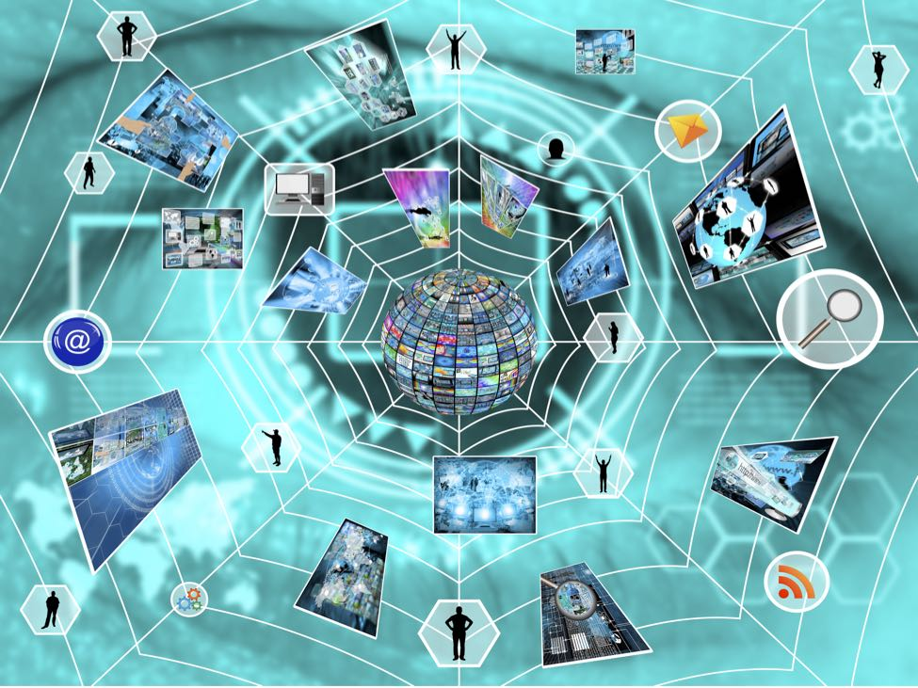
Contribution of the Internet of Things to Evaluation Design: Prospects and Problems

Slide 2
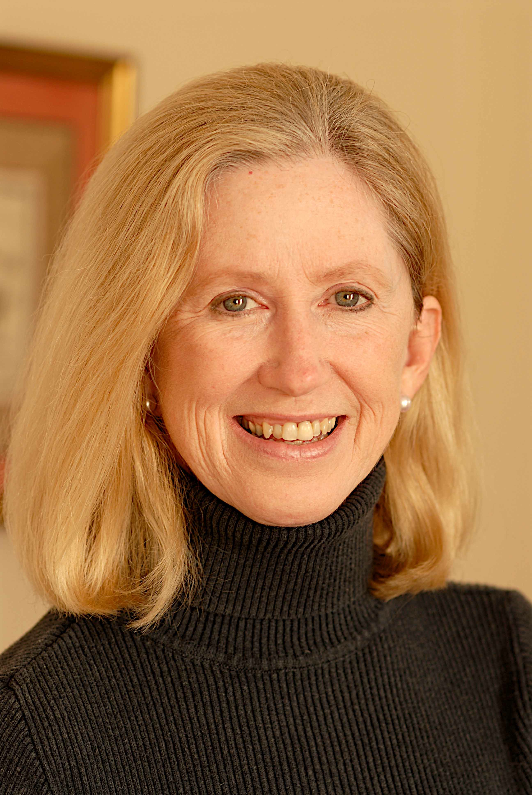
Contribution of the Internet of Things to Evaluation Design: Prospects and Problems
Gunn's early career included work at NASA on large-scale scientific computation and global communications, with special emphasis in infrared satellite image processing, computational fluid dynamics, and global climate and weather modeling. She also did work in robotics engineering at IBM, Morton Thiokol, United Technologies/Pratt & Whitney, Lockheed-Martin, Rolls-Royce, and the US Navy.
Gunn was the first woman to earn a Ph.D. in mechanical engineering from Purdue University, where she also earned an M.S. in computer science. In 2008 she was awarded an honorary doctorate in science from Purdue.
Moira Gunn is an Assistant Professor in the School of Management at the University of San Francisco
(from https://en.wikipedia.org/wiki/Moira_Gunn)
Moira Gunn

Slide 3
Introduction
The technology developing around the idiom of the Internet of Things can extend the utility of dense semiconductor arrays into every aspect of our lives if we but ask.
We would like to consider the prospects
And then the problems
Our discussion will take up
the sensors
the wireless collection
and the observers

Slide 4
From the Call- Evaluation Design
An evaluation design integrates evaluation theories, approaches, and methods to achieve a set of intended purposes in a specific context. An evaluation design encompasses more than research design. It also includes:
the use of evaluation as a direct means of creating change, for example by working with stakeholders in ways that promote equity and empower communities;
strategies for understanding, working with, and building consensus among stakeholders;
the thoughtful combination of quantitative and qualitative methods;
the application of evaluation for formative, summative, and developmental purposes;
and the development of evaluative criteria that establish what matters, to whom, and why.
Evaluation design is dynamic, changing as programs develop and real-world challenges emerge. Given this complexity, what constitutes an exemplary evaluation design? Does flexibility and responsiveness come at the expense of quality, credibility, or usefulness? Can we learn to design evaluations that are faster, cheaper, and better? How do we balance the competing interests of stakeholders?

Slide 5
The Sensor Universe
Many are in this business
We will look at a few explicitly
Intel
IBM
Libelium

Slide 6
Intel (from PC World, January 2016)
A decade ago, Intel’s primary data source for its PC and server microprocessors were the people who used Intel’s products. Today, those data sources are sensors connecting the Internet of Things, and Intel wants them everywhere.
“We’re entering a new era of technology where consumers are choosing experiences over products,” said Krzanich [Intel’s CEO], during the keynote address. “The technology that enables the new experience... that’s the product that will be successful in the future.” (http://www.pcworld.com/article/3019557/internet-of-things/intel-embraces-internet-of-things-puts-sensors-on-everything.html)

Slide 7
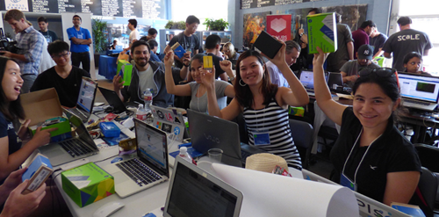
Intel IoT Kits

Slide 8
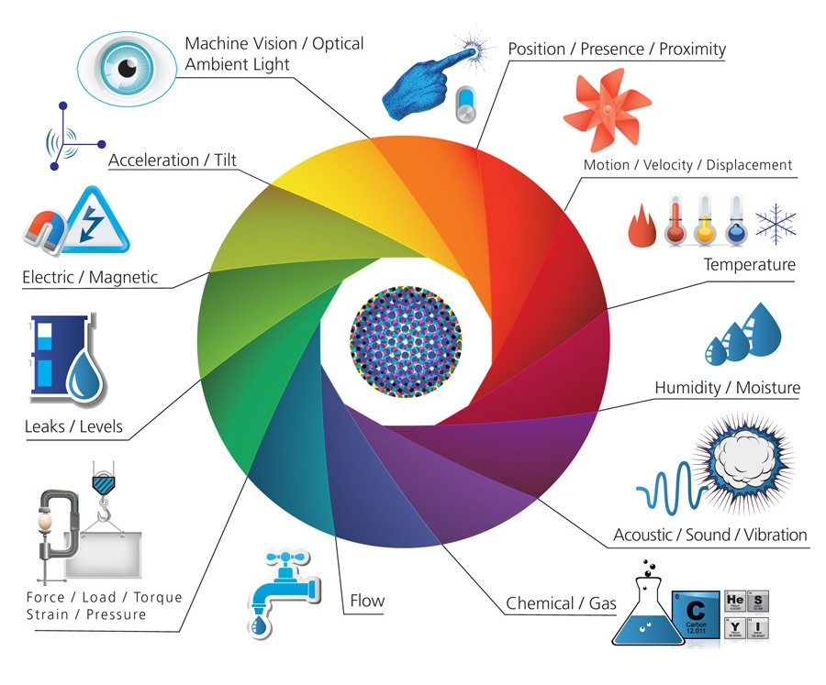
Still Others
Notes:
Scroll below this graphic to see kits

Slide 9
Since 2008, there are more objects connected to the Internet than persons in the world and this figure will hit 50 billion by 2020!. Now we can interact not only with contents in websites but with real objects.
For the first time, we can live in Smart Cities full of sensors that help us to improve our lifestyle and machines which talk to other machines on their own. As a result, people and objects jump into the Internet adding new layers of data and complexity. The “virtual” Internet we knew is becoming more “physical” than ever: we have entered into the Internet of Things era.

Slide 10
E-Health
The e-Health Sensor platform allows Arduino and Raspberry Pi users to perform biometric and medical applications where body monitoring is needed by using 9 different sensors: pulse, oxygen in blood (SPO2), airflow (breathing), body temperature, electrocardiogram (ECG), glucometer, galvanic skin response (GSR-sweating), blood pressure (sphygmomanometer) and patient position (accelerometer). The e-Health Platform has been designed by Cooking Hacks (the open hardware division of Libelium) in order to help researchers, developers and artists to measure biometric sensor data for experimentation, and test purposes.

Slide 11
MySignals
MySignals allows you to measure more than 20 biometric parameters such as pulse, breath rate, oxygen in blood, electrocardiogram signals, blood pressure, muscle electromyography signals, glucose levels, galvanic skin response, lung capacity, snore waves, patient position, air ow and body scale parameters (weight, bone mass, body fat, muscle mass, body water, visceral fat, Basal Metabolic Rate and Body Mass Index). These broad sensing portfolio makes MySignals the most complete eHealth platform in the market. (Asin & Gascon, 2016)
Notes:
Another low cost kit

Slide 12
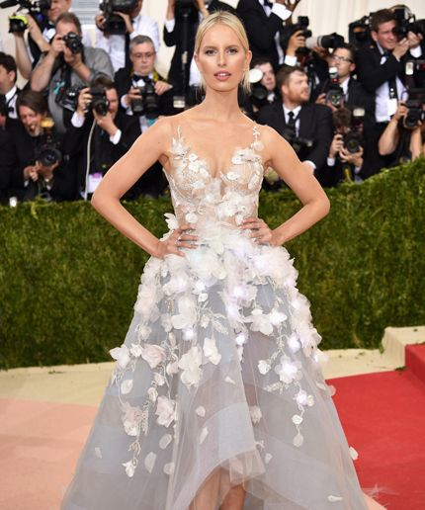
One more thing…
The final cognitive thread in the collaboration weaves technology into the very fabric of the dress, enabling Met Gala enthusiasts to join the cognitive conversation on the red carpet. Using Watson Tone Analyzer, the dress will tap into social sentiment from Twitter users on the cognitive dress, extracting context around the tone of their messages. The dress, embedded with LED lights, will change colors in real-time as the public conversations around the Met Gala unfold online.
https://www.ibm.com/blogs/internet-of-things/cognitive-marchesa-dress/

Slide 13
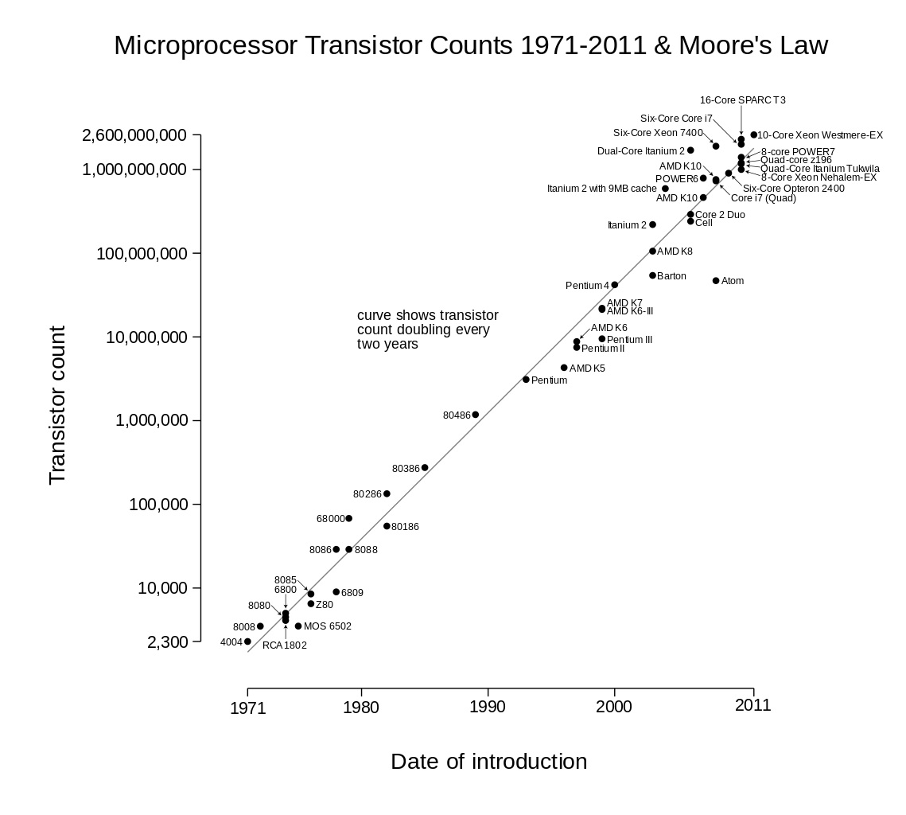
Realization of Moore’s Law

Slide 14
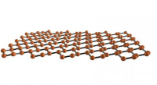
Where does Moore’s Law “hit the wall?”

Slide 15
The Wireless Airscape
The burgeoning Internet of Things (IoT) field is putting a strain on the available unlicensed spectrum. With the predicted billions of connected wireless devices, current spectrum will eventually become overloaded and create considerable interference problems. (Frenzel, 2016)

Slide 16
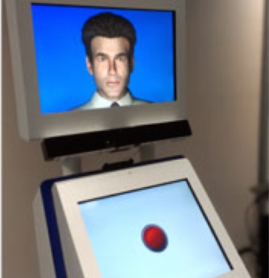
Unobtrusive, Obsequious Observation
the kiosk analyzes an interviewee's voice
for anomalies that may prompt a border officer to probe deeper into a particular response.

Slide 17
Watching People Watch
BBC Example
Honda
Proctor & Gamble

Slide 18
Technology employed
Emotient FACET
Affectiva AFFDEX
Noldus FaceReader
See http://www.wsj.com/articles/startups-see-your-face-unmask-your-emotions-1422472398

Slide 19
Handling the Data
Ever wondered how to track small, high-value devices where there might be varying strengths of Wi-Fi, GPS, and cell tower signal?
At its heart, the core value from IoT stems from data. A lot of people refer to data as the new gold but the reality is it’s the new oil. When oil comes out of the ground it has intrinsic value, yet it’s not much use to anyone in its raw form. The true value of data, like petrol and diesel, can only be realized after being refined. (https://www.ibm.com/blogs/internet-of-things/location-iot/)

Slide 20
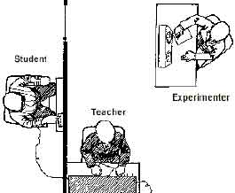
We can but should we ought?
See also: http://www.simplypsychology.org/zimbardo.html

Slide 21
What we’ve seen…

Slide 22
So what do you think
What kind of data collection device would you like to have
What sort of devise would you prefer to not be used?

Slide 23
Thank you
Paul Lorton, Jr
lorton@usfca.edu

Slide 24
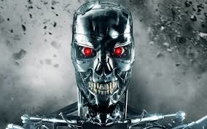
Postscript – what next…?

