Slide 1
Summer Camp Evaluation
The Youth Outcomes Battery & Camp Program Quality Assessment
Laurie Browne, Ph.D.
Ann Gillard, Ph.D.

Slide 2
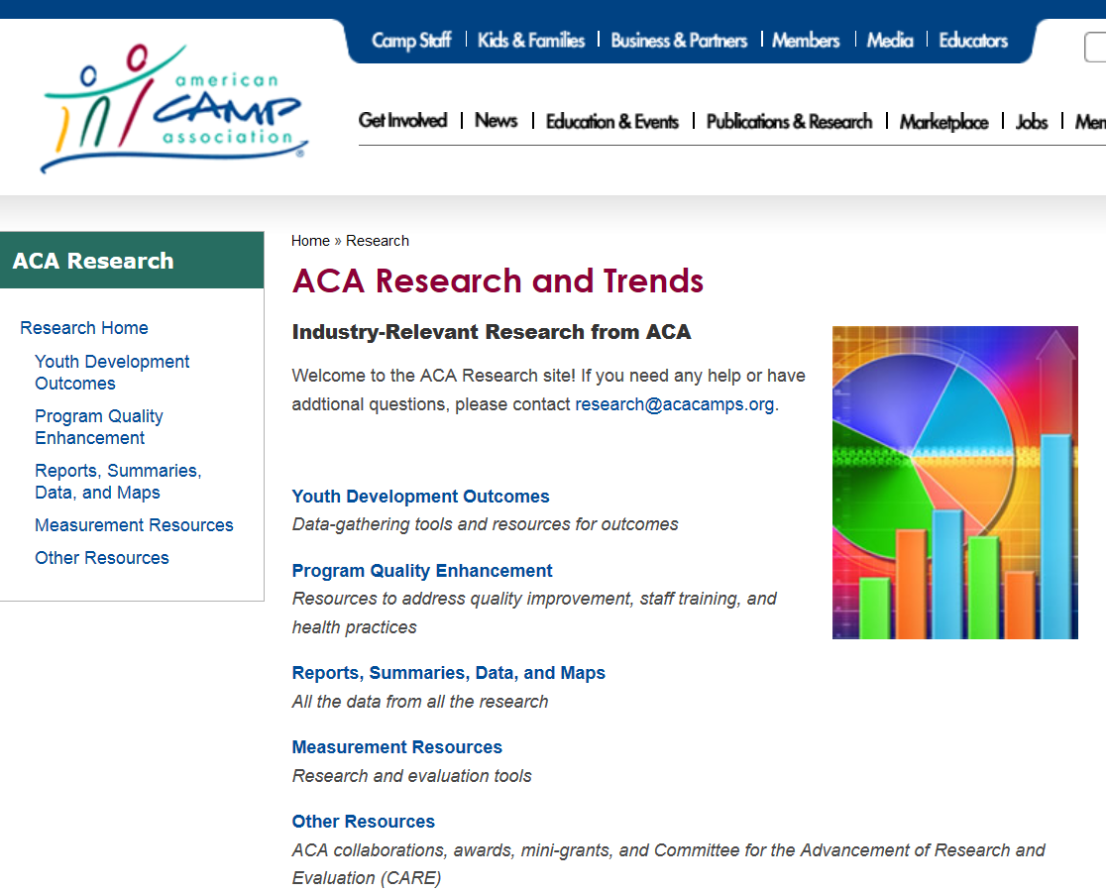
Deb Bialeschki
Director of Research, American Camp Association
Notes:
BACKGROUND: 2 min.
Includes the methods
Introduce self, where work, where’s Deb
Least interesting, but sets tone
Introduce characters who will be introduced later: YOB, CPQA

Slide 3
What is camp?
Notes:
ACTIVITY - Ann: Gather background on audience: How many of you have gone to camp? How many of you have evaluated camp programs? How many evaluate afterschool or out-of-school-time programs?
Share experience or story related to conflict with the concept being discussed
ACTIVITY: Think, pair, share:
Think of your own camp experience, or a meaningful experience in nature if you’ve never been to camp. Think about what that experience meant for you. Think about what changes that experience had in you. If there were no changes, think about why. Write this down.
Find a partner and share your answers.
Ask for volunteers to share their experiences and their changes.
Highlight common themes (on flipchart or whatever).

Slide 4
Camp is a context for
positive
youth
development.
Notes:
20% bottom line - (6 min)
Conclusion
Tell main finding and why it matters for the audience: 11 million kids attend camp every summer. We better make sure the camps are delivering developmentally appropriate experiences for them.
Identify the key points, bottom line: The CPQA and YOB are good tools to use to figure this out.
Rest of material illustrates the bottom line
Provide a roadmap of the presentation at the beginning
Ideas:
Great ideas gone bad
The problem was…: We “know” that camp is important. It’s a hallmark of American culture. But does it really have an effect? Can we measure the magic?
We should have… [bottom line]
6 word presentation story – something tweetable
Foreshadow the rest of talk
Tell them here what you’ll tell them in the Explanation

Slide 5
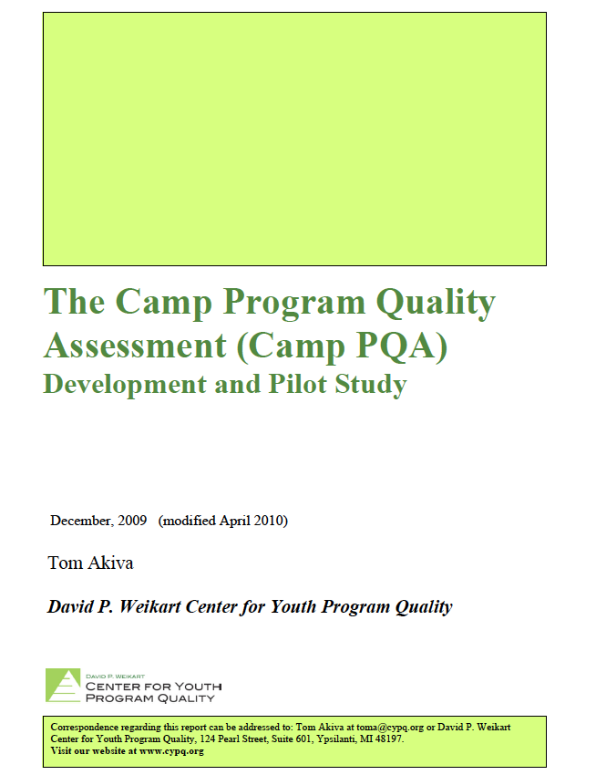

Slide 6
Inputs
Camp Experience
Positive Youth Development

Slide 7
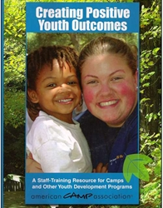
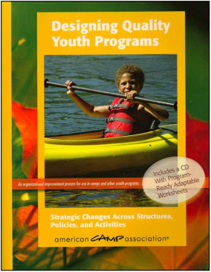
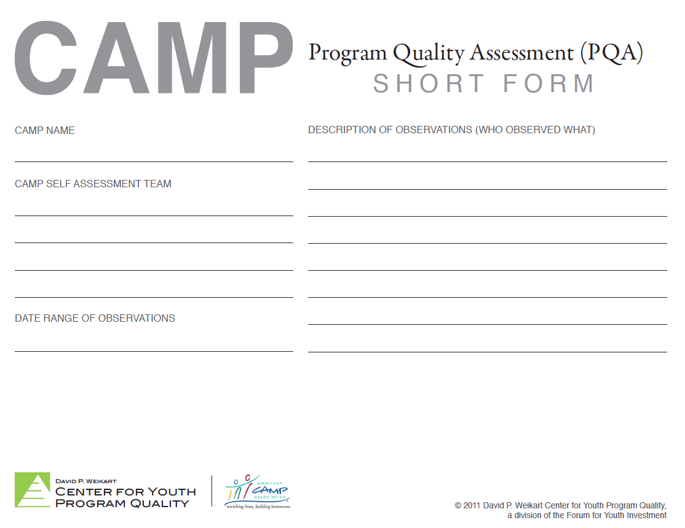
Inputs
Camp Experience
Positive Youth Development

Slide 8
Friendship Skills
Responsibility
Independence
Family Citizenship
Teamwork
Competence
Exploration
Affinity for Nature
Problem Solving Confidence
Camp Connectedness
Spiritual Well-Being

Slide 9
Young Camper Analysis Tool

Slide 10
Older Camper Analysis Tool (Basic)

Slide 11
Older Camper Analysis Tool (Detailed)

Slide 12
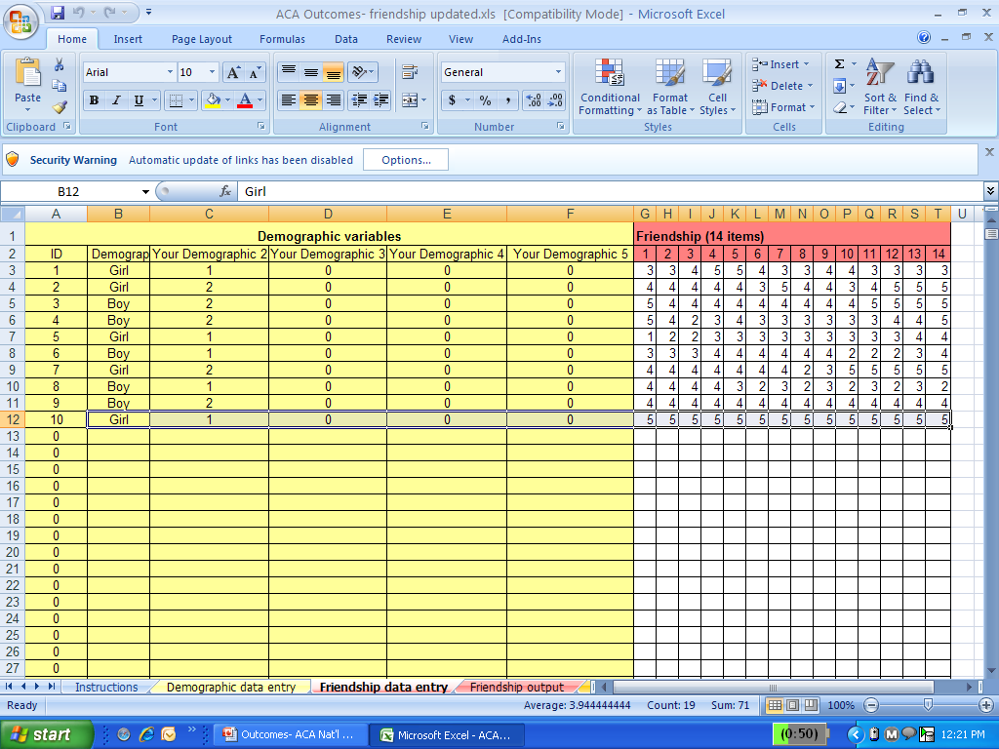
Notes:
Template slide screen shot excel

Slide 14
The following data are based on this number of camper surveys: |  |  | 10
The following percentage of campers felt their friendship skills “increased a little bit, maybe”:
 | 80.00%
The following percentage of campers felt their friendship skills “increased some, I am sure”:
 | 40.00%
The following percentage of campers felt their friendship skills “increased a lot, I am sure”:
 | 10.00%

Slide 15
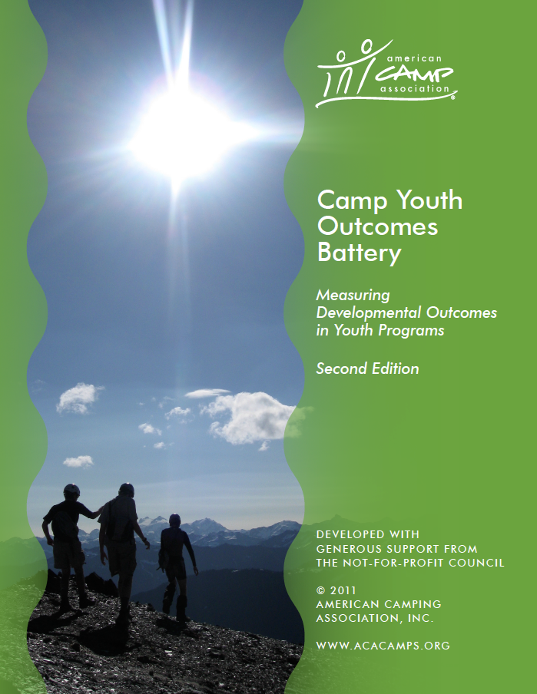
Pitfall | Tip for success
Assessing too many outcomes | Focus on one outcome at a time
Not collecting interesting demographics | Choose demographics based on how your camp is divided
Not engaging staff | Invite staff to select target outcome
Putting too much stock into your first round | Treat it as a learning experience

Slide 16
Structured activities
Informal climate
Administrative practices

Slide 18
Engagement
Activity Environment
Learning Environment

Slide 19
Form A: Structured Activities
Activity Climate
Learning Environment
Engagement

Slide 20
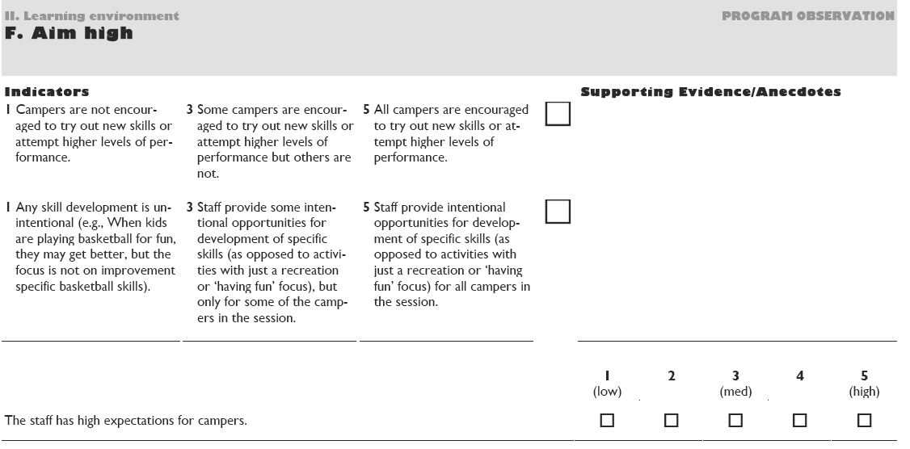

Slide 21
Form A2: Informal Climate
Informal Climate
Nature Supplement

Slide 22
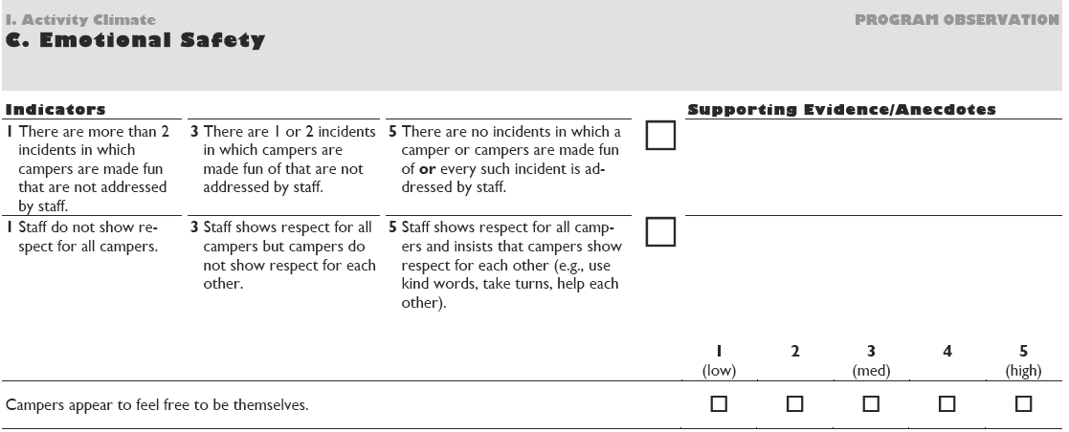

Slide 23
Form B: Administrative Practices
Support for climate
Support for learning
Support for youth voice
Continuous improvement
Support for nature experiences

Slide 24
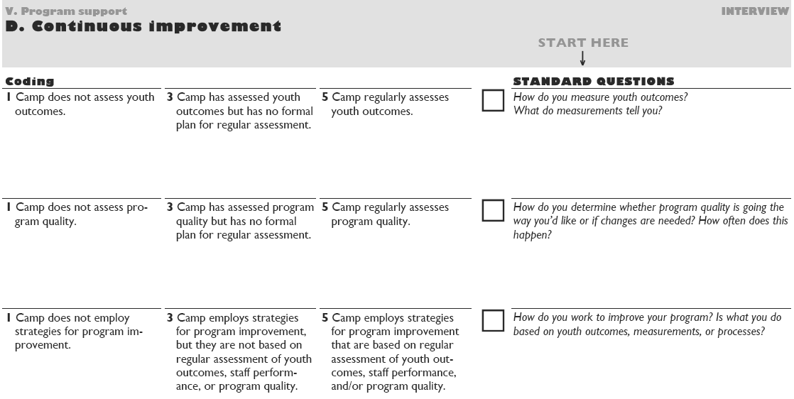

Slide 26
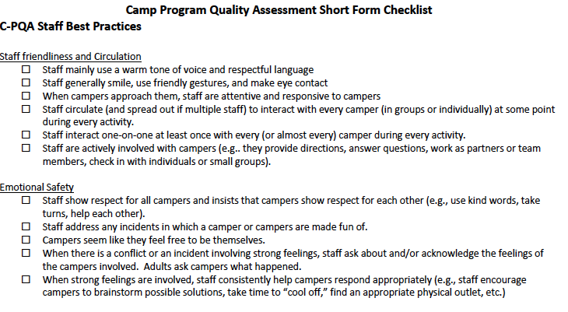

Slide 27
Challenges
Opportunities
Notes:
15% so what
- 7 minutes
- Bring back to the audience’s context – you can use these tools to easily evaluate youth outcomes.
Situate self and findings back to evaluation field – importance of triangulation, importance of non-obtrusive methods, importance of being able to easily translate findings into action. Importance of recognizing youth outcomes happen in camp and we can measure that.
What are the barriers to using YOB and CPQA?
Evaluating a program that does NOT have outcomes or a theoretical basis
Fears of numbers
Fears of reducing complex phenomena to a number or a word
“We already know this works”
Opportunities for YOB & CPQA
Changing camp’s culture to an evaluative one, one that uses data to drive decisions
Use in program staff training and assessment
Use in LIT and CIT type programs
Can use to spread out knowledge of evaluation to other members of the organization
You, your peers, evaluation field
Lit review, connect back to lit and/or need for the study
Camp research has shown (Henderson, Bialeschki, Garst, etc.)….
These tools need more testing in a variety of youth contexts and with a variety of youth populations
- Progress from concrete to abstract recommendations

Slide 28
Use the CPQA and YOB
Tell others about these tools
Promote camp as a context for positive youth development
Notes:
10% call to action
- 4.5 min
- End on strong note
- Explicitly state next steps you want people to do next
Do this… Don’t be afraid, kiss the fish! It’s good luck for you and for campers. Paul Newman kissed the first fish he caught at our camp, and tossed him back for luck. Use these tools to enhance your evaluations of OST programs such as camp.
Methods to exchange their emotional or cognitive energy

Slide 29
Three things:
What you learned
New ideas
What you will do
Notes:
Call to Action
ACTIVITY: Bracelets
1. Choose a cord.
2. Tie 3 knots to represent 3 things you learned or 3 new ideas you had or 3 things you will do.
3. Find a buddy.
4. Tell your buddy your 3 things
5. Ask your buddy to tie on your bracelet. Friendship skills are important!

Slide 30
Notes:
Questions, comments, things to contemplate….
- Connect with us in these ways…See handout.

