Slide 1
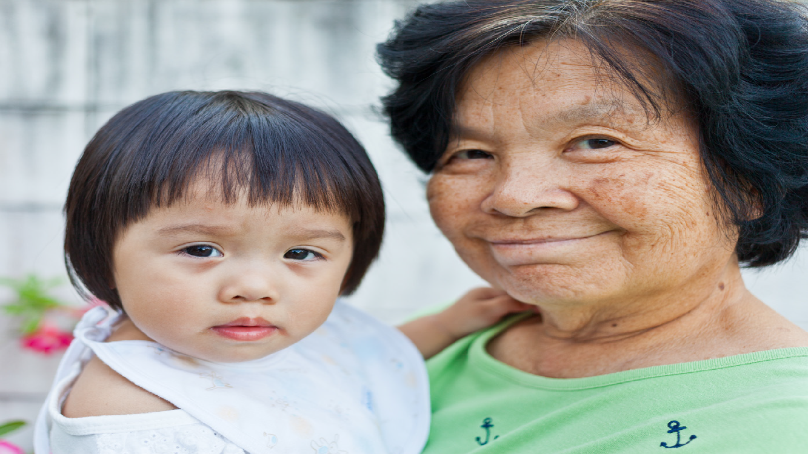
Building Equitable Evaluation Capacity in Communities
NOVEMBER 14, 2019

Slide 2
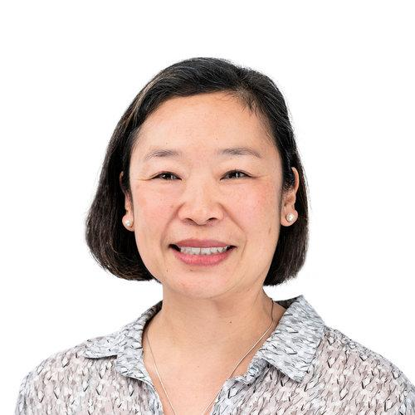
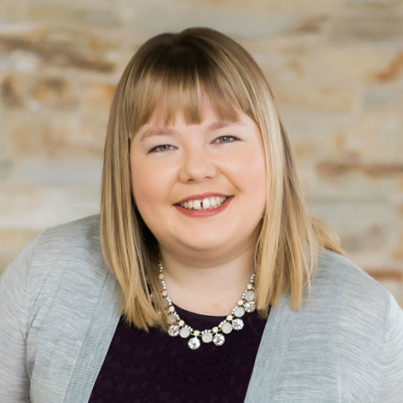
Introductions
Erika Takada
Senior Consultant
Katie Harkin
Program Associate
Notes:
To get a sense of who is in the room, would you raise your hand if you’re an evaluator?
And if you’re a funder?

Slide 3
Learning Objectives
SHARE
IDENTIFY
ENCOURAGE
lessons learned from our work supporting community-based organizations in evaluating their programs
what worked well from the perspective of both the evaluator and the funder
the spread of equitable evaluation practices
Notes:
Our theme for this session is working to ensure that evaluation leaves no one behind.
Our objectives are to:
Share what we learned in working with community-based organizations to evaluate their programs.
Identify what worked well from the evaluator and the funder perspective.
Encourage the spread of equitable evaluation practices.

Slide 4
Agenda
Overview and context setting
Evaluation approach and methods
Breakout groups
Key takeaways
Questions
Notes:
In our time together this afternoon we will:
Provide an overview of the grantmaking strategy and equitable evaluation
Share our evaluation approach and methods
Lead a short activity in small groups
Reflect on funder-evaluator collaboration,
And hold a few minutes at the end for questions

Slide 5
Early Learning Strategy (2014-2024)
To improve the quality of early learning experiences in both formal and informal settings for children (birth through age five) in California by supporting parents, caregivers, and educators so that all young children grow up healthy, ready for school, and on track to reach their full potential.
Notes:
The David and Lucile Packard Foundation is a family foundation based in California that focuses on improving the lives of children, families, and communities; and restoring and protecting our planet.
The Foundation’s Early Learning strategy is a 10-year strategy which launched in 2014: to improve the quality of early learning experiences in both formal and informal settings for children birth to five in California, with the ultimate goal that all young children grow up healthy, ready for school, and on track to reach their full potential.
We do this by supporting professional development in formal settings (like preschool) and increasing the quality of interactions in informal settings. Our work in informal settings is what I’ll be talking to you about today.

Slide 6
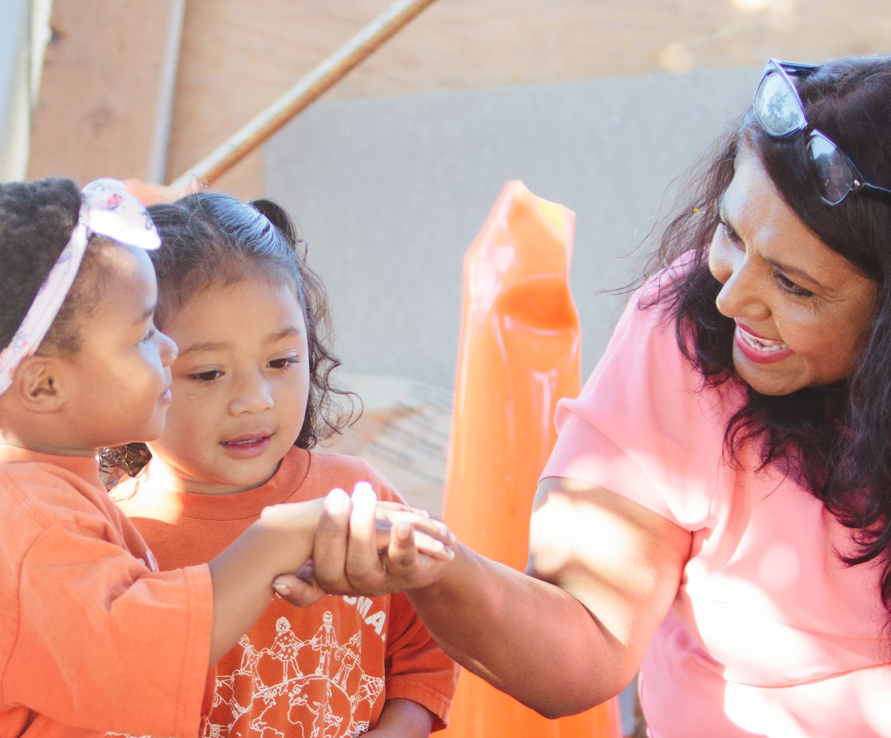
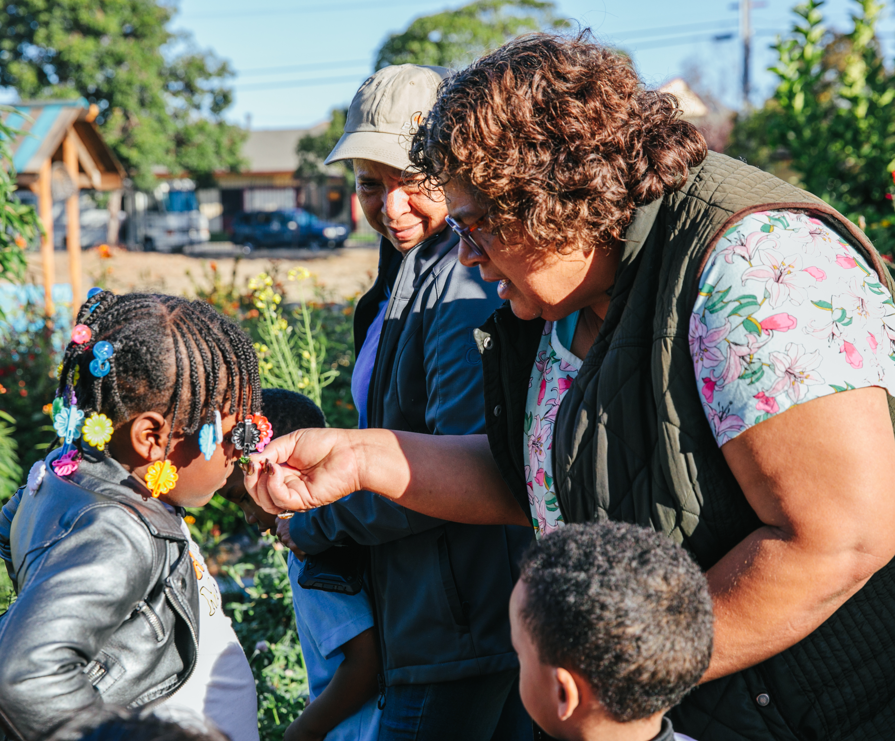
Family, Friend, and Neighbor (FFN) Grantmaking Strategy
WHAT IS FAMILY, FRIEND, AND NEIGHBOR CARE?
HOW DOES IT RELATE TO EQUITY?
Leveling the playing field for young children requires improving the quality of care provided in all of the settings where they receive care
Raising up FFN caregivers as critical people in the lives of young children
Notes:
I’ll provide some context on what family, friend, and neighbor care is before giving an overview of our grantmaking strategy.
What IS family, friend, and neighbor care?
Picture a grandmother caring for her grandchild, or an auntie or a neighbor.
Most FFN caregivers are women of color and in CA the majority are Spanish-speaking. They are not part of a formal system or network of other caregivers, so they often feel socially isolated.
According to the National Survey of Early Care and Education, it is the most common form of non-parental care used by families with young children. More common than center-based care and preschools.
While it is used by families from all socioeconomic backgrounds, families with low-incomes are more likely to rely on family, friend and neighbor care for a variety of reasons. These include that is more affordable than center-based care, and that it is generally more flexible in accommodating their varied work schedules, including evening, weekend, and overnight care.
It is also the setting where the majority of infants and toddlers receive care, 80% of children ages 0-3 in California are in FFN care.
How this grantmaking strategy relates to equity:
Leveling the playing field for young children requires improving the quality of care provided in all of the settings where they receive care.
The strategy also recognizes the critical role that FFN caregivers play in the lives of young children, and seeks to raise their profile among other educators in the field.

Slide 7
Family, Friend, and Neighbor (FFN) Grantmaking Strategy
1
2
3
4
Support Research
Identify Projects
Test and Learn
Scale What Works
Demographics
Motivations
Resources
Networks
Time-Limited
Potential for Scale
Proof Points and Lessons
Networks
Platforms
Notes:
Now that you know a little bit about FFN care, I’ll walk through the strategy we developed to bolster the quality of that care.
The core hypothesis underlying our FFN strategy is that providing information to FFN caregivers, and connecting them to resources, to each other, and to formal caregivers can support them in creating stimulating and rich learning experiences for the children in their care.
It is an emergent strategy, and there are not many other funders in this space. So, we started by funding research to learn about the field of informal care, then funded some small pilots projects, then testing and learning through those pilots, and now we have identified some which we believe have the potential to scale, and we are in the fourth phase: scaling what works. Our talk today will focus on the evaluation of phases 2 and 3.
Given that our strategy is emergent, a core component has been funding evaluation at each stage of our grantmaking. Our evaluation partner – Erika at Engage R+D, provided technical assistance to our grantees and supported them in gathering data to measure the impact of their programs on FFN caregivers.
I will turn it over to Erika to provide an overview of equitable evaluation and how it relates to her approach to working with our grantees.

Slide 8
Why is Equitable evaluation important?

Slide 9
FFN caregivers face many challenges
No formal child development training
Working with families
Isolation
Lack of access to quality information and resources
Stress and exhaustion
Notes:
Even with so many children in the care of informal caregivers (as you learned from Katie), as a group, they are the most under-resourced caregivers. FFN caregivers face many challenges.
Since they are not a part of a system, the challenge in the early education field is to appropriately and adequately address these challenges by reaching families and caregivers in the community with quality resources.
Additionally, although families across all socio-economic levels, race/ethnicity use informal care, some families are more likely to use FFN care than others:
Families with low incomes in low-wage, entry level jobs
Families of color, particularly newly arrived and immigrants (African-American, Latino, refugees and immigrants)
By choice or circumstances, not all caregivers, families and children have access to the same quality of resources
So it becomes important to level the playing field for quality early childhood experiences and kindergarten readiness.

Slide 10
Use evaluation to advance equity
Diversity of their teams moving beyond cultural to disciplines, beliefs, and lived experiences
Cultural appropriateness and validity of their methods
Ability of the design to reveal structural and systems-level drivers of inequity (present-day and historically)
Degree to which communities have the power to shape and own how evaluation happens
Equitable Evaluation Initiative, https://www.equitableeval.org/ee-framework
Notes:
Knowing this provided us with the opportunity to align our evaluation practices with an equity approach and
Evaluators must

Slide 11
Equitable evaluation approach

Slide 12
FFN Evaluation approach
Listen and Learn
Custom Data Plan
Add
Logic Modeling Session
Webinars
Convening
Co-Design and Ongoing Technical Assistance

Slide 13
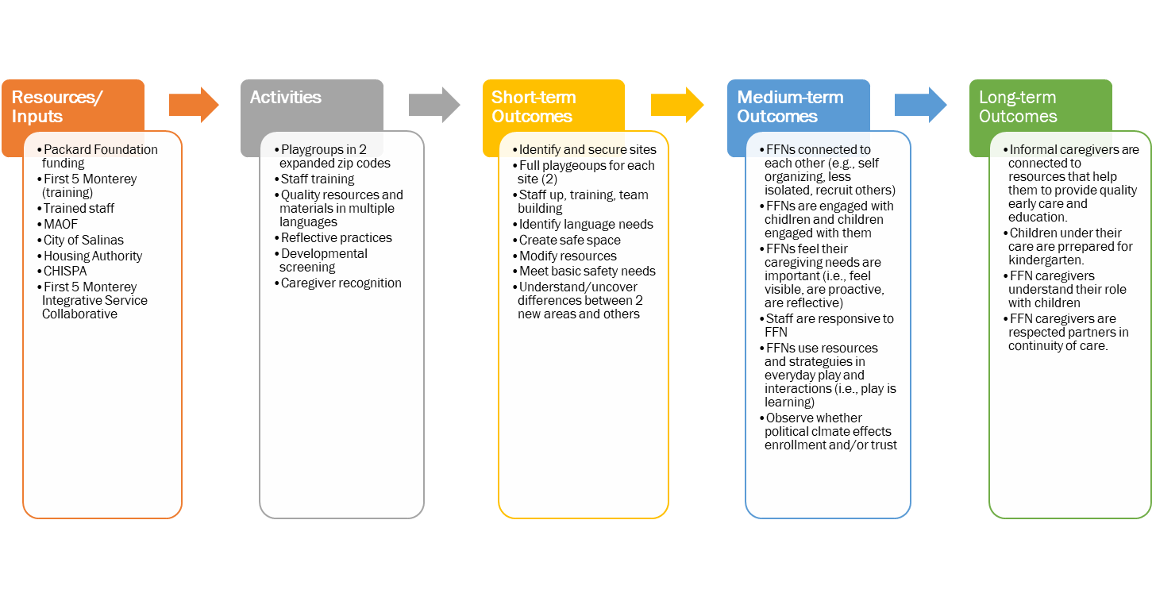
FFN project logic model

Slide 14
Ffn learning community convening

Slide 15
Methods
Lean Data
Co-Design
Triangulate Data
Thematic Analysis
Capacity Building
Learning Comm.

Slide 16
In the community

Slide 17
Go kids! salinas

Slide 18
Go kids! Salinas
Key Strategy Elements
Community open house events
2-hour weekly playgroups
Trained facilitators/mentors
High quality materials and resources
Developmental screenings

Slide 19
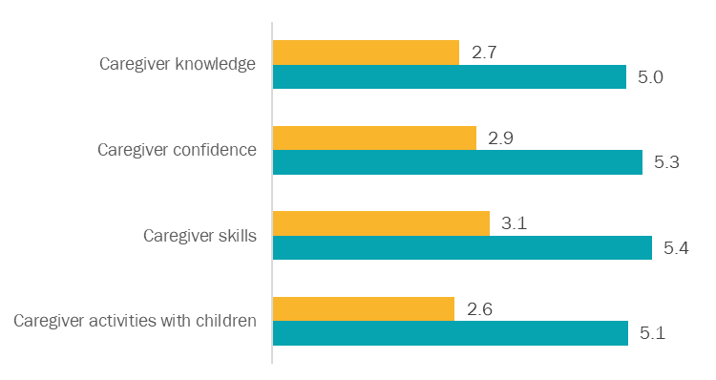
Sample of findings from Go Kids!
BEFORE
AFTER

Slide 20
Elements of success for FFN programs
Trusted community agencies and organizations
Opportunity for consistent participation
Reduce isolation of caregiver
Ongoing outreach
Value as a caregiver/teacher
Strong trusting relationship with mentor/facilitator

Slide 21
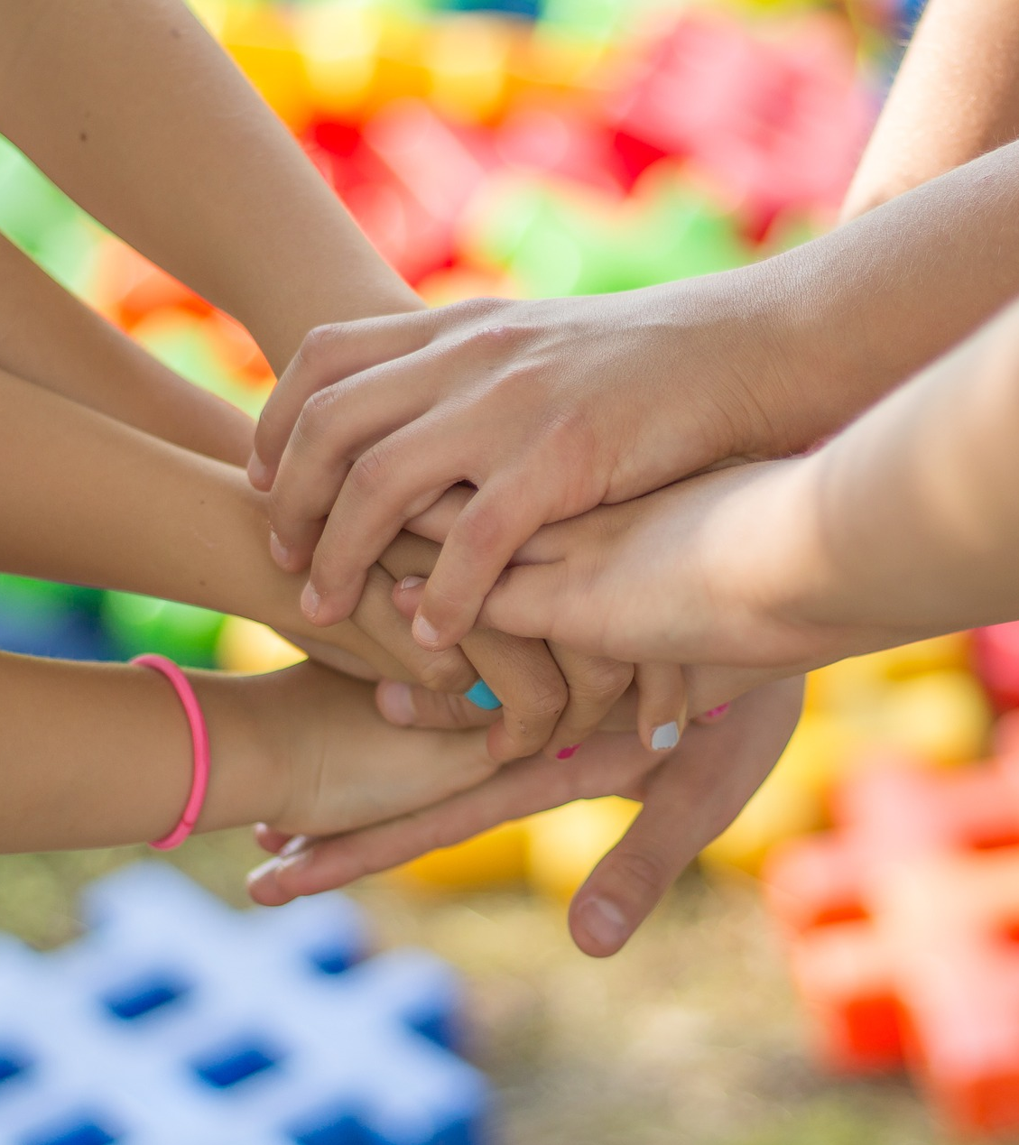
It’s important for us and we like to make friends. She is a best friend [pointing to another caregiver], and outside playgroup in the park she’s really nice. She knows we are Muslim – some people have problems with Muslims – and other moms, they are kind with us and talk with us, and they are hearing us and they will ask about why we are wearing a scarf. We made a lot of friends here. It’s a safe space.
FFN Caregiver in Oakland, CA

Slide 22
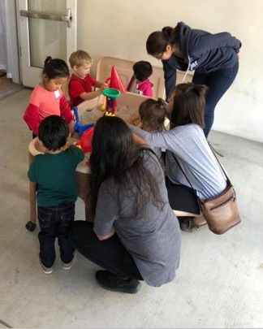
My daughter never sang before, and now she knows three songs and sings in the car and house.
FFN Caregiver in Fresno, CA

Slide 23
Breakout Groups
1
PLEASE REFLECT ON YOUR ANSWER TO THE QUESTION BELOW THAT CORRESPONDS WITH YOUR ROLE
2
SHARE YOUR RESPONSE WITH A FEW PEOPLE AROUND YOU
FUNDERS
What opportunities do you see to implement an equitable approach to evaluation in your grantmaking strategy?
EVALUATORS
Where do you see promise in conducting equitable evaluations? Where has it worked well?
NONPROFITS
If you're asked to implement an evaluation of your program, what opportunities do you see with regard to equitable evaluation?
Notes:
Now we’d like to hear from you — we’ve been doing enough talking.
We have developed questions for you to reflect on, for the funders in the room we’d like you to think about ‘what opportunities you see to implement an equitable approach to evaluation in your grantmaking.
Evaluators - we’d like you to reflect on where you see promise in conducting equitable evaluations, where has it worked well?
And for nonprofits, we’d like you to think about what opportunities you see to implement equitable evaluations of your programs.
We’ll give you a few minutes to reflect individually and then ask you to share with a few people around you. Then we’ll ask a few brave people to share key takeaways with the larger group.

Slide 24
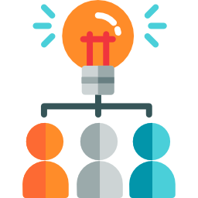
Funder / Evaluator Collaboration
Funder Perspective
Evaluator Perspective
Fund evaluation from the beginning
Develop trusting relationships with grantees
Communicate expectations with grantees
Be open to co-design and unconventional methods
Prioritize learning
Learn together with funder and grantees
Treat evaluator as thought partner in the work
Icons from www.flaticon.com
Notes:
Now we’d like to share some key takeaways, based on what we learned through working together on this strategy.
What worked well from the funder perspective:
We set aside part of the grantmaking budget for evaluation when we started our grant planning process – it’s important to fund evaluation from the beginning of the strategy, because this is an emergent strategy and our goal is to experiment and learn.
We communicated our expectation with prospective grantees through our RFP; that they would be working with an external evaluator, and that the purpose was to facilitate shared learning among a cohort of grantees and with the foundation.
We prioritized learning instead of accountability and emphasized the exploratory nature of our grantmaking, trying out several approaches to find a few that work.
We facilitated an introduction between the grantees and Erika and her team and let them take it from there – though we did attend some of the logic model meetings.
Finally, we consulted Erika as a thought partner, seeking her input when determining which pilot projects to fund, which of those funded projects had the potential to scale, which grantees we should continue to fund.
Erika has become an integral part of our strategy team.
Also, a note that this is not a particularly novel approach to evaluation for the Early Learning team at the Packard Foundation, it’s the way we do our work. However, we recognize that this is not necessarily common practice across philanthropy or even within our own foundation.

Slide 25
Questions?

Slide 26
References
Contact Information
Packard Foundation Early Learning website
Engage R+D Evaluation Report: Innovations in Family, Friend and Neighbor Care
Harder+Co Evaluation Report: Engaging Family, Friend, and Neighbor Informal Caregivers
Literature Scan Report: Informal Child Care in California: Current Arrangements and Future Needs
Blogs: Convening with Care; Learning on All Fronts with Foundations and their Grantees; This is What Quality Looks Like: A visit with families, friends, and neighbors
Equitable Evaluation Initiative website
Erika Takada
etakada@engagerd.com
@erika_takada
Katie Harkin
kharkin@packard.org
@katie_harkin

