Slide 1
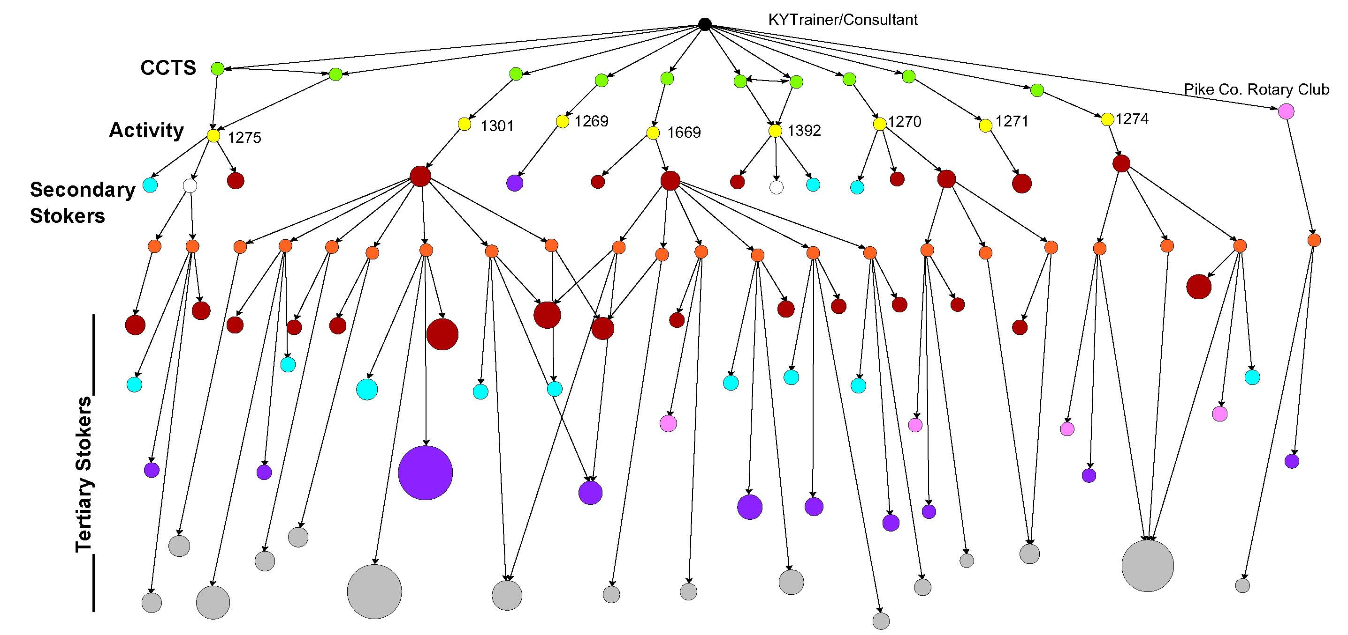
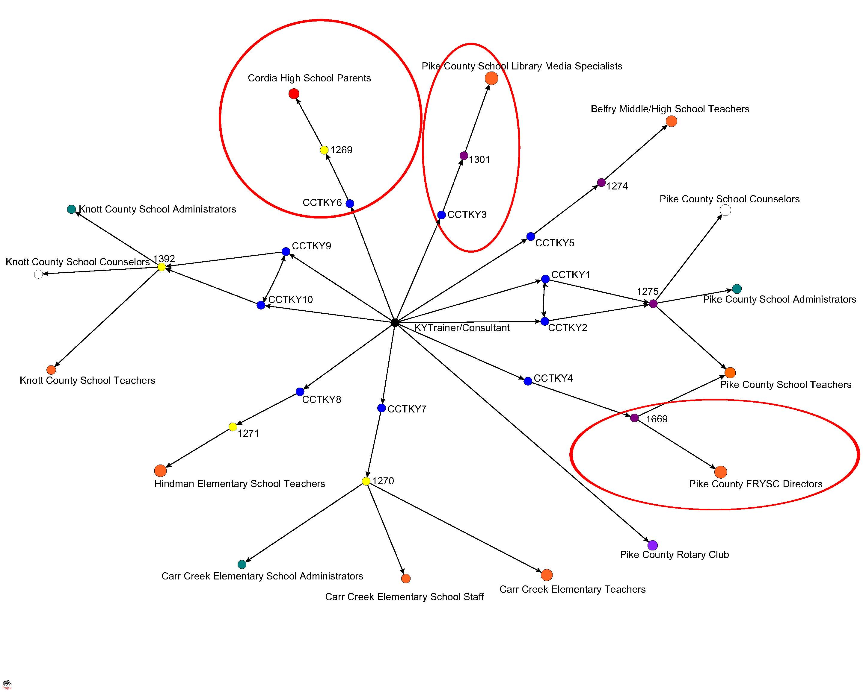
Using Social Network Analysis to Inform Community Capacity Building in a National Science Foundation Funded Science, Technology, Engineering, and Math Project
Donna-Jean P. Brock, Sandra B. Schneider, Lydia I. Marek, and Peggy S. Meszaros
Purpose
Project
Methods
Social Network Analysis sociograms were used to make project information flow in an observable way to inform project effectiveness. Feedback from this information flow could result in modifications to participant practices and relationships to better serve overall project goals (Rubright & Fifield, 2010).
The Appalachian Information Technology Extension Service (AITES) project’s overarching goal is to increase girls’ interest in jobs requiring Information Technology (IT) skills. A train-the trainer model was used to transfer information about IT within targeted communities. Knowledge transfer begin with Community Cohort Team’s (CCT) training of community members (i.e., Secondary Stokers). Community members, in turn, continue to further serve as knowledge transfer mechanisms (i.e., Tertiary Stokers).
PAJEK (a tool for network analysis) was used to create sociograms from tracking of outreach or contacts. A greater understanding of best practices was obtained through triangulation of sociograms with other tracking data. This information was disseminated within subsequent team and board meetings as well as to CCT in workshop trainings.
Interpretation of CCT Outreach Processes
Effectiveness of the Train-the-Trainer Model
Targeting Key Players facilitates community outreach:
CCTKY3 and CCTKY4 identify new stokers (School Library Media Specialists and Family Resource and Youth Services Directors) that are uniquely positioned to continue AITES outreach (see outreach to Tertiary Stokers in Figure 2).
Only one activity focused on parents.
Course Correction: Identify and connect with key stakeholders who are ideally situated to outreach to girls , paying particular attention to strategies to reach busy parents.
Trainer/Consultants are central to the network:
In the short term, the centralization of the Trainer/Consultants may help CCTs to reach their full implementation potential.
In the long term, the highly centralized role of the Trainer/Consultant may obscure identification of rising champions for the project and negatively impact project sustainability.
Course Correction: Slowly phase Trainer/Consultants from a leadership role to a facilitator role that serves to bolster project champions and future leaders.
The Train the Trainer model was an effective information transfer mechanism:
10 CCTs and 1 Trainer/Consultant outreached to 130 community members (i.e., Secondary Stokers), who then outreached to 1,545 community members (i.e., Tertiary Stokers), including parents and girls.
The sociogram identified three key activities that were most successful in community outreach (1274, 1669, and 1301).
Figure 2: KY Outreach Using the Train-the Trainer Model
Figure 1: KY CCT Outreach to the Community
Identification of Best Practices
Successful Activities:
Targeted key players that have outreach potential, a shared interest in the goals of AITES, and time to devote to the AITES message.
Had participants create action plans.
Collaborated with community participants to conduct more activities.
AITES Project:
Allow project participants an opportunity to see and reflect upon their location in the AITES network (Dobrowski & Martinez , 2010).
Use sociograms to foster participants’ self-determinations, make their impact on the project visible, and encourage community ‘buy-in’ of the project (Fetterman, 1994).
References::
Dobrowski & Martinez (2010). Funder’s Use of Network Analysis to Build Intentional Collaboration. Panel Presentation (545) at the November 2010 AEA Annual Conference, San Antonio, TX.
Fetterman, D.M. (1994). Empowerment Evaluation: Presidential Address. Evaluation Practice, 15(1)1-15.
Rubright, J. & Fifield, S (2010). Social Network Analysis: A Practical Introduction for Beginners. Workshop Presentation at the November 2010 AEA Annual Conference, San Antonio TX.
2011 ANNUAL AMERICAN EVALUATION ASSOCIATION CONFERENCE, ANAHEIM, CALIFORNIA
This research is supported by NSF-GSE/EXT 0832913.

