Slide 1
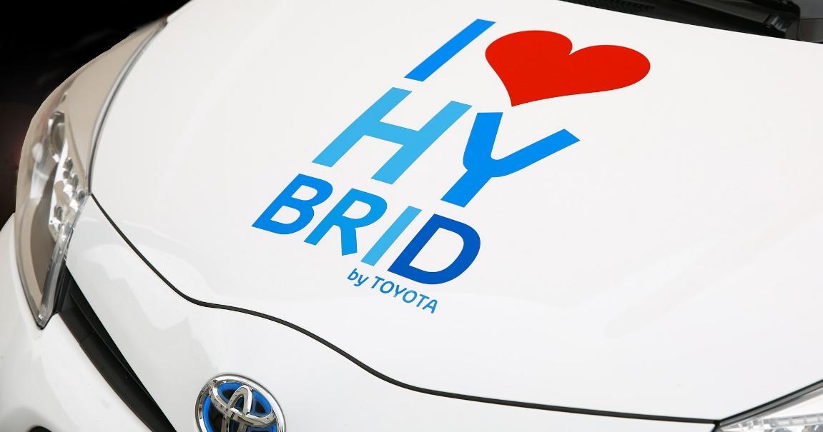
Toyota Prius Evaluations Two Examples of Hybrid Evaluand-Evaluator Models of Formative Evaluation
Ginger Fitzhugh and Jackie DeLisi
Evaluation 2017
Notes:
Hi, everyone! My name is Ginger Fitzhugh. My colleague Jackie DeLisi, who couldn’t be at AEA, and I will be kicking off our panel by talking about Toyota Prius Evaluations—what they are and when they can be useful.
Jackie and I lead evaluations of two NASA-funded projects where the evaluands (those being evaluated) and the evaluators share responsibility for different parts of the evaluation.
I’m going to start by briefly explaining what I mean by Toyota Prius or “hybrid” evaluations, and give several examples of what that looks like in our NASA evaluations. Then I’ll share some benefits, challenges, and other things to think about when deciding if a hybrid approach is right for your project or evaluation.

Slide 2
Let’s take a “formative” road trip!
Notes:
(Bear with me as I stick with the car metaphor…) When our clients are embarking on a new project, it’s the beginning of journey for them and for us as their evaluation partners.

Slide 3
Let’s take a “formative road trip!”
Notes:
While they probably have a map and may have plotted a route, some of the destinations they plan to visit in their efficient Prius are new and unfamiliar. It’s possible there will be construction on their planned route and they might need to take a detour.
So how do you document what you’re seeing and doing on that road trip? You probably want to take photographs so you can remember where you went and what you did, and also so you can share it with others.
Here are 3 ways of taking “formative” photographs.

Slide 4
3 ways of collecting formative data
Professional
Evaluation team collects and analyzes data
Notes:
In one model, the evaluation team is responsible for all the data collection. The professionals design data collection tools, collect the data directly, analyze it and report it back to the project team to help them make decisions about how to design their projects.

Slide 5
3 ways of collecting formative data
Professional
Selfie
Evaluation team collects and analyzes data
Evaluands collect and analyze their own data independently
Notes:
In the “selfie” model, the evaluands collect and analyze information themselves.

Slide 6
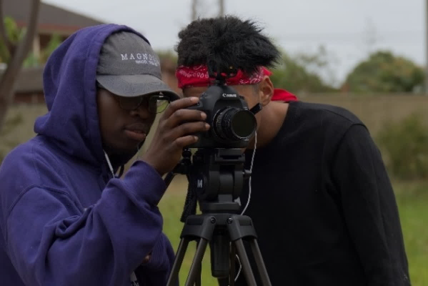
3 ways of collecting formative data
Professional
Selfie
Collaboration
Evaluation team collects and analyzes data
Evaluands collect and analyze their own data independently
Evaluands and evaluation team collaborate on collecting data
Notes:
In the third approach, the evaluands and the evaluation team collaborate on collecting formative data (for example, co-creating instruments, co-collecting data, or where each team has a different, complementary role—for example the evaluands collect data and the evaluation team analyzes the data and reports the results back).

Slide 7
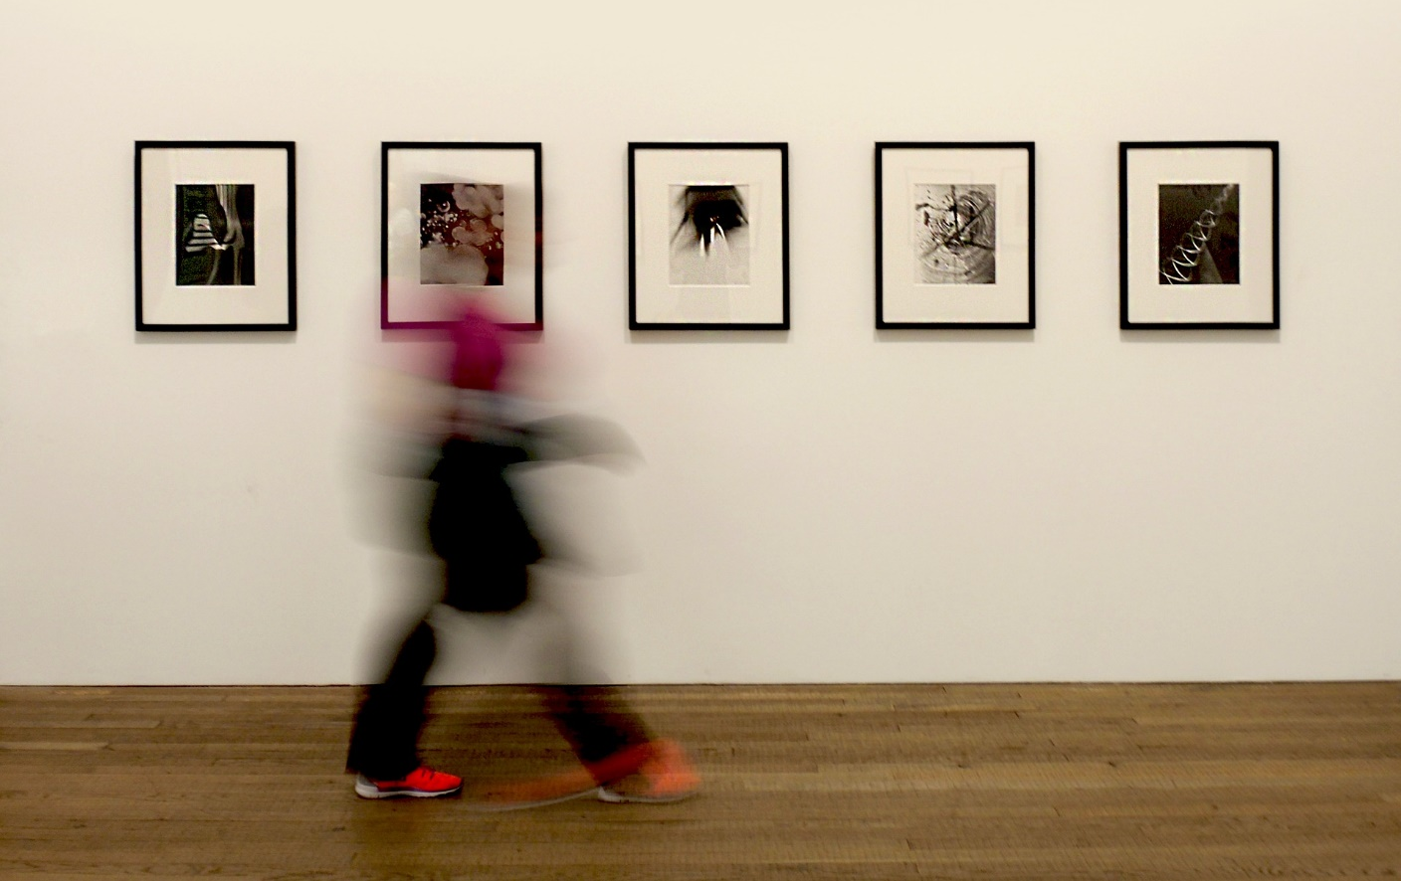
Create a formative photo gallery
Collaborative Work
Self-Portrait
Collaborative Work
Professional
Notes:
When you use all three approaches together, the project team has a formative gallery of their road trip that they can use to reflect and adjust…
And that’s what I mean by a hybrid model--where in some cases the evaluation team has sole responsibility for collecting and analyzing data, in orders the evaluand collects formative data independently, and in still others you share evaluation responsibilities.

Slide 8
NASA@ My Library
Notes:
I’m going to share examples of each kind of formative data collection from our two projects, starting with some examples from one called NASA@ My Library.
NASA@ My Library is a project that aims to get NASA and STEM materials to people of all ages through public libraries. The project team selected 75 libraries across the country to participate in the project for four years.

Slide 9
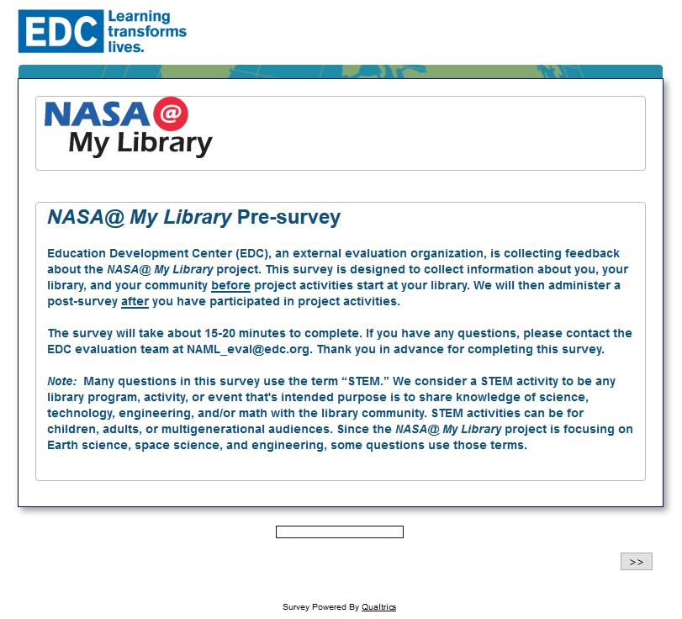
Examples from NASA@ My Library
Professional
Developed, administered, analyzed, and reported library staff pre-survey
Notes:
In the first example, the evaluation team created a pre-survey to collect baseline data from the participating library staff. We designed the survey, administered it, analyzed the data, and reported the results back to the project team so they could use them as they began to roll out activities.

Slide 10
Examples from NASA@ My Library
Professional
Selfie
Developed, administered, analyzed, and reported library staff pre-survey
Developed, administered, analyzed and reported front-end survey re: how libraries use tablets
Notes:
The project team has also done some formative data collection independently. The lead organization designed and administered a front-end survey to a much larger group of libraries’ regarding whether and how they used tablets, and what kinds of electronic resources they would find useful.

Slide 11
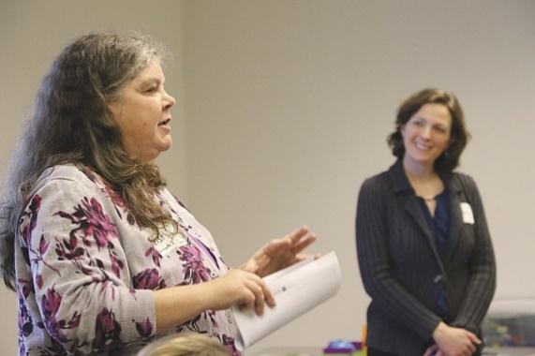
Examples from NASA@ My Library
Professional
Selfie
Collaboration
Developed, administered, analyzed, and reported library staff pre-survey
Developed, administered, analyzed and reported front-end survey re: how libraries use tablets
Conducted joint site visit to pilot library to observe community meeting and program activities
Notes:
In other cases we’ve worked very closely together and shared evaluation responsibilities. For example, two members of the evaluation team and a member of the project team conducted a joint site visit to a pilot library together, and both the evaluation team and the project team member collected data and reported on what we learned.

Slide 12
Examples from NASA@ My Library
Professional
Conducting site visits to libraries to observe programming and conduct interviews
Notes:
Here are a few more examples from NASA@ My Library. While the previous example was a joint site visit, the evaluation team also plans to conduct our own site visits to a sample of libraries in the coming moths to observe programming and interview the library staff and patrons about their experiences with the project.

Slide 13
Examples from NASA@ My Library
Professional
Selfie
Conducting site visits to libraries to observe programming and conduct interviews
Developed, administered, analyzed and reported needs assessment survey re: State Library Associations’ interests
Notes:
One of the partner organizations in the project is doing work with State Library Associations and they did an informal survey to their members to learn about state libraries’ interests in NASA-related materials and public programming. What they learned has informed their work.

Slide 14
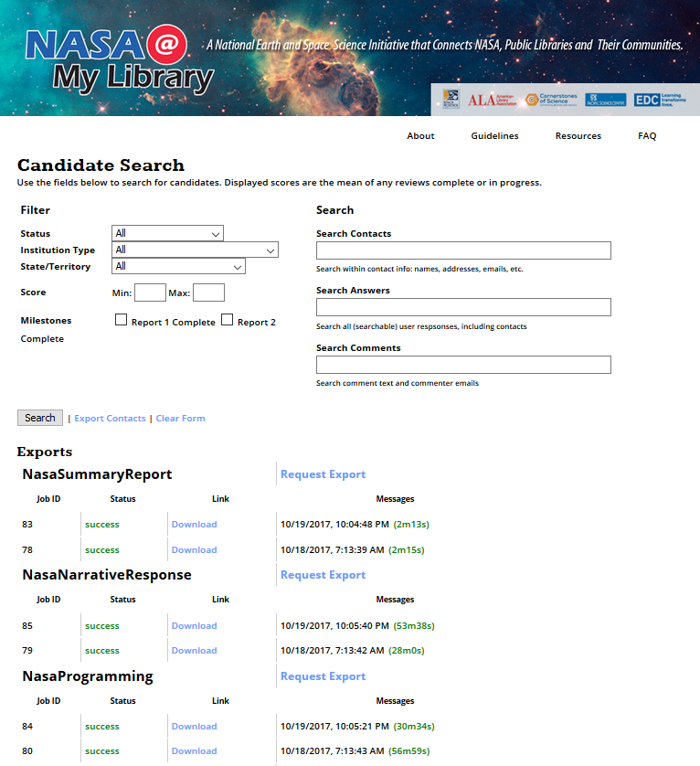
Examples from NASA@ My Library
Professional
Selfie
Collaboration
Conducting site visits to libraries to observe programming and conduct interviews
Developed, administered, analyzed and reported needs assessment survey re: State Library Associations’ interests
Co-developed online Annual Report form for libraries to report project activities
Notes:
A last example from NASA@ My Library is that we collaborated on an online Annual Report form which the libraries use to report project activities each year. The project team and the evaluation team co-developed the form, and the project team and evaluation teams will each analyze and use different parts of the data.

Slide 15
Examples from Real World, Real Science
Notes:
Now turning to the second NASA CAN project to share more examples of hybrid evaluation approaches.
Real World, Real Science is project based in Portland, Maine. They are designing a new, hands-on informal science center experience for 5th and 6th grade students about climate science using NASA data, and the ways in which human activity intersects with climate. The team is also developing companion in-classroom curricula for students to engage in when they are back at school.

Slide 16
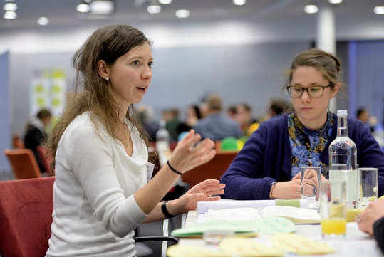
Examples from Real World, Real Science
Professional
Conducted teacher focus groups
Notes:
The evaluation team and the project team have been doing lots of formative data collection to help the project team design the informal and classroom experiences. We conducted focus groups with a group of teachers who attended a recent workshop to ask them about their curriculum needs.

Slide 17
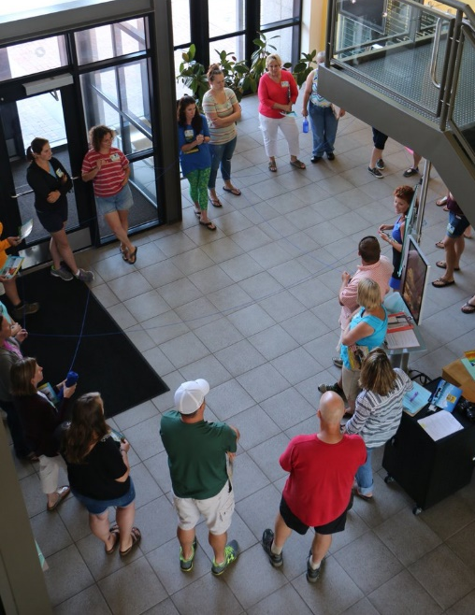
Examples from Real World, Real Science
Professional
Selfie
Conducted teacher focus groups
Informal conversations with educators at teachers workshops
Notes:
In addition to the more formal focus groups the evaluation team conducted, the project team had informal conversations with teachers at their trainings.

Slide 18
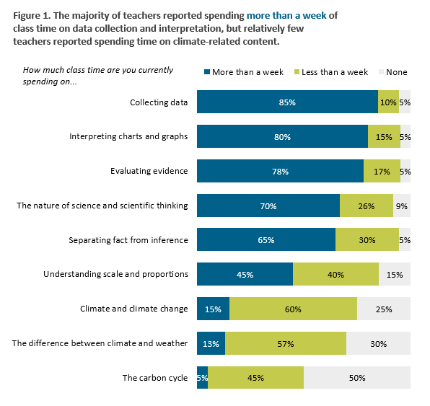
Examples from Real World, Real Science
Professional
Selfie
Collaboration
Conducted teacher focus groups
Informal conversations with educators at teachers workshops
Evaluand developed teacher survey and evaluation team analyzed data
Notes:
We’ve also collaborated on some evaluation activities. The project team designed and administered a teacher survey, and then provided the evaluation team with the data to analyze and report.

Slide 19
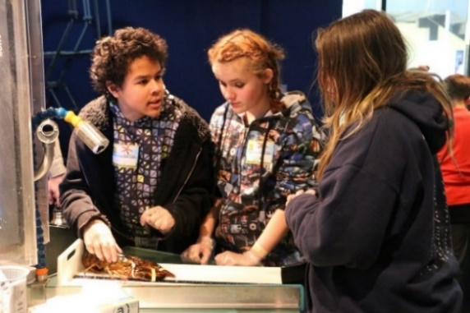
Examples from Real World, Real Science
Professional
Conducted observations using Dimensions of Success
Notes:
A few more examples. The evaluation team used the Dimensions of Success observation tool to observe students as they interacted with current science center components to understand how students were engaging with STEM and what content they were learning.

Slide 20
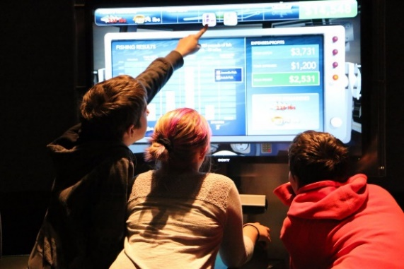
Examples from Real World, Real Science
Professional
Selfie
Conducted observations using Dimensions of Success
Exhibit designer doing
user testing of possible
components
Notes:
The exhibit designer is currently doing user testing of possible components of the new experience.

Slide 21
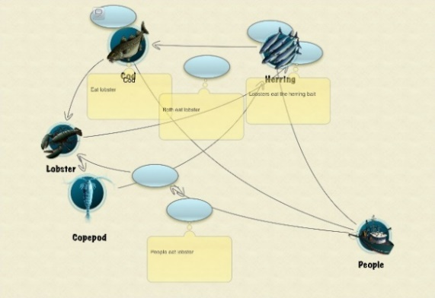
Examples from Real World, Real Science
Professional
Selfie
Collaboration
Conducted observations using Dimensions of Success
Exhibit designer doing
user testing of possible
components
Conducted cognitive interviews with students re: exhibit activities
Notes:
Finally, both the project team and the evaluation team have done cognitive interviews with students to explore their thinking about visual representations to figure out what students have misconceptions about to figure out what kind of graphs and data would be useful for the project.

Slide 22
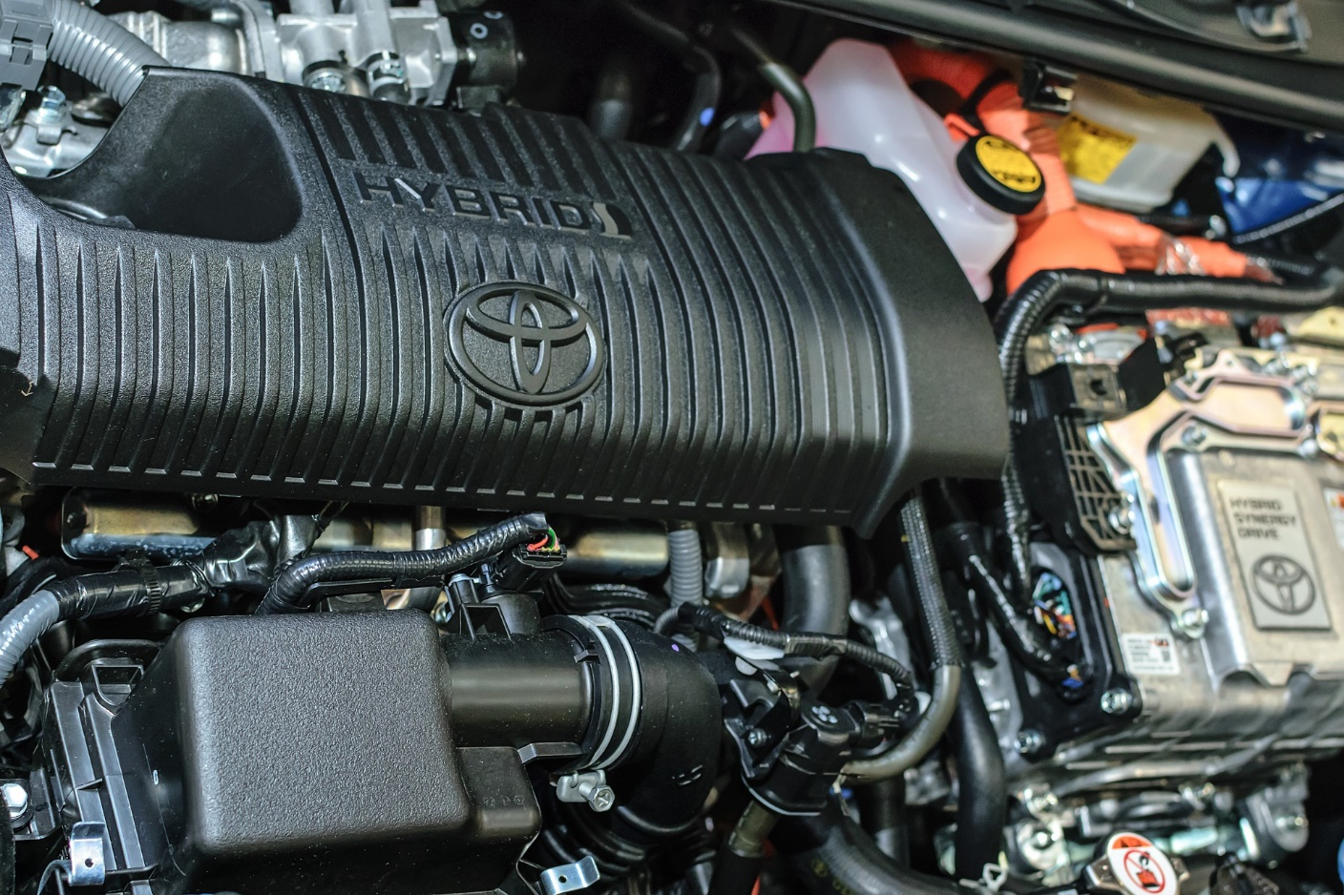
Let’s look under the hood
Notes:
Now that I’ve shared a number of examples of the hybrid approach, I want to turn to when and why you might want to use it in your own work.

Slide 23
Benefits to hybrid evaluations
Notes:
There are a number of benefits associated with using a blended approach to data collection where the evaluands and evaluation team share responsibility.

Slide 24
Benefits to hybrid evaluations
 | Works with clients who have history of collecting data
Notes:
First, it can work well if the evaluands have experience or a tradition of collecting and using their own data for internal learning.

Slide 25
Benefits to hybrid evaluations
 | Works with clients who have history of collecting data
 | Capitalizes on complementary expertise
Notes:
Hybrid approaches can capitalize on complementary expertise and resources of the project team and the evaluation team. For example, many clients have existing relationships to those providing data, while the evaluation team typically has expertise how to design reliable data collection tools and analyze many kinds of data.

Slide 26
Benefits to hybrid evaluations
 | Works with clients who have history of collecting data
 | Capitalizes on complementary expertise
 | Clients can gather feedback to inform revisions
Notes:
By using a blended model, clients can gather immediate feedback to inform timely revisions.

Slide 27
Benefits to hybrid evaluations
 | Works with clients who have history of collecting data
 | Capitalizes on complementary expertise
 | Clients can gather feedback to inform revisions
 | Evaluators can focus on bigger picture
Notes:
By splitting the formative data collection responsibilities, evaluators can focus on understanding bigger picture and building toward measuring project outcomes while the project team focuses on the details of how to best design the interventions.

Slide 28
Benefits to hybrid evaluations
 | Works with clients who have history of collecting data
 | Capitalizes on complementary expertise
 | Clients can gather feedback to inform revisions
 | Evaluators can focus on bigger picture
 | Greater buy-in, ownership
Notes:
Finally, another big benefit is the potential for greater buy-in by your clients because they literally own some of the data, and are heavily involved in helping to design and implement the evaluation so it is useful to them.

Slide 29
Challenges to hybrid evaluations
 | Potential for role confusion
Notes:
There are also challenges associated with using a hybrid evaluation approach of shared responsibility.
First, there is a potential for role confusion. When can and should the client be responsible for collecting their own data, and when would it be better handled by the evaluation team?

Slide 30
Challenges to hybrid evaluations
 | Potential for role confusion
 | Communication and coordination key
Notes:
Which leads to the importance of communication and coordination. You don’t want to duplicate your efforts and you want to make sure everyone’s expertise is used appropriately.

Slide 31
Challenges to hybrid evaluations
 | Potential for role confusion
 | Communication and coordination key
 | IRB issues with data collection and sharing
Notes:
There can be IRB issues with sharing evaluation responsibilities, including about confidentiality and who owns the data. If evaluation teams are collecting the data themselves, they need to be clear about if they can share the raw data with the project team.

Slide 32
Challenges to hybrid evaluations
 | Potential for role confusion
 | Communication and coordination key
 | IRB issues with data collection and sharing
 | Need for immediate feedback means multiple reports
Notes:
This challenge is not necessarily unique to hybrid evaluations, but to any learning-focused evaluations such as developmental evaluations, rapid-cycle or action research models. The project team’s need for immediate feedback means they need the results quickly, and can result in the creation of multiple reports as they iterate and modify their design.

Slide 33
Challenges to hybrid evaluations
 | Potential for role confusion
 | Communication and coordination key
 | IRB issues with data collection and sharing
 | Need for immediate feedback means multiple reports
 | Advanced planning helpful, but not always possible
Notes:
Finally, advanced planning is helpful, but not always possible. The overall challenge is working with the PIs to find the right balance of thinking ahead while also still being flexible to changes in timeline and development schedules.

Slide 34
Other considerations for hybrid evaluations
 | Responsiveness and flexibility key
Notes:
I want to end with some other things to think about when considering whether a hybrid or blended evaluation approach is a good fit.
It’s important to be flexible and responsive to needs of the project and your client. Your evaluation plan needs to have some flexibility built into it, and your budget needs to have room for supporting the increased communication and reporting that may be necessary.

Slide 35
Other considerations for hybrid evaluations
 | Responsiveness and flexibility key
 | PIs may need guidance about evaluator roles
Notes:
Some project leads or PIs may need guidance about how to work with an evaluator (for example, when the evaluation team’s external orientation or expertise means they could/should independently collect data).

Slide 36
Other considerations for hybrid evaluations
 | Responsiveness and flexibility key
 | PIs may need guidance about evaluator roles
 | Sponsor expectations re: need for external evaluator
Notes:
The expectations of the project funder or other stakeholders may be a factor in deciding whether there is a need for external evaluator and what kinds of data are appropriate for the project to collect about itself.

Slide 37
Other considerations for hybrid evaluations
 | Responsiveness and flexibility key
 | PIs may need guidance about evaluator roles
 | Sponsor expectations re: need for external evaluator
 | Could be most appropriate when project is new
Notes:
The examples that I reviewed in our two projects are all about data collection for formative purposes. This kind of hybrid approach could be most appropriate when an intervention or project is new, in an early stage of development, or requires great deal of iteration.

Slide 38
Other considerations for hybrid evaluations
 | Responsiveness and flexibility key
 | PIs may need guidance about evaluator roles
 | Sponsor expectations re: need for external evaluator
 | Could be most appropriate when project is new
 | (Repeat after me!) Regular communication is critical
Notes:
Finally, it bears repeating. Communication is key. You need to be in touch regularly re: about the project team’s learning and reporting expectations, as well as about who will be responsible for which aspects of the data.

Slide 39
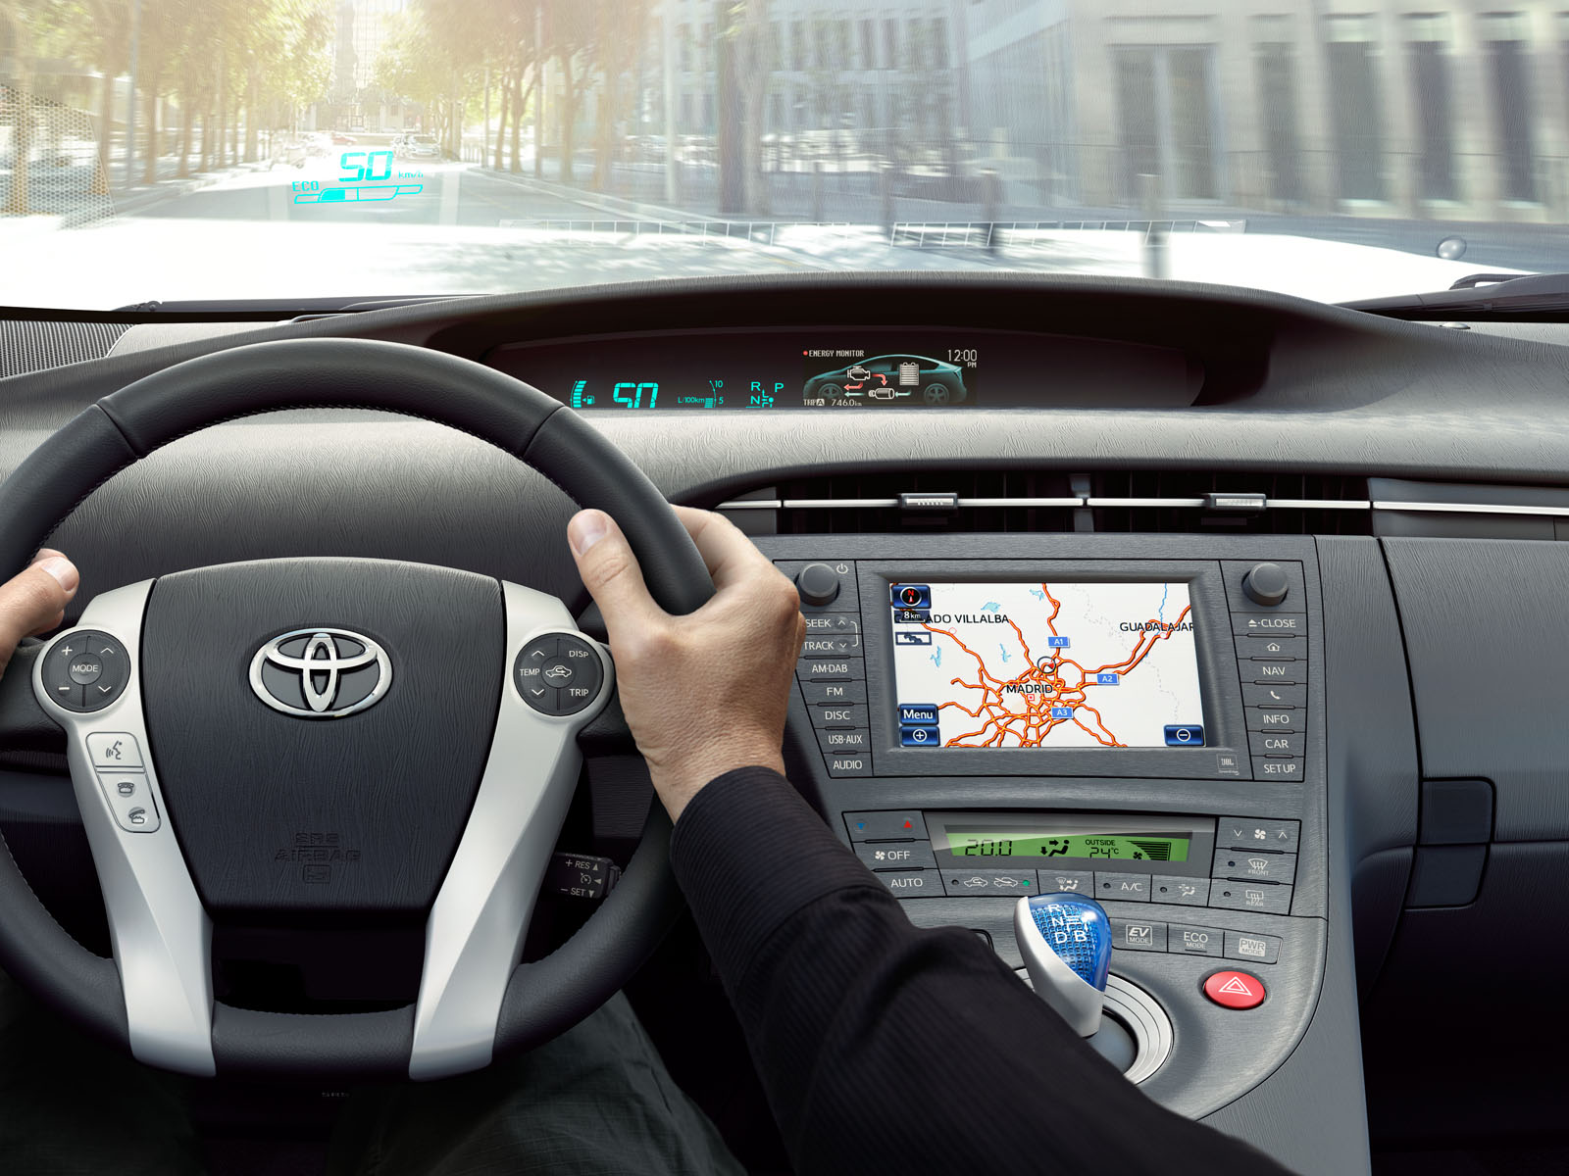
Where to?
Toyota Motor Europe
Notes:
As evaluators, we need to be good at reading dashboards. Like hybrid cars—which quickly shift from gasoline-powered to electric powered based on what will be most efficient and effective based on current readings—we need to be ready to shift and adapt our approaches.

Slide 40
Questions?
Notes:
Thanks for taking this quick road trip with me.
We have time for a few quick questions. There will be more time following all the presentations for more questions and discussion.

