Slide 1
APPLYING GENDER and FEMINIST LENS(ES) in EVALUATION
Mary Faith Mount-Cors, Ph.D.
EdIntersect, LLC/Iris Group
@edintersect and @faface
maryfaith@edintersect.com
Svetlana Negroustoueva
dTS/Iris Group
svetlana@irisgroupinternational.com

Slide 2
Constructing the lens
What do you see here?
What is going on here?
Notes:
Bottom Line:
We need to think about how we look at things. At what we are seeing. The lenses we use make a difference.
It may not always be clear how to do this. We want to explore that through our examples and yours.
“You can’t see it all if you don’t have the right set of lenses”
We use gender analysis and feminist thought in approaching our work, but we may not check that against how others are using these. (?)

Slide 3
(De)constructing the lens..
What do you see here?
What is going on here?
Notes:
What difference does it make that the daddy lion is asleep to the left in the photo?

Slide 4
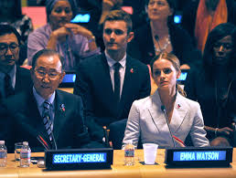
What is a feminist lens?
Notes:
As Emma Watson implored us in her U.N. speech, we need to be aware of what feminism is and is not - and so we also need to be aware of what feminist evaluation is and is not.
(audience engagement) Does anyone remember what she said the definition of feminism was?
“For the record, feminism, by definition, is the belief that men and women should have equal rights and opportunities. It is the theory of the political, economic and social equality of the sexes.” Emma Watson
(her points - it is NOT man-hating and also patriarchy is detrimental to men as well as women)

Slide 5
What is a gender lens?
Example: USAID is a donor with a clear policy and requirements for implementing partners to address design and evaluation with gender analysis.
Notes:
For gender analysis, USAID is a key resource and donor who drives a gender lens as essential to program effectiveness. The Rainbow Framework Better Evaluation resources for the theme of gender analysis point you to USAID resources.
http://betterevaluation.org/themes/gender_analysis
What is considered is how the different roles and status of women and men within “the community, political sphere, workplace, and household (for example, roles in decision-making and different access to and control over resources and services)” (USAID, 2012) influence how a program or project is designed. Also considered, is how the intended outcomes of program and project activities affect women and men differently (USAID, 2012).

Slide 6
What’s the difference?
aims to change the lives of women
how to think about an evaluation to inform design, data collection, communication of findings
historical roots
aims to document and map the lives of women
concrete guidelines and prescriptive methods for data collection and analysis
historical roots
Notes:
Ask the audience to take a look and tell which is which.. (left side if feminist lens, right side is gender).
(Audience engagement) Rhetorical question: How do you see the distinction between feminist evaluation and gender approaches? Do you agree or disagree with these distinctions?
Donna Podems has provided a useful set of distinctions between feminist evaluation and gender approaches. Podems says that we can choose what elements of each approach are appropriate for a given evaluation design.
The four key distinctions are:
Feminist evaluation and gender approaches have different historical roots and bring their own strengths and weaknesses to an evaluation.
Gender approaches aim to document and map the lives of women, while feminist evaluation aims to change them.
Feminist evaluation would be used to guide the evaluation methodology if the evaluation questions seek to understand why differences exist between men and women and to bring about social change
Feminist evaluation offers broad guidance that encourages an evaluator how to think about an evaluation, and how to use that reflection to inform the evaluation’s design, data collection, and communication of findings. Gender approaches often provide more concrete guidelines and prescriptive methods for data collection and analysis.

Slide 7
What’s the difference?
Gender Approaches | Feminist Approaches
Would identify the differences between women and men in different ways. Do not challenge women’s position in society, but rather document/record it; tend to map women’s position | Would explore why differences between women and men exist. Challenges women’s subordinate position; attempts to strategically affect women’s lives, as well as the lives of marginalized persons
See the word as “men” and “women”. Evaluates women as a homogenous class, without distinguishing within: race, culture. | Would acknowledge and value differences, not considering women as a homogenous category.
Assume that equality of women and men is the end goal, and approach evaluation as such; | Would acknowledge that women may not want the same; that would affect criteria, conclusions, judgements and recommendations.
Focus on collecting specific gender data, do not include advocacy | Guides evaluators to be reflexive: evaluation are not value free, consider different ways of knowing, stress diferent voices and give voice to wome within different contexts and advocate for marginalized groups
 | Suggests biased approach; should be considered within the context pf its intended use and social, policical and cultural appropriateness.
©2014 Iris Group, Inc. All rights reserved.
Notes:
Inclusion. Evaluating HR & GE requires assessing which groups benefit and which groups contribute to the intervention under review. Groups need to be disaggregated by relevant criteria: disadvantaged and advantaged groups depending on their gender or status;
Participation. Evaluating HR & GE must be participatory. Stakeholders of the intervention have a right to be consulted and participate in decisions about what will be evaluated and how the evaluation will be conducted. In addition, the evaluation will assess whether the stakeholders have been able to participate in the design, implementation and monitoring of the intervention. It is important to measure stakeholder group participation in the entire programming process as well as how they benefit from results.
Fair power relations. Evaluating HR & GE must address power relations. Both HR & GE seek, inter alia, to balance power relations between or within duty bearers and right-hold- ers. The nature of the relationship between programme implementers and stakeholders can support or undermine this change. When evaluators assess the degree to which power rela- tions have changed as a result of an intervention, they must have a full understanding of the context in which the change took place. Further, they must conduct the evaluation in a way that is sensitive to the empowerment of disadvantaged groups, e.g. women’s empowerment where women are the disadvantaged gender within a given context. In addition, evaluators should be aware of their own position of power based on status, which can influence the responses to queries through their interactions with stakeholders who may occupy lower status positions. Therefore, evaluators need to be sensitive to these dynamics.

Slide 8
What’s the same?
looking at relations between women and men
how the different roles and status of women and men influence how a program or project is designed
how the intended outcomes of program and project activities affect women and men differently
gender indicators are based on gender analytical models that have emanated from a feminist analysis of societies, relationships and development.
indicators by themselves are insufficient to reflect and express women’s experiences especially in areas such as women’s empowerment or participation. Pay more attention to women’s experiences.

Slide 9
Child literacy example
You want to know if a child literacy program was effective. You look at child reading data collected before and after a teacher training intervention. Sample matching shows that homework help at home was one of three covariates with reading growth. What does this lead you to look at next?
Notes:
USAID did not clearly address gender in the reading intervention. Teachers trained, children tested. Parents not engaged. My own external evaluation for my independent research. Then, using more insight from literature to build a feminist lens into a cultural model for literacy.
Use two examples to elucidate the use of feminist lens

Slide 10
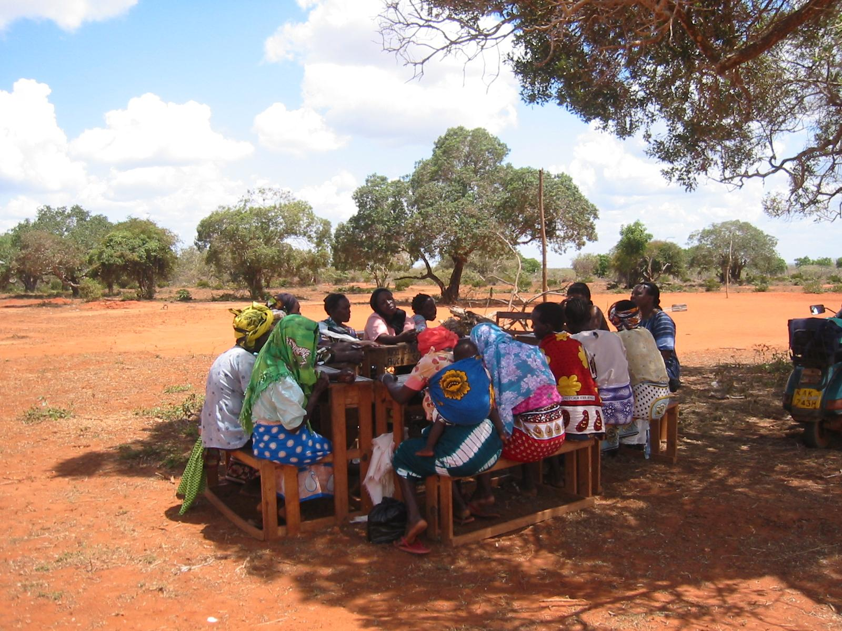
Focus group discussions with mothers
African feminist literature
Role of mother
Differences with Western feminist thought
Notes:
In one example, we demonstrate how building a cultural model for evaluation of child literacy programs in developing country settings, such as USAID's Early Grade Reading Assessment, brings a focus on the role of the mother, critical aspects of African feminisms, and overlaps and contradictions with Western feminisms.
In our first research example, we add the literature about specific feminisms we have incorporated for specific contexts that make evaluation culturally responsive.
In my research, I talked about the design as:
Explanatory Sequential Design Procedures (on the basis of Ivankova, Creswell & Stick, 2006). Uses mixed methods. Quantitative data analysis of reading scores. Selection of three school sites out of this analysis. Qualitative data collection and analysis of participants who were left out of program - mothers.
Another way to describe it would be:
Illustrative Case Study as defined by Rainbow Framework. http://betterevaluation.org/blog/better_use_of_case_studies_in_evaluation
This is descriptive in character and intended to add realism and in-depth examples to other information about a program or policy.

Slide 11
1. Broadly understanding gender dimensions of the project : SilvaCarbon
Using gender analysis
Secondary data: results of country specific studies
The evaluation should cover:
Literature of carbon management, terrestrial monitoring an REDD+ and gender strategies
SilvaCarbon’s definitions of GE/WE in the context of its mission, goals and activities.
SilvaCarbon’s categorization of gender differentiated program beneficiaries, such as workshop participants, members of its community of experts, audiences for materials, recipients of technical assistance, community based resource persons, etc.
SilvaCarbon’s stated objectives and interventions for ensuring that both male and female beneficiaries benefit from its interventions.
SilvaCarbon’s GEFE oriented targeted/expected results as reflected in performance indicators, program statements and progress reports.
©2014 Iris Group, Inc. All rights reserved.
Notes:
In synthesizing information on SilvaCarbon’s gender dimensions. The evaluation should cover:
SilvaCarbon’s definitions of gender equality and women’s empowerment in the context of its mission, goals and activities.
SilvaCarbon’s categorization of gender differentiated program beneficiaries, such as workshop participants, members of its community of experts, audiences for materials, recipients of technical assistance, community based resource persons, etc.
SilvaCarbon’s stated objectives and interventions for ensuring that both male and female beneficiaries benefit from its interventions.
SilvaCarbon’s GEFE oriented targeted/expected results as reflected in performance indicators, program statements and progress reports.
Gender analyses that have been done for SilvaCarbon or more generally for carbon management and monitoring activities should be referenced by this evaluation.

Slide 12
1. Broadly understanding gender dimensions of the project: SilvaCarbon
“Objective 2. Build capacity of selected developing countries to use forest and terrestrial carbon monitoring and management methodologies and technologies.”
SilvaCarbon develops resource materials, networks and provides training and technical assistance to personnel from participating countries-→ ensure that males and females in participating countries benefit equally from these capacity building services→ efforts should have been taken to invite women and men for all the trainings from the start →Disaggregating rates of participation and learning outcomes by sex would help to identify gender gaps.
Objective 4. Strengthen the community of forest and terrestrial carbon technical experts.
The community should draw equally on the talents of men and women as reflected in the membership as well as products and services provided by this community.
Objective 5. Interagency cooperation and collaboration.
All involved agencies involved in SilvaCarbon have to make GEFE a priority, if GEFE is to become a SilvaCarbon priority.
The differences in the levels of commitment, participation and productivity demonstrated by sex of scientists involved in SilvaCarbon could impact on the success of the program.
Gender aspects may be in the training content, materials and methods.
Identify, compare and assess agency and interagency mechanisms and organizational arrangements for engendering SilvaCarbon.
Notes:
Use project documents relating to SilvaCarbon’s planning and progress reporting to identify up-front, the gender dimensions of SilvaCarbon’s overall mission, goals, and activities. Information on SilvaCarbon’s gender dimensions should be used to weave-in gender focused evaluation questions/sub-questions, integrate gender considerations in the instruments for gathering evaluation data and in the evaluation report. In this respect, the components of the evaluation report (SOW, May 30th 2014, pages 7-8) need to include a component that could be titled for example as, Summary Description of SilvaCarbon’s Program Priorities. Oddly, the report does not propose to describe the program at all.
At least three of SilvaCarbon’s five objectives have gender dimensions:
“Objective 2. Build capacity of selected developing countries to use forest and terrestrial carbon monitoring and management methodologies and technologies.”
SilvaCarbon develops resource materials, networks and provides training and technical assistance to personnel from participating countries. In keeping with USAID’s GEFE policy, it’s important to ensure that males and females in participating countries benefit equally from these capacity building services. For example, efforts should have been taken to invite women and men for all the trainings from the start of the SilvaCarbon program. Disaggregating rates of participation and learning outcomes by sex would help to identify gender gaps.
Males and females generally have different ways of using the physical environment. Consequently, males and females are likely to contribute differently to increasing or decreasing carbon emissions. So, if Objective 2 has a community-based component in its networks or in the practices for reducing carbon advocated through training and technical assistance, then the evaluation needs to assess the ways in which SilvaCarbon addresses the positive and negative aspects of gender roles, norms and values impacting carbon management and monitoring. It’s important to note that some gender aspects of SivaCarbon may be found in the actual content of training materials and training methods.
Objective 4. Strengthen the community of forest and terrestrial carbon technical
experts.
The community of forest and terrestrial carbon technical experts established by SilvaCarbon
should draw equally on the talents of men and women as reflected in the membership as well as products and services provided by this community. The differences in the levels of commitment, participation and productivity demonstrated by male and female scientists involved in SilvaCarbon would impact on the success of the program.
Objective 5. Interagency cooperation and collaboration.
All agencies involved in SilvaCarbon have to make GEFE a priority, if GEFE is to become a SilvaCarbon priority. As a part of assessing SilvaCarbon’s overall performance, the evaluation would need to identify, compare and assess agency and interagency mechanisms and organizational arrangements for engendering SilvaCarbon.

Slide 13
2. Adopt gender sensitive evaluation questions: SilvaCarbon
1. Are the stated SilvaCarbon objectives being met?
Has SilvaCarbon built the capacity key stakeholders, including males and females in participating developing countries to use forest and terrestrial carbon monitoring and management methodologies and technologies?
2. Has the community of forest and terrestrial carbon technical experts been strengthened? Are men and women equally represented in this community?
What factors have facilitated or impeded meeting SilvaCarbon objectives and why?
3. In what ways can SilvaCarbon improve its approach?
What program design elements and interventions should be changed to ensure that men and women benefit more equally from SilverCarbon’s benefits?
How can the existing interagency structure and coordination be improved to: Enhance meeting SilvaCarbon objectives?
Achieve Gender Equality and Women’s Empowerment?
Notes:
Determining the extent to which women and women-owned businesses are:
Participating in PFAN;
Successful in securing financing;
Achieving operationalization of projects;
PFAN mentoring successfully addresses the needs of women.

Slide 14
Budget for integrating gender in the evaluation
Invest “extra” funds for integrating gender as an additional piece of work.
The Evaluation Team should have gender in evaluation expertise
Engendering the data collection instruments for key informant interviews, online survey, pre and post training assessments and site visits
Highlight GEFE related findings and recommendations in evaluation report(s)
Weave-in GEFE related findings and recommendations into the evaluation’s main findings and recommendations as relevant.
Findings relating to gender gaps using sex-disaggregated data: tables, charts and other graphics.
Summary charts/graphics could be prepared to list in summary form.
The most important GEFE related findings should be included in the Executive Summary.
Ensuring that gender sensitive data are analyzed comprehensively and the findings incorporated adequately in the evaluation report and presentations.
Notes:
Use project documents relating to SilvaCarbon’s planning and progress reporting to identify up-front, the gender dimensions of SilvaCarbon’s overall mission, goals, and activities. Information on SilvaCarbon’s gender dimensions should be used to weave-in gender focused evaluation questions/sub-questions, integrate gender considerations in the instruments for gathering evaluation data and in the evaluation report. In this respect, the components of the evaluation report (SOW, May 30th 2014, pages 7-8) need to include a component that could be titled for example as, Summary Description of SilvaCarbon’s Program Priorities. Oddly, the report does not propose to describe the program at all.
At least three of SilvaCarbon’s five objectives have gender dimensions:
“Objective 2. Build capacity of selected developing countries to use forest and terrestrial carbon monitoring and management methodologies and technologies.”
SilvaCarbon develops resource materials, networks and provides training and technical assistance to personnel from participating countries. In keeping with USAID’s GEFE policy, it’s important to ensure that males and females in participating countries benefit equally from these capacity building services. For example, efforts should have been taken to invite women and men for all the trainings from the start of the SilvaCarbon program. Disaggregating rates of participation and learning outcomes by sex would help to identify gender gaps.
Males and females generally have different ways of using the physical environment. Consequently, males and females are likely to contribute differently to increasing or decreasing carbon emissions. So, if Objective 2 has a community-based component in its networks or in the practices for reducing carbon advocated through training and technical assistance, then the evaluation needs to assess the ways in which SilvaCarbon addresses the positive and negative aspects of gender roles, norms and values impacting carbon management and monitoring. It’s important to note that some gender aspects of SivaCarbon may be found in the actual content of training materials and training methods.
Objective 4. Strengthen the community of forest and terrestrial carbon technical
experts.
The community of forest and terrestrial carbon technical experts established by SilvaCarbon
should draw equally on the talents of men and women as reflected in the membership as well as products and services provided by this community. The differences in the levels of commitment, participation and productivity demonstrated by male and female scientists involved in SilvaCarbon would impact on the success of the program.
Objective 5. Interagency cooperation and collaboration.
All agencies involved in SilvaCarbon have to make GEFE a priority, if GEFE is to become a SilvaCarbon priority. As a part of assessing SilvaCarbon’s overall performance, the evaluation would need to identify, compare and assess agency and interagency mechanisms and organizational arrangements for engendering SilvaCarbon.

Slide 15
Gender analysis
Monitoring
Evaluation

Slide 16
Gender Analysis and Integration Matrix (GAIM)
GENDER ANALYSIS/ ASSESSMENT/AUDIT QUESTIONS What do we need to know? What are possible gender gaps? | ANSWERS What are the answers to our gender analysis questions (and why do they present a barrier or opportunity for the project)? | RELEVANCE Is there a gender gap? Is it within the manageable interest of the project to address it? (yes/no/partially) | PROJECT RESPONSE Describe how the gender gap is or should be addressed in the project. Link to results framework and/or specific activities when applicable. | INDICATORS How will we measure this? When possible, use existing indicators in the PMP. | EVALUATION Do evaluation questions address results of gender analysis and effectiveness of project response? Are gender evaluation findings covered throughout and recommendations provided?

Slide 17
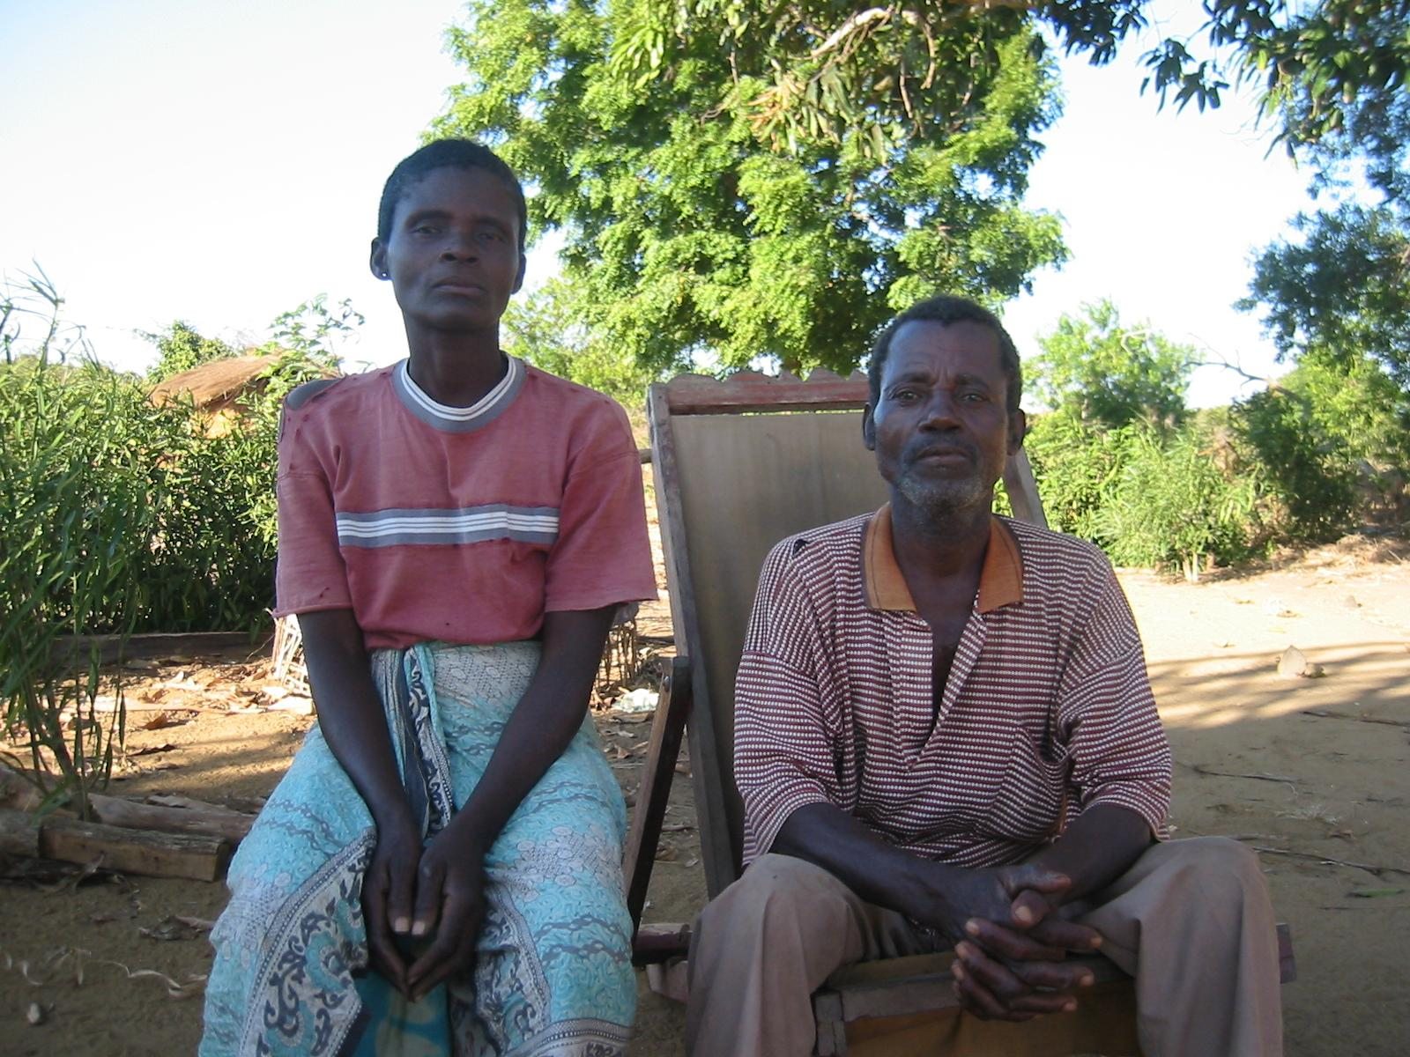
Your example
Notes:
Give handout
Could be social sector, directly apparent that it’s about men and women. could be agriculture, environment, and something that is less apparent to you in its gender and feminist angles.
(Audience engagement). Think-pair-share:
Think of a research or evaluation example.
Write your example on an index card on your handout.
Turn to your neighbor and share with your neighbor.
Would you bring a gender lens? A feminist lens? To these examples..Does making the distinction matter to you?
Use their cards

Slide 18
From AEA on evaluation:
What is the quality of program or policy implementation?
What outcomes are being achieved?
Are the real needs of people being met?
Notes:
So, can you conduct a good evaluation WITHOUT using a feminist or gender lens?
As Donna Podems says, often a negative reaction only indicates that the person is unaware of what feminist evaluation means. In addition, rather than starting with a potentially off-putting term - feminist evaluation - you can start with describing the approach itself rather than leading with the term. In addition, adaptation of feminist evaluation to integrate with other evaluation approaches will work - and well.

Slide 19
Call to Action
Know the gender and feminist lens/approach and how it fits with other approaches you will use in an evaluation.
Inform others by describing the approach and giving examples rather than naming it first.
Ensure you do not miss the sleeping lion in the corner

