Slide 1
Building Evaluation Capacity through Community of Practice
the Explore Computer Science Research Project
Breauna Spencer, Audrey Rorrer, Sepi Hejazi Moghadam
American Evaluation Association
November 16, 2019

Slide 2
exploreCSR mission and objectives
Mission
Objectives
Enhance the undergraduate experience and increase womens' motivation to pursue graduate study and research careers in computer science by supporting
Intensive Research Experiences
Community
Foster a sense of community and support from peer groups and both near-peer and faculty mentors.
Skills
Provide practical skills and know how to help women succeed both in their undergraduate program and beyond.
Confidence
Instill confidence that comes from knowing women have the skills to contribute to problem solving beyond the classroom.
Motivation
Motivate, inspire and challenge women through exposure to real-world research problems in computer science.
Scale
Identify best practices and resources that can be shared via a “toolkit” to help scale the program in cost-effective ways.
Notes:
Notes:
Guided by the body of evidence and resources around effective interventions to increase women in research pathways and modeled on, and inspired by, OurCS, Carnegie Mellon University's innovative workshop to engage undergraduate women in hands-on research.
We decided to launch a pilot funding program to support institutions delivering research-focused workshops for women.
Collectively, we hope provide opportunities for undergraduate women in CS (and related fields) to learn more about research pathways and work on exploratory problems in teams led by researchers from academia and industry. As part of this pilot we also want to identify key components of the workshops that can be scaled via “toolkits” that can transfer to other schools in cost-effective ways.

Slide 3
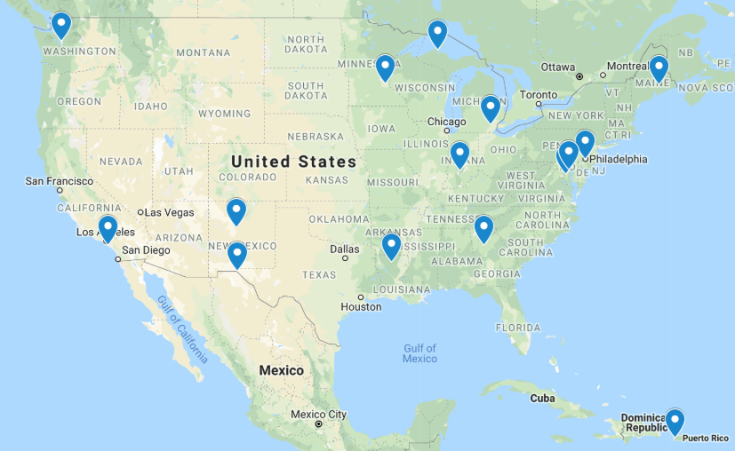
exploreCSR funded 15 Universities that planned to reach ~1,200 undergraduate women in 2018-2019 AY
Notes:
https://www.google.com/maps/d/u/0/edit?mid=1X1NzYWxDZ2FbItbizoaQ7sa9JjRjcT-f&hl=en&ll=27.778906771669035%2C-97.70813981462425&z=4

Slide 4
Summary of R&E results

Slide 5
Summary of findings
Core construct | Finding
Self-Efficacy | Self Efficacy increased significantly
Interest in Graduate School | Graduate School Intent increased significantly
Attitudes about CS Research | Attitudes about CS Research improved (slightly)
Research Skills | Research Skills increased significantly
Identity | Identity as a CS Research Scientist increased significantly
Community | Mentoring and Overall Program Evaluation was strong

Slide 6
Changes from Pre to Post Survey
Construct | Pre (n=525) | Post (n=365)
Self Efficacy | 3.96 (0.82) | 4.07* (0.72)
Graduate School Interest | 3.64 (0.90) | 3.80* (0.85)
Attitudes | 4.46 (0.54) | 4.48 (0.55)
Research Skills | 3.05 (1.04) | 3.84* (0.86)
Identity as Scientist | 2.85 (0.97) | 3.20* (1.03)
Mentoring | N/A | 3.58 (0.82)
Program Evaluation: Networking/Plans | N/A | 4.34 (0.63)
Program Evaluation: Sentiments | N/A | 4.11 (0.77)
*Significance levels <.05.
Notes:
Pause here for survey questions

Slide 7
Qualitative Themes
Themes | Sample Quotes
Skills: Research, Critical Thinking | “[Based on Based on attending the workshop series], I was able to learn more about computer science and all of the different fields that [are] in it and I can [learned] how research works and [how it advances as you continue on in your field].”
Mentoring: Culture of Curiosity | “I [learned the] different ways that a problem can be approached. So like, they pretty much gave us four different options of people who were in some sort of situation where they could be something developed to help them. An then each group got to decide which person they wanted and what they would do. So, just seeking the different ways that people would decide to help someone when there are many different ways you can approach it.”
Community: Strong Belonging | “[This workshop helped further cultivate my computer science identity] because it allowed me to be comfortable with making statements like I am a computer scientist, and I will always be a computer scientist. Nobody can sway me from this field no matter how hard they try, because this is what I am supposed to do.”
Graduate School: Awareness & Opportunity | “My opinion about going to graduate school changed. Before [attending the workshop, no one ever talked] to me about the idea of going to graduate school. I thought it was something [only some scholars got to do]. Now [after] attending the conference, I felt like I really wanted to go to graduate school at some point. Maybe not right now but I know I want to go to graduate school.”

Slide 8
Evaluation Approach

Slide 9
Mixed Methods Methodology
Quantitative | Qualitative
Core constructs: Six on Pre-/Post-survey Optional Constructs: Sense of Belonging, Peer Relationships, Teamwork, Mindset & Grit Post-survey: Mentoring and Program Evaluation items on Post-survey Distribution: Surveys distributed by Faculty prior to and at end of events | Interviews: Six core constructs Semi-structured interviews conducted with mentors and students Phenomenological Qualitative Research Methodological Approach was used to analyze the data using Dedoose software Ethnographic Observations: Used the Classroom Observation Protocol for Undergraduate STEM (COPUS) to conduct observation data Incentives: Received a $20 Amazon gift card

Slide 10
Evaluation Theory
Faculty (User) Engagement
Situation Analyses
Early & often
15 sites
Specify evaluation questions
Individual site reports
Utilization Focused Evaluation (Patton)

Slide 11
Putting Theory into Practice
Kick-off Meeting
Introductions
Share evaluation approach and process
Tweak survey to accommodate faculty research and evaluation questions
Schedule and plan observations and data collection
Faculty Meetings
Workshop Details
Length and structure of workshop
Types of activities
Reporting
Individual site reports
Data packages
End-of-Year Meeting
Summative report
Discussion of lessons learned

Slide 12
Discussion
Challenges
Fidelity of Implementation across the Intensive Research Experiences
Participation: Response rates, interviewing remotely
Solutions
Developed tracking system for codifying workshops in 2019-20:
Seminar topics, structure, cohort movement through the workshops, levels of engagement in research, types of mentoring
New survey incentives
Targeted observations
Talking points for Site Faculty to announce evaluators and set expectations

Slide 13
Lessons Learned
Customization with a catch: streamline survey and have decision deadlines
Targeted qualitative samples
Codify workshops via structured questionnaire
One to one meetings with Faculty are time consuming and essential
Notes:
Many faculty wanted their own program evaluation items, which became redundant for the students. We decided to forgo this option in year 2; faculty are invited to include survey scales of interest to them, for example, mindset, but they must determine these by a deadline so that we are not editing in a hurry.
Observations were time consuming and costly- decided to set a target sample from which to draw interviews
Tighted up our meetings with faculty to set expectations, have a questionnaire for monitoring the type of workshops they are developing to assist with implementation fidelity- this is enabling us to operationalize and codify the workshop structures. For example: is mentoring one-to-one or peer, or informal group mentoring, or none at all

Slide 14
Appendix

Slide 15
Background
Research Questions
Do eCSR programs foster a sense of community, build skills, confidence and motivation in student participants around computing research?
How do eCSR programs create community and build student skills, confidence and motivation to pursue computing research?
What are identified practices that enable institutions to scale computing research opportunities for women, that are cost-effective?
Evaluation Questions
Do eCSR programs, collectively and independently, achieve the stated goals of increasing sense of community, building technical and professional skills, developing confidence and motivation in student participants to engage in computing research?
What are the long-term impacts of the eCSR program, collectively and independently, on the computing research pipeline for women?
Do eCSR programs collaborate and propagate practices?
What value does eCSR bring to the computing research pipeline efforts?

Slide 16
Abstract to AEA Workshop
The Explore Computer Science Research (eCSR) evaluation team has developed an evaluation community of practice with supporting tools to address the challenges of conducting a complex, large multisite project evaluation among semi-formal and informal learning initiatives. The eCSR mission is supporting women in computer science research. The evaluation design incorporates a mixed-methods approach that integrates program evaluation into the applied research of community building initiatives among underserved populations in computer science. The value to the audience will be the presentation of a) a practical model for conducting complex, multi-site evaluation that includes the integration of applied research; b) an overview of the qualitative and quantitative evaluation model; and c) lessons learned from the inaugural year of the national program. Our model is applicable to any multi-site initiative addressing fidelity of implementation, data collection and collective impact measurement. The eCSR evaluation approach is broadly applicable across the practice of evaluation.

Slide 17
Description of survey and interview participants
Quantitative
Qualitative
Demographics | Pre (n = 525) | Post (n = 365)
Gender and race Female Female of color | 87% 65% | 89% 71%
School level Frosh Soph Junior Senior Grad | 15% 23% 26% 25% 11% | 14% 23% 23% 27% 14%
SES ladder Low (1-4) Medium (5-7) High (8-10) | 21% 45% 35% | 19% 43% 38%
Demographics | Students (n = 23) | Mentors (n = 13)
Gender and race Female Female of color | 100% 77% | 84.62% 38.46%
School Level Soph Junior Senior | 33% 33% 33% | NA
SES Ladder Low (1-4) Medium (5-7) High (8-10) | 54.5% 41% 4.5% | N/A N/A N/A
Notes:
A subjective measure of socioeconomic status (SES). Students were asked to think of their families during their childhood and then rank on a ladder where they saw their family falling. The top of the ladder (10) is for those of highest status in the community while the bottom of the ladder (1) is for those of lowest status in the community. This measure has been asked in multiple research settings and we can benchmark exploreCSR responses against a US representative sample (source).

