Slide 1
Towards Defining and Mainstreaming “Made in Africa Evaluation.” #Eval2018
OLADAYO OMOSA (Doctoral Candidate)
&
THOMAS ARCHIBALD (Assistant Professor)
Agricultural, Leadership, & Community Education
Virginia tech
November 3, 2018
AEA2018, Cleveland, Ohio

Slide 2
Background/Problem
Before we start talking, let us decide what we are talking about.
−Socrates, in Plato’s Phaedrus

Slide 3
Background/Problem
Two-Pronged:
Instrumental Grounds: Imported Western evaluation methods may in fact lack validity and lead to bad development outcomes
Symbolic Grounds: May reify subjugation and cultural hegemony, in the vein of neo-imperialism and the ‘colonization of the minds.’
Problem addressed in recent years through the development of the “Made in Africa Evaluation” (MAE) concept.

Slide 4
MAE/CRE Concept
MAE is described as the promotion and adaptation of an African-rooted evaluation framework by identifying and developing a uniquely African approach to evaluation.
MAE has conceptual and practical Overlap with Cultural Responsive Evaluation (CRE)
Chilisa’s (2015) synthesis paper moved the field towards conceptualizing MAE to prevent it from becoming an empty buzzword.
However, her efforts fell short of offering a concise definition around which some consensus may arise. As such, there is a need to more clearly define MAE.

Slide 5
Purpose of Study
Building on Chilisa’s foundational work, the purpose of this study is twofold:
To develop a consensus on the definition of MAE.

Slide 6
Research Questions
Overall, the study aims to address the following research questions:
How do thought leaders in African evaluation define Made in Africa Evaluation?

Slide 7
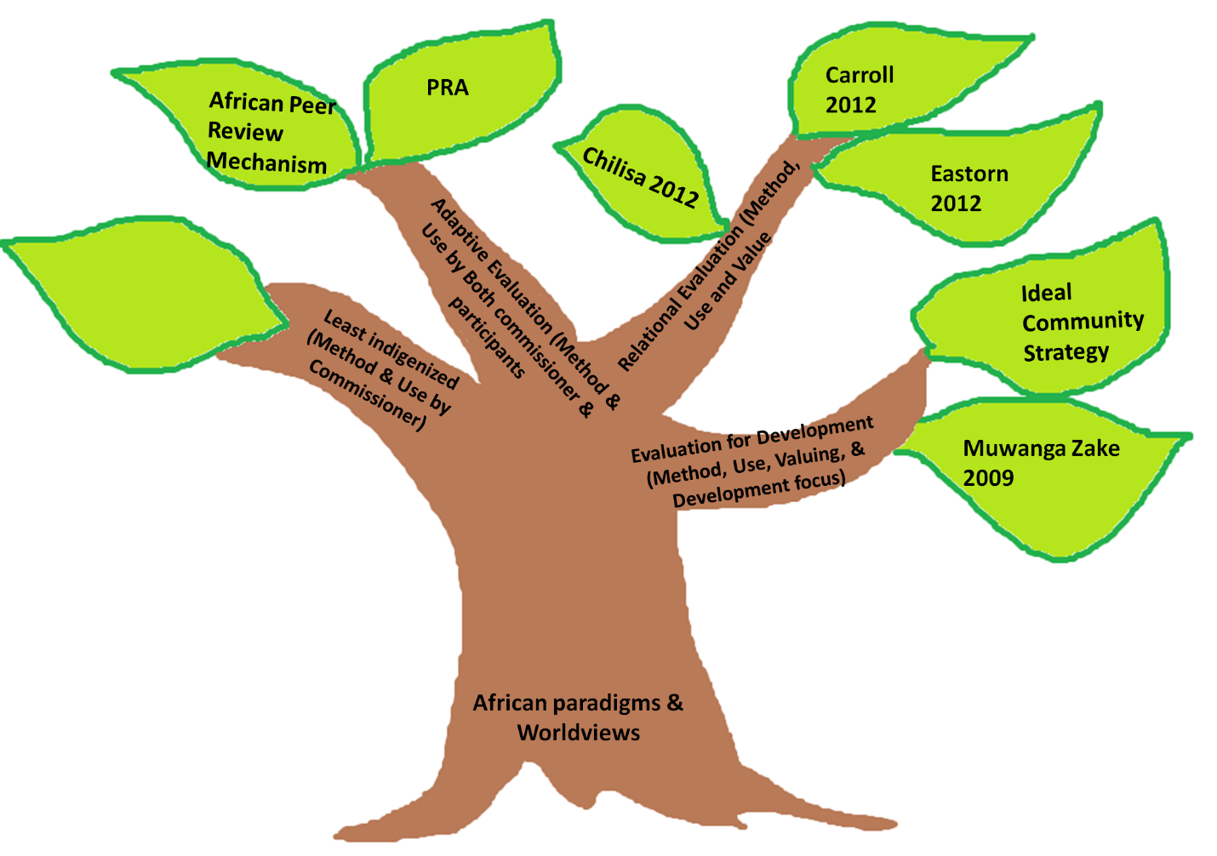
The African Evaluation Tree Metaphor
Figure 1: The African Evaluation Tree Metaphor Adapt
from Chilisa 2015

Slide 8
Methods
Multiple Methods Approach
Common evaluation concepts/ideas related to CRE are identified
MAE journal articles/literature are identified and selected
The identified ideas was used as evaluative lens (Conceptual/Concept Analysis).
Delphi Technique will be used to build consensus
17 Participants purposively selected (subject to their willingness to participate)
7 Participants responded and participated
Participants email was obtained from publicly available databases.
Stages of the Delphi Technique:
Round One Questionnaire
Round One Follow-Up
Round Two Questionnaire

Slide 9
Table 1: Common Concepts/ideas Associated with CRE
S/N | Identified Evaluation Concepts/Ideas/Descriptions Related to CRE
1 | Power relations
2 | Evaluation as way of life
3 | Participatory evaluation
4 | Adapting evaluation to lifestyle
5 | Africa led or Afro-centric evaluation
6 | Indigenous evaluation
7 | Localized knowledge
8 | Challenging western worldviews

Slide 10
Table 2: Source/Description of Literature for the Conceptual Analysis
S/N | Title | Author(s) | Source | Year
1 | Developing an African-rooted program evaluation approach | Fanie Cloete | African Journal of Public Affairs, 9(4), 55-77 | 2016
2 | A synthesis paper on the made in Africa evaluation concept. African Evaluation Association | Bagele Chilisa | AfrEA Website (www.afrea.org) | 2015
3 | Historical development & practice of evaluation | Mouton, C., Rabie, B., Cloete, F., & De Coning, C | Evaluation management in South Africa and Africa (pp. 28-78). Stellenbosch:African Sun Media | 2014
4 | Made in Africa Evaluation: Uncovering African Roots in Evaluation Theory and Practice | Chilisa, B., & Malunga, C. | Paper Presented at the Bellagio Conference. | 2012

Slide 11
Table 3: Adapted/Excerpted statements to be Rated (with their Sources)
Statements # | Statement Descriptions | Source(s)
S₁ | Questioning evaluations that show successes of projects while the reality is completely different | Chilisa (2015), Cloete (2016), Mouton et al., (2014).
S₂ | Conducting evaluation with an eye towards addressing the macro-micro disconnect and power relations in the community | Chilisa (2015), Mouton et al., (2014)
S₃ | Conducting evaluation that promotes partnerships of knowledge systems and of evaluation actors and stakeholders | Chilisa (2015) and Cloete (2016)
S₄ | Conducting evaluation with an eye towards challenging Euro-western worldviews and hidden, subtle racist theories embedded in current methodologies. | Chilisa (2015), Chilisa & Malunga (2012), and Mouton et al., (2014).
S₅ | Conducting evaluation in African settings using localized knowledge, tools and data collection methods | Chilisa (2015), Chilisa & Malunga (2012), and Mouton et al., (2014).
S₆ | Considering Africa lead and Africa-centric evaluation to mean evaluation done by African professionals only | Chilisa (2015)
S₇ | Conducting evaluation with an eye towards promoting African values and worldviews | Chilisa (2015), Chilisa & Malunga (2012), and Mouton et al., (2014).
S₈ | Considering the adaptability of my evaluation work to the lifestyle and needs of the African community where evaluand is situated | Chilisa (2015)
S₉ | Considering participatory methodologies as congruent with African worldviews and value system | Chilisa (2015), Cloete (2016), and Mouton et al., (2014).
S₁₀ | Conducting evaluation with an eye on building the capacity of participants as co-evaluators and promoting evaluation as a way of life for all Africans | Chilisa (2015) and Cloete (2016)

Slide 12
Table 4: Rating Form For Round One Questionnaire
Least Important (1) | Minimally Important (2) | Moderately Important (3) | Important (4) | Very Important (5) | Highly Important (6)
# | # | # | # | # | #
# | # | # | # | # | #

Slide 13
Table 5: Suggested Definition of MAE by Participants
1.
2.
3.
4.
5.

Slide 14
Analysis Plan for Round One Delphi
Statements with higher mean than the averaged mean of all the statements is considered more important than statements whose mean ratings are less than the averaged mean.
These categories of statements fall into the quadrants I and III in figure 2 below.
Typically, these are statements with high means.
For this study, consensus is defined as the extent to which agreement had been reached about an item level of importance on an individual survey

Slide 15
Analysis Cont’d
Also, using excel, the variance of the rating for each statement is calculated and also the average variance will be calculated.
For this study, the averaged variance forms the guiding post or criteria to form a consensus on an item.
Consensus is reached if a statement’s variance is less than the averaged variance of all the statements rated in that round.
Conversely, a dissensus remains if a statement’s variance is greater than the averaged variance of all the statements rated.
Typically, statements with a very low variance show that there is a consensus. This is because there is a very little deviation from the mean.

Slide 16
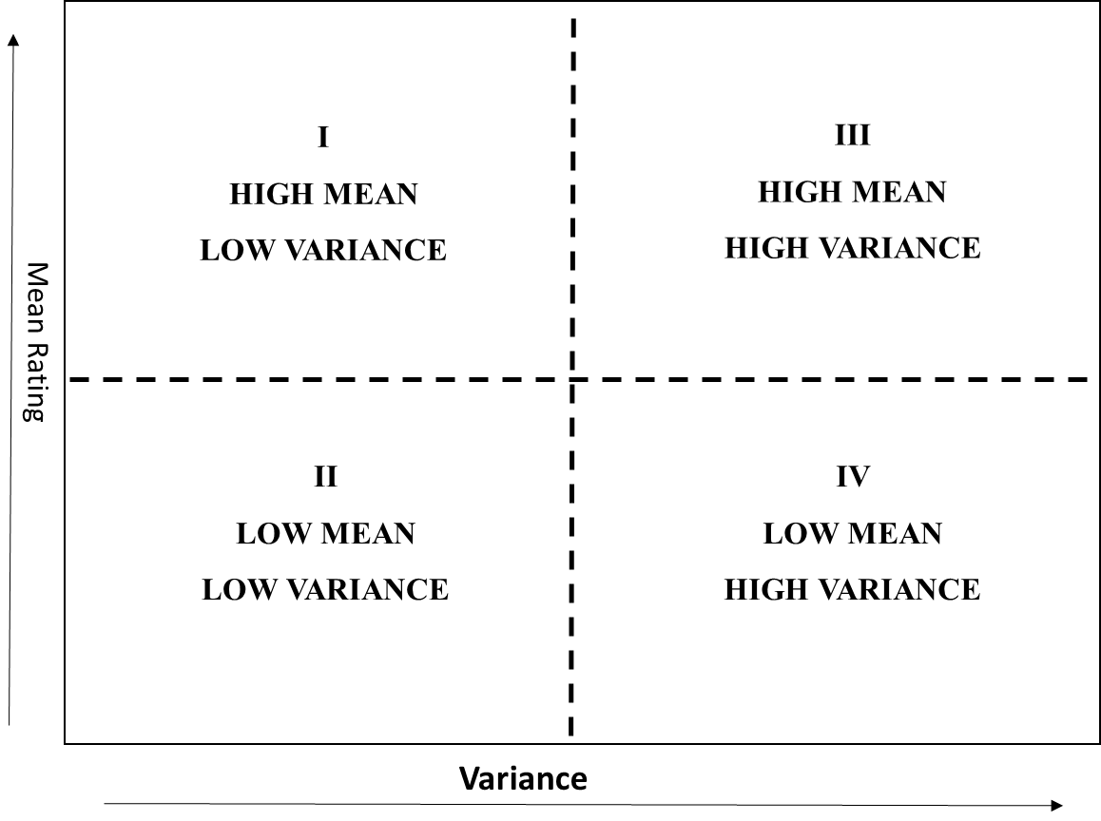
Figure 2: Possible Categories of Statements with Respect to Averaged Mean and Variability

Slide 17
Table 6: Summary Statistics of all the Statements
Statements | Variance | Mean
S3 | 3.71 | 5.9
S4 | 3.14 | 5.48
S10 | 4.14 | 5.14
S8 | 3.86 | 4.81
S9 | 3.43 | 3.62
S1 | 2.43 | 2.95
S2 | 2.43 | 2.29
S6 | 1.71 | 1.24
S7 | 4.29 | 0.90
S5 | 5.14 | 0.48

Slide 18
Table 7:Summary Statistics of five Statements on Which Consensus Has Been Reached in Round One
Statements # | Statements | Mean | Variance
S1 | Questioning evaluations that show successes of projects while the reality is completely different | 2.43 | 2.95
S2 | Conducting evaluation with an eye towards addressing the macro-micro disconnect and power relations in the community | 2.43 | 2.29
S5 | Conducting evaluation in African settings using localized knowledge, tools and data collection methods | 5.14 | 0.48
S6 | Considering Africa led and Africa-centric evaluation to mean evaluation done by African professionals only | 1.71 | 1.24
S7 | Conducting evaluation with an eye towards promoting African values and worldviews | 4.29 | 0.90

Slide 19
Table 8: Overview of statements to be Rated in Round Two
Statements # | Statements Description (Remaining Statements from Round One)
S3 | Conducting evaluation that promotes partnerships of knowledge systems and of evaluation actors and stakeholders
S4 | Conducting evaluation with an eye towards challenging Euro-western worldviews and hidden, subtle racist theories embedded in current methodologies.
S8 | Considering the adaptability of my evaluation work to the lifestyle and needs of the African community where evaluand is situated
S9 | Considering participatory methodologies as congruent with African worldviews and value system
S10 | Conducting evaluation with an eye on building the capacity of participants as co-evaluators and promoting evaluation as a way of life for all Africans

Slide 20
Table 9: Overview of Statements to be Rated in Round Two Contd.
Statements # | Statements Description (Panelists Suggested Statements)
B1 | Conducting evaluation with sensitivity, understanding, and with the intention of making visible evaluative African knowledge, values, and worldviews.
B2 | Conducting evaluation in a culturally sensitive and responsive manner,
B3 | Conducting evaluation studies that are consistent with evaluation standards developed and used by African Evaluation Association (VOPE) and aligned with the professionalization views of a given African country (since Africa is a continent and not a country)
B4 | Focusing evaluation on the empowerment of individuals to pursue their own life choices optimally in a given context
B5 | Capturing the degree of complexity inherent in the evaluation as accurately as possible.

Slide 21
THANK YOU
QUESTIONS, COMMENTS, SUGGESTIONS, & FINAL THOUGHTS

