Slide 1
Cultivating M&E Champions
How do we cultivate champions who can promote quality and consistency in M&E practice in a large and decentralized organization?
Facilitated by:
Tanya Lalwani, Sr. Monitoring, Evaluation, and Learning Officer
Results Management, Measurement, and Learning
American Evaluation Association conference
October 2016
PATH/Eric Becker
Notes:
Thank you all for your interest in this Think Tank. My name is Tanya Lalwani and I am a Sr. M&E and Learning Officer at PATH.
Today I will share a little bit about how we are approaching this question at PATH, and you will get a chance to hear form others as well. The question we will is answer is how do we cultivate M&E champions who can promote quality and consistency in M&E practice in a large decentralized organization. We will also get an opportunity to hear from you, what has or hasn’t worked in your respective organizations.

Slide 2
PATH: Accelerating global health innovations.
Serving women and children
Notes:
For those of you who are less familiar with PATH, a quick introduction - PATH is an international non-profit that is a leader in global health innovation.
PATH focuses on women and children.
PATH works in more than 70 countries, primarily in Africa and Asia.
We work across five main areas—or platforms; vaccines, drugs, devices and tools, diagnostics, and systems and service innovations.

Slide 3
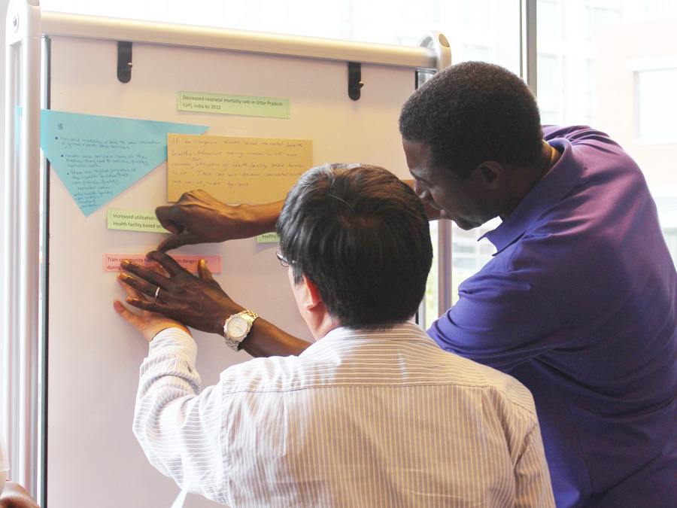
Rationale for the M&E Champions program:
Develop an organizational culture that supports the use of M&E data, resources, and services, and promotes stronger practice.
PATH/Mike Wang
Notes:
I am guessing given your interest in this topic, several of you are familiar with the context that a large organization such as PATH brings with it. PATH has a really diverse portfolio of projects, operates in a decentralized manner, and has limited overhead funding data - we are hampered in our ability to use our data and information (institutional or programmatic) for decision making.
We all face a similar challenge; how do we develop an organizational culture that supports the use of M&E data, resources and services. This drove the rationale for the Champions Pilot program that we implemented in 2016.

Slide 4
Our M&E Approach: Multiple touchpoints - develop a culture that supports more use of M&E data, resources, and services
Professional Mentorship Program
M&E Team
Champions Program
Technical assistance
Proposal development
Data parties
Data Labs and Managing data
Long term
Medium term
Short term
Resources
Informal mentoring
Informal mentoring
Practice Standards and Tools
E Learnings
CoP newsletter
Self assessments
Notes:
How do we develop our organizational culture that promotes more use of M&E? Given our decentralized nature, we offer multiple touchpoints to deepen our engagement and strengthen our practice across projects.

Slide 5
M&E Champions Pilot Program: structure 5 M&E champions representing priority projects, paired with a TA point person and a peer-reviewer
Project Team
M&E Officer
RPM
Research officer
PADM
M&E
Peer-reviewer
TA point person
Notes:
The Champion is supported by a TA point person from the M&E Department and a Peer-reviewer who provides additional technical support.

Slide 6
Future influence of M&E Champions: PATH’s M&E CoP and external M&E ecosystem
Project Team
PADM
M&E Officer
RPM
Research officer
Project Team
M&E Officer
RPM
Research officer
PADM
M&E
Peer-reviewer
TA point person
Project Team
PADM
M&E Officer
RPM
Research officer
Project Team
PADM
M&E Officer
RPM
Research officer
Notes:
In the long run our expectations investing in the Champions is that they will influence their projects, PATH’s M&E CoP and the external M&E ecosystem.

Slide 7
M&E Champions Pilot Program - design
We focused on building relevant capacities and skills by orienting the Champions to PATH’s M&E Practice Standards and Tools and providing hands-on TA to support their functions.
Acquire knowledge of M&E Practice Standards and Tools
Know when to apply Practice Standards and Tools
Apply tools in the Project
Adapt tools based on experience
Produce examples
Share broadly
Become an M&E Champion
Group sessions (4 web-based virtual meetings)
Supported by TA point person and peer-reviewer from the M&E team
Notes:
This schematic shows how we designed the program. Given our limited resources we really relied on virtual sessions to make the champions aware of the M&E resources and expertise that sits on our team. They had an opportunity to also understand when to apply the tools. And designed a scope of work to interact with the tools. At the end of the program we really hope that the champions can produce strong examples of M&E that we can share broadly with our CoP.

Slide 8
Example agenda for a virtual group session
Session item | Time assigned
Getting Started - checking devices for audio, video, screen-share quality | 5 minutes
Exchange – meet M&E Department team member Cathleen Collins | 10 minutes
Champion presentations - Yussif, Jicko | 10 minutes
Main topic presentation - orientation to M&E Practice Standards and Tools | 30 minutes
Q&A | 5 minutes
Sharing project experience Champions to come prepared each time to either respond to #1 or present #2 Share a high point in your project since our last meeting. What made it happen? Share an example of work you are proud of in terms of quality and talk about it. | 15 minutes
Next steps | 10 minutes
Feedback, Poll | 5 minutes
Notes:
The group sessions were organized using Skype for Business and were very interactive in nature. Here is the agenda for one of the group session, you will notice besides sharing the M&E tools we also built in time for exchanges between the champions to share their work and with members of our team.

Slide 9
M&E Champions Pilot Program - expected outcomes
Participants take on an expanded role as M&E Champions.
Final deliverables demonstrate meeting/exceeding one or more M&E Practice Standard(s).
Technical Assistance helps build capacity in specific competencies.
Notes:
To measure progression toward achieving the expected benefits to PATH and the M&E department, we focused on measuring 3 overreaching aspects of the program:
Participants and their ability to serve as M&E champions
Final deliverable quality, relevance, and achievability
Effective & sustainable skill transfer from TA to participant

Slide 10
Feedback from program participants*
What did you gain from this experience?
“At first I had a lot of questions about how to use the template for data analysis. I had a session with my TA where I learned how to approach the tool. It was very helpful.”
“My TA’s and Peer-Reviewer’s feedback broadened my mindset and helped with my critical thinking process.”
What role would you like to play and what actions do you plan to take as an M&E Champion?
“In September, I hope to share the tools with my colleagues …[and specifically] with a team member, who is new and from another project.”
“When time permits, I hope to have some kind of orientation with the field staff, even if they don’t use the tools, so they can understand what the tools mean.”
*Based on findings from midline evaluation conducted by M&E Intern, Alena Johnson

Slide 11
Rubrics used to measure the program outcomes*
Criteria | Program Performance
 | Strong (All 5 champions) | Good (3 – 4 champions) | Low (=< 2 champions)
Participants take on an expanded role as M&E Champions
Participants are knowledgeable about PS&Ts.
Participants champion M&E PS&Ts.
Participants leverage the M&E Department.
Final deliverables demonstrate meeting/exceeding one or more M&E Practice Standard
Final deliverables are predicted to meet PATH quality standards.
Final deliverables address a specific project need.
Participants take ownership of final deliverables.
Technical Assistance helps build capacity in specific competencies
TA is leading to participant capacity building.
Usefulness of TA
*Based on findings from midline evaluation conducted by M&E Intern, Alena Johnson
Notes:
In general at the mid-term we did find that the program was hitting the mark in terms of achieving it’s outcomes.
This approach is working!
A few considerations for improvement:
Conflicting project priorities and time constraints are consistent challenges.

Slide 12
Think Tank
Move to the corner of the room closest to you.
Discussion questions: 30 minutes
1. Engage: What approaches have others taken to engage Champions and cultivate the discipline of M&E across a large organization?
2. Sustain: How do you sustain the relationship with the Champions who graduate from the program?
3. Scale: How can we scale efforts and cultivate more M&E Champions?
4. Evaluate: What success metrics and methodologies would you use to measure a program?
Reconvene and report back: 40 minutes (10 minutes per group)

Slide 13
Reference slides
Notes:
The next set of slides are from the Session used to orient the Champions to the

Slide 14
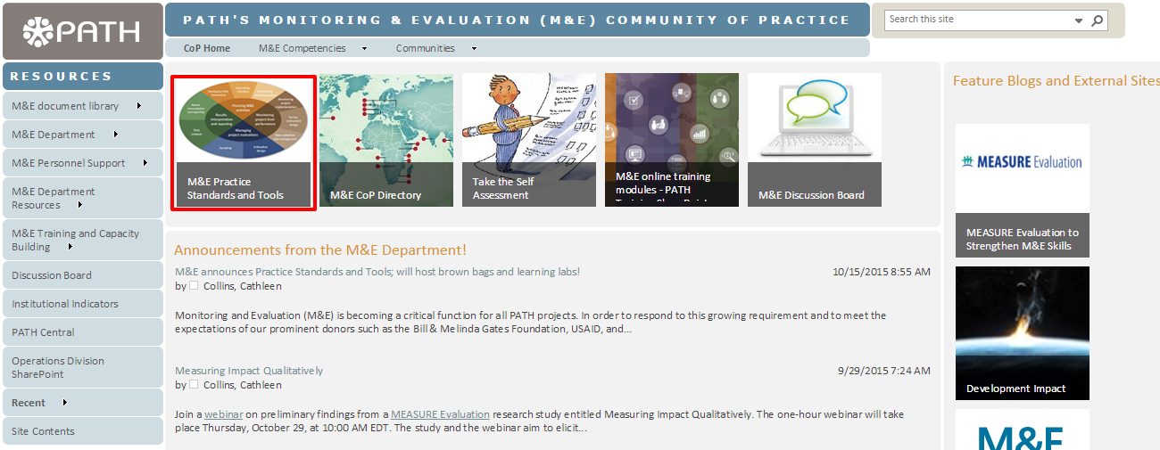
M&E Community of Practice
Community of Practice
Knowledge sharing
Interested in joining M&E CoP? Contact Jenny Shannon, jshannon@path.org
Notes:
Before we start in on the Practice Standards and our tour, I wanted to share with you a little about M&E’s primary channel for knowledge sharing and exchanging M&E ideas: the M&E Community of Practice, a PATH-wide network of over 250 M&E professionals and staff working in or interested in M&E.
The M&E Community of Practice SharePoint site is the comprehensive resource hub for the CoP and houses the Practice Standards and Tools as well as a wide variety of M&E resources including information about the services and programs of the M&E department such as the M&E self-assessment, announcements about internal and external training opportunities, links to relevant blogs and websites. Cathleen mentioned this as well today, please type in “Yes visited” in the chat window if you have visited our CoP site.
This is the landing page and you can see the link to the Practice Standards & Tools page outlined in red. Clicking there will take you to this page… [next slide]

Slide 15
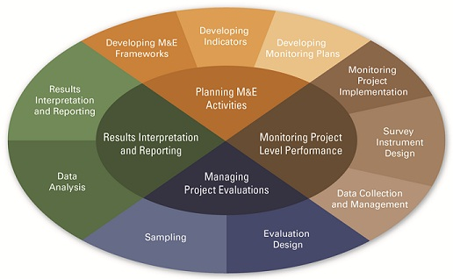
M&E Practice Model
Notes:
This is the landing page for the M&E Practice Standards & Tools. The M&E Practice Standards are organized by the M&E Practice Model shown here. We’re going to zoom in on it so you can see it a bit better [click]
The inner ring shows the 4 life cycle phases of M&E: projects begin by planning M&E activities, then monitoring project performance and managing project evaluations (if relevant), and finally, interpreting and reporting results
The outer circle the more specific M&E activities associated with each of the 4 phases.
There are practice standards and tools associated with each of these sections of the practice model. Let’s check them out…when we click on “Developing M&E Frameworks”… [click] then it takes me to this page [next slide]

Slide 16
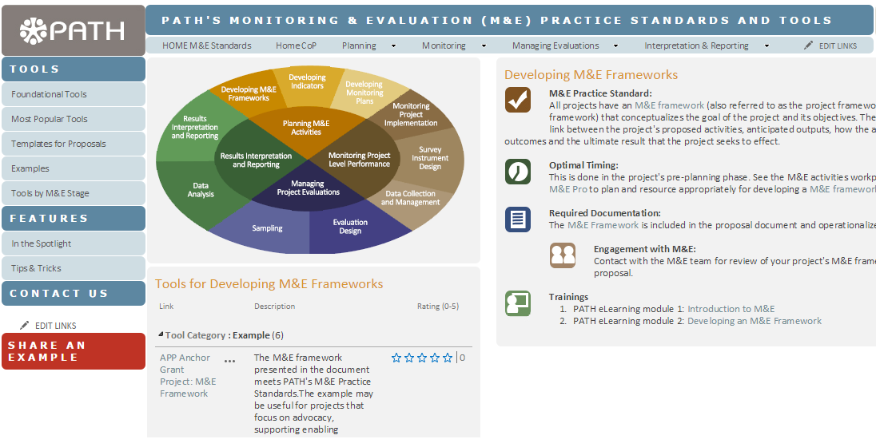
M&E Practice Standard - Developing M&E Frameworks
Notes:
Here is a screenshot of the Practice Standard for Developing M&E Framework.
No matter which area of the practice model you click on the page will be structured in this same way:
On the right, there is key information and guidance about the standard [click], optimal timing for when in the project life cycle this standard is completed [click], required documentation [click], how you can engage with the M&E Department for support [click], and available trainings related to the specific activities [click].
The overall guidance is on the right side, and the relevant tools can be found under the practice model image [click].

Slide 17
Tools to meet practice standards
Guidance
Templates
Examples
M&E terminology at PATH
Donor guidance
Checklists
TORs
Report outlines
M&E Pro
M&E Framework
M&E Plan
Results Tracker
LOE and other M&E management templates
M&E templates for proposals
Data Dictionary
M&E Frameworks
M&E Plans
Evaluation Design
Data Dictionary
Notes:
Now, you might be wondering what types of tools are available for each of these M&E stages in the practice model. There are 3 categories of tools to help meet M&E Practice Standards across the project life cycle:
First, Guidance
M&E Terminology at PATH – guidance on the language that PATH uses to talk about M&E (goal, objectives, outcomes, outputs)
Donor guidance mapped to terminology used at PATH
Checklists to ensure all needed steps for key activities are undertaken – such as data entry, data cleaning.
TORs outlines, such as those for recruiting a data collection firm
Report outlines, including ones for how to put together an evaluation report
Next, Templates
M&E Pro is the PATH suite of templates relevant to the entire project life cycle. M&E Pro is an Excel workbook that has separate tabs for each template and includes the 3 foundational tools I mentioned : the M&E framework, the M&E plan and the results tracker. The workbook also includes templates for planning and managing activities like estimating LOE for a project and tracking the M&E activities.
This can be downloaded as the full workbook, or as individual templates.
In addition to M&E Pro, we have created templates for use in proposal development.
And finally, there is a data dictionary template to document essential details about variables within a dataset
And last but not least, the Practice Standards site has M&E Examples from PATH projects! These examples meet the PATH M&E standards and are intended to be used as a reference. We plan to continue to compile strong examples as more projects use the tools and share examples with us. (Before we’re finished today, I’ll be sure to tell you how you can share your examples with us!)

Slide 18
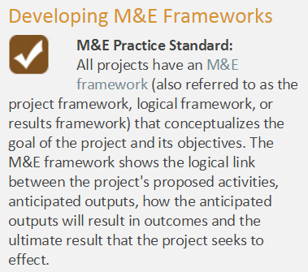
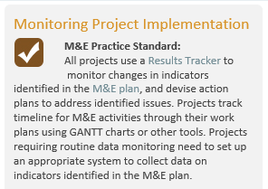
M&E Practice Standards: Foundational M&E activities
Notes:
While each of the stages of the practice model have relevant tools and guidance, there are 3 standards that we refer to as the “foundational” standards. These are the minimum standards that every project should have in place for M&E.
[click] Developing M&E frameworks - all projects at PATH must have a M&E Framework that conceptualizes the goal, objectives, and intended outcomes of the project.
[click] All projects develop and implement an M&E plan that operationalizes the M&E Framework. It identifies indicators associated with the goal, objectives, and outcomes and includes specifies for all identified indicators, including : precise definition, calculation, unit of measurement, frequency and schedule for data collection, baseline, target, and responsible person for collecting data on the indicator.
[click] All projects should use a results tracker to monitor changes in indicators identified in the M&E Plan.
These 3 tools (M&E framework, M&E plan, and results tracker) are referred to as our foundational tools.
Which of these tools do you have in place on your projects? Type in the chat window.

