Slide 1
Evaluation for Social Justice
Amy Hilgendorf, PhD
Kate Westaby, MS
Victoria Faust, MPA
University of Wisconsin-Madison
American Evaluation Association 2015
Notes:
AMY
Welcome and introductions
Overview:
First we’ll look at what “social justice” means and the focus on SJ in evaluation
Then we’ll look at some well known evaluation approaches as they seek to advance SJ, and land on some remaining questions about how to realize SJ in evaluation relevant to our own work
In small groups we’ll then discuss some case examples of pursuing SJ in evaluation to explore what this may look like in practice and how we may improve such efforts
Finally, we’ll come back as a group to reflect on what “evaluation for social justice” could/should be and how to do it

Slide 2
What is “Social Justice”?
“Justice in terms of the distribution of wealth, opportunities, and privileges within a society”
“Full and equal participation of all groups in society”
“Everyone deserves equal economic, political and social rights and opportunities”
“Giving to each what [each] is due”
Notes:
AMY
1st – New Oxford American Dictionary
2nd– Social Justice Training Institute
3rd – National Assoc of Social Workers
4th - Center for Economic and Social Justice
→ Some also talk of the “social contract,” like the theorist John Rawls, in the sense of rights and duties and the distribution of “benefits” and “burdens”
In considering groups, or how to determine just distribution/participation/etc., typically call for attention to class, race, ethnicity, gender, sexual identity, gender identity, nationality, immigrant status, and other historical lines of oppression.

Slide 3
“Social Justice Evaluation”
Social justice-oriented evaluation “seeks to increase understanding of the interdependency of individual, community, and society using a more judicious democratic process in generating knowledge about social problems and social interventions and using this knowledge to advance social progress.” (Thomas & Madison, 2010)
Rejection of the possibility of value neutrality
Critical understanding of sociopolitical forces and power dynamics influencing the definitions of social problems and their causes, as well as the evaluation context
Analysis that illuminates inequities and the systemic and structural injustices behind them, and promotes action
Facilitation of open discussion, deliberation, and engagement in public discourse
Attention to all stakeholders and diverse viewpoints, especially giving voice to those most affected
Inclusive approaches
Explicit attention to issues of diversity, cultural responsiveness, and multicultural validity
Broad and accessible dissemination of evaluation findings
Critical reflection of one’s own values, beliefs, and prejudices, and in relation to others
Trust building and attention to “interpersonal validity”
“Evaluator as agent of change”
Notes:
AMY
Over the years, explicit discussion of “social justice evaluation” or “social justice-oriented evaluation” has come up, but never really gained traction. We see references to SJ in the AEA Mission, Vision, Values and Governing Principles as an “end goal.” References to related concepts in the Guiding Principles and the Cultural Competency statement, etc.
Several TIGs highlight SJ orientations or goals, including this one (CP).
Annual conferences
1994 Annual Conference: Evaluation and Social Justice
Evaluation journals
New Directions for Evaluation, 1990: “Evaluation and Social Justice: Issues in Education”
New Directions for Evaluation, Summer 2015: “Evaluation and Social Justice in Complex Sociopolitical Contexts”
Regional conferences:
Both the Minnesota Evaluation Studies Institute (MESI) and MilwaukeeEvaluation! Held conferences in 2015 highlighting “social justice” as a central focus of evaluation
AEA365 search for SJ – returns 15-20 with explicit mentions, especially recently
It seems that SJ has been a longstanding focus in evaluation, and perhaps an increasing one. Some authors have talked explicitly of “SJ evaluation” or “SJ-oriented evaluation,” but SJ as an evaluation approach has never seemed to gain much traction.
In calling for more attention to integrating SJ into the teaching of evaluation, Thomas and Madison (2010) provide many ideas of what a “SJ evaluation” may be.

Slide 4
How do Evaluators Work for Social Justice?
Culturally Responsive Evaluation | Democratic Evaluation
Empowerment Evaluation | Participatory Evaluation
Developmental Evaluation | Feminist Evaluation
Equity-Focused Evaluation | Indigenous Evaluation
Collaborative Evaluation | Critical Social Theory Evaluation
Utilization-Focused Evaluation | Transformative Paradigm
Notes:
AMY/KATE?
Even among those who work explicitly for SJ, there is considerable variation in how one does so…
Social workers may seek to increase access and opportunity by providing individual services and advocating for policy and structural change
SJ educators seek to “guide students in critical self-reflection of their socialization into [the] matrix of unequal relationships and its implications,” analyze mechanisms of oppression, and support students’ ability to challenge hierarchy – and address schools’ role in reproducing inequities
Community organizers focus on relationship-building and power-building among everyday community members, identification of shared concerns, and strategic research and action to target demands for their communities and tactics to influence the people who can make those changes happen
massive citizen protests and alternative summits to the G8, World Trade Org, etc. – Global Justice Movement
So, how do evaluators and evaluation work for social justice?
Various well known evaluation approaches discuss SJ and indicate that use of these approaches can realize SJ goals in an evaluation. This list is not exhaustive.
Let’s look at a few well known evaluation approaches as they seek to realize social justice.
Transformative Paradigm (Mertens)
Culturally Responsive Evaluation (Hood, Hopson, Kirkhart)
Equity-Focused Evaluation (Bamberger & Segone)
Empowerment Evaluation (Fetterman & Wandersman)
Collaborative Evaluation (Rodriguez-Campos)
Developmental Evaluation (Patton)
Utilization-Focused Evaluation (Patton)
Democratic Evaluation (Hanberger; Picciotto)
Participatory Evaluation (Gujit)
Feminist evaluation (Podems; Seigart)
Indigenous evaluation (LaFrance)
Critical social theory evaluation (Freeman, Mabry)

Slide 5
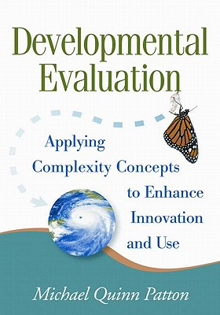
Questions program assumptions, values, policies, practices, and system dynamics that lead to a problem
Focused on social innovation or complex environments. Social justice is complex:
Difficult to define and has no obvious answers
Tangled up root causes
Involves stakeholders with diverse values, interests, and positions
Recognizes that people are highly emotional and social and live in systems, organizational and societal.
Accountability is focused on innovators’ fundamental values and commitment to making a difference.
Patton, M. Q. (2011). Developmental Evaluation: Applying Complexity Concepts to Enhance Innovation and Use. New York, NY: The Guilford Press.
Notes:
KATE

Slide 6
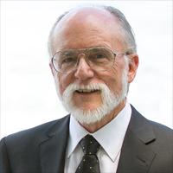
Developmental evaluators ask:
Are we being true to our vision?
How have systems contributed to this problem?
What patterns are emerging?
What’s being learned?
Now what?
What does it mean?
What principles are being followed?
What developments occur over time?
Who or what is being excluded, marginalized, or made a victim by the way in which this situation is being viewed or is operating?
Patton, M. Q. (2011). Developmental Evaluation: Applying Complexity Concepts to Enhance Innovation and Use. New York, NY: The Guilford Press.
Notes:
KATE

Slide 7
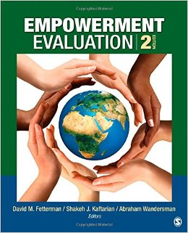
David Fetterman – AEA presidential introduction in 1994 – was controversial
Aims to increase the probability of program success by providing program stakeholders with tools for assessing the planning, implementation, and self-evaluation of their program & mainstream evaluation as part of the planning and management of the program or organization
Fetterman, D. M., Kaftarian, S. J., & Wandersman, A. (2014). Empowerment Evaluation, 2nd Ed. SAGE Publications
Notes:
KATE
Controversial – evaluator not necessarily the expert, not making judgments about the program
Tends to be used in international approaches

Slide 8
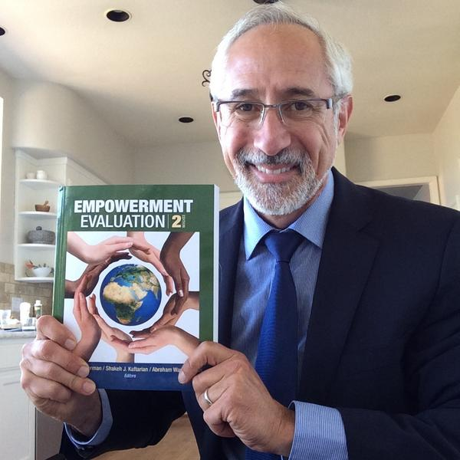
Critical concepts:
Self-determination – make their own choices
about program direction, build evaluation capacity
Democratic approach, never conducted by a single person
Gives voice to those who often don’t have one
Build a community of learners
Evaluator as a coach/critical friend
someone who believes in the program, but still asks the critical questions
is a co-equal – not a superior, not a servant
Guided by principles of truth and honesty – understand an event from multiple perspectives and worldviews – try to see it in context
https://www.youtube.com/watch?v=B8pZ3_ntX6E
http://people.ucsc.edu/~ktellez/266Readings/Empowerment%20Evaluation.PDF
Notes:
KATE
3 Steps
Mission
Where do you want to go? What are you about?
Democratic, transparent, give voice
Taking stock
List activities – all key activities
Prioritize with dots – everyone gets 5 – most important activities to assess from now on
Rate those with the most dots (rate from 1 – low/poor to 10 – high/good)
Discuss amongst group – open dialogue
Average across so everyone’s voice counts equally, average the averages
Plan for the future
Goals – what their goals are – based on what was just assessed
Strategies come from the evidence just assessed
Using the Evidence

Slide 9
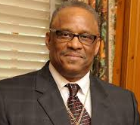
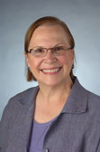
Culturally Responsive Evaluation
Emphasis on understanding a program as it functions in the context of culturally diverse groups
Explicit attention to culture and race
Social responsibility to address unequal opportunities and resources
Attention to power differentials
Evaluator understands own cultural values
Hopson, R. K., & Kirkhart, K. E. (2015). Culturally Responsive Evaluation (CRE): Theory to Practice and Back Again. Presented at the 2015 American Evaluation Association Summer Institute.
Notes:
KATE
Education Research
“Responsive Evaluation” Robert Stake – U Illinois – 1973 – focused on issues of importance to program practitioners rather than decision-makers
“Culturally Relevant Pedagogy” Gloria Ladson-Billings – mid 1990s – critical importance of teaching to and through cultural strengths of ethnically diverse students to improve academic achievement
Stafford Hood – late 1990s
Other pics: Rodney Hopson & Karen Kirkhart
http://aea365.org/blog/rodney-hopson-on-culturally-responsive-evaluation/
http://education.illinois.edu/CREA/crea-origins

Slide 10
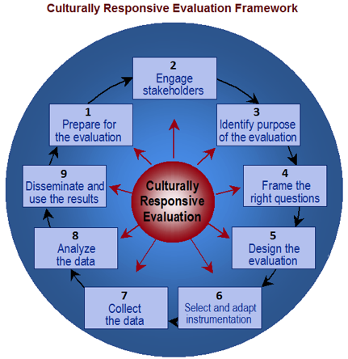
Will a cultural insider be required to guide the evaluators in their interactions and understandings?
How is power held, exercised, and shared (or used oppressively) in this context?
Whose values are marginalized and whose values are privileged?
http://aea365.org/blog/rodney-hopson-on-culturally-responsive-evaluation/
Notes:
KATE
Education Research
“Responsive Evaluation” Robert Stake – U Illinois – 1973 – focused on issues of importance to program practitioners rather than decision-makers
“Culturally Relevant Pedagogy” Gloria Ladson-Billings – mid 1990s – critical importance of teaching to and through cultural strengths of ethnically diverse students to improve academic achievement
Stafford Hood – late 1990s
Other pics: Rodney Hopson & Karen Kirkhart
http://aea365.org/blog/rodney-hopson-on-culturally-responsive-evaluation/
http://education.illinois.edu/CREA/crea-origins

Slide 11
Evaluation for Social Justice
Does the object of evaluation reproduce unfair, unjust advantage or privilege? Does it promote a fair, just distribution of social resources and social opportunities?
Are people connected to the object of evaluation and most impacted by inequities defining the need for an evaluation and the presence and role of an evaluator?
What type of knowledge is privileged in the context of the evaluation and in the evaluation itself?
Who defines how evaluative judgements are made?
What social power exists to leverage results of an evaluation and who has it?
Notes:
VICTORIA
As we have looked at these evaluation approaches in their relation to SJ and tried to realize SJ in our own work, a number of questions arise. These kinds of questions force us to consider differently the roles of the evaluator, the planning process, the methods we use, the stakeholders, etc.
If this is the frame that we operate from, then what types of tensions and realities do we have to negotiate??

Slide 12
Social Justice Evaluation: Case Examples
Planning for and Building Social Justice throughout an Evaluation
Victoria Faust
Course Corrections: Integrating a Social Justice Lens into an Ongoing Evaluation
Kate Westaby
What Now? Promoting Action for Social Justice from Evaluation Findings
Amy Hilgendorf
Notes:
Overview of cases, then small group discussions (15 mins.)

Slide 13
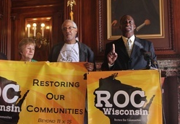
Planning for and Building Social Justice throughout an Evaluation
Reimagining Criminal Justice to Improve the Health of Wisconsin’s Families and Communities
Notes:
VICTORIA

Slide 14
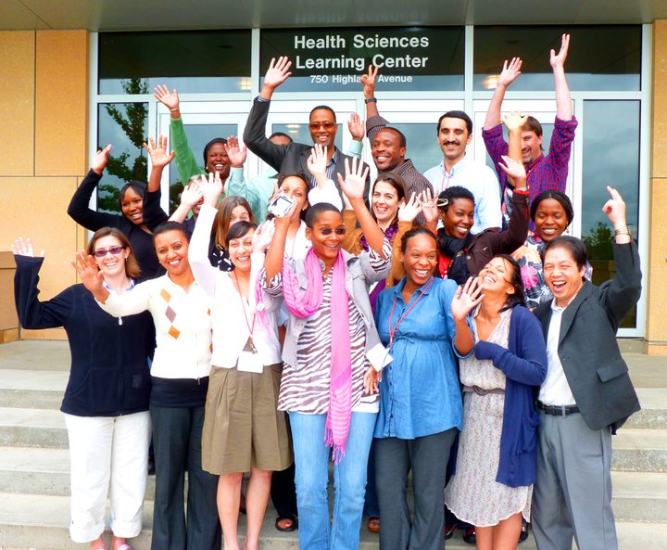
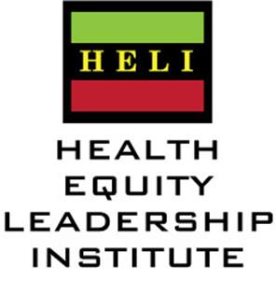
Course Corrections: Integrating a Social Justice Lens into an Ongoing Evaluation
Notes:
KATE

Slide 15
What Now? Promoting Action for Social Justice from Evaluation Findings
Coalition Health Equity Capacity Feedback
Notes:
AMY

Slide 16
Discussion
Notes:
AMY
Type in key themes/key questions/what resonated/etc.?
Prompt?: What do evaluators need (orientations, skills, competencies, etc.) to do SJ evaluation?

