Slide 1
Sustaining an Evaluator Community of Practice
David J. Bernstein, Westat, Chair
Michael Hendricks, Evaluation Consultant
Kathryn Newcomer, The George Washington University
Mary Ann Scheirer, Scheirer Consulting
Valerie Jean Caracelli, U.S. Government Accountability Office
Brian L. Yoder, American Society for Engineering Education
+++ Current/former Washington Evaluator (WE) Board +++
+++ Washington Evaluator Members +++
+++ AEA Members and Conference Attendees +++
October 17, 2014, 1:45-3:15; Room 710, Colorado Convention Ctr.

Slide 2
Session Outline
Facilitator Introductions
Session Introduction
Reflections on an Evaluator Community of Practice: Washington Evaluators
Think Tank: Sustainable Practices for Maintaining Evaluation Communities
Sharing Learning
Washington Evaluators

Slide 3
Session Introduction
What does it take to establish and maintain an evaluation community of practice?
A Historical Example: Celebrating 30 Years of the Washington Evaluators
Exploring together: Sustainable practices that can support evaluators and the evaluation field.
Washington Evaluators

Slide 4
Celebrating 30 Years
Enjoy the Washington Evaluators 30th Anniversary slide show.
Washington Evaluators

Slide 5
Washington Evaluators 30th Anniversary Celebration October 1, 2014 Cleveland Park Library
The WE Board:
Brian L. Yoder, President
David J. Bernstein, President-elect
Eric Abdullateef, Past-president
Nick Hart, Treasurer
Ann Emery, Secretary and Communications Committee Chair
Valerie Caracelli, Program Committee Chair
Robin Kelley, Membership Committee Chair

Slide 6
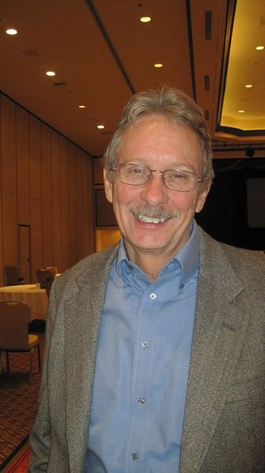
Celebrating 30 Years of WE
WE Founding Chair Mike Hendricks

Slide 7
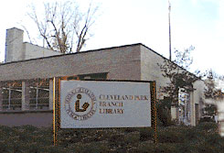
Celebrating 30 Years of WE
Location for the WE Organizing Meeting September 1984
and
30th Anniversary Celebration 2014

Slide 8
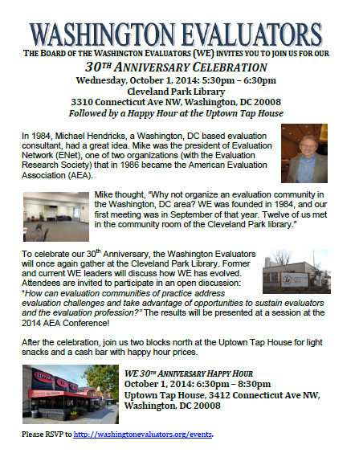
Celebrating 30 Years of WE

Slide 9
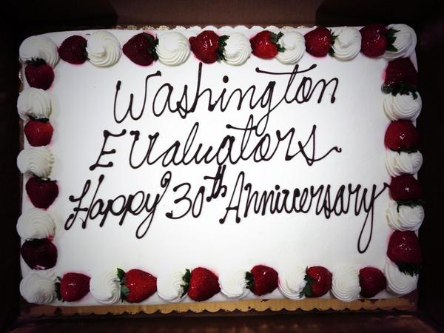
Celebrating 30 Years of WE

Slide 10
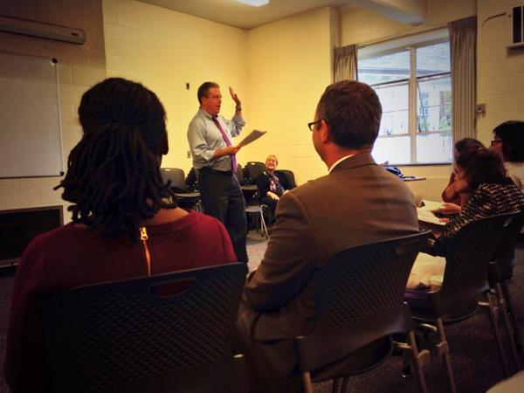
Celebrating 30 Years of WE
WE President-elect David Bernstein

Slide 11
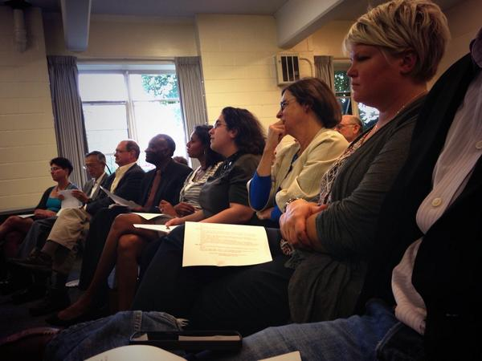
Celebrating 30 Years of WE
30th Anniversary Guests

Slide 12
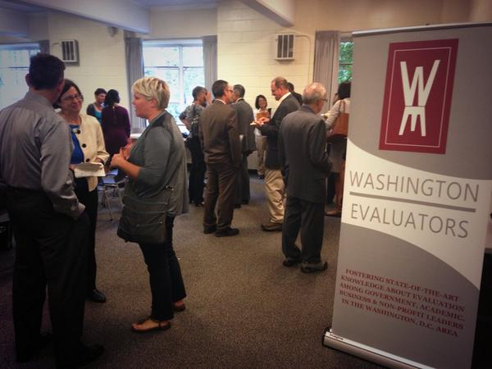
Celebrating 30 Years of WE
30th Anniversary Guests

Slide 13
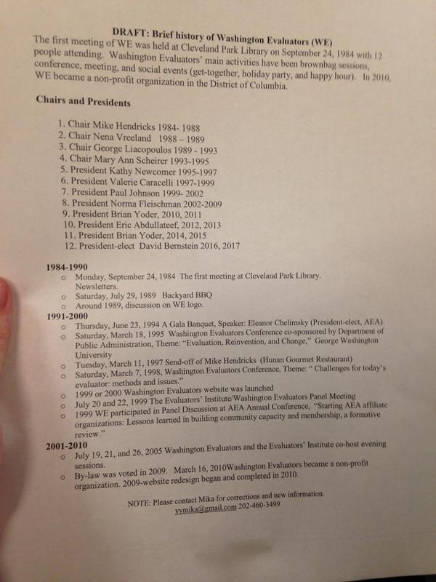
Celebrating 30 Years of WE
WE History

Slide 14
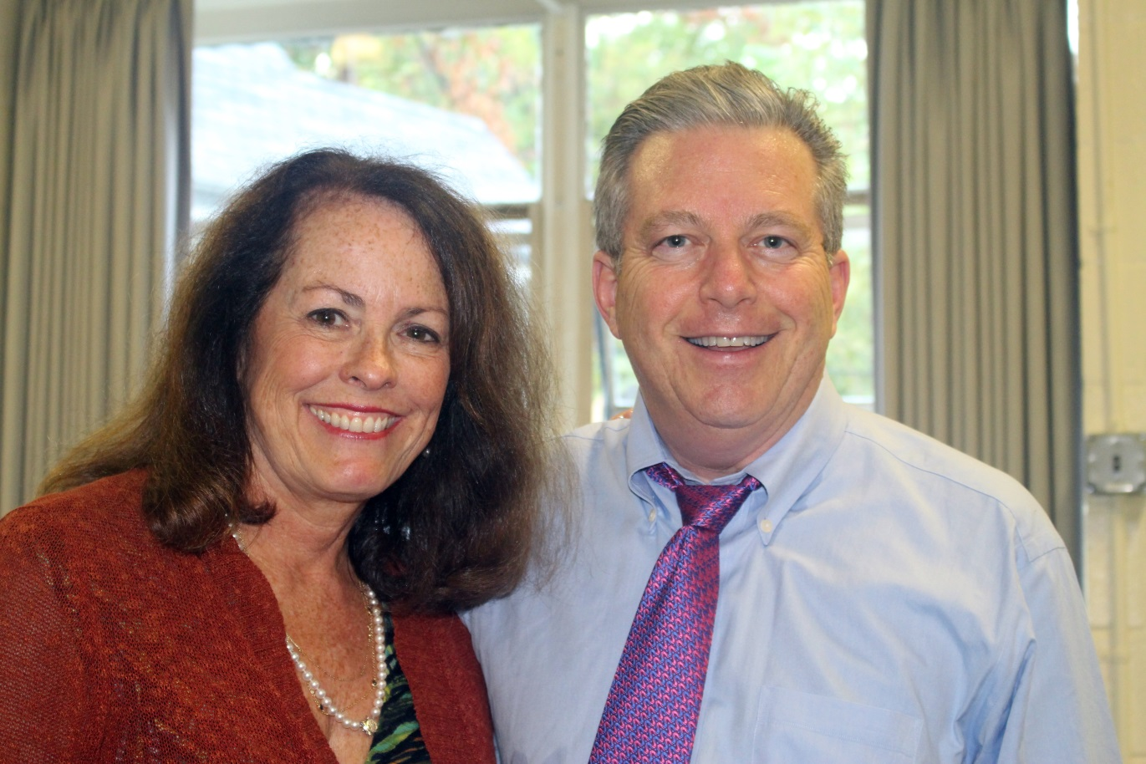
Celebrating 30 Years of WE
Former WE President Kathy Newcomer
and
WE President-elect David Bernstein

Slide 15
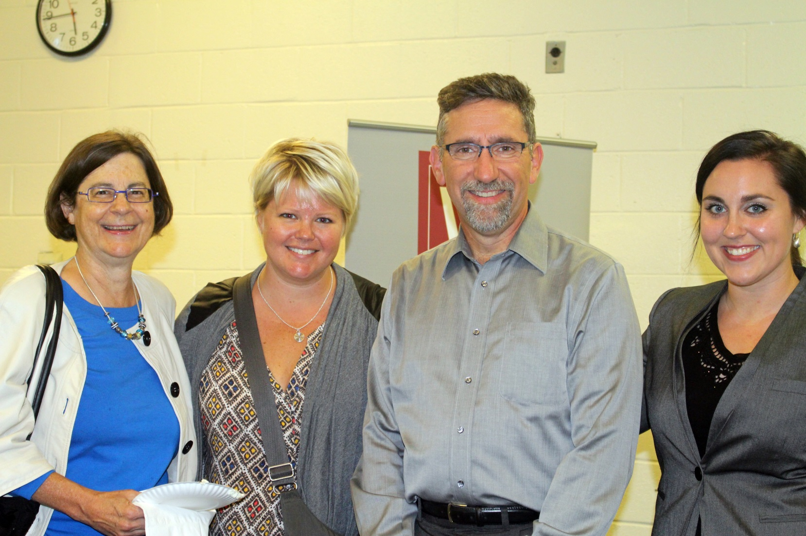
Celebrating 30 Years of WE
WE Secretary Ann Emery and Guests

Slide 16
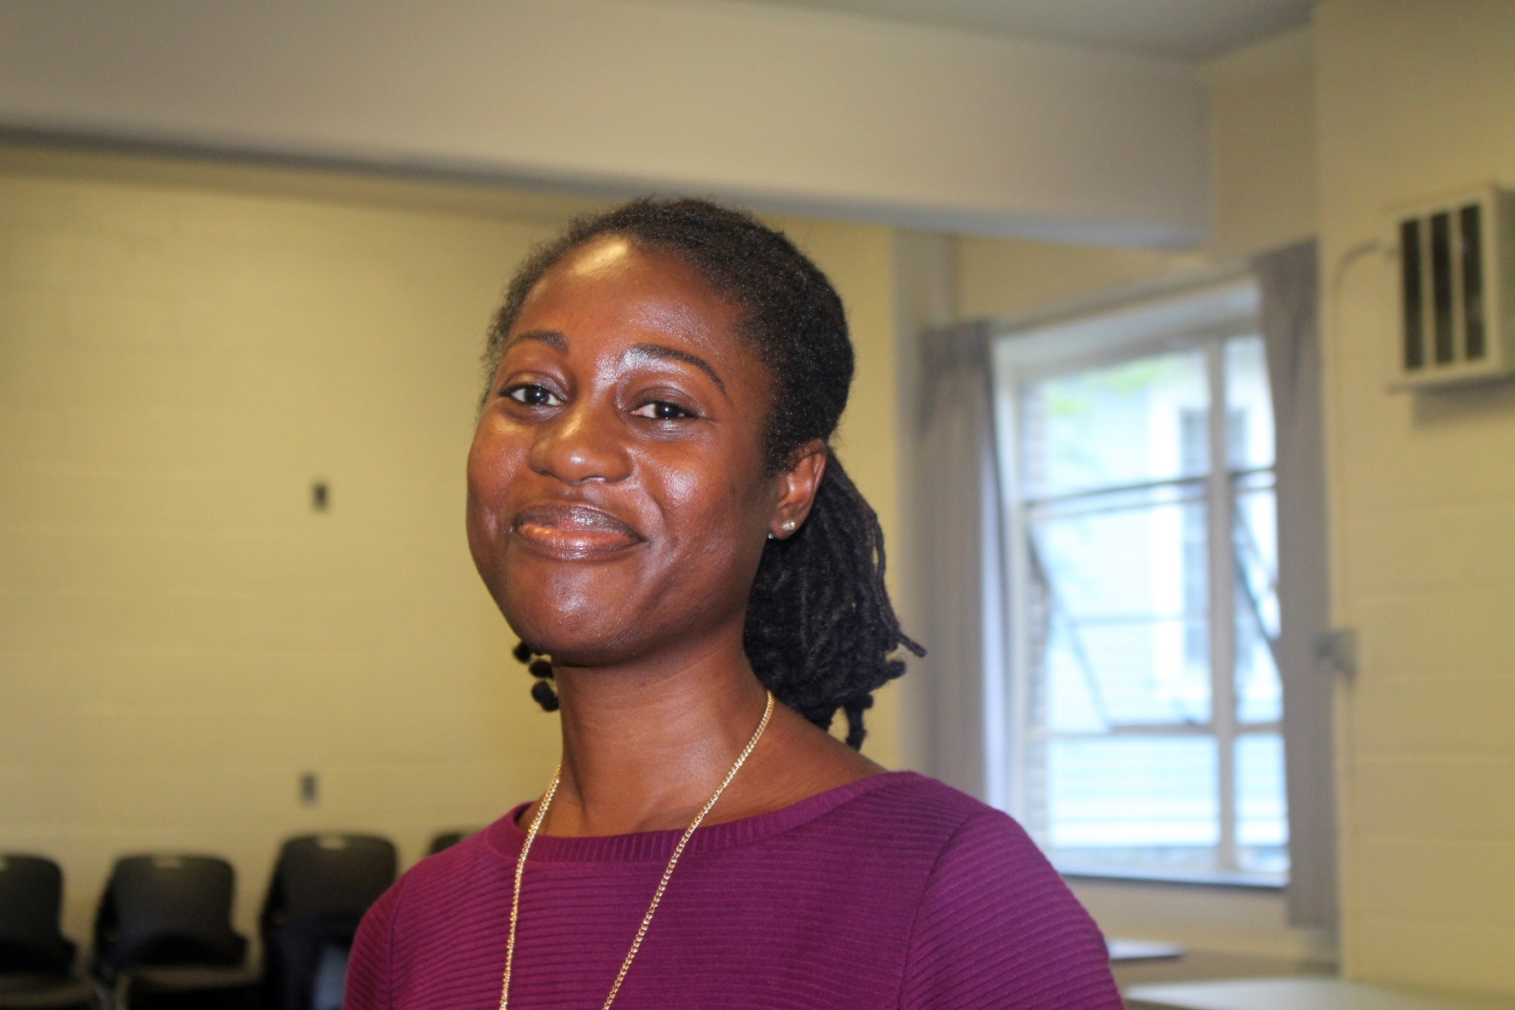
Celebrating 30 Years of WE
Neesa Dshoan Wilkerson

Slide 17
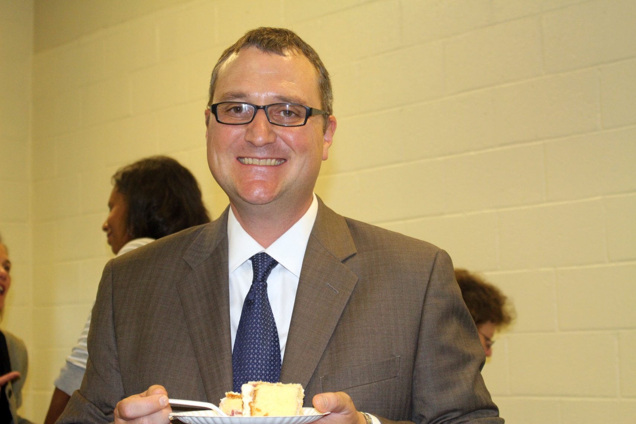
Celebrating 30 Years of WE
WE President Brian Yoder

Slide 18
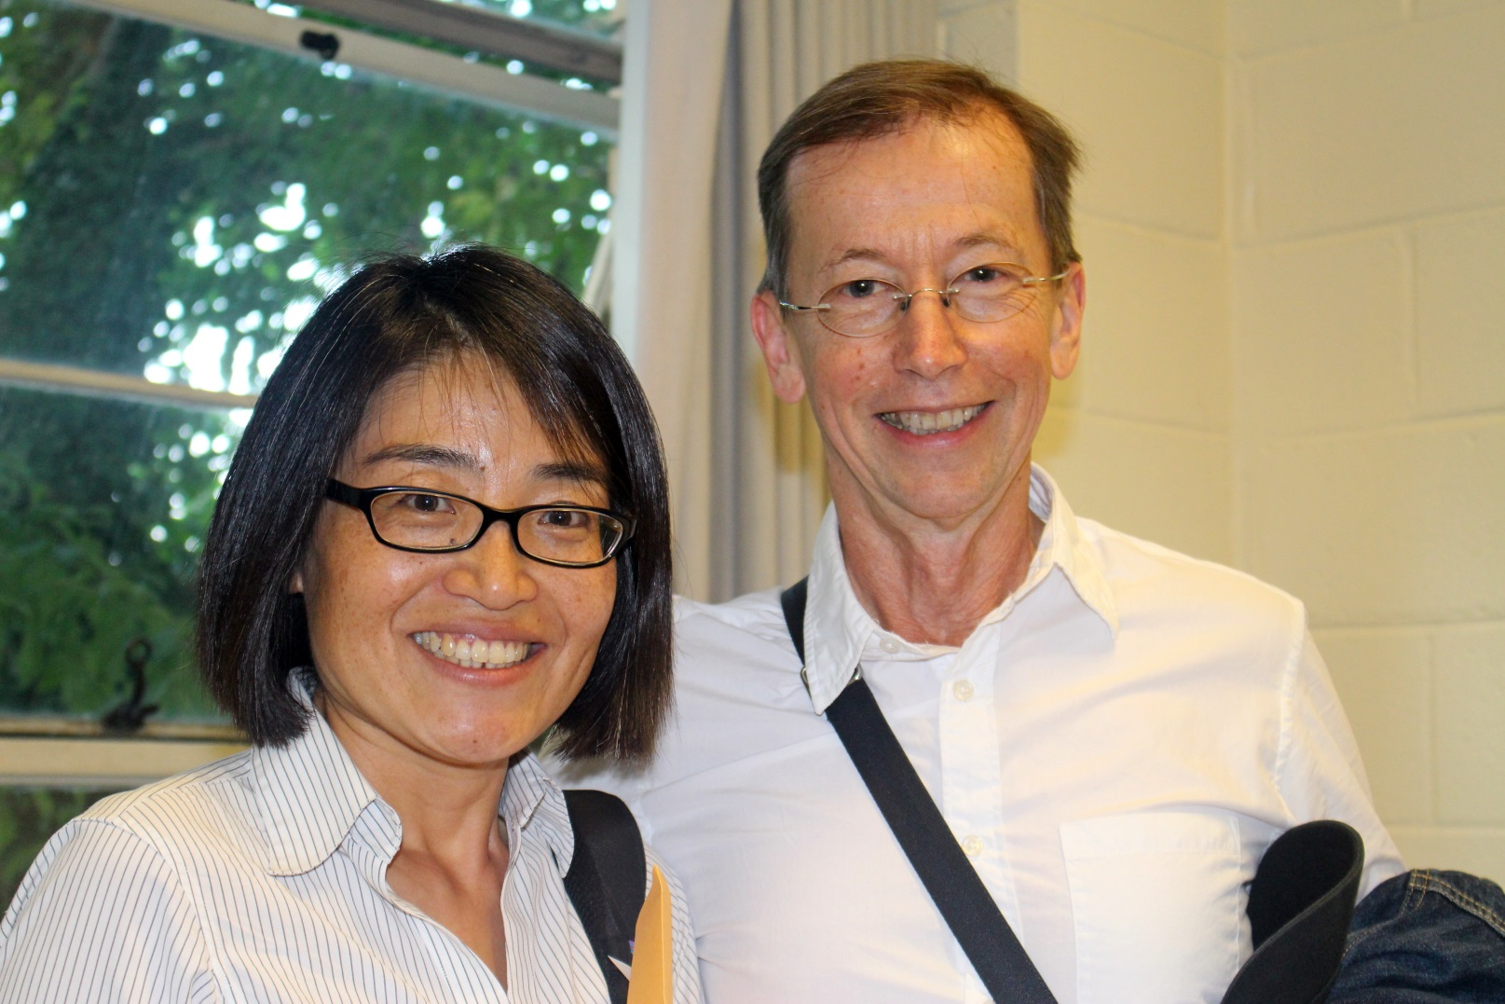
Celebrating 30 Years of WE
Mika Yamashita, WE Historian
Former AEA Treasurer Brian Yates

Slide 19
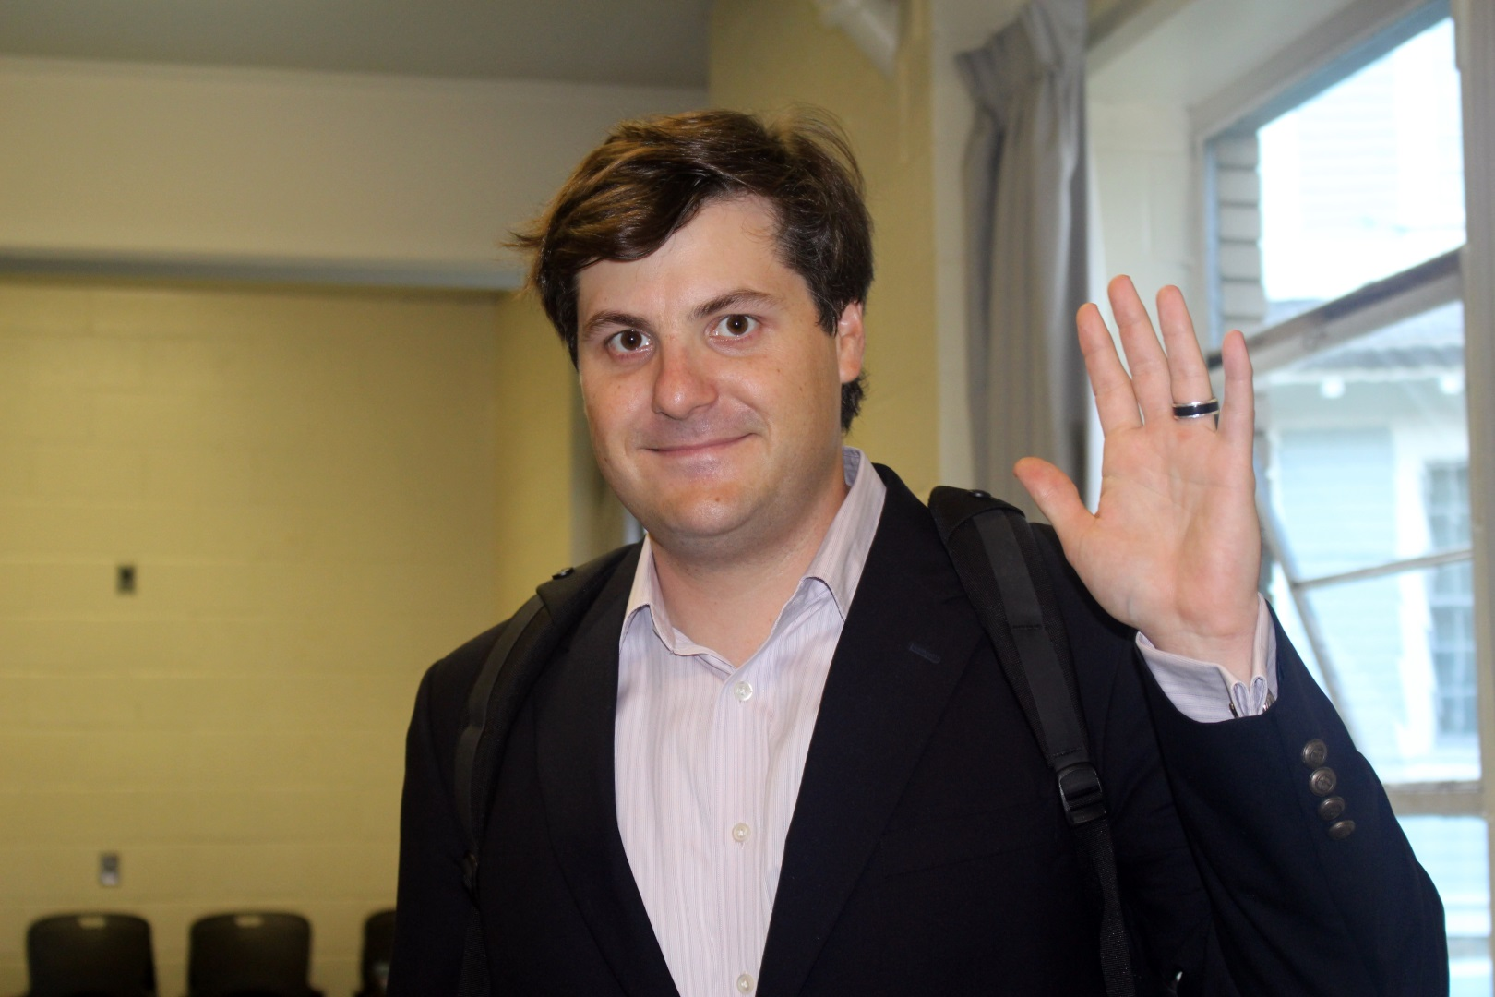
Celebrating 30 Years of WE
WE Guests Enjoying the Anniversary

Slide 20
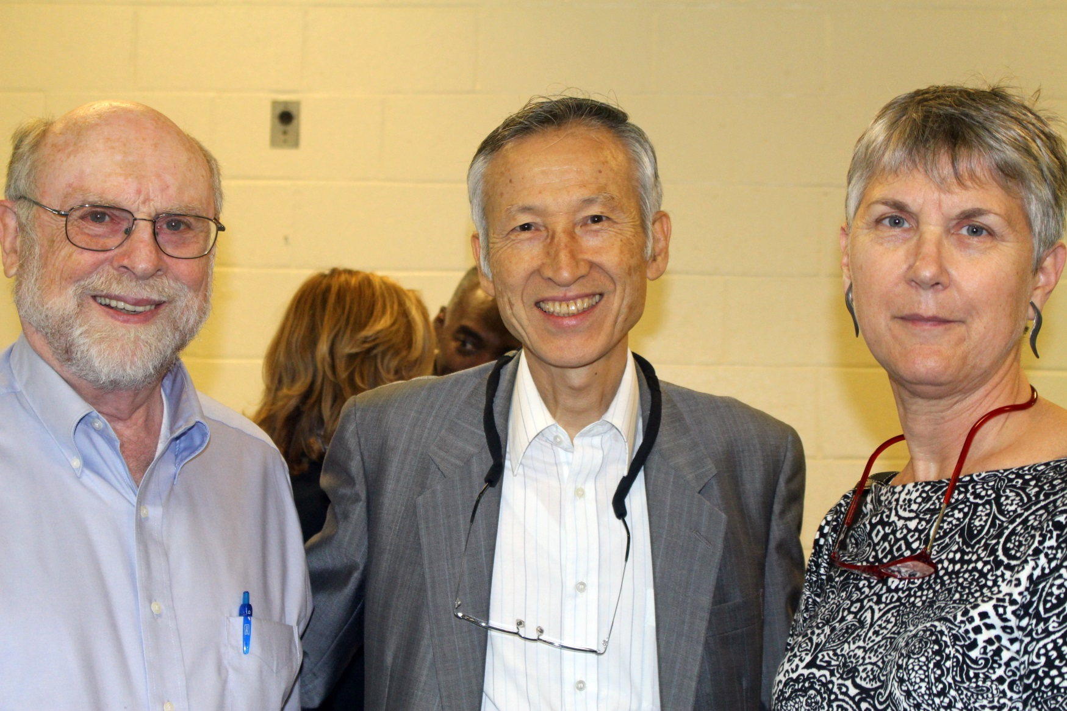
Celebrating 30 Years of WE
WE Guests Enjoying the Anniversary

Slide 21
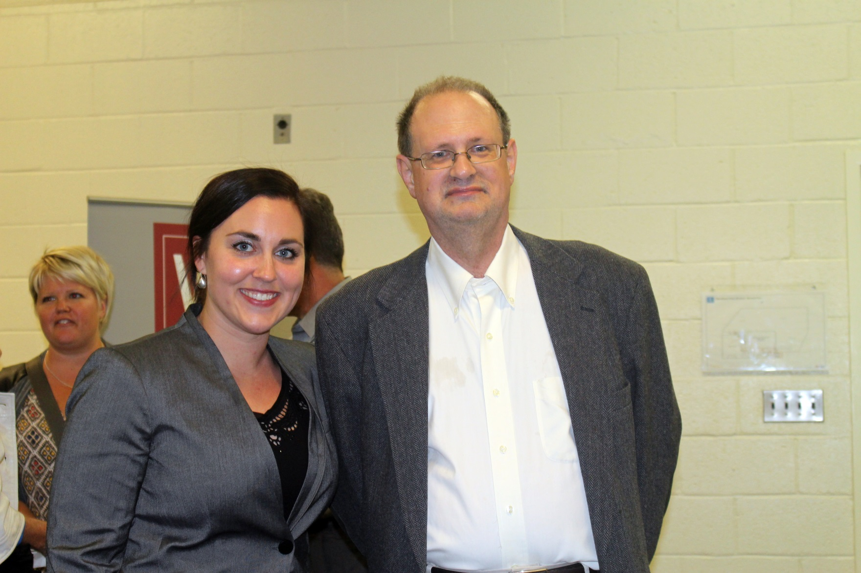
Celebrating 30 Years of WE
WE Secretary Ann Emery and Guest

Slide 22
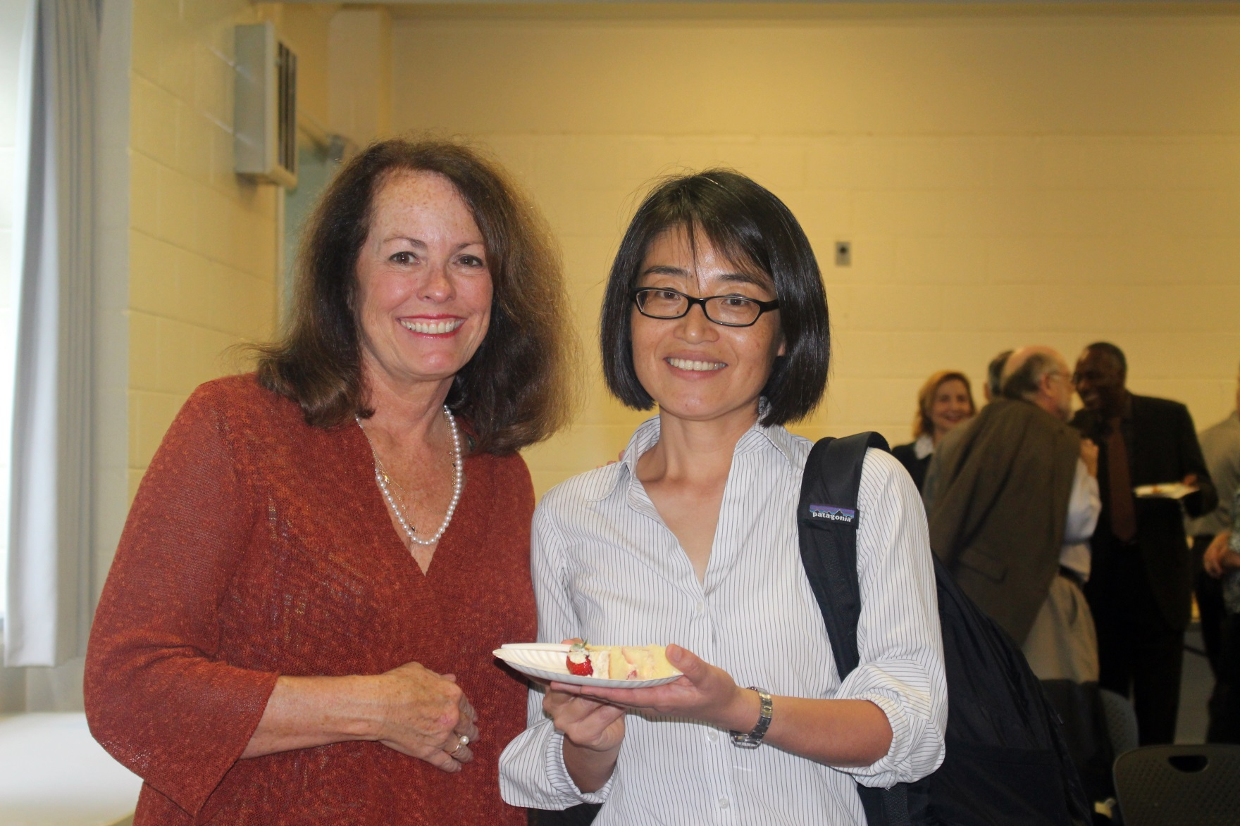
Celebrating 30 Years of WE
Kathy Newcomer and Mika Yamashita

Slide 23
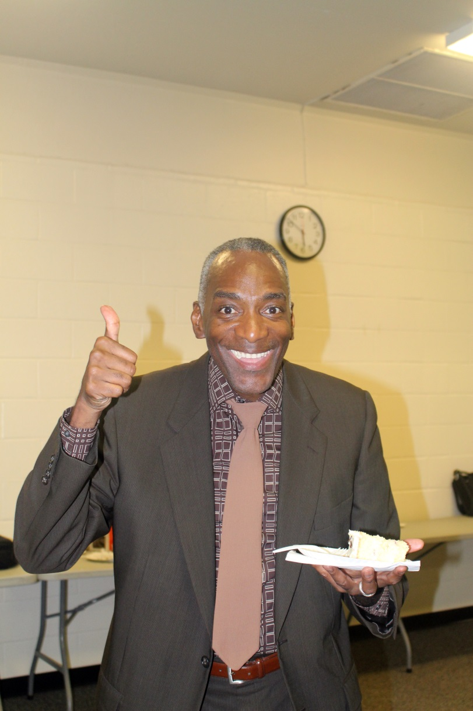
Celebrating 30 Years of WE
WE Past-president Eric Abdullateef

Slide 24
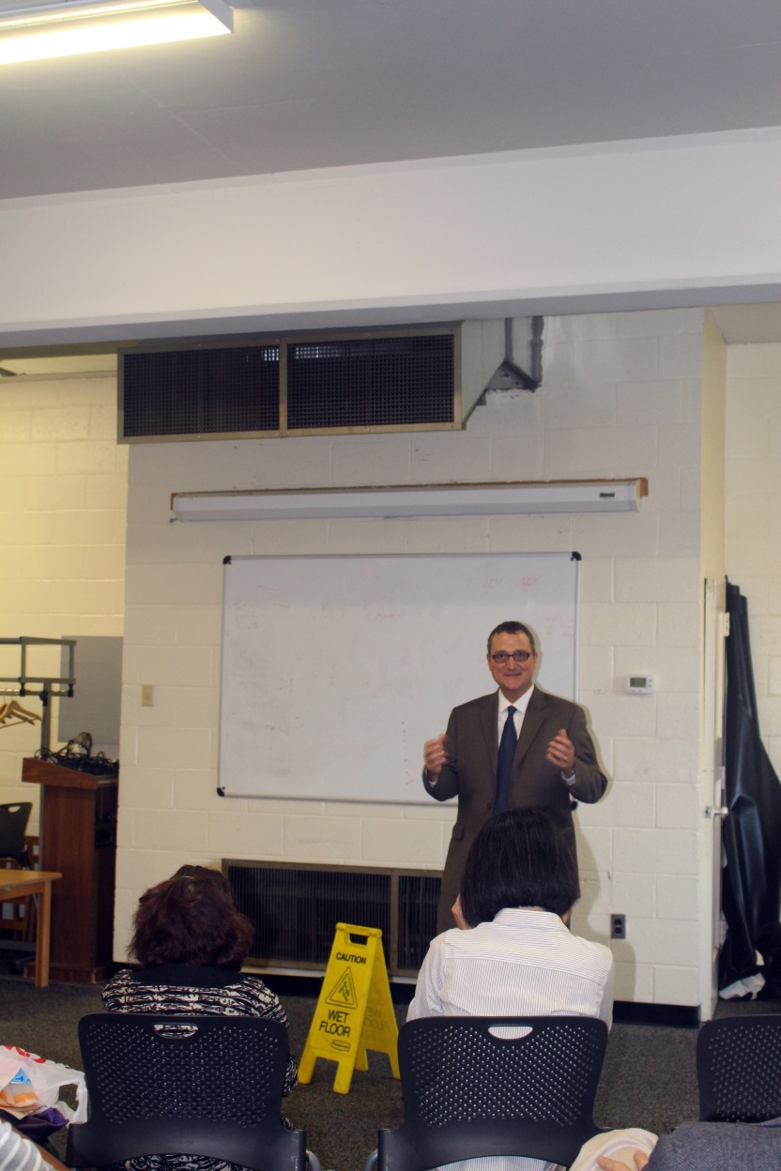
Celebrating 30 Years of WE
We President Brian Yoder

Slide 25
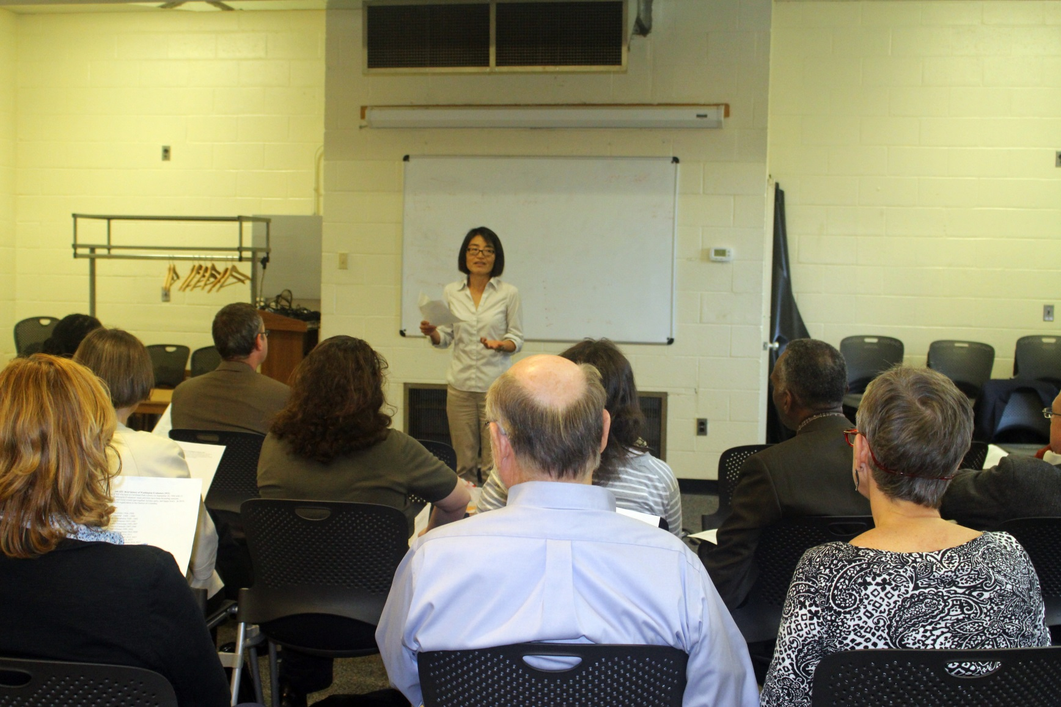
Celebrating 30 Years of WE
WE Historian Mika Yamashita

Slide 26
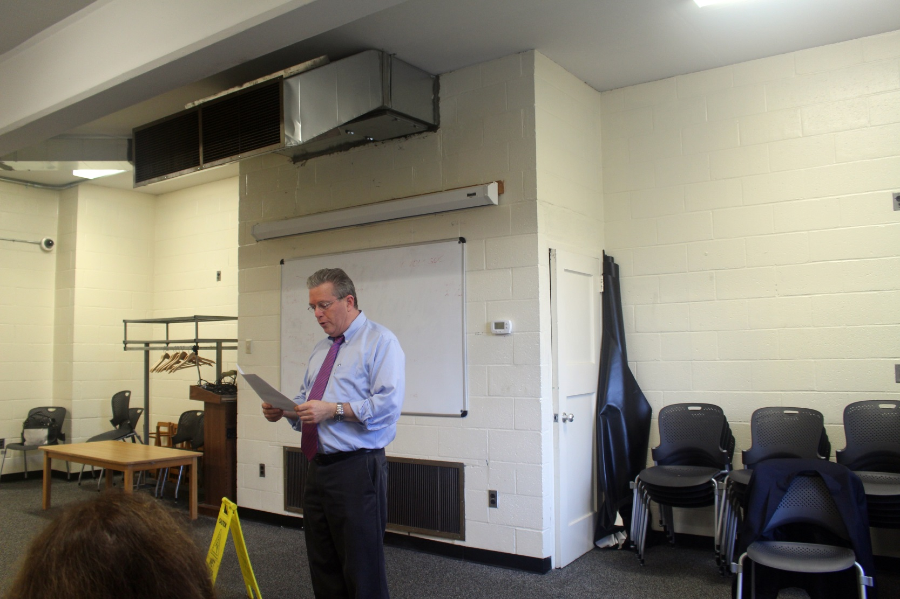
Celebrating 30 Years of WE
WE President-elect David Bernstein

Slide 27
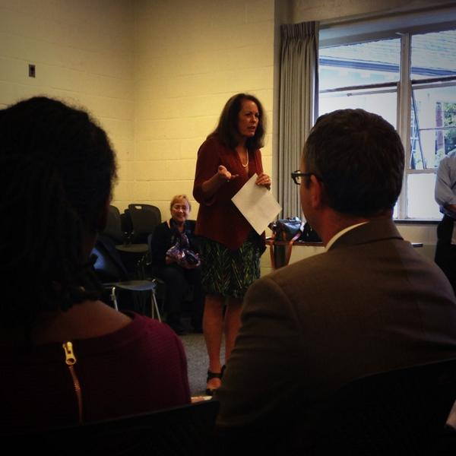
Celebrating 30 Years of WE
Former WE President Kathy Newcomer and Program Chair Val Caracelli

Slide 28
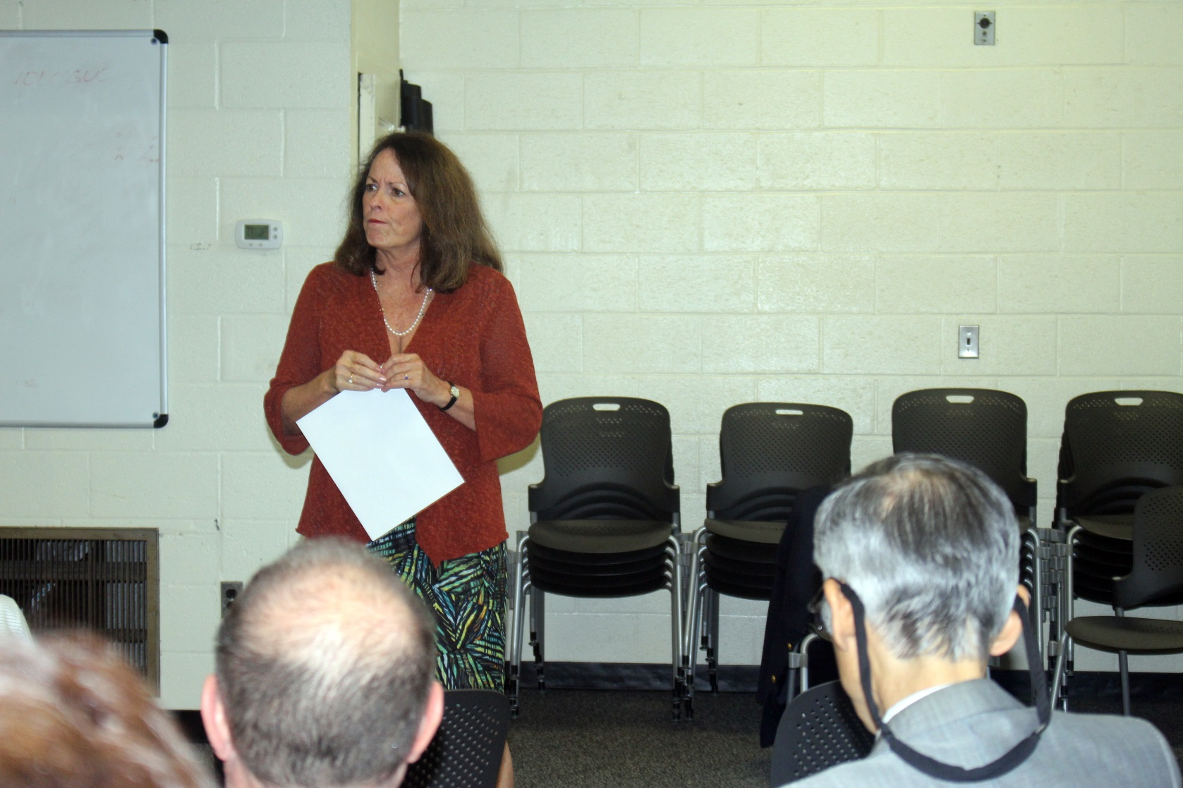
Celebrating 30 Years of WE
Former WE President Kathy Newcomer

Slide 29
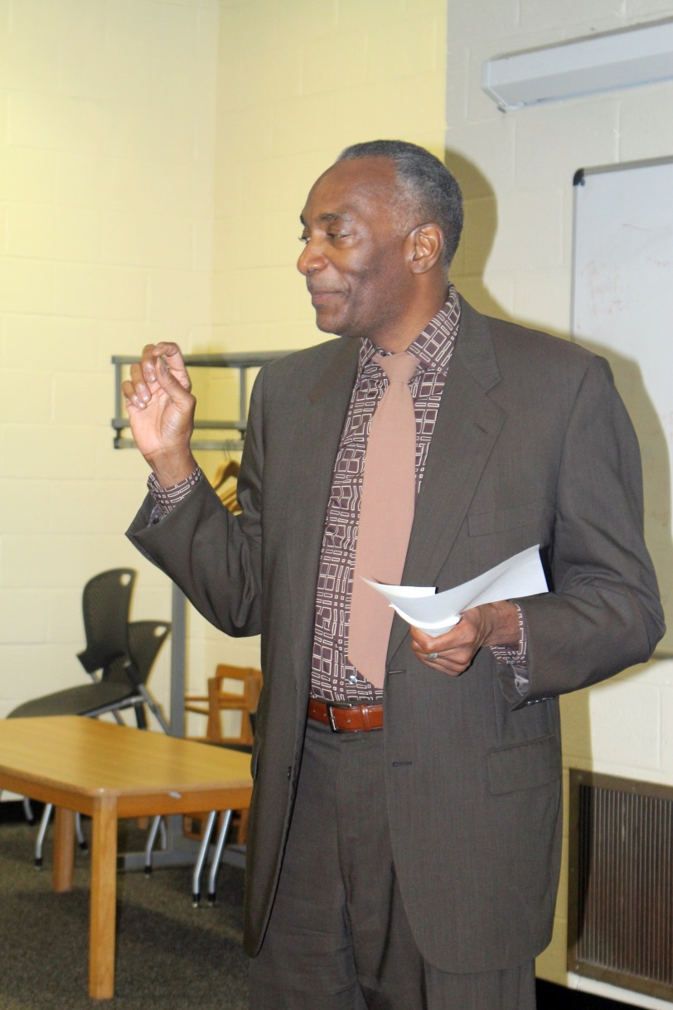
Celebrating 30 Years of WE

Slide 30
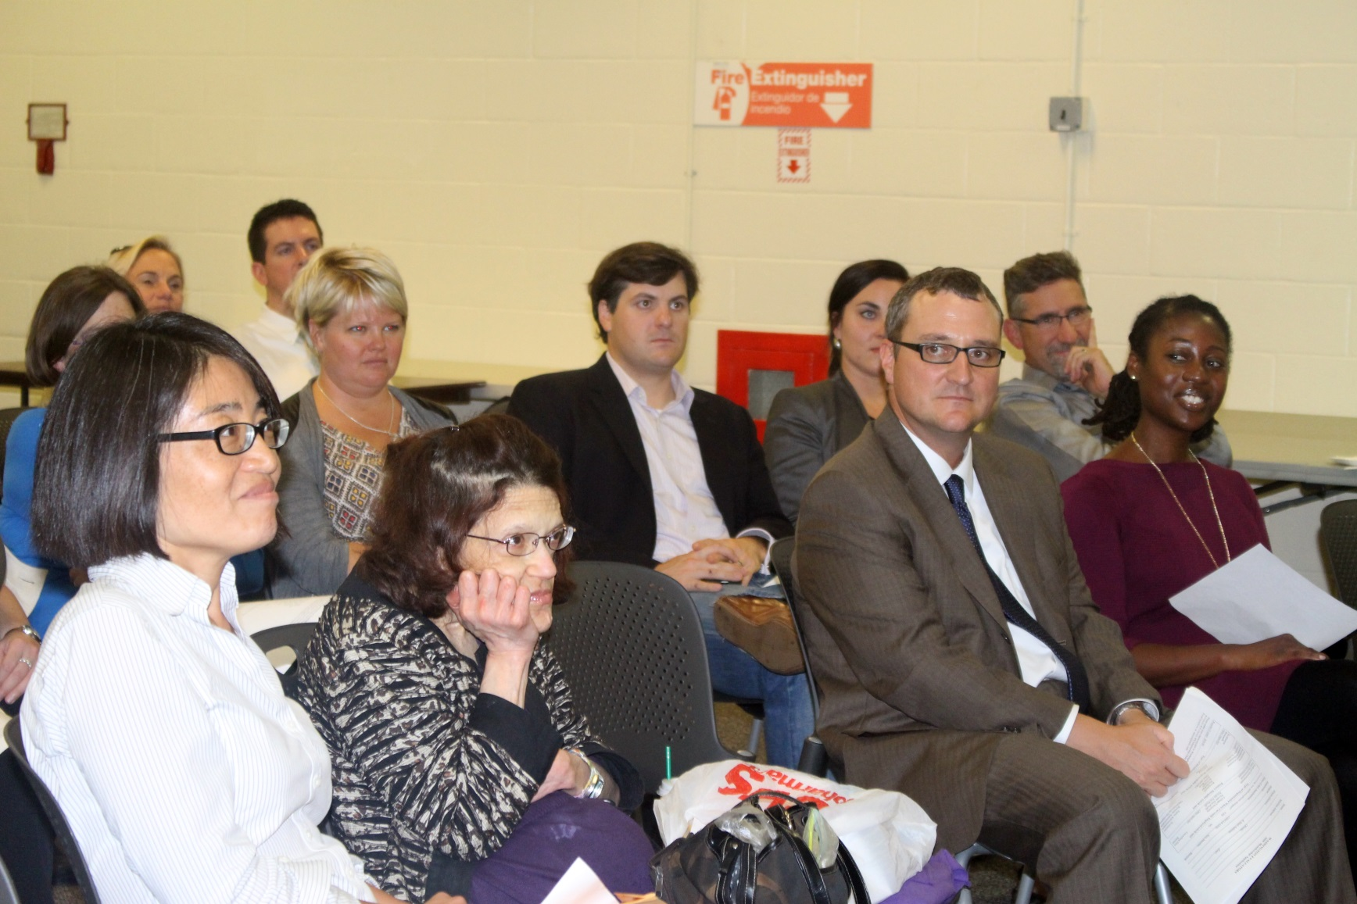
Celebrating 30 Years of WE

Slide 31
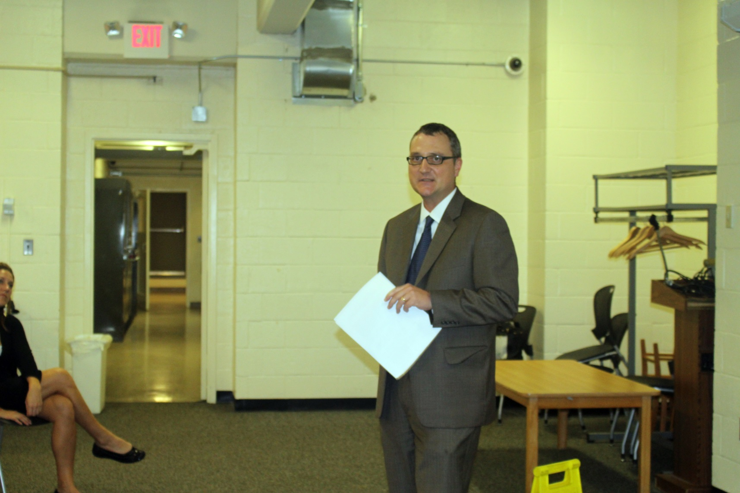
Celebrating 30 Years of WE
WE President Brian Yoder

Slide 32
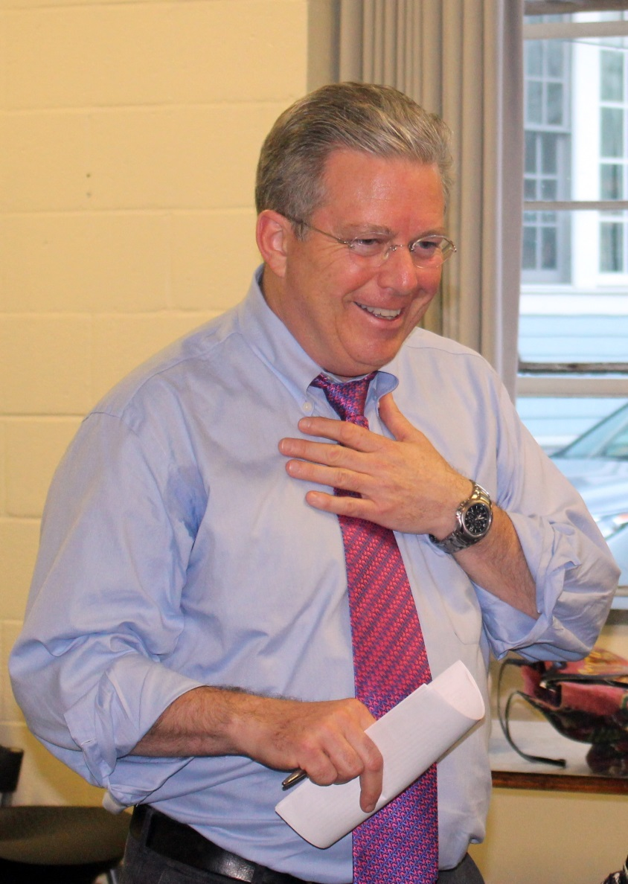
Celebrating 30 Years of WE
WE President-elect David Bernstein

Slide 33
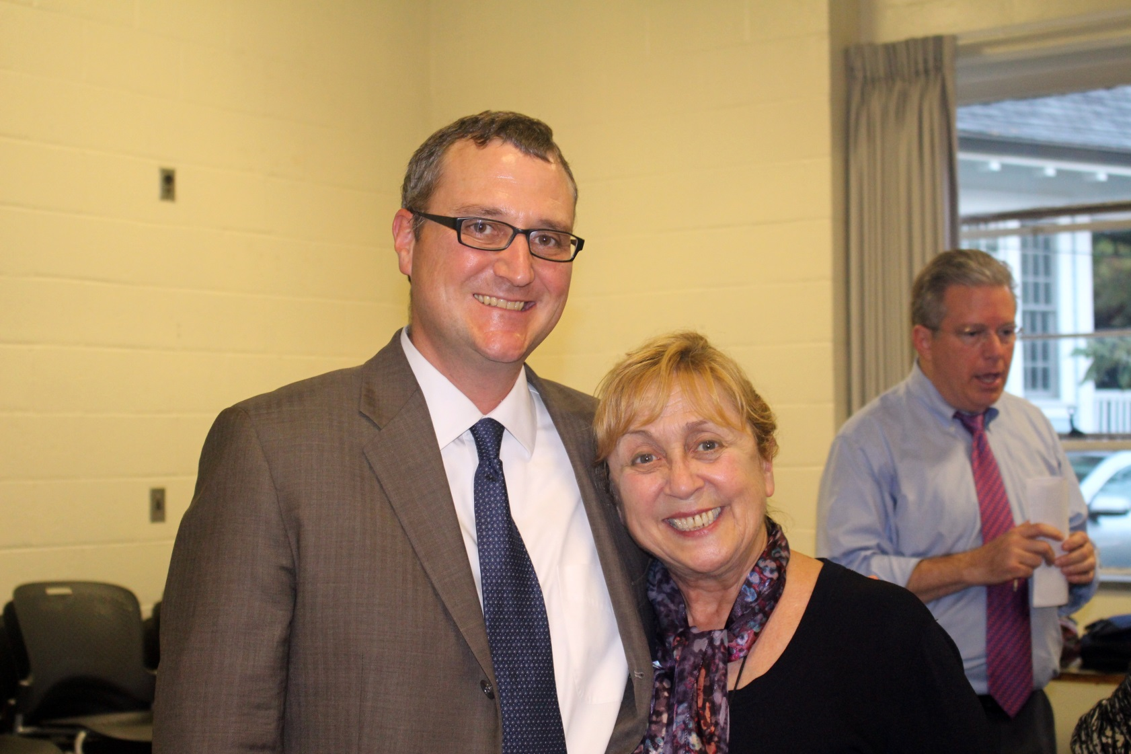
Celebrating 30 Years of WE
Brian Yoder and WE Program Chair Val Caracelli

Slide 34
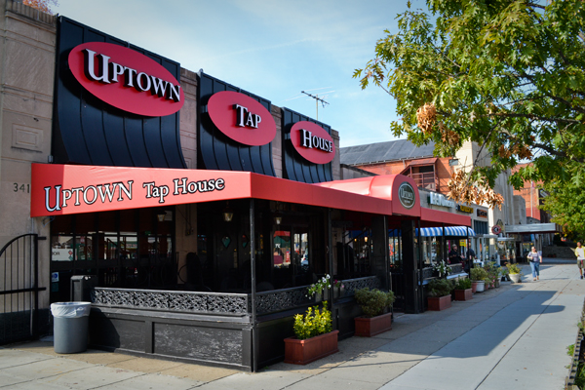
Celebrating 30 Years of WE
Time to Celebrate
30th Anniversary Happy Hour
at the Uptown Tap House

Slide 35
Celebrating 30 Years of WE

Slide 36
Celebrating 30 Years of WE
Photo Credits:
Valerie Caracelli
Ann Emery
David J. Bernstein

Slide 37
Contact Information
Washington Evaluators
www.washingtonevaluators.com
Twitter: @washeval
LinkedIn: Search for Washington Evaluators on LinkedIn

Slide 38
WE Member Input on Communities of Practice
Networking and Social Activities
Activities that foster personal connections.
“Speed-dating” format to share ideas on topical subjects.
Evaluation-related Resources and Guidance
Website with standardized definitions and resources.
Guidance for evaluators, such as affiliate-area resources.
Case clinics to provide in-depth focus on evaluation issues.
Searchable member directory with interests, tools, etc. (WE has one, but members don’t always complete provide information).
Mentoring and Peer Support
Buddy system to pair evaluators by their interests.
Ways of integrating those new to the evaluation community (see mentoring).
Washington Evaluators

Slide 39
Think Tank Format
Per AEA, a think tank is a 90-minute session focusing on 1 issue/question.
Small Group Discussion: 20 Minutes.
Reconvene to share enhanced understanding through discussion facilitated by Chairperson: 20 Minutes.
(Concise, Specific, Operational Ideas)
Wrapping Up/Next Steps: 5 Minutes
Washington Evaluators

Slide 40
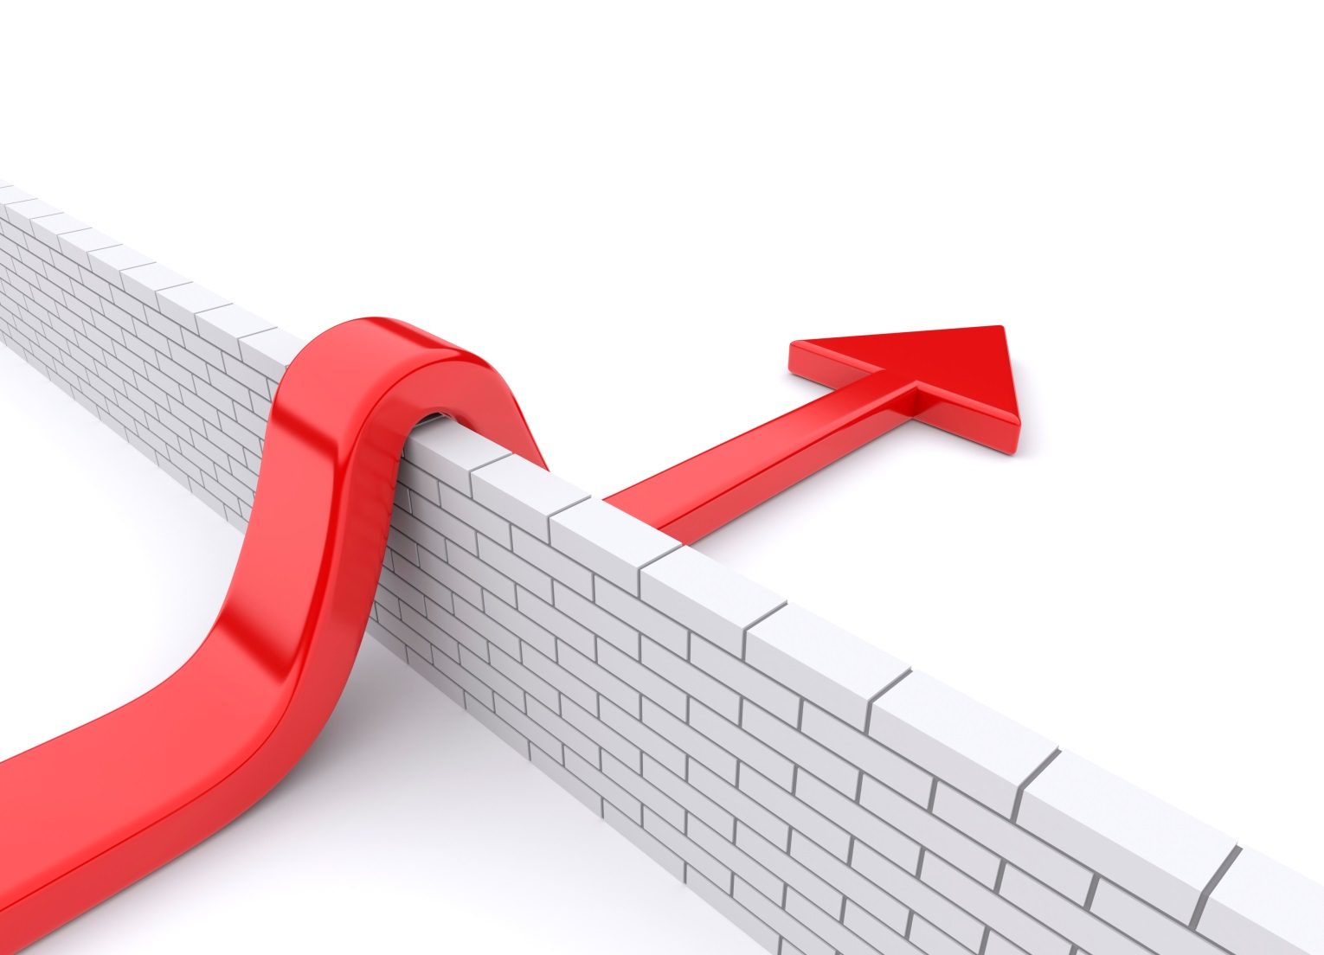
Think Tank Questions
How can evaluation communities of practice take advantage of opportunities and address challenges to sustain evaluators and the evaluation profession?
What are the opportunities?
What are the challenges?
What practices sustain evaluators?
What practices sustain the evaluation profession?
Sustainable progress.
Operational ideas for AEA affiliates.
Support for evaluators and the profession.
Washington Evaluators

Slide 41
Contact Information
Washington Evaluators
www.washingtonevaluators.org
Twitter: @washeval
LinkedIn: Search for Washington Evaluators on LinkedIn
AEA’s Local Affiliates Collaborative: http://www.lacaea.org/
Washington Evaluators

