Slide 1
Do Evaluation Knowledge and Skill Transfer? :
Building Local Expertise Through Exposure/Collaborative Evaluation Practice With International/External Evaluation Practitioners (in Indonesia)
B. Dwiagus Stepantoro
InDEC (Indonesian Development Evaluation Community)
2013 AEA Conference, Washington D.C

Slide 2
CONTEXTS
Post-Reform in Indonesia → public demand development results
Paris Declaration → Jakarta Commitment → public demand for Aid Effectiveness
Growing number of evaluation and/or M&E related works in Indonesia
Growing numbers of Local Indonesian professionals working in Evaluation/M&E

Slide 3
How do local evaluation practitioners build their professional self-capacity?
TRAINING
Reading Materials
Learning by Doing

Slide 4
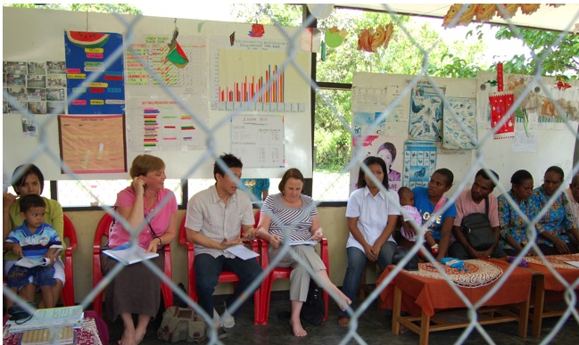
How about, exposure to /participation in Evaluation and/or M&E Exercise?

Slide 5
Key issues:
Growing number of International/Expat Evaluation/M&E Practitioners working in Indonesia
Indonesia has become a ‘training ground’ for international/expat
… but what did the local/national get from it?

Slide 6
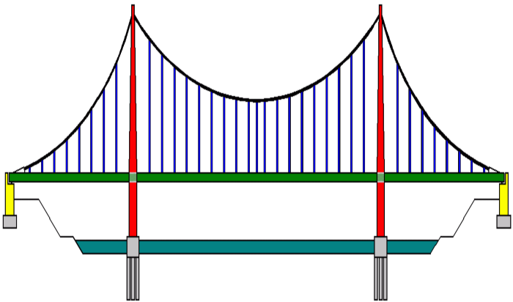
Key Questions:

Slide 7
Method
Respondents:
74 participants
Indo-MONEV –Listserv (555 subscribed members)
InDEC – LinkedIn Group
InDEC and Indo-MONEV – Facebook Group
Questioner – self-perception and assessment (subjective)
Online Survey

Slide 8
Respondents Profile - Affiliation
International – Donor/Bilateral/Multilateral
International – NGO
Company/Contractor
Individual/Independent
Government
Academia
Local NGO
Other

Slide 9
Respondents Profile - Experience

Slide 10
Respondents Profile – Job Desc

Slide 11
Experience of Collaboration/Participation

Slide 12
Type of collaboration

Slide 13
Roles and Contribution
n = 67
n/a = 7

Slide 14
Gain More knowledge/skill?
Extremely
Large Amount
Not at all
Fairly Little
Fairly Large
How to design & implement M&E Syst.
How to design & conduct Evaluation
How to commission Evaluation
How to design & implement ECB
How to promote evaluation use
Knowledge: culture, politic, ethic, etc.

Slide 15
FACTORS – average rating
NOT AT ALL INFLUENTIAL
SOMEWHAT INFLUENTIAL
EXTREMELY INFLUENTIAL

Slide 16
CONCLUSION
Knowledge transfer does happen between local & expat
Only when there are:
a highly motivated and confident local practitioners for learning
a keen, trusted, and skilled expat/int’l practitioners for knowledge sharing

Slide 17
for LOCAL (individual) Practitioners?
Build self-motivation – purpose-driven
Build self-confidence – equal partner
Be pro-active as an active learner
Be open and respectful to the partner
Be opportunistic – use any opportunity for interaction → Make a plan!
Gain support from supervisor & peers

Slide 18
For EXPAT/INT’L Practitioners?
Equip yourself with knowledge/skills on how to impart knowledge and skills
Allocate time/space and Create mechanism for interaction →
Be respectful to Local Practitioners
It’s a give and take situation
NO EXCUSE!!!

Slide 19
For InDEC (Indonesian Development Evaluation Community)
Continuous reminder for Local Practitioners for self-capacity building
Provide peer support or tips/guidance
Advocacy to the ‘commissioning’ institutions to provide space and opportunity

Slide 20
TERIMA KASIH
B. Dwiagus Stepantoro
InDEC (Indonesian Development Evaluation Community)
Email: bdwiagus@gmail.com or info.indec@gmail.com

