Slide 1
Measuring Inter-Agency Collaboration and Coordination in First 5 Fresno County: Experiences of Evaluators and Stakeholders in Understanding Systems Change Over Time
Gary Resnick, Evaluation Director, Harder+Company
Olivia Arnold, Evaluation Officer, First 5 Fresno
American Evaluation Association Conference
November 5, 2011

Slide 2
First 5 Fresno County (F5FC)
FY 2010/2011
Disbursed approximately $15 million to funded agencies (around 110 contracts)
Funded services reached close to 8,600 clients:
4,458 children (51%)
2,693 parents (32%)
1,370 professionals in the community (16%)
34 selected other (1%)
Notes:
FY 2009-2010 F5FC disbursed approximately $16 million to funded agencies
Parents: 2571 - 29.97%
Prenatal: 122 – 1.42%
0-3: 2162 – 25.20%
3-5: 2296 – 26.76%
Providers: 1370 – 15.97%
Other: 58 - .68%
99,549
Fresno County Population- State of California Dept of Finance, Race/Ethinicty Population and Sex Detail
FY 2010/2011 Contract Breakdown
FOCUS AREA # AMOUNT
Family Strengthening #=32 $5.5 million
Early Care & Education #=32 $2.9 million
Health #=12 $2.9 million
System Improvement #=34 $4.3 million

Slide 3
To what extent has First 5 Fresno acted as a catalyst and convener for change in systems of care in Fresno County?
Service Integration: Methods for local health, education, social, and other service providers to increase collaboration and coordinate services
When resources are limited and agency budgets are under pressure, agencies must do more with less
To make service integration work, collaboration needs to occur among agency administrators as well as front-line service providers
Notes:
Goals of Service Integration:
To provide a seamless system of care for children and families
Traditional service delivery systems are fragmented, duplicative, and tied to categorical funding
Benefits of Coordination and Collaboration:
Streamline eligibility systems to allow easier and quicker access to services
reduce administrative costs
focus on primary prevention and early intervention to reduce long-term costs

Slide 4
Measuring Coordination and Collaboration – The Levels of Collaboration Scale¹
What are the levels of collaboration that were measured?
No interaction 0 | Networking 1 | Coordination 2 | Collaboration 3
 | Aware of organization; loosely defined roles; little communication; all decisions are made independently. | Share information; some defined roles; frequent communication; some shared decision making. | Share ideas and resources; frequent communication is characterized by mutual trust; decision making is done jointly.
1. Frey BB, Lohmeier JH, Lee SW, Tollefson N, and Johanning ML. (2004). Measuring change in collaboration among school safety partners. American Journal of Evaluation 2006; 27; 383
Notes:
Data Collection:
Web-Based Survey to Service Providers
Year One: 29 funded agencies
Average 1.96 staff per agency
57 respondents
4 executive directors (7%)
22 program coordinators (39%)
20 line staff (35%)
Year Two: 46 funded agencies plus 27 non-funded agencies
Average 2.08 staff per agency
96 respondents (funded agencies)
9 executive directors (9%)
48 program coordinators/managers (46%)
39 line staff (37%)
27 funded agencies same as Year One (93% of original group)
Response Rates: 100 percent, Year One, Year Two

Slide 5
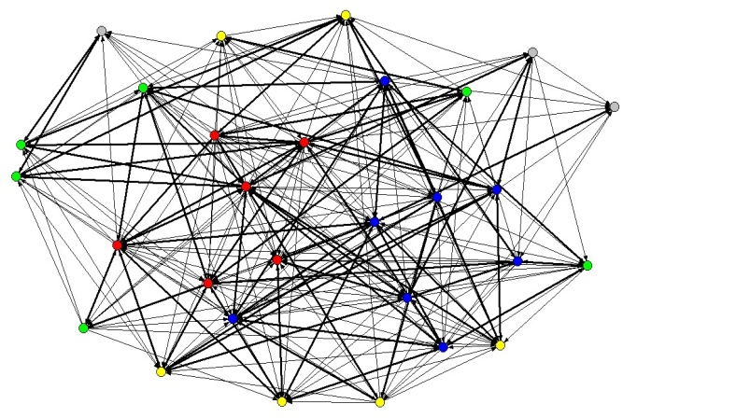
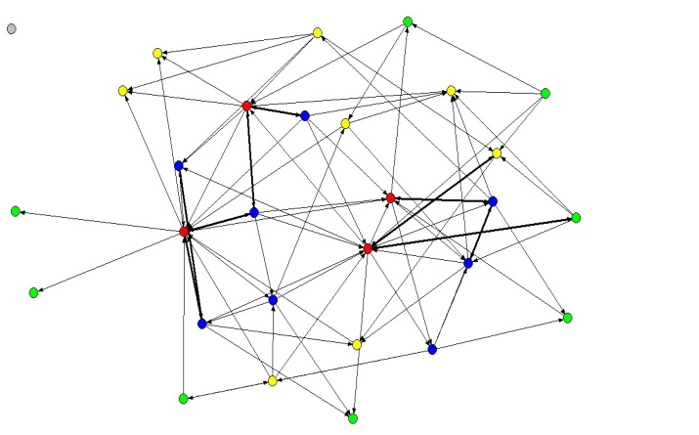
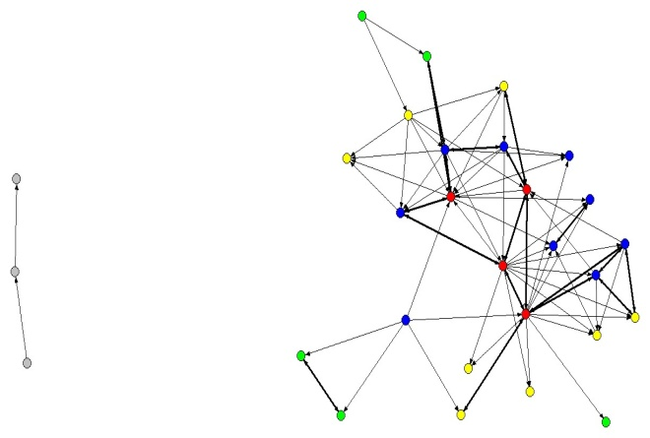
First Year Results – Funded Service Network
Networking 1
Aware of organization; loosely defined roles; little communication; all decisions are made independently.
Coordination 2
Share information; some defined roles; frequent communication; some shared decision making.
Collaboration 3
Share ideas and resources; frequent communication is characterized by mutual trust; decision making is done jointly.
62% of all interactions between funded agency partners were rated Networking
19% of all interactions between funded agency partners were rated Coordination
19% of all interactions between funded agency partners were rated Collaboration
Notes:
Findings:
Service providers are highly connected to each other, but mainly at the level of Networking, suggesting room for change towards greater levels of coordination and collaboration among service providers in the future.
A core group of service providers described as “key players” appear to be strategically placed at the network center based on the number and strength of their interactions with other agencies. These key players are at the heart of the network because they have more direct interactions with many other agencies.
At the Coordination and Collaboration levels, there are an almost similar number of interactions between agencies, with other agencies being more relatively isolated. This pattern suggests that a few agencies have long-standing relationships with other agencies at the higher levels of the Collaboration Scale, but that other agencies are not part of these relationships.
The establishment of already-existing collaboration relationships between agencies appears related to these agencies having received funding from First 5 in prior years, thus suggesting the role of First 5 Fresno in enhancing collaboration between agencies. The challenge is to bring in more of the other agencies who are not already part of established collaborative relationships and to encourage them to become more highly integrated into the system of care in Fresno County.

Slide 6
Change in Funded Agency Network Across Two Years
 | Year One, n=27 |  | Year Two, n=27
 | n | % | n | %
Density (total interactions from possible) | 415 | 59.1% | 365 | 52.0%
Networking Only | 261 | 62.9% | 235 | 64.4%
Coordination Only | 69 | 16.6% | 75 | 20.5%
Collaboration Only | 85 | 20.5% | 55 | 15.1%
Coordination and Collaboration | 154 | 37.1% | 130 | 35.6%
Notes:
Findings:
Reduced Density of Funded Service Provider Network
No change in Networking
Increase in Coordination
Decrease in Collaboration
Shift from Collaboration to Coordination
Tentative Hypothesis:
Agencies experienced across-the-board reductions in year two budgets
Reduced budgets meant decrease in collaborative activities, e.g. MOU’s
Less costly to do more coordination than collaboration
F5FC provides its service providers with both formal (e.g., program meetings, Learning Circles, Outcome Cluster meetings) and informal opportunities to interact with each other

Slide 7
Two-Year Change in Collaboration, n=27
Year One
Year Two
21% of all interactions between funded agency partners were rated Collaboration
15% of all interactions between funded agency partners were rated Collaboration
Notes:
The star pattern shows a well-established set of interactions among a few subgroups of service providers

Slide 8
Implications: Evaluator’s Perspective
Define network and its members
Need 100% response rate or close to it
Identify possible interventions to improve service integration
Explain network analysis to stakeholders
Utility for policymakers, agency staff, funders
How to stimulate greater collaboration
Understand Limits
Statistical significance
Strength of ties but not content of ties
Expected timing of network-related change

Slide 9
Communicating Results
Outcome/Impact
Commission
Service Providers
Continue to provide regular opportunities
Providers act as “conveners”
Program Review Committee
Evaluation meetings with staff and the Commissioners
Quarterly cluster meetings
SOW & budget development meetings
Initiative meetings
Identify next steps
Review of referrals & collaboration
Sustainability
On-going TA
Notes:
Coordinate services:
Decrease duplication
Save resources
Determine referral sources:
Establish relationship or interagency agreement
Refine referral and feedback procedures
Bridge communication with Service Providers
Assist in making referrals to community agencies
Use available resources to make decisions about what steps to take after screening

Slide 10
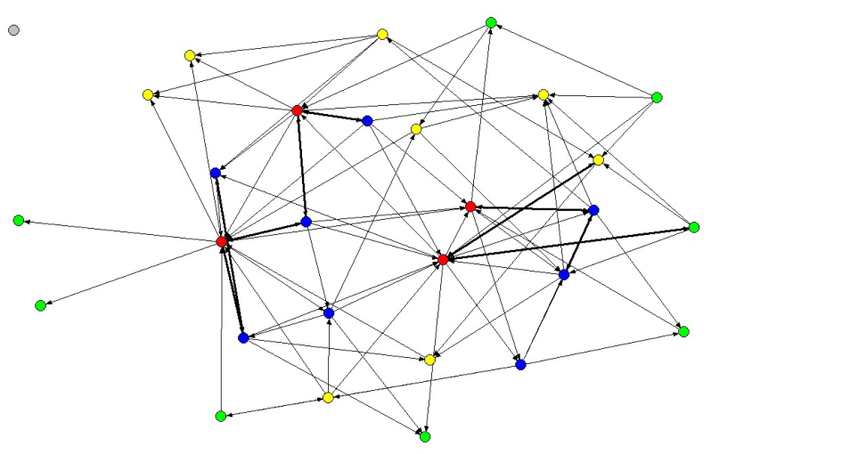
CASA - Case Study
Collaboration
Coordination
Notes:
WHO IS CASA?
CASA is an organization of neutral, court-appointed Advocates who are the voice for abused and neglected foster children in Fresno and Madera Counties.
WHY IS CASA NEEDED?
In Fresno and Madera counties, there are over 2,000 children in the foster care system, and studies show that children with a CASA volunteer are substantially less likely to spend time in long-term foster care.
THE RESULTS
When a child connects with a permanent family, their chances for a successful future and positive contributions to their community increase dramatically.
Not Highly connected to each other
Limited direct interactions
No real long-standing relationships

Slide 11
CASA - Case Study (Cont’d)
Evaluated past interactions
Reviewed program leadership
Identified beneficial relationships
Improved training for Advocates & Supervisors
Re-vamping of training curriculum
Increased connection to DSS
Increased effectiveness because of greater access
Increased cooperative spirit
Stronger partnerships /strengthened relationships
Maximizing resources
Complete revamp of how
CASA is working

