Slide 1
Causal Loop Diagrams
Design and Applications
Jeff Wasbes
Research Works, Inc.
AEA Annual Conference, 2011 Anaheim, CA

Slide 2
Presentation Outline
Introduction
The what and the why…
Mechanics
The how…
Structure and Behavior
Some tips
On good diagramming practice
Cautions

Slide 3
Introduction
What are Causal Loop Diagrams?
An important tool for representing the feedback structure of systems
They are useful for
Quickly capturing hypotheses about the causes of dynamics
Eliciting and capturing the mental models of individuals or teams
Communicating important feedbacks you think might be responsible for a problem

Slide 4
An endogenous point of view
Discovering and representing feedback processes that encourage “Policy Resistance”
Identifying Confounding Variables and Sources of Ambiguity
Cognitive Maps and “Fundamental Attribution Error”
How might the behavior change if the structure of the system is altered?
Sterman, 2000.

Slide 5
When…?
Early and Often
An iterative process as we learn more about the system and its behavior
Why…?
Bounded Rationality
7 ± 2

Slide 6
Argyris: Double Loop Learning
Action causes consequence
Consequence affects action (more or less of the same)
Single Loop Learning
Works within the same Governing Rule Boundaries

Slide 7
Argyris: Double Loop Learning
Action causes consequence
Consequence causes reconsideration of Rule Boundaries
Double Loop Learning
Realigns the system through valid information

Slide 8
Mechanics of CLDs

Slide 9
The problem…
Litter in a Public Park (a simple example)
DGS Personnel and Resources
Maintenance
Clean Park
Increased Use

Slide 10
A Causal Loop Perspective…
All objects (variables) are nouns

Slide 11
Constructing a Simple Diagram
All objects (variables) are nouns
All links show causality
All links have Polarity

Slide 12
Constructing a Simple Diagram
All objects (variables) are nouns
All links show causality
All links have Polarity

Slide 13
Positive Link Polarity
+
Litter
Park Maintenance
An increase in the amount of Litter causes Park Maintenance to change to a level of effort that is more than it would have otherwise been…
Time
OR
A decrease in the amount of Litter causes Park Maintenance to change to a level of effort that is less than it would have otherwise been…
Time

Slide 14
Constructing a Simple Diagram
All objects (variables) are nouns
All links show causality
All links have Polarity

Slide 15
Litter
Park Maintenance
Negative Link Polarity
-
An increase in the level of effort in Park Maintenance causes the amount of Litter to change to an amount less than it would have otherwise been…
Time
OR
A decrease in the level of effort in Park Maintenance causes the amount of Litter to change to an amount greater than it would have otherwise been…
Time

Slide 16
Constructing a Simple Diagram
All objects (variables) are nouns
All links show causality
All links have Polarity
All loops have polarity

Slide 17
Balancing/Negative Loops
Balancing 1st Order Loops generate Goal-Seeking Behavior

Slide 18
Reinforcing/Positive Loops
Reinforcing 1st order loops generate exponential growth or decay

Slide 19
Constructing a Simple Diagram
All objects (variables) are nouns
All links show causality
All links have Polarity
All loops have polarity
…and the important ones should have names

Slide 20
Show important delays in the system
What story does this diagram tell?

Slide 21
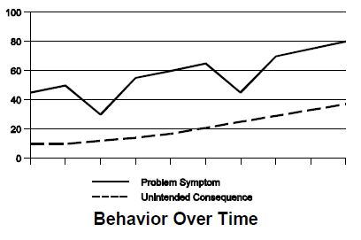
Fixes that Fail
Map the structure leading the problem symptoms
Map the structure leading to the unintended consequences
Identify the fundamental causes to the problem
Find connections between both sets of loops…
Find high-leverage interventions
Are there new unintended consequences?

Slide 22
Fundamental Cause…?
Notes:
1st Order Positive Loops cause exponential growth or decay. By engaging the positive, first order Public Engagement Loop, we might be able to cause the current state of the system (litter) to be lower than it would have been otherwise.

Slide 23
Systems Archetypes
An aide to understanding structure and behavior

Slide 24
Limits to Growth

Slide 25
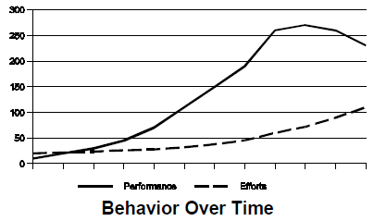
Limits to Growth

Slide 26
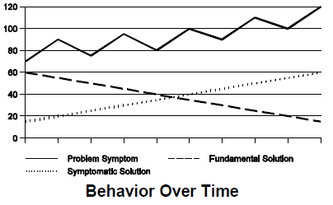
Shifting the Burden

Slide 27
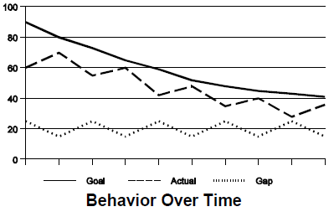
Eroding Goals

Slide 28
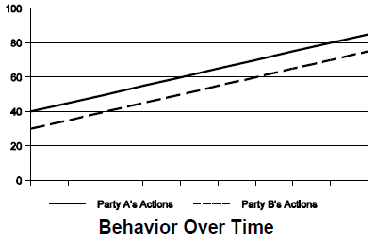
Escalation

Slide 29
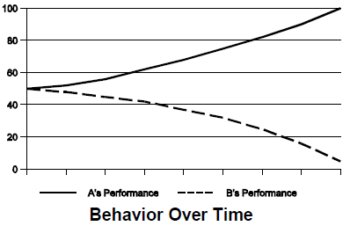
Success to the Successful

Slide 30
Choose the Appropriate Level of Aggregation
Your diagram should communicate a story – don’t overcomplicate
Make the goals of negative loops explicit
Distinguish between actual and perceived conditions

Slide 31
Minimize Clutter

Slide 32
Minimize Clutter
Organize your diagram to minimize crossed lines
Model the System to Solve the Problem
Vensim PLE:
www.vensim.com
A free software package for formulating SD models

Slide 33
References
Argyris, C. and Schön, D. (1974) Theory in practice: Increasing professional effectiveness, San Francisco: Jossey-Bass.
Braun, William. 2002. The System Archetypes.
Richardson, GP. 1986. Problems with Causal Loop Diagrams. System Dynamics Review 2(2):158-170.
Sterman, JD. 2000. Business Dynamics: Systems Thinking and Modeling for a Complex World. Irwin McGraw-Hill: Boston.
Thank you!

Slide 34
For follow-up or questions
Jeff Wasbes
jwasbes@researchworks.org
jwasbes@gmail.com
Thank you!

