Slide 1
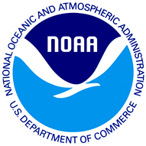
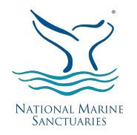
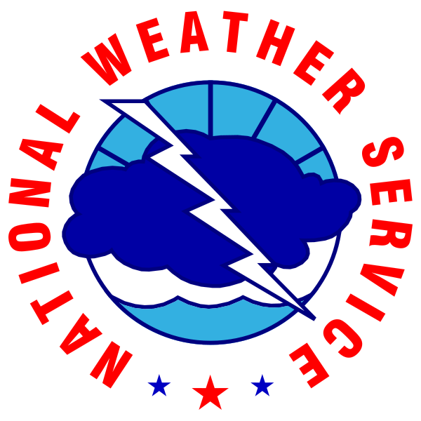
An Evaluation of Partnerships in NOAA Education
Diana L. Payne, Ph.D. Connecticut Sea Grant / University of Connecticut
American Evaluation Association conference
Denver, Colorado
October 16, 2014

Slide 2
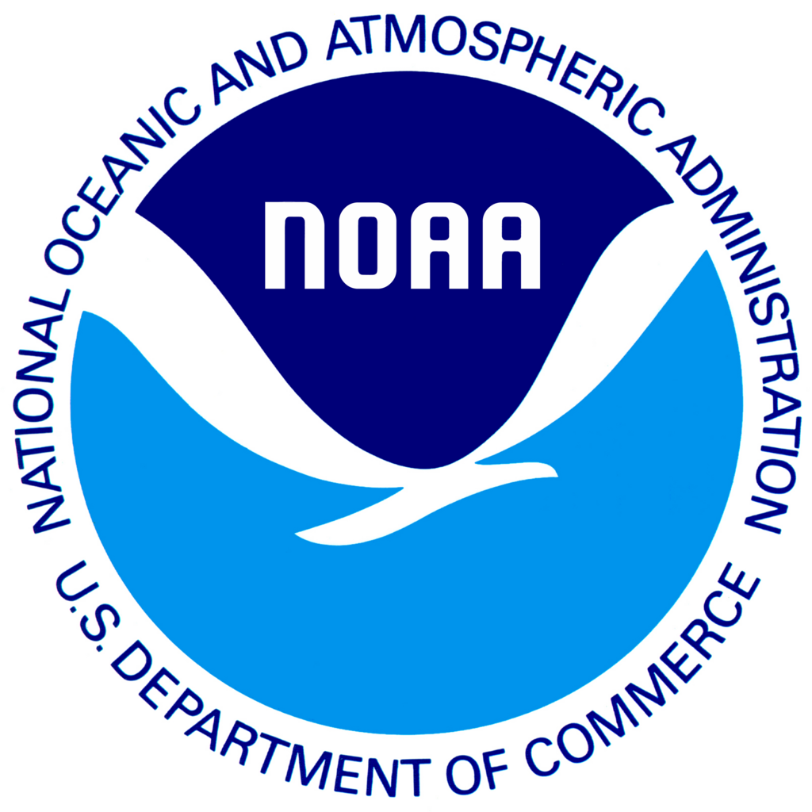
Overview
Internal evaluation by NOAA Education program staff and internal evaluators to study NOAA’s portfolio of education partnerships.
Goal: To better understand how NOAA Education partnerships are formed, fostered, sustained, and evaluated.
Includes responses to National Research Council’s (NRC) publication NOAA’s Education Programs: Review and Critique.
Participatory process evaluation
Portfolio review

Slide 3
Research Questions
How can NOAA partners help complete our mission?
In what ways does NOAA maximize its Education partnerships?
What commonalities are shared by NOAA Education high-return partnerships?
What tools and strategies are needed to foster an effective NOAA partnership portfolio?
Notes:
In addition to recommendations made by the NRC, the following questions were developed by the PWG leads and evaluation leads at an initial meeting in 2013 and reviewed by the PWG members

Slide 4
Methods
Portfolio Review
An internal evaluation of an agency’s portfolio efforts in relation to goals and outcomes.
Includes developing research questions, collecting and analyzing data, and developing actionable recommendations.
Partnerships Survey
Total number of responses in survey (n=67)
NOAA Education Council members were asked to report on their Top 5 partnerships.
Case Studies
Identified based on survey data and working group members.

Slide 5
Evaluation Design
Notes:
Based on the research questions, the PWG leads and evaluation leads outlined the following sequential, mixed-methods design to help answer the research questions. The results of the quantitative component (e.g., survey) would provide a broad view of the portfolio. The qualitative component (e.g., case studies) would examine partnerships by analyzing mechanisms and outcomes related to success.

Slide 6
Guiding Questions-Survey Data Analysis
With whom does NOAA Education partner?
What types of institutions are represented in NOAA Education partnerships?
How does NOAA Education formalize partnerships?
What is the current status of NOAA Education partnerships?
How long have NOAA Education partnerships been in place?
Where are NOAA Education partners?
How much funding has NOAA contributed to the partnership?
How much staff time has NOAA contributed to the partnership?
Does the partner share NOAA Education goals and objectives?
Does the partnership align with NOAA Education output measures?
Does the partnership allow NOAA to reach new audiences?
Does the partnership provide access to expertise, facilities, and technology NOAA does not have?
Does the partnership allow NOAA to provide unique expertise and/or opportunities?
Could the outputs and activities be achieved in the absence of the partnership?
Notes:
Fourteen analysis questions were developed by evaluation leads to help guide working group members in analyzing the survey data. The questions were developed based on the Partnership Survey items, survey responses and evaluation questions. The answers provided a broader understanding of who NOAA Education partners with, the strategies for partnering, and the resulting outcomes of the partnership. The 14 questions were:

Slide 7
Case Studies: 3 Core Models
Core Model 1: Partnerships with Informal Education Institutions
Core Model 2: Partnerships with Non Profit Institutions
Core Model 3: Partnerships with a Focus on Local Issues
Notes:
The PWG identified case studies that represented broad categories of partners identified in
the survey data and to which working group members could easily access data. The PWG
had limited time and needed to rely on the working group to document partnership case
studies (i.e., convenience sampling). With examples of case study partnerships selected,
three broad categories were identified as core models based on the type of partner: 1)
informal education institutions; 2) nonprofit organizations; and 3) partnerships with a local
focus.

Slide 8
Core Model 1:
Partnerships w/ Informal Ed. Institutions
Survey results: NOAA Education programs have numerous partnerships with informal education institutions (e.g., zoos, aquariums, museums); 32% of partnerships reported in the survey were of this type.
Partnerships with informal education institutions help NOAA:
1) increase access/reach to broader audiences and diverse populations (some
of which might not be reached in the absence of the partnership);
2) better distribute NOAA science, data, technology and issues important to
NOAA (e.g., via exhibits, websites); and
3) facilitate broader impacts of NOAA science and scientists.
Key components to success include:
- Consistent communcation between specific points of contact for each partner
Example 1A: NOAA and the Exploratorium
Example 1B: NOAA and the Oakland Museum of California (OMCA)
Example 1C: NOAA and Science on a Sphere (SOS)
Notes:
The contacts are committed to sustaining the partnership, and may or may not have been integral to the formation of the partnership. The mutual points of contact can also facilitate opportunistic collaborations to capitalize on the capabilities each partner brings to the relationship.

Slide 9
Core Model 2:
Partnerships with Non Profit Institutions
Survey results: NOAA Education programs have many partnerships with non profit institutions; 25% of partnerships reported in the survey were of this type, and have a more targeted audience (e.g., in-service teachers, students) and content (e.g., atmospheric and ocean science; surviving severe weather events).
NOAA partnerships with non profit institutions have resulted in:
1) long-term involvement of partners and participants;
2) products and programs that have been leverageable for additional support
(funding and/or in kind) from other federal agencies and organizations; and
3) involvement of highly recognized celebrities in the support and promotion of
projects.
Key components to success include:
- meaningful evaluation
- support from program leadership
Example 2A: NOAA Partnership with the American Meteorological Society (AMS)
Example 2B: NOAA and PLAN!T NOW Young Meteorologist Program
Notes:
They are generally more targeted in terms of audience (e.g., inservice teachers, children) and/or content (e.g., surviving severe weather events) than partnerships with informal institutions.

Slide 10
Core Model 3:
Partnerships with a Focus on Local Issues
Survey results: 61% of the partnerships reported take place at the local or state level (40% local, 21% state).
Local partnerships allow NOAA to:
1) capitalize on interest in local issues directly connected to mission and goals;
2) encourage local (and often sustainable) collaboration among scientists,
educators and others on common community issues; and
3) leverage local and/or regional funding and resources.
Key components for success include:
established personal relationships among key people knowledgeable about
the local issue(s)
leveraged in-kind resources (e.g., meeting space, ship/vessel time, technical
support).
Example 3A: EPA Great Lakes National Program Office (EPA GLNPO) partnership with Center for Great Lakes Literacy (CGLL)
Example 3B: NOAA and Channel Islands Naturalist Corp Volunteer Program of Channel Islands National Marine Sanctuary (CINMS) and Channel Islands National Park (CINP)
Notes:
Given the geographic and content diversity (e.g., ocean, coast, Great Lakes, atmosphere, weather) and the individual education mandates within specific NOAA Education programs, forging partnerships with a focus on local issues is a unique strength of NOAA.

Slide 11
Research Question 1: How can NOAA partners help complete our mission?
Increase Program Reach
NOAA partners help programs reach audiences, in number and in type. (Q6: 97% reach new audiences; CS 1A: Exploratorium, CS 1C: Science on a Sphere)
Increase Program Efficiency
NOAA partners contribute resources to meeting shared goals. NOAA makes efficient use of investments and assets. (Q8: In 94% of partnerships, NOAA provides science & techology; CS 3A: Great Lakes)
Increase Program Effectiveness
NOAA partners bring their expertise and unique capabilities to partnerships (Q7: 87%). NOAA programs are more effective by leveraging these strengths.

Slide 12
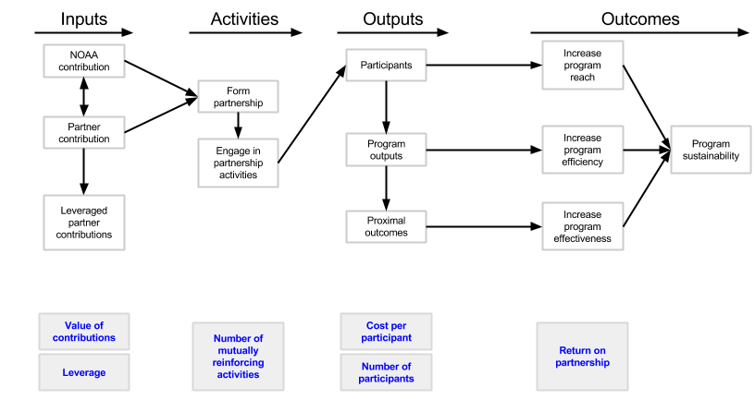
Research Question 1: How can NOAA partners help complete our mission?

Slide 13
Research Question 2: In what ways does NOAA maximize its Education partnerships?
NOAA maximizes partnerships when:
Partners leverage NOAA funding and support into additional investments from other funders (AMS, CINP)
Personal relationships are leveraged as well as dollars (Exploratorium, OMCA, SOS, Great Lakes)
Local resources and expertise are leveraged (GL, CINP)
NOAA offices are able to expand upon a partnership to involve broader participation (Exploratorium)
Partnerships reach a level of maturity where relatively modest in-kind contributions by NOAA are needed to sustain the partnership (Exploratorium, AMS)

Slide 14
Research Question 3: What commonalities are shared by NOAA Education high-return partnerships? (1 of 2)
Performance aspects indicating a high-return partnership:
Partners leverage NOAA dollars (SOS, Great Lakes)
Staff time is invested by partners is equal to or greater than NOAA staff (SOS)
Partners bring in multiple partners (SOS, Great Lakes)
Partnership opens the doors to new partners (SOS, AMS, P!N, Great Lakes, OCMA)
NOAA resources are used in new and different ways (Exploratorium, SOS, P!N)
Opportunities are capitalized on as they arise (P!N, Great Lakes, CINP)

Slide 15
Research Question 3: What commonalitiets are shared by NOAA Education high-return partnerships? (2 of 2)
Organizational aspects that indicate a high return partnership:
Successfully forging gaps between different organizations (Exploratorium)
Partner learns about NOAA and the capabilities of the agency (Exploratorium, SOS, AMS)
Partner successfully navigates NOAA bureaucracy and increases their connectivity to different parts of NOAA (Exploratorium, AMS)
Communication occurs through primary representatives from each partner (Exploratorium, OMCA, SOS, AMS)

Slide 16
Research Question 4: What tools and strategies are needed to foster an effective NOAA partnership portfolio? (1 of 2)
NOAA partnerships are most effective when there is:
Regular, ongoing communication between NOAA and the partner(s);
An emphasis on meaningful evaluation;
Support from both NOAA and partner leadership; and
A cultivation of critical personal relationships.
When forming a new partnership or transitioning an existing partnership, the following should be reviewed:
Partnership definition and criteria;
Partnership mechanisms for both formation and dissolution; and
Programming goals and resources.

Slide 17
Research Question 4: What tools and strategies are needed to foster an effective NOAA partnership portfolio? (2 of 2)
The following are essential for an effective NOAA Education partnership portfolio:
● Involving NOAA General Counsel when providing
resources or support beyond normal duties;
Determining whether a MOU or MOA is the best to use
and knowing that mechanisms can change over time; and
Establishing a point of contact in each NOAA line office
to facilitate partnership formation.

Slide 18
Recommendations (1 of 2)
The Education Council can direct the objectives of working groups. Future working groups should take on the following tasks:
Develop a guidance manual for establishing new partnerships or transitioning existing ones.
Disseminate the guidance manual and a collection of MOUs as resources for partnership development.
Provide training for NOAA educators in forming new partnerships and transitioning existing partnerships.
Conduct a cost-benefit analysis of partnerships.
Conduct a gap analysis based on the existing dataset of NOAA Education partnerships.
Notes:
5. also includes Monetizing the contributions and outcomes of partnerships.

Slide 19
Recommendations (2 of 2)
The NOAA Education Council ‘s Monitoring & Evaluation working group should take on the following tasks:
6. Develop partnerships performance measures, track total
number of partnerships, goals, money, leverage and
who is involved.
7. Review and revise the NOAA Education Partnership
survey.
8. Explore the role that partnerships contribute to existing
performance measures.

Slide 20
Response to NRC report (1 of 2)
National Research Council’s (NRC) publication NOAA’s Education Programs: Review and Critique
To better understand how NOAA Education partnerships are formed, fostered, sustained, and evaluated
NOAA Education can now:
Foster and facilitate efficient and effective education partnerships across line offices and on multiple scales (i.e., local, state, regional ,federal and international).
Focus on assuring that partnerships have clear, mutually agreed upon goals, make wise use of NOAA resources, and provide a reach that NOAA would not have in
the absence of the partnership.

Slide 21
Response to NRC report (2 of 2)
NOAA Education can now:
Focus on productive partnerships to support local and state education systems while promoting NOAA’s education and stewardship mission.
Examine the quality of external partnerships.
Improve the evaluation expertise of staff members in understanding what is required to better evaluate, design, improve and deliver NOAA Education programs.

Slide 22
Reflections
Challenges:
Participatory evaluation requires time, particularly with very smart, busy people
Anticipate unexpected delays (e.g., gov’t shutdown)
Successes:
Members of the Working Group had hands on experience with real, relevant data
Final product has already had impact (AMS Case Study)
Provided an opportunity to work with an evaluation professional within NOAA Education
Access the Executive Summary and complete report: http://www.oesd.noaa.gov/leadership/edcouncil/partnerships_portfolio.html

