Slide 1
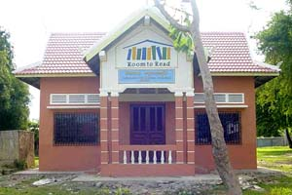
Definitions and Dashboards
at Room to Read:
Data Quality in an
International Education
Organization
www.roomtoread.org
November 5, 2011 AEA Annual Conference
Notes:
1

Slide 2
Where We Work
Nepal
2000
Vietnam 2001
Cambodia 2002
India
2003
Laos
2005
Sri Lanka
2005
South Africa 2006
Zambia
2007
Bangladesh 2008
Tanzania
2011
Cumulative Results, 2011:
School Libraries: 12,522 Local Language Titles: 591
Schools Constructed: 1,450 Local Language Books: 6.0 M
Girls on Scholarship: 13,667 Total Students Benefiting: 6.0 M

Slide 3
Global Indicators
Performance measures that show progress toward program objectives:
Collected for all programs in all countries
Collected for all active projects
13 collected quarterly; 25 collected annually
Examples:
Number of schools constructed
Number of local language books published
Number of books checked out
Number of girls who advance to the next grade

Slide 4
Defining and Using Global Indicators
Getting definitions right:
“Telephone” line from HQ to Country M&E Managers to Program Officers to field-level data collectors
Internal and external use:
Improve current program performance and future program planning
Describe trends and implications of changes in programs over time
Demonstrate results
Provide context for numbers beyond our projects

Slide 5
Project Database
Our project database is important for three key stages of the global indicator process:
Data entry
Data quality checking
Data analysis
Dashboards are used for all three stages
Dashboard characteristics:
Graphic
Country-specific
Allow drill-down

Slide 6
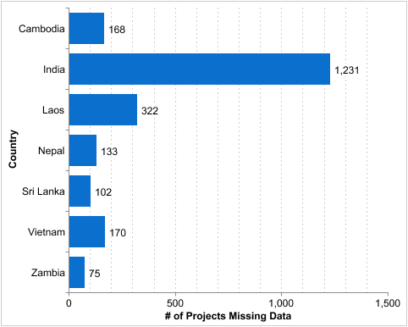
Dashboards: Data Quality
Missing Library System Data
How many 2009, 2010, and 2011 (established by 1 Oct 2011) RR/CRR projects are missing data in the Book classification system in place? (11)or Reading level system in place? (11) fields?

Slide 7
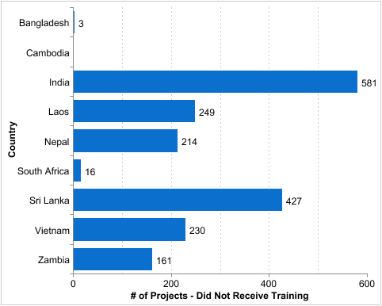
Dashboards: Program Quality
Did Not Receive Training
How many 2009, 2010, and 2011 RR/CRR projects did not receive training from 1 Jan 2011 - 15 Feb 2012?

Slide 8
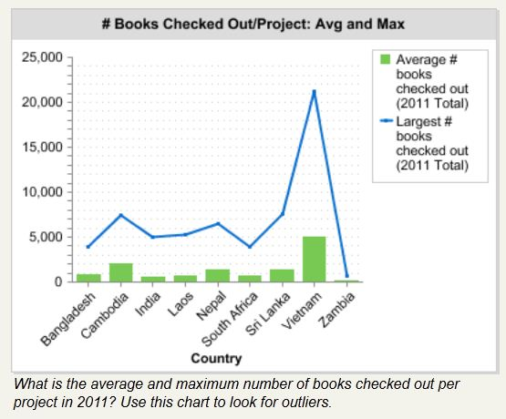
Dashboards: Looking for Outliers

Slide 9
Lessons Learned and Challenges
Dashboard Lessons:
Dashboards streamline data quality checking
Links to underlying reports help build database capacity at field level
Dashboards help push ownership, responsibility, and accountability down
Dashboard Challenges:
Consistently closing the loop on program improvement

Slide 10
Definitions and Dashboards
at Room to Read:
Data Quality in an
International Education
Organization
Michael Wallace michael.wallace@roomtoread.org
Rebecca Dorman rebeccashayne@gmail.com
Wally Abrazaldo wabrazaldo@gmail.com
November 5, 2011 AEA Annual Conference
Notes:
10

