Slide 1
When Empowerment Meets Power Distance
Meng Melody Jia
Claremont Graduate University
Email: jiameng2010success@gmail.com

Slide 2
Power
Distance

Slide 3
Power Distance

Slide 4
Little
Power Sharing
No Results found!
China Blanks Nobel Prize searches.

Slide 5
Presumption
-Cultural Value?
Notes:
Campbell
”Any specific challenge to an unexamined presumption of ours should be taken seriously”

Slide 6
Democratic
V.S.
Autocratic
Notes:
Campbell
”Any specific challenge to an unexamined presumption of ours should be taken seriously”

Slide 7
Empowerment does not work every time!

Slide 8
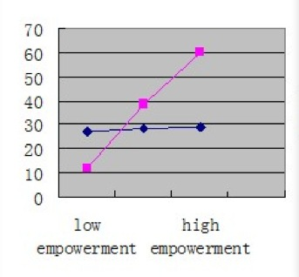
Low Power Distance
High Power Distance

Slide 9
Whether you would like to be empowered?

Slide 10
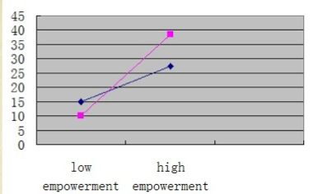
High Supervisory Support
Low Supervisory Support
Supervisory Support
Empowerment
Work Outcomes

Slide 11
Leadership Empowerment with Supervisory Support

Slide 12
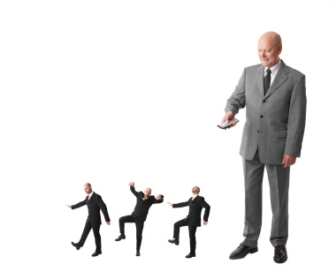
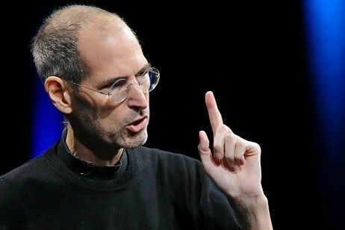
Ready to Handover Your Power to Frontline workers?
Notes:
Handover the power from the high status participants down to include participants of all status.

Slide 13
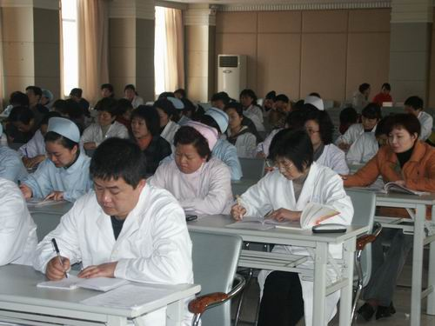
Let’s Change the Setting First!

Slide 14
Leadership Empowerment Approach
Informal Leader
Evaluators
Management
Evaluators
Frontline Workers
To ease the power difference

Slide 15
Informal Leader

Slide 16
Leadership Empowerment Approach
Informal Leader
Evaluators
Management
Evaluators
Frontline Workers
To bring the power sharing down to workers

Slide 17
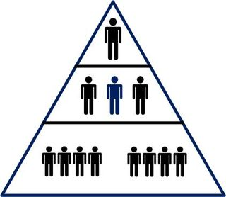
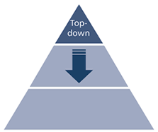
High Power Distance Countries
Hierarchical Organizational Structure

Slide 18
As an Evaluator,
Question the Underlying Assumptions of Your Approaches and Localize them to Better Serve Your Clients.

Slide 19
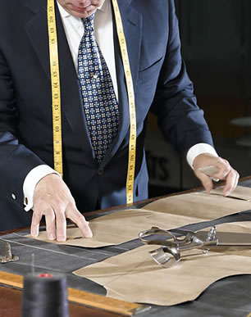
Modify and localize…
Group Average Scores instead of Individual Scores
Face Concerns
Trust Building
Informal Groups

Slide 20
Thank You !
Meng Melody Jia
Claremont Graduate University
Email: jiameng2010success@gmail.com

