Slide 1
“I Go to the Ghetto School”
There are “Good” People on Both Sides
American Evaluation Association Annual Conference
November 14, 2019 Minneapolis, Minnesota
Helping students, educators, and leaders flourish
Research & Evaluation ● Consulting & Training ● Systemic Improvement

Slide 2
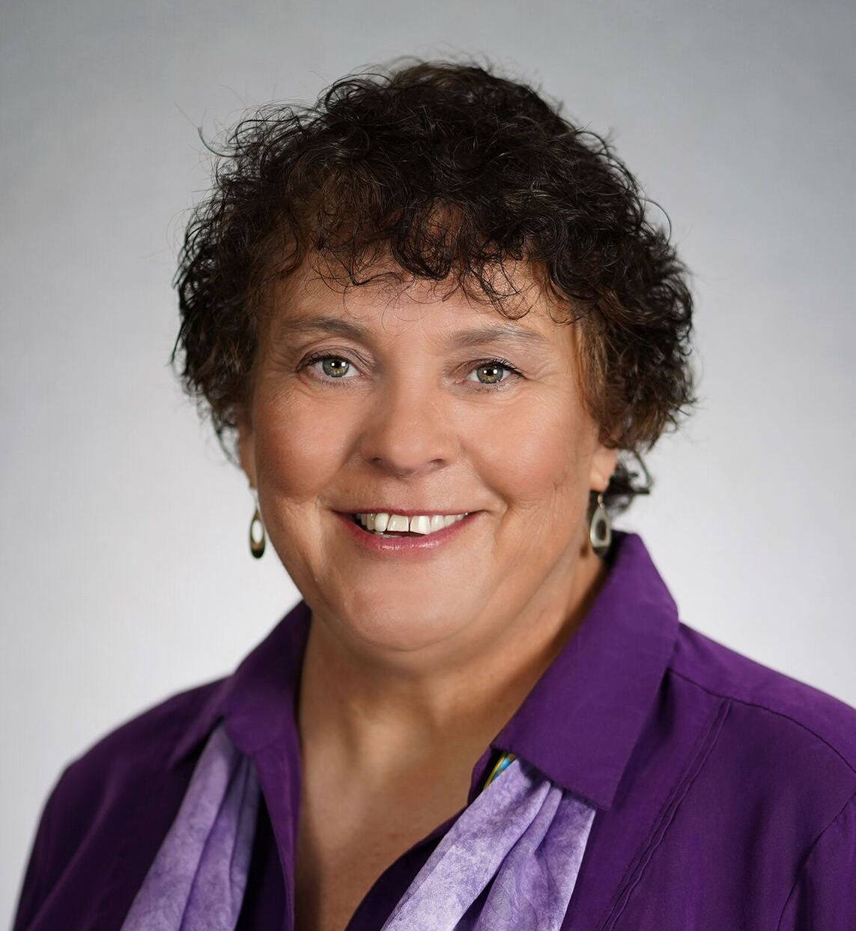
Our Presenters
Dr. Lisa Jones
Managing Researcher
McREL International
Dr. Jones is a Managing Researcher in the Denver office. She holds a Ph.D. and M.A in Organizational Leadership, Policy and Development (formerly Educational Policy and Administration) and a B.A. in Psychology from the University of Minnesota. Dr. Jones minored in Educational Psychology as a Ph.D. student.

Slide 3
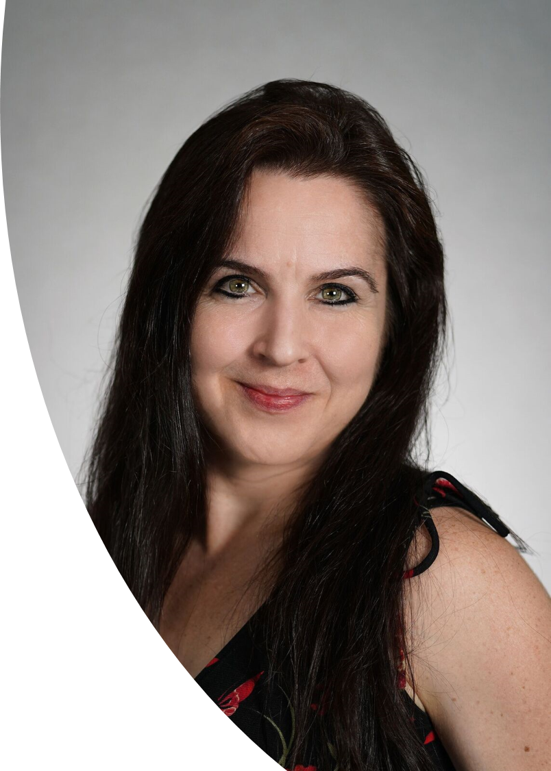
Our Presenters
Dr. Sheila A. Arens
Executive Director, Research & Evaluation / McREL International
Dr. Arens provides research and evaluation oversight for the McREL and for the REL Pacific contract. She holds a Ph.D. in Inquiry Methodology from Indiana University and a M.A. in Experimental Psychology from the University of Colorado.

Slide 4
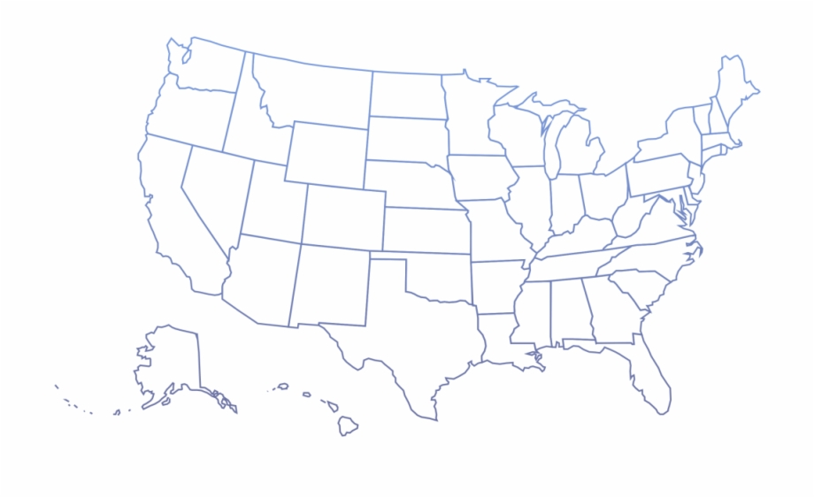
HATE AT SCHOOL: Southern Poverty Law Center (2019)
In Illinois, white elementary students call black students apes and monkeys.
In New York, a middle school student writes in a textbook that he will lynch the black husband of a white teacher.
In Minnesota, a middle school student tells a Latinx child that his mother should be in jail with all the illegal immigrants.
In Massachusetts, a 10-year-old Muslim girl gets a note saying, “You’re a terrorist. I will kill you.”
In Oklahoma, a fifth-grader draws a swastika and writes “white power” on his hand.
Costello, M., & Dillard, C. (2019). Hate at School. Southern Poverty Law Center, p. 4. Montgomery, Alabama. https://www.splcenter.org/sites/default/files/tt_2019_hate_at_school_report_final.pdf
Notes:
Not all bias is as explicit as this slide shows. Education institution sometimes implicitly (or unknowingly) supports bias – large public school system in Denver requiring Spanish-speaking parents to produce paperwork for their children before enrolling them.
Before it gets to this …

Slide 5
IT Starts Here
“We are the most diverse middle school with the most poverty. It’s not conducive to learning.”
Buffalo Hills Middle School Teacher
Notes:
Implicit bias shows itself in the comments of teachers such as this one. When a teacher shares a perception such as this then how do you think it plays out in the classroom with her students? The same teacher said she holds high expectations of all students. The classroom observation data did not reflect this.

Slide 6
Racial Framing
“The racial frame is “an overarching white worldview that encompasses a broad and persisting set of racial stereotypes, prejudices, ideologies, images, interpretations and narratives, emotions, and reactions, as well as . . . inclinations to discriminate,” (p. 170).
“Frames work to shape perception, and the racial frame shapes White perceptions and values about race. The frame acts as a screen to block facts and events inconsistent with the frame,” (p. 171).
(House, 2017)
Notes:
Consider House’s statement about racial framing within the context of the teachers’ comment about diversity and poverty. In that context, the term “Diverse” is code for “racially different from me.” Socioeconomic status is highly correlated with arbitrary racial/ethnic categories. Frames impact the way people perceive the world – those who frame it and those who are framed by it. We argue that the teachers comment reflects her implicit (in this case it is explicit) bias that people who don’t look like her and live at the poverty level either can’t or won’t learn.

Slide 7
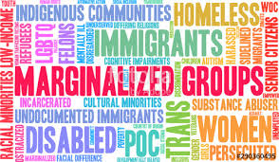
The White Frame
“The focus on race in the United States is based mainly upon physical attributes, and every culture that resides in the United States is directly or indirectly affected by it … Race, and by extension racism, defines how people interact, what chances of success they may or may not have, and how they might be granted or deprived of the basic rights of humanity … Moynihan’s ‘dilemma’ continues today having expanded to other marginalized groups,” (Bledsoe, 2018, p. 512).
Notes:
Introduction to AEA section on Race and Evaluation, Bledsoe referenced Daniel Patrick Moynihan’s 1965 US Department of Labor Report in which he “described the plight of the African American family as dire,” (Bledsoe 2018).
Bledsoe extended the to other marginalized populations given that money funding supports programs using the White racial frame to address “issues” related to “intentionally marginalized populations.” She recognizes Ernest House’s (2017) supposition that essentially says that societies may view themselves as democratic and acts somewhat democratically but doesn’t recognize the extent of racism in said democratic society then it will continue to design policies and programs that will continue to cause consistent damage to the marginalized groups.
Melvin Hall reminds us that race is a social construct rather than biological or physical. Helms and colleagues argued that “imputing behavior to a person solely on the basis of the person’s ascribed racial category is “racial profiling.” We do this in schools when we use socially constructed racial categories to explain test performance. Are the categories accurate? Do they truly represent who we are in the world?

Slide 8
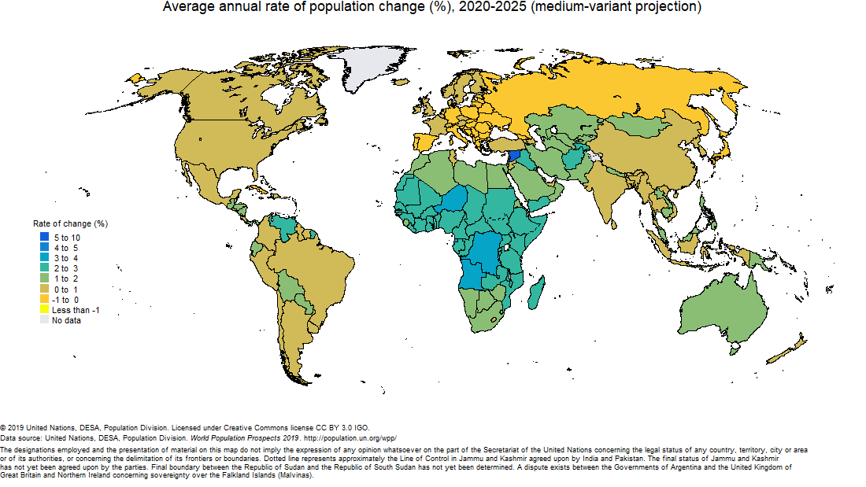
60%
8%
10%
35%
15%
6%
<1%
Notes:
The United Nations map you see here shows projected population changes over a five-year period. The percentages represent the proportion of the global population that reside within the six continents shown here.
How would you categorize people based on physical perceptions of race/ethnicity? When you look at the world map and you see where the largest proportion of people reside, it becomes challenging to use the few racial/ethnic categories that exist to “define” the world population. Years ago, my friend from Kenya was frustrated by others who would refer to her as African America. You see, Newayra lived in the US only while working on her graduate degree. She always had plans to return to Kenya, her home. So, when she was identified as African American by both whites and blacks, she felt insulted because she identified herself as Kenyan and even more so as Kikuyu.
Yet, the white fame described by Bledsoe (2018) and House (2018) is pervasive in the US and in Europe. In the US, racial/ethnic categories are used to report student assessment results. In some cases, it is broken down by White and Minorities. Looking at this map, I’m struggling with seeing Minority as anything other than white.
60% of the world’s population live in Asian (China and India, alone, account for 35% of the world’s population)
15% live in Africa
Europe 10%
North America 8%
South America 6%
Oceania <1%
Central Intelligence Agency. (2019). The World Factbook. https://www.cia.gov/library/publications/the-world-factbook/geos/xx.html
United Nations, DESA, Population Division. World Population Prospects 2019. https://population.un.org/wpp/Maps/

Slide 9
Institutional Racism
“Individual racists need not exist for institutional racism to persist in the dominant culture … racism is not fluid … one day benefiting Whites and another day (or even era) benefiting people of color … instead, the direction of power between Whites and people of color is historic, traditional, normalized, and deeply embedded in the fabric of US society.”
(Thomas, Madison, Rockcliffe, DeLaine, & McDonald Lowe, 2018, p. 516)
Notes:
Emerson (2010) said that different racial groups define the term “racism” differently. For example, Whites view the term as indicative of overt prejudicial words or actions or observable discrimination. However, according to Emerson, people of color view it differently. For them, racism is a combination of prejudice plus power and the power comes from being part of the group that controls our systems (e.g., education, health care, government, economics, and even religious). Because whites traditionally hold power to the US social institutions, then only whites can “perpetuate racism.”

Slide 10
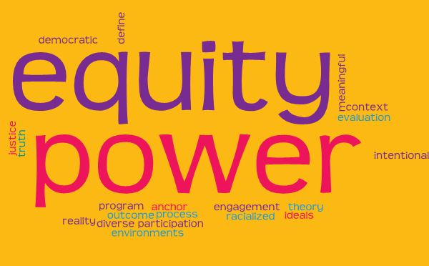
Evaluation and Racism
“The power to define reality is a supreme power. It must not be used casually,” (Thomas et al., 2018, p. 516).
Notes:
As evaluators, we travel in the experienced lives of other human beings. Thomas et al argue that oftentimes people’s lived experiences are remediated by the “racialized” context of the very programs, services, and communities in which they live. We have the responsibility to “speak for those who cannot speak for themselves.”
Many programs are targeted at symptoms (such as the education achievement gap) rather than the structural inequalities that lurk underneath. Thomas et al urge us to consider how access to opportunities are situated in policies and institutions that reinforce biases “even in the absence of racist actors or racist intentions.” (p. 517).
Hall (2018) reminds us that evaluators need to understand how the term racism is used. For example, in many of our evaluation contexts we hear terms such as “diversity”, which some social scientists argue is more palatable than the term racist or racism. Conflict softens discussions about racial inequities and helps us feel better about ourselves. But is this the role of the evaluation enterprise – to apply terms that soften or even detract from the lived experiences of those who receive services or participate in programs that we are hired to evaluate?

Slide 11
“Can social justice live in a house of structural racism in the field of evaluation?” (House, 2018)
“Structural racism: A system of hierarchy and inequity … the preferential treatment, privilege, and power for White people at the expense of Black, Latino, Asian, Pacific Islander, Middle Eastern, and other racially oppressed people,” (Caldwell & Bledsoe, 2018, p. 9).
Notes:
Consider these statements:
Evaluation is political
Power and privilege live in the evaluation world.
As you reflect on these statements, remember that Hall said that “U.S. problems of race and racism are also evaluation problems.” (Hall, 2018, p. 570)
Evaluation is derived from social science research, which historically perpetuates structural racism. The “traditional” frameworks of social science research are used to evaluate cultural and social differences– specifically being conducted by those who do not value the context or lived experiences of people of color.
In educational research and evaluation, we use “race/ethnicity” as a variable to explain outcomes such as proficiency on state accountability assessments. Hall (2018) argues that the term “race” is not robustly defined in science; yet, we use it and in doing so, reinforce existing cultural stereotypes. This is what Helms and colleagues (2005) called “racial profiling.” In research and evaluation, we attribute differences in outcomes based on individuals’ “ascribed” racial categories.
“Evaluators should seek alternative strategies that can provide more balance in the discovery of truth by incorporating the world views of minorities that participate in social programs,” (Thomas et al., 2018, p. 524).
“School policies and their effects are a frequent object of evaluation and can illustrate how race and racism may be factors just below the surface of the evaluand,” (Hall, 2018, p. 572).
As evaluators, we find ourselves juxtaposed between the need to provide credible evaluations, advocate for social justice, and generate sufficient revenue to continue our work. Recently, our evaluation team needed to balance these issues when conducting a Diagnostic Review in a secondary school.

Slide 12
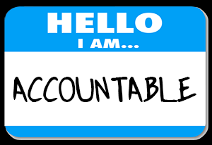
The Diagnostic School Review
To what extent does a school review process reveal evidence of institutionalized racism?
Notes:
What does it look like to enter a racialized environment when you (evaluator) are trying to understand the program, its macro- and microcontext, and its outcomes, all while conceptualizing, implementation, and disseminating and evaluation that is both rigorous and useful?” (Thomas et al., 2019, p. 519).
Our evaluation team encountered a racialized environment when we conducted a diagnostic school review. We were forced to balance our roles as evaluators committed to ideals of equity and social justice while remaining within the boundaries of state requirements for diagnostic reviews. Diagnostic reviews are conducted in schools that are “trapped” on a state’s accountability clock. The purpose of the diagnostic review is to identify the bright spots and challenges occurring within a school. The review is aligned to adopted domains of school turnaround: leadership, talent development, instruction, and culture of improvement. Our process involves administration of an online survey followed by a two day site visit in which we conduct focus groups, interviews, classroom observation, and a whole staff collaborative assessment process. Results from the review are used by schools and districts to apply for school improvement funds (capped at $75,000 per year) to increase achievement. The process, itself, is not designed to elicit racism at the school and district level. However, using the lenses of both institutional and structural racism, we were able to capture how racism is subtly embedded in a middle school culture.

Slide 13
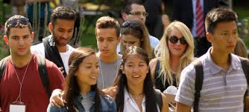
The City of Fort Bennet
Population: 165,080
Estimated household income (2016): $59,357
Percent of residents living in poverty: 15.7%
Notes:
Since 2000, the population of Fort Bennet has grown by 39%.
The estimated household income is $6,320 less than the rest of the state.
In 2018, approximately 9.6 of the states residents lived in poverty.
Primary economic driver in Fort Bennet – a local university

Slide 14
Buffalo Hill Middle School
Notes:
The demographic trends between the 2015-16 and 2018-19 school years.
Not shown is the population of students identified as migrant which rose from 0% to less than 1% in this time frame.
The chart shows an increase in the proportion of students identified as white while the student population identified as Latino/a declined.
Similarly, students eligible to receive free or reduced priced meals declined. Finally, the proportion of students who receive special education services remained stable.
The interview and focus group participants said that the demographics of the school changed significantly in the “last few years.” However, the data do not show this.
“Race is often interpreted as an explanatory variable to explain why social ills occur,” Thomas et al., 2018, p. 519

Slide 15
Achievement Data: English Language Arts
Students | 2016 | 2017 | 2018 | 2019
All Students | Approaching | Approaching | Does Not Meet | Exceeds
English Language Learners | Approaching | Approaching | Does Not Meet | Meets
Free/Reduced Lunch Eligible | Approaching | Approaching | Does Not Meet | Meets
“Minority” | Approaching | Approaching | Does Not Meet | Meets
IEP | Does Not Meet | Approaching | Does Not Meet | Approaching
Notes:
State Achievement Data
Reminder: we collected our data after the 2017-18 school year achievement data were available.

Slide 16
Achievement Data: Math
Students | 2016 | 2017 | 2018 | 2019
All Students | Approaching | Approaching | Approaching | Meets
English Language Learners | Does Not Meet | Approaching | Does Not Meet | Meets
Free/Reduced Lunch Eligible | Approaching | Approaching | Does Not Meet | Approaching
“Minority” | Does Not Meet | Approaching | Does Not Meet | Meets
IEP | Approaching | Approaching | Does Not Meet | Approaching

Slide 17
Focus Groups
Teachers
Parents
Students
School leaders selected participants
Representative sample
Notes:
Protocol Themes (Staff):
Relationship between the district and the school
Student and teacher relationships
Parent engagement
Collaboration and goals
(Students)
Future hopes and goals
Relationships with school staff
Great teaching examples
Instructional grouping
Likes/dislikes about school
What would make the school better
(Parents)
Parent relationships with school staff
Perceptions about school climate and culture
School improvement

Slide 18
From the mouths of teachers …
It’s easier for me to relate to our kids because I’m Latino and can switch languages—speak to them in Spanish.
We have blurred boundaries here. In the Latino community, there are consequences for your behavior. But, we don’t handle our own business. There are more rules at home and our school culture has fewer rules. At school, they’re allowed to get in trouble a lot. But, not at home.
Notes:
We asked the other teachers in the focus group about their own perceptions related to the bilingual teacher’s relationship with students. One person said, “It’s the reality – this is how it is. The respect that he has with the kiddoes.”
Teachers also told us that some “kids will automatically come in respecting you.” “For other kids, you have to earn their respect – they aren’t going to respect you just because you’re a teacher.” Although we didn’t probe further about respect, we did wonder if this was a reference to the students who are not from the dominant, affluent white culture in the school.

Slide 19
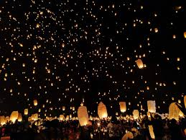
“Some students …”
Some students have “preferred adults” in the office. And, that undermines our classrooms. We start to accept more acting out behaviors in classrooms.
We have equity issues here. Some kids don’t have a computer at home. It’s hard to prescribe the same thing for all schools. [District does this] We have a diverse population and one-size does not fit all.
H O P E
Notes:
In our interviews with school leaders, we learned that the “preferred adults” in the office are bilingual. Furthermore, we heard from leaders that students “feel more comfortable” with adults who speak Spanish with them.
Despite teachers’ ‘negative’ comments such as: “We are the most diverse middle school with the most poverty. Its not conducive to learning,” we found pockets of hope. One teacher framed the “poverty – diversity” discussion through the lens of equity.

Slide 20
“I Go to the Ghetto School”
We have to find a way to acknowledge what kids experience outside of here, without making excuses for behavior. We need to guard against them hearing what we say about them. They hear what we think about them. ‘Oh – you’re at Lincoln. At the Ghetto School.’ Some kids proudly say, ‘I go to the Ghetto School.’
Notes:
The underlined phrase was said in anger and occurred right after another teacher said, “Parents do not know how to use a phone because they are poor and don’t speak English.”

Slide 21
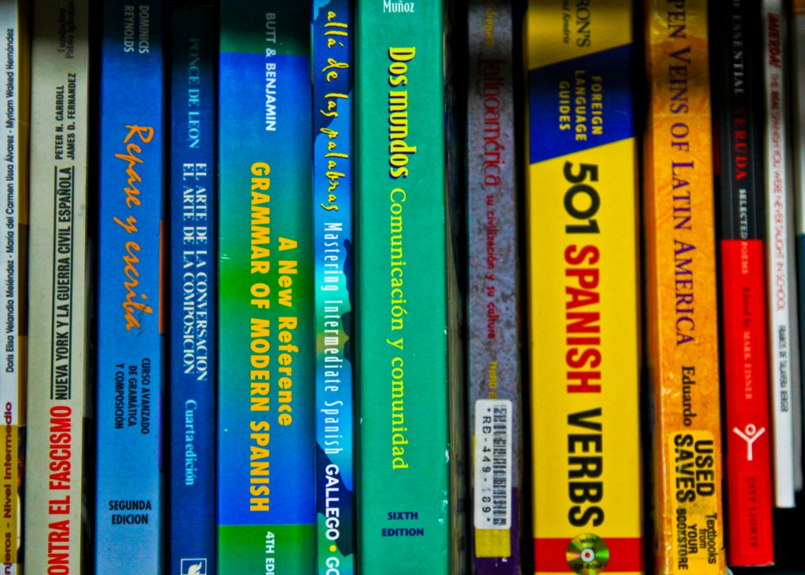
Students: “I’m bilingual and I don’t get why I have to take Spanish!” (Latino)
We have to take Spanish and a lot of kids don’t like it. I want to take French or German, but I have to take Spanish. (White Female)
Spanish is required as an encore class. Some students think it’s super stressful and they skip class. (White Female)
Notes:
Encore class is considered a “specials” class in this school. Back in the day, we may have called these ‘electives.’ However, in this school, students do not choose their ‘electives.’
Students say they want to take non-Spanish classes, and multiple students described Spanish as ‘stressful.’ How is French or German less stressful? And, why the interest in French and German?
What is even more troubling, however, is the comment by the student who speaks both Spanish and English. This student participated in the same focus group as the student who wants to learn French or German. Is this comment reflective of the internal racism this student experiences as a result of the culture and structure of both the school and the educational system as a whole? Our limited time with students (and their need to return to class) did not allow us to dig deeper into this comment. Furthermore, as an evaluator, what effect would additional probing of this student’s comment have on the relationship with other students in this particular focus group? The other students represented the dominant culture.

Slide 22
Compassion? Or, Racism?
Usually kids that act that way have stuff at home that they’re struggling with. But, they don’t need to act mean to everyone.
Notes:
Student lens

Slide 23
Parents’ / Guardians’ Perceptions
I want my daughter to learn more English in school and be successful in life.
I want kids to get encouragement from teachers and opportunities for all kids. I want them to help my child grow.
I always communicate by phone. She asked me what my needs are – family needs – this happened because I’m from out of the country. The office always asks if the family needs something.
Notes:
The parent focus groups were comprised of parents identified as Latino/a and white. In one focus group, there was a male parent who’s family is homeless (qualifies for McKinney-Vento aid). He was also white. To ensure that all parents’ / guardians’ voices were heard, the school provided translators who spoke both Spanish and English.
The Spanish speaking parents’ comments reflected their desire for their children’s success. And, also said that teachers can communicate with bilingual staff who shared information with parents.
Remember the teachers’ comment about parents not knowing how to use a phone … ?

Slide 24
Parents Referring Other Parents
I have a lot of friends who have said ‘I don’t know if I made the right choice …There are a lot of parents who wish it were stricter…I had one friend who withdrew her child because the language they were using was life-threatening and racist.
Notes:
Right choice sending their child to this middle school.
Another parent said she was “embarrassed” because she referred her friend to this middle school. She also said she is likely to send her child to a different middle school next year.

Slide 25
School Safety
Some behavioral staff don’t know what teachers are supposed to do about it. Some violent stuff my son has seen, and it has affected his perception of the school and his safety. It’s hard to understand why some kids can be violent and nothing is done about it.
Some kids give attitude. They roll their eyes. The do back talk. I want my kid to be free and act positively and respectfully toward teachers.
Notes:
[In response to prompt: can you provide examples of the violent behaviors?]
School safety is a huge issue in our national discourse. It is a complex issue. But, talking back? Attitude? Rolling eyes? Are these “violent” behaviors? This remark came from white, middle class parent.

Slide 26
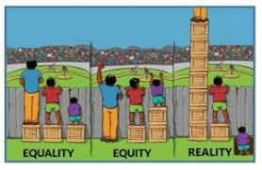
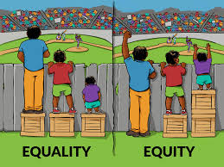
Reflections
Who Gets Heard?
Notes:
We learned that the Buffalo Hills community ‘dividing line’ that separates the haves/have nots is called “Buffalo Plains Avenue.” Those on the southside have greater access to opportunities that are less accessible by the northside community. The poverty is situated north of Buffalo Plains Avenue. We heard that there is an “attitude” of arrogance from the “Buffalo Plains people.” School leaders told us they have more money and tend to view the school and northside community as “less than” while also feigning compassion, “They just can’t help it!”
We learned from the school leaders that a parent who participated in the focus group was angry because translators were in the group. “It took too much time to translate between English and Spanish. I didn’t get to talk as much as I wanted.” We also learned about efforts to bridge the difference in students’ backgrounds. This was often described as a “culture issue” that stems from differences in student backgrounds or “neighborhood boundaries.”

Slide 27
Perception vs. Reality
Significant Shifts
Home Hurts
Violent Behaviors
Measurable Decrease
Home Supports
Age-Appropriate Behavior
Notes:
Demographic trends since the 2015-16 school year show a decrease in the proportion of Latinx students and an increase in the percentage of White students as well as a decrease in the proportion of students eligible for student supports.
Kids can’t help it because of what is happening at home. Consistent in the parent data was the shared hopes for their children to be successful
Violence is perceived differently. While one parent reported that students talk back to teachers and roll their eyes behind the teacher’s back, other parents viewed that a behavior expected from students in this age group. Careful because some often attribute actual violent behavior (stalking, sexual assault) as “boys being boys.” In one classroom observation, we witnessed one student hitting another one with a flip-flop while the teacher was working with another student.

Slide 28
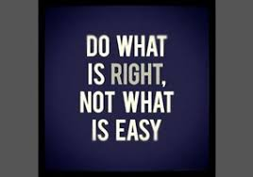
What’s An Evaluator to Do?
Notes:
Don’t bite the hand that feeds you.
Competition between funding and our commitment to social justice.
It isn’t easy.

Slide 29
Courage
“Talking about race agitates most Whites at the unconscious level and most Whites acknowledge that our society is stratified by race but do not see this as a social problem as much as an unpleasant fact of life …a racialized lens means paying attention, even when uncomfortable,” (Thomas et al, 2018, p. 521).
Notes:
Whites are especially challenged by the term “racism,” perhaps, partly because it is perceived as “name-calling.” Perhaps, it shows a fundamental misunderstanding or ignorance about the interplay between prejudice and power. In American culture and abroad, we live in a world in which power is maintained by whites – especially more affluent whites. As evaluators we felt compelled to report what we observed at Buffalo Hills in our report to the school and district. Given the association between prejudice and power, we used a conflict frame as you’ll see in the next slide.

Slide 30
Recommendation to School
Recognize that conflict is inherent when schools change and decide what kind of “conflict culture” BHMS wants to develop.
The dominating conflict culture is characterized by overt, heated conflict that is viewed positively and that the community likes.
The collaborative conflict culture maintains openness about conflict and focuses on reaching solutions that will benefit the entire community.
The avoidant conflict culture views conflict as dangerous and prioritizes harmonious relationships while remaining in denial about the conflict that bubbles just below the surface.
(Murphy & Louis, 2018)
Notes:
One of our recommendations was to focus on culture and conflict. The way Murphy and Louis represented conflict culture types provides the school and district with a frame to consider conflict as a means toward strengthening the community – especially collaborative conflict. In the case of Buffalo Hills Middle School, the racism resides within an overwhelming urge to avoid conflict and believe that the school culture is on the “right” track. People can become aware of their biases and understand how implicit, institutional, and structural racism thwarts the hopes and dreams of the children they serve.

Slide 31
Next Steps
Stay Engaged
Experience Discomfort
Speak Your Truth
Expect / Accept Non-Closure
Notes:
Singleton offers us these four agreements so we can hold “courageous conversations” with one another. As evaluators, it is challenging because our team is committed to social justice and we believe our words and actions can contribute to social change. In conversations or reports, we find while we cannot ignore the implicit biases we observe, we often tread carefully because of the financial arrangements between us and our clients. Yet, we also find that we can use the context in which we are working to determine the most effective way to communicate implicit (and explicit) biases in a community.
Context matters

Slide 32
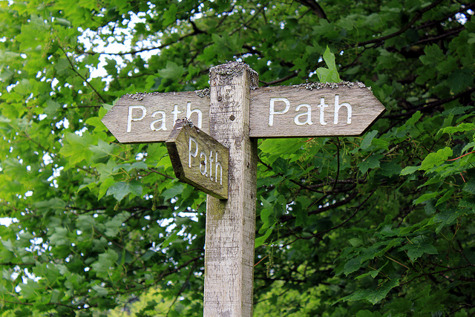
Notes:
As evaluators, we have choices even though it doesn’t always look that way. We can take the safe path to protect our money. We can avoid saying or even hinting at anything.
Or, we can report those observations of implicit bias, institutional and structural racism within the context in which we are working. Context.

Slide 33
References
Bledsoe, K.L. (2018). Introduction to the section on race and evaluation. American Journal of Evaluation, 39(4), 511-513. DOI: 10.1177/1098214018798510
Caldwell, L.D., & Bledsoe, K.L. (2019). Can social justice live in a house of structural racism? A question for the field of evaluation. American Journal of Evaluation, 40(1), 6-18. DOI: 10.1177/1098214018815772
Central Intelligence Agency. (2019). The World Factbook. https://www.cia.gov/library/publications/the-world-factbook/geos/xx.html
Costello, M., & Dillard, C. (2019). Hate at School. Southern Poverty Law Center, p. 4. Montgomery, Alabama. https://www.splcenter.org/sites/default/files/tt_2019_hate_at_school_report_final.pdf
Hall, M.E. (2018). Evaluation’s race problem in the United States: A call to action for the profession and the American Journal of Evaluation. American Journal of Evaluation, 39(4), 569-583. DOI: 10.1177/1098214018792624.
House, E.R. (2017). Evaluation and the framing of race. American Journal of Evaluation, 38(2), 167-189. DOI: 10.1177/1098214017694963.
Murphy, J.F., & Louis, K.S. (2018). Positive school leadership: Building capacity and strengthening relationships. New York: Teachers College Press.
Singleton, G.E. (2015). Courageous conversations about race: A field guide for achieving equity in schools, second edition. Thousand Oaks: Corwin.
Thomas, V.G., Madison, A., Rockcliffe, F., DeLaine, K., & McDonald Lowe, S. (2018). Racism, social programming, and evaluation: Where do we go from here? American Journal of Evaluation, 39(4), 514-526. DOI: 10.1177/1098214018772910
United Nations, DESA, Population Division. World Population Prospects 2019. https://population.un.org/wpp/Maps/

