Slide 1
Assessing the Alignment of the Current Research Landscape With a Strategic Plan for Advancing Autism Research
Duane Williams
American Evaluation Association 2012 Annual Meeting
October 27, 2012
Notes:
title

Slide 2
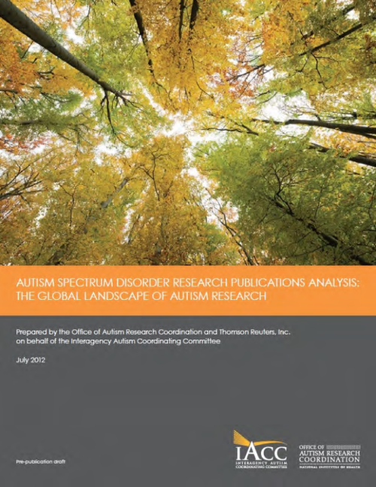
ACKNOWLEDGMENTS
Office of Autism Research Coordination (OARC)/ National Institute of Mental Health (NIMH)
Autism policy expertise
Susan Daniels
Sara Dodson
Sarah Rhodes
Elizabeth Baden
Discovery Logic / Thomson Reuters
Data, analysis and expertise in scientific publication metrics
Yvette Seger
Brian Lawton
Joshua Schnell
Nicole Jones
Miguelina Perez
Cyrus Davani
Find the full pre-publication draft on the IACC website at: http://iacc.hhs.gov/publications-analysis/july2012/index.shtml
Notes:
Collaborative, different roles

Slide 3
AUTISM RESEARCH PUBLICATIONS ANALYSIS: PURPOSE
Requested by the Interagency Autism Coordinating Committee (IACC)
Aligns publications with 7 critical research areas of IACC Strategic Plan
Informs the committee and other stakeholders of the state of Autism Spectrum Disorders (ASD) research
Identify key trends, opportunities, and research gaps
Notes:
Who is the IACC- FACA- advises HHS on Autism research efforts
They have laid out a plan for ASD research w/ 7 critical research areas
based on strategic plan we identified research gaps

Slide 4
STUDY QUESTIONS
Main questions addressed:
How much has the autism research field grown in recent years?
What research topics are being addressed and how has this changed over time?
Who is funding autism research?
Where is autism research being conducted?

Slide 5
METHODOLOGY
Keyword approach identified primary research articles within Thomson Reuters ScienceWire™ Publication Catalog (Correlates records within MEDLINE & Web of Science)
Publications with keywords and MeSH Terms including:
Autism, Asperger's, Pervasive Developmental Disorder, and variants
Terms identified within:
Title
Keywords
Abstract
MeSH Terms (MEDLINE only)
Manual review of 2010 data to confirm relevance (~1% of articles found not to be autism focused research)
25,000+ primary research articles were published from 1980 to 2010
Notes:
Automated approach to identify relevant ASD research based on keywords
Key words included variants not shown here
Key words had to appear in certain fields
We tested relevance and found only 1% not relevant

Slide 6
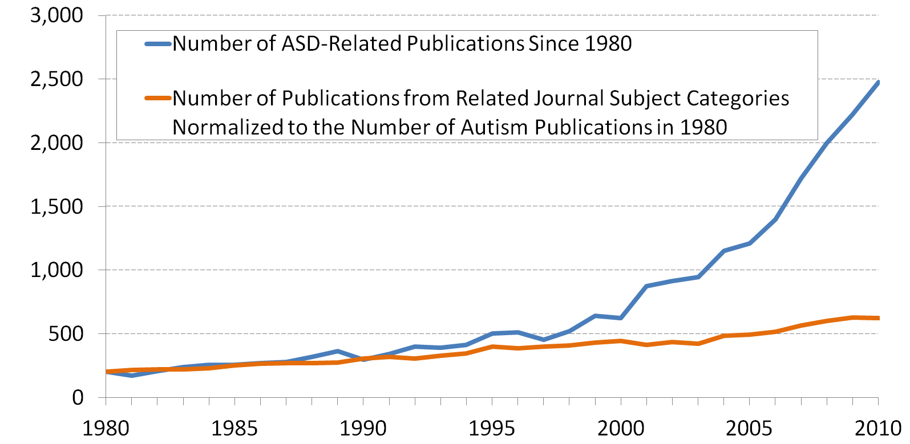
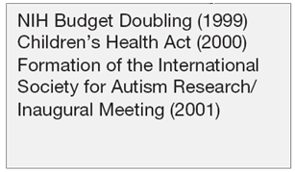
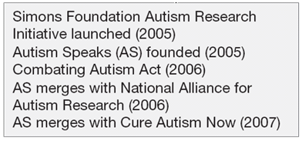
HOW MUCH HAS AUTISM RESEARCH GROWN SINCE 1980?
Number of ASD Publications
Notes:
Research has truly grown, with certain key time periods showing accelerated growth
We identified relevant events that likely contributed
For comparison, we looked at the rate of growth of articles published in similar journal subject categories

Slide 7
WHAT TOPICS ARE BEING ADDRESSED?

Slide 8
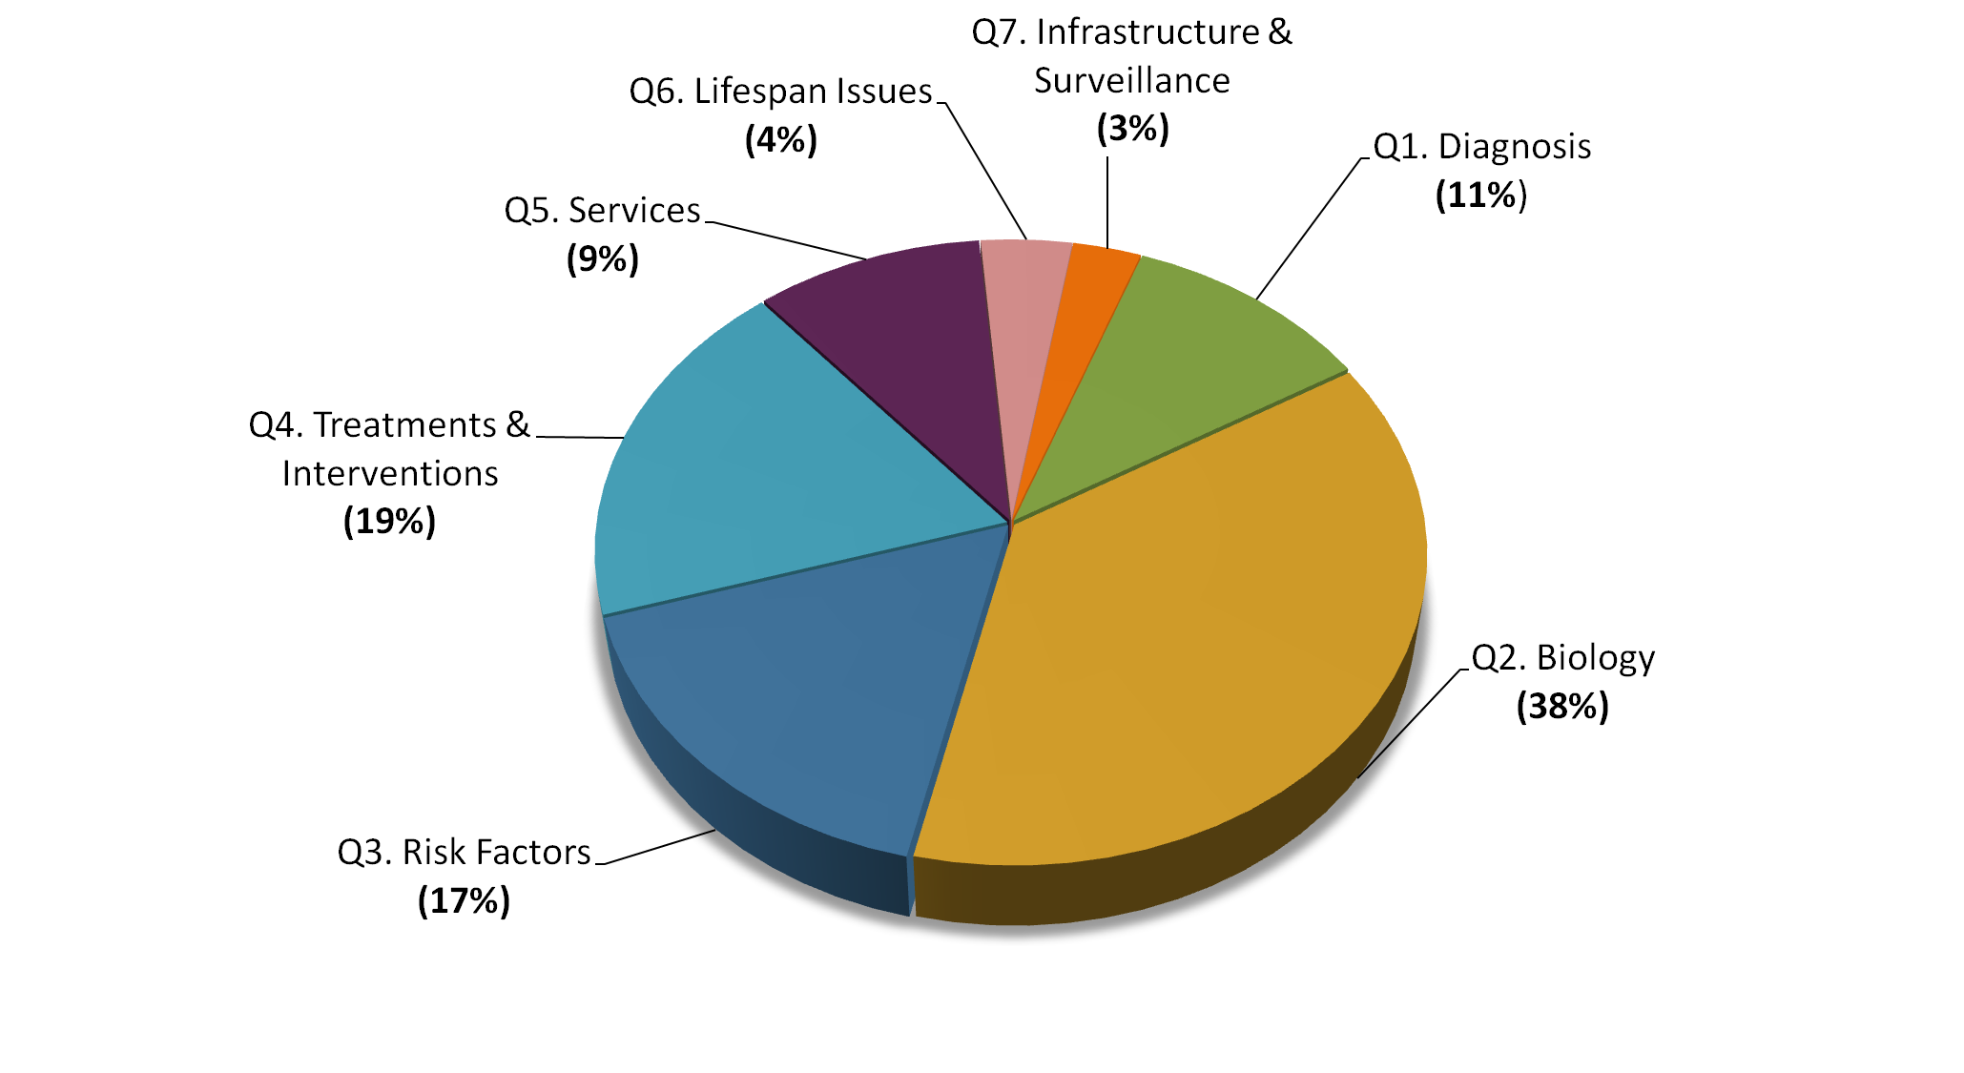
WHAT TOPICS ARE ADDRESSED IN ASD RESEARCH LITERATURE?
Articles assigned to one critical research area of the IACC Strategic Plan
More publications observed in “basic” research areas than “translational/applied”
2010 publications were classified by OARC policy analysts
Notes:
Here the seven slices of the pie represent the seven critical research areas.
This diagram is for 2010 publications which were manually reviewed.
Works for 2010, trends over time takes more effort

Slide 9
AUTOMATED APPROACH TO CLASSIFY PUBLICATIONS FROM 1980-2009
Customized algorithm was used to classify publications from 1980 to 2009 based on manually classified 2010 publications
Modified BM25 algorithm
“bag of words” algorithm, context not considered
User supplies text corpus (i.e., set of publication abstracts)
Program ranks pairs of text in order of most to least similar
Higher ranks given when rare terms within the corpus are found frequently within the two bodies being compared
Prior publications assigned to the category of most similar manually assigned 2010 publications
Automated approach used to classify >20,000 articles
Review of over 3,000 publications suggests ~85% accuracy

Slide 10
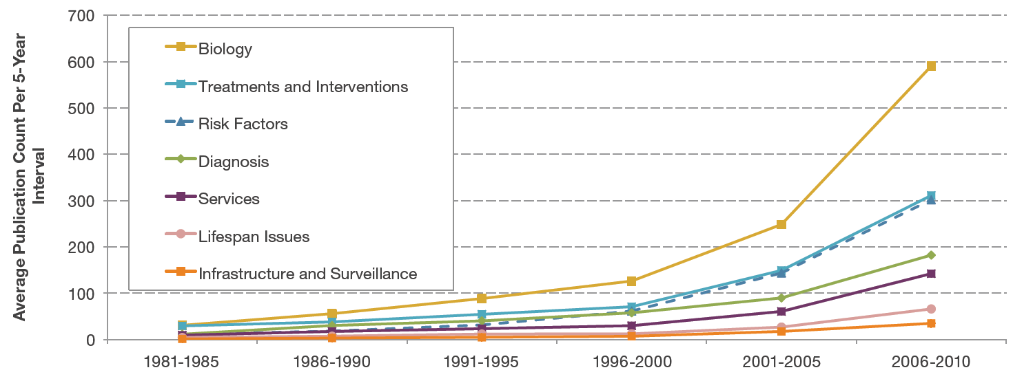
HOW HAS THE ASD RESEARCH LANDSCAPE CHANGED OVER TIME?
Primary focus continues to be in understanding the basic biological processes of ASD
Notes:
While biology continues to lead, risk factors has seen significant growth

Slide 11
WHO IS FUNDING THE RESEARCH?

Slide 12
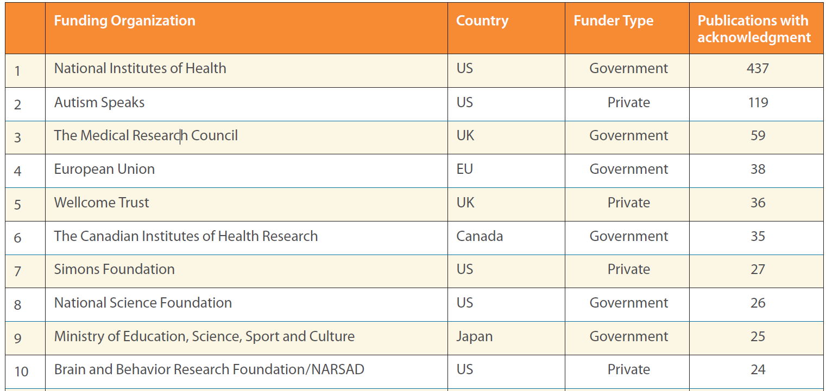
WHO IS FUNDING ASD RESEARCH?
2010 publications acknowledged >700 funders world wide
Non-US funders accounted for ~50% of all acknowledgments.
Only 36% of autism publications acknowledged a funding source
Notes:
Used funding acknowledgements sections
Manually normalized funding agencies
Only 1/3 acknowledged support

Slide 13
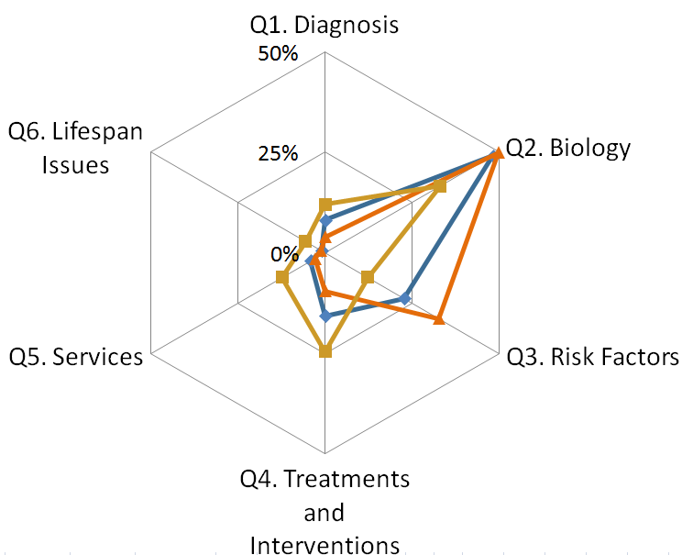
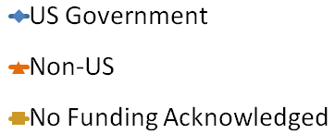
DID RESEARCH EMPHASIS VARY BY FUNDER TYPE?
US Government funding acknowledgements come primarily from biology research publications
Low rates of funding acknowledgment make it difficult for funders to track and report research progress.
Notes:
Research footprint to establish a baseline for comparison by individual funders
Interestingly, for “no funding acks” there’s a different trend. Indicating that there are funders in this type of research that are being missed.

Slide 14
WHERE IS THE RESEARCH BEING CONDUCTED?

Slide 15
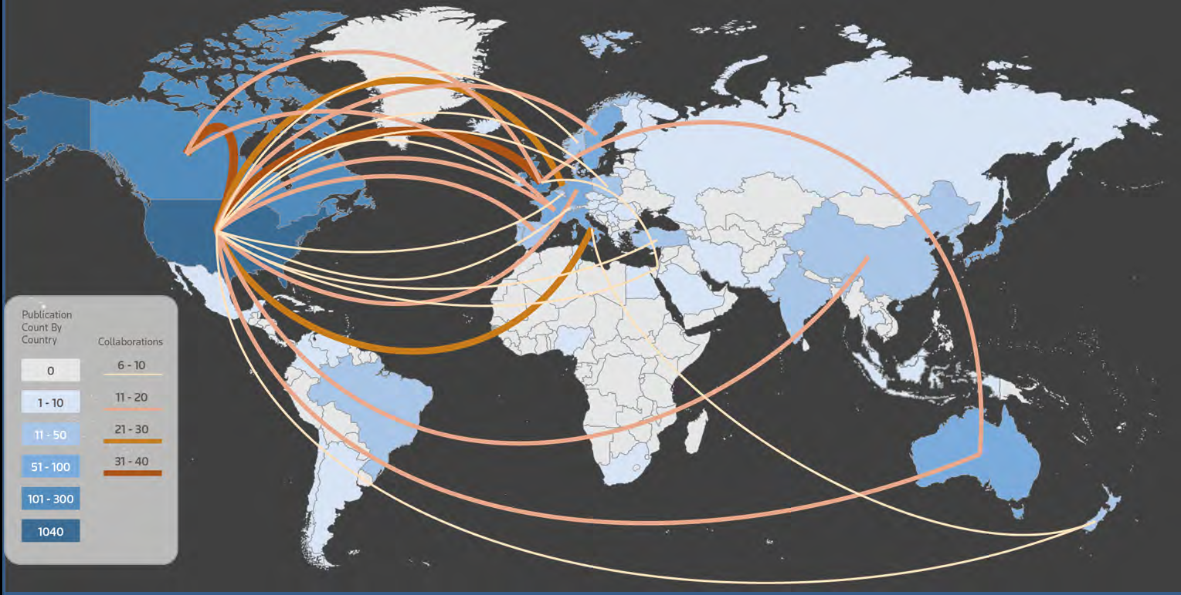
WHERE IS AUTISM RESEARCH BEING CONDUCTED?
ASD research published by authors in over 50 countries
Collaboration is most extensive between researchers in North America and Western Europe
Notes:
Canada & france
US & UK

Slide 16
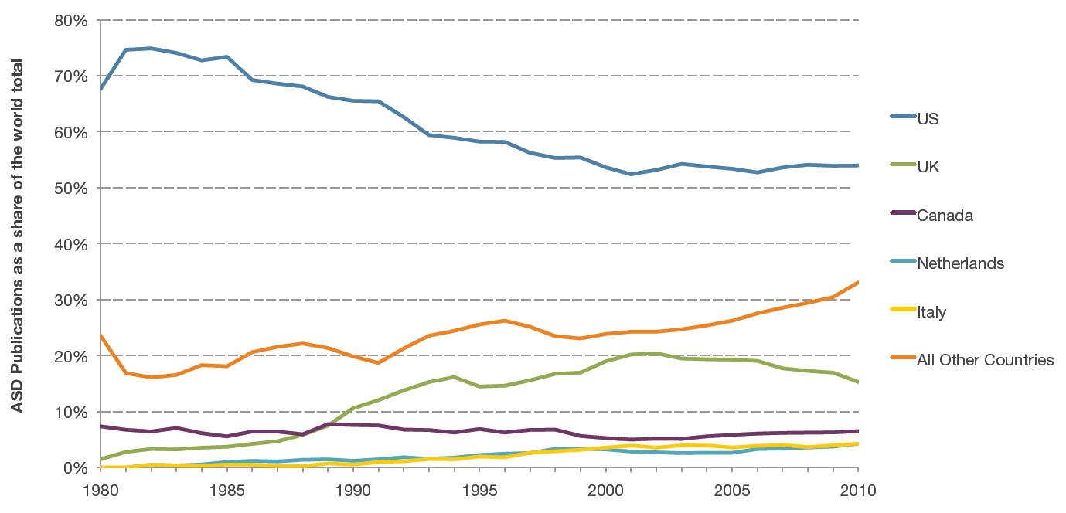
INTERNATIONAL CONTRIBUTIONS TO ASD RESEARCH HAVE INCREASED
The US accounts for the largest number of publications each year
The contribution from other countries is growing over time
“All Other Countries” category is led by China, Taiwan, South Korea, India, Brazil, and Poland

Slide 17
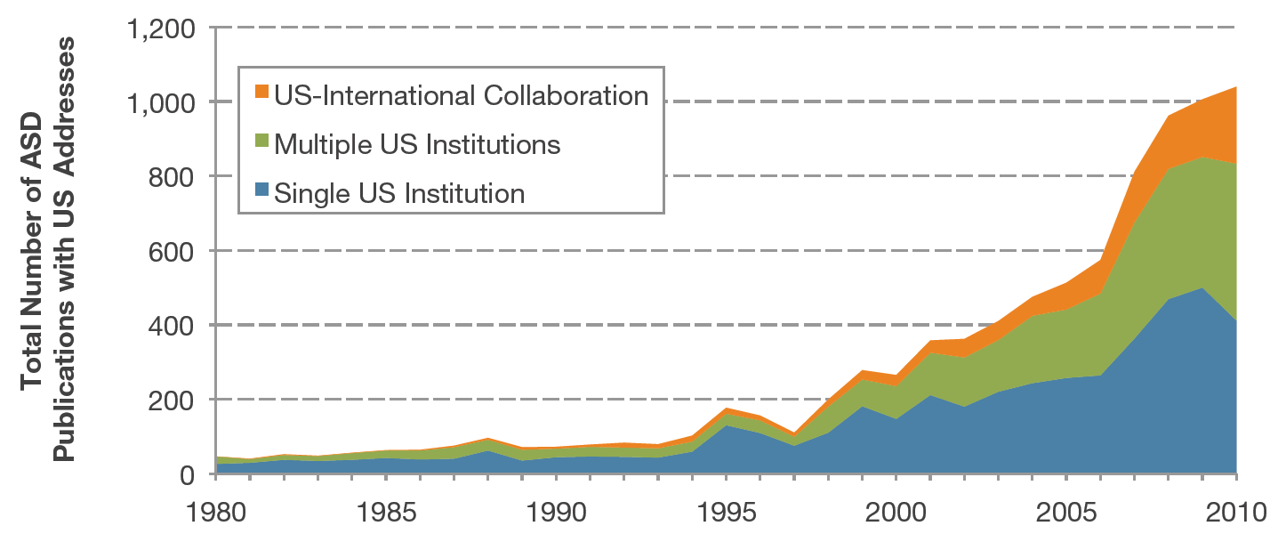
AUTISM RESEARCH IS BECOMING INCREASINGLY COLLABORATIVE

Slide 18
CONCLUSIONS
Automated methods used to inform funding organizations of research gaps and trends over time
Author addresses inform us of the level of research in different countries and the changes in the level of collaboration
In 2010, ASD research was published by authors in over 50 countries and more than 1,800 research institutions worldwide.
A recent sharp increase in publications was observed from China, South Korea, Taiwan, India, Brazil, and Poland.
Multi-institution and international collaborations increasing over time
Research footprint highlights benchmarks for potential funding agencies, showing current research emphases by funder type
Much more can be found in the IACC report, including analysis of collaborations between countries and institutions.

Slide 19
CONTACT INFORMATION
Title: Assessing the Alignment of Current Research Landscape With a Strategic Plan for Advancing Autism Research
Presenter: Duane Williams, duane.williams@thomsonreuters.com
Session Chair: Elizabeth Hsu, hsuel@mail.nih.gov
Policy related questions should be directed to the Office of Autism Research Coordination: IACCPublicInquiries@mail.nih.gov

Slide 20
DISCUSSION

Slide 21
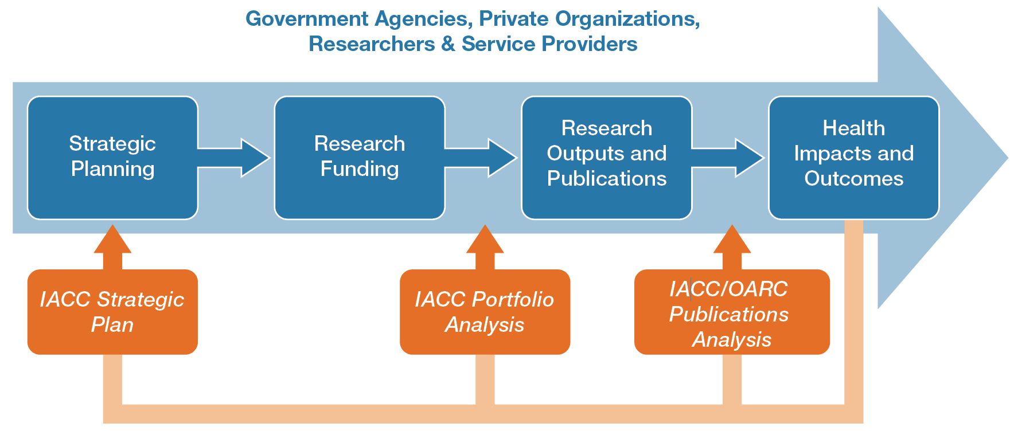
HOW DOES THIS ANALYSIS FIT WITHIN OTHER IACC/OARC ACTIVITIES?
IACC/OARC documents inform Federal agencies and other funding organizations at various stages in the strategic planning process.
IACC/OARC
Notes:
Check out my suggested text in orange

