Slide 1
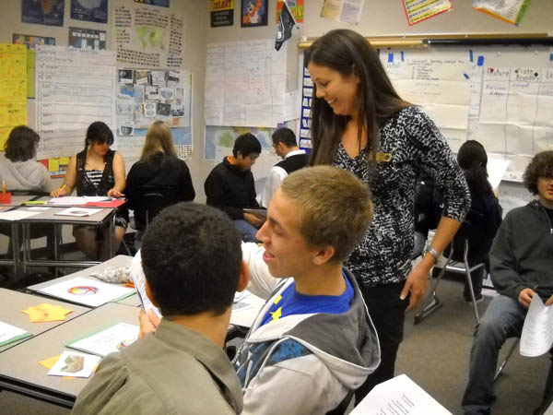
Notes:
One of our challenges in evaluating many educational programs is: How do we know if a teacher is really implementing a program she has been trained to use. How often does she use it? Does she use it as intended or adapt it? What parts does she use?

Slide 2
Measuring implementation in a randomized controlled trial of an educational intervention
Kari Nelsestuen
Theresa Deussen
AEA 2012 - Minneapolis

Slide 3
Education Northwest is a regionally based nonprofit that works throughout the nation to create strong schools and communities. Since 1966, we have served the Northwest as its regional educational laboratory.
Our work focuses on a wide-ranging set of challenges, including:
Improving teaching and learning
Strengthening school, district, and state reform efforts
Engaging families and communities
Conducting research and evaluation on important policy and practice issues

Slide 5
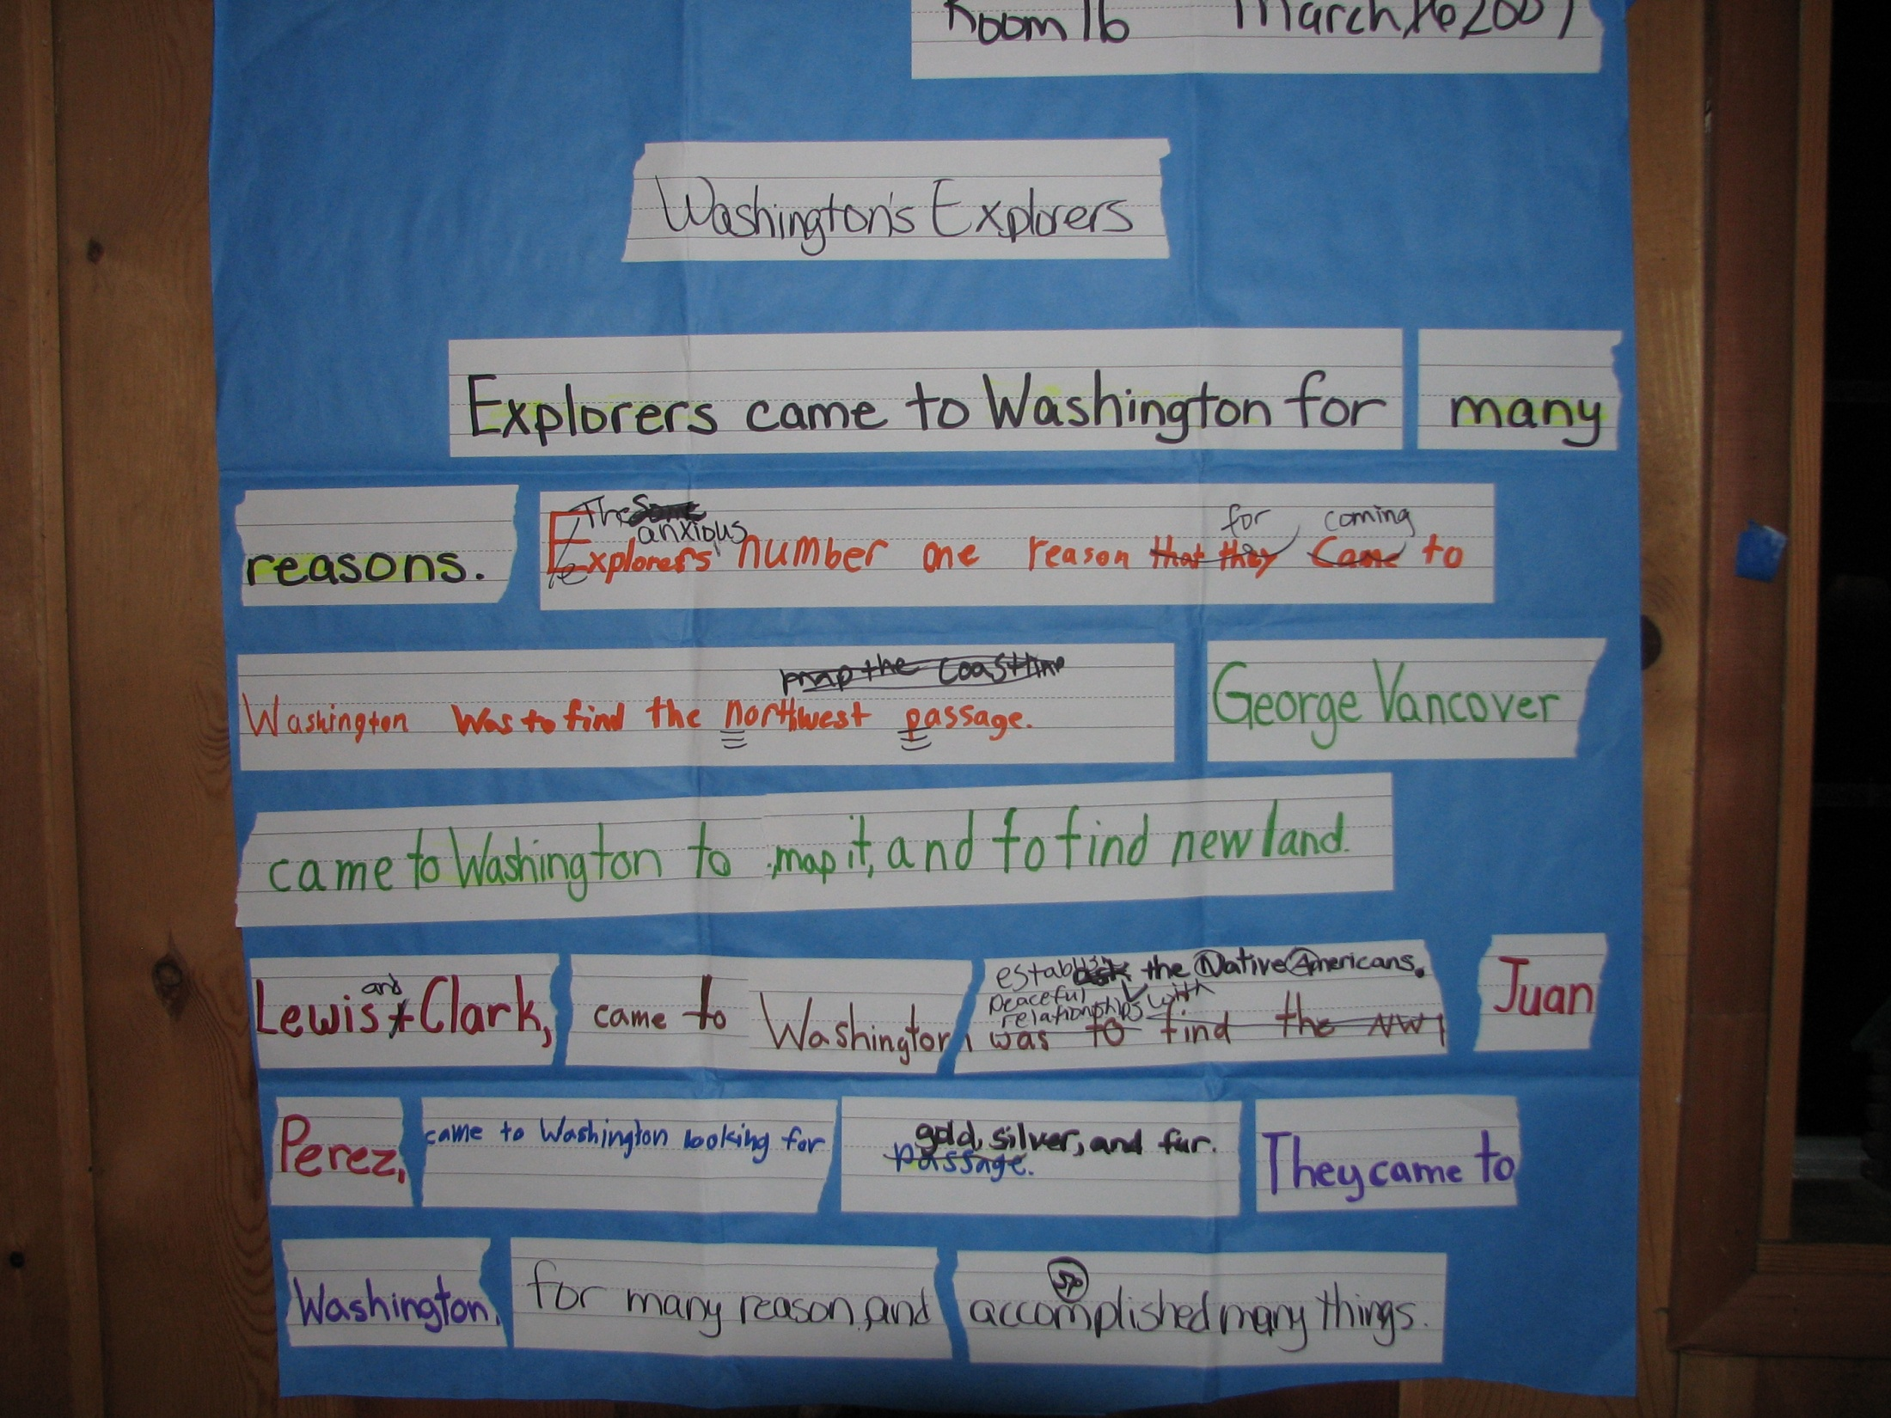

Slide 6
To what degree did teachers in the treatment group implement Project GLAD as intended?
How many of the instructional strategies did teachers use?
How well (with what level of fidelity) did teachers use the strategies?

Slide 7
FREQUENCY
surveys
QUALITY
observations

Slide 8
Monthly Surveys
7 monthly online surveys
41 treatment teachers
2 time samples
35 questions about frequency

Slide 10
Observations
30 schools (15 treatment)
5 observations over 2 years
21 rubrics
135 descriptors

Slide 12
Survey results describe frequency

Slide 13
Observations results describe the average fidelity, or quality, of strategies

Slide 14
High
Frequency
Low
Quality
High

Slide 15
High
Team Tasks
Chants
Frequency
Mind Maps
Low
Quality
High

Slide 16
Strategy Implementation by Teacher
Pictorial Input Charts*

Slide 17
Implementation by School

Slide 18
So what did we learn?

Slide 19
Kari.Nelsestuen@educationnorthwest.org
Theresa.Deussen@educationnorthwest.org
The research reported here was supported by the Institute of Education Sciences, U.S. Department of Education, through Grant R305A100583 to Education Northwest. The opinions expressed are those of the authors and do not represent views of the Institute or the U.S. Department of Education.

