Slide 1
The Choices We Make: Upping the Ante, or It’s Hard to See Racism When You’re White
Presented by Steven E. Mayer, Ph.D.
Effective Communities Project
Moderated by Ricardo Millett, Ph.D.
Millett and Associates
Presented at AEA 2012
Minneapolis

Slide 2
Four Big Discussion Questions
1. What do you (in the audience) think of a more partisan role for evaluation in the challenge to improve conditions in society? Would you embrace it or oppose it?
2. Should considerations of racial or any other ‘injustice’ influence your approach to practice? Why or Why not?
3. What experiences have you (in the audience) had in pursuing more far-reaching recommendations, such as in the realm of policy?
4. What ethical principles govern the choices you make in your professional practice and how do they align with AEA’s?
Notes:
Ricardo welcomes, introduces session, introduces discussion questions.

Slide 3
Notes:
SEM Intro Thank you, Ricardo, for that generous introduction.
Ricardo and I go back to 1993, when he began work with the W.K. Kellogg Foundation as its Evaluation Director.
I was there as a consultant to Kellogg in the review and upgrade of its already excellent evaluation protocols, working as a team with John Seeley of FERA.
Ricardo was a huge influence on me, introducing me to the African-American literature of social criticism, which opened new pathways of thought for me.
And since then, I’ve been fortunate to include him as a steadfast friend and ally.
I write a blog called JustPhilanthropy.org – and that’s its URL if you want to find it.
The tag line says, “Blogging from the confluence of philanthropy, justice, and evaluation.” The photo in the first blog when I launched this site shows one of those Alaska braided rivers, where streams come together and break off and come together again – as with my three blogging themes.
&&&

Slide 4
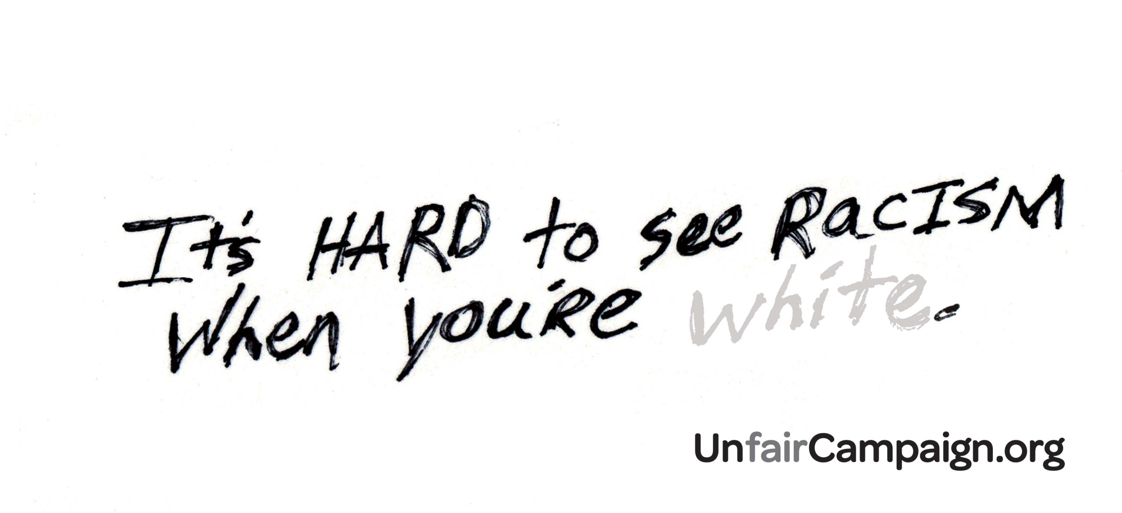
Notes:
So on February 23 of this year (2012), I posted a blog called, “It’s Hard to See Racism When You’re White.” And that’s what got me into this … Presidential Strand of this fine conference.
That title – It’s hard to see racism when you’re White -- wasn’t original to me. I got it from a billboard in Duluth, part of the “Unfairness Campaign” conducted there by a coalition of nonprofits fed up with the silence of racism.
It’s hard to see racism when you’re White -- that billboard raised quite a ruckus in Duluth, and the Twin Cities’ StarTribune picked up on it, reporting that many local White folks were enraged, interpreting the message as anti-White, as an insult to their intelligence. As one said, “They’re saying we’re stupid.”
Then I wrote about it. My main point was that their main point -- It’s hard to see racism when you’re White -- is no doubt true, but not because Whites are stupid. It’s because, just as fish will be the last to discover water, Whites are so enmeshed in the systems we created that we can’t see how they work in our favor. We’re just too close.
The performance data for society’s systems and markets -- for housing, finance, employment, law enforcement, economic development, etc -- favor Whites as a group over other groups, on average. Every study shows this.
Those systems apparently operate with ground rules, typically unspoken, that create barriers to more equitable outcomes, and create a pattern of institutional racism that is typically unseen and unacknowledged by Whites because, as the billboard points out, we’re just too close to see what we’ve created.
&&&

Slide 5
Notes:
I’d learned the truth of that billboard’s message through my work as an evaluation practitioner, since the early 1970s.
Just before taking up blogging, I led a six-year project, sponsored by Ford Foundation, to discover “benchmarks for evaluating progress in philanthropy’s support of social justice, particularly racial equity. “ It went well, and I learned a lot about the ongoing legacy of institutional racism.
Before that, I’d completed many dozens of projects in several ..tributary streams forming the confluence of evaluation, philanthropy, and social justice, beginning as the founding director of Rainbow Research (in 1974), a fine organization many of you may know through its current work under the capable leadership of Dr. Barry Cohen.
While at Rainbow we did work in a variety of issues -- neighborhood revitalization, child abuse and neglect, community economic development, adult literacy, community-based philanthropy – really the whole gamut of social issues that nonprofits, foundations, and government agencies are concerned with.
And to help us at RR in making choices as to what projects to take on we developed a number of value-based rules: the proposed project should help advance a significant social issue we care about, we could design it so there’d be plenty of good lessons to be learned, it had to be for an organization we respected. Those criteria (along with occasional considerations of cash flow) served us well at RR and I continue that same tradition through the Effective Communities Project, my present cover since 1998.
&&&

Slide 6
Thesis #1
We all make choices in our work, and all our choices are values-based, whether we know it or not.
Notes:
My point with reciting this history is to propose a thesis -- that in one’s career path, one is always making values-based choices. It’s very possible that your own underlying criteria for making those choices may not always be apparent when you’re making them; but in retrospect, which provides better angles for viewing and understanding your actions, they’re easier to see.
&&&

Slide 7
Lesson #1
The vineyards we choose to work in are a choice; and the ones we choose not to work in are a choice as well.
Notes:
In support of this thesis, I’ll cite three big lessons from my own career. I invite you to consider them in relation to yours.
“We choose the vineyards we work in, and the ones we don’t work in. Becoming an evaluator is a choice. (Ricardo could have played 2nd base for Panama’s Malta Vigor Nacionales but that position was already taken by the great Rod Carew, who became a Hall of Famer with the Minnesota Twins. Ricardo took an offer to study at Brandeis, and became a Hall of Fame evaluator).
We choose our specialties: evaluating early childhood education programs is a choice, as is evaluating school reform. Evaluating Occupy Wall Street is a choice, as is evaluating the Republican National Committee. Over a career, the values guiding those choices become more evident.
&&&

Slide 8
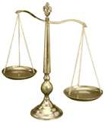
Lesson #2
In our evaluation designs, we make choices all the time.
Notes:
“In designing our evaluations, we make many choices.
The measures we choose to gauge program success is a major choice.
Do we measure mental illness or mental health? Return to prison or return to community? Lives saved or lives lost?
Who we listen to in making our choices is a choice: Do we rely on our professional judgment (as developed or undeveloped as they may be), or follow our client’s dictates, and/or bring in the perspectives of known stakeholders, including those served by the program?
Choosing measures may be guided not so much by considerations of science as by cultural context; they are in effect political choices.
The language of mental illness, for example, came from 19th century views of pathology; the language of mental health came from 20th century views of holistic medicine.
Measuring return to prison (recidivism) reflects values based in retributive justice, rather than successful return to productive community life, with values based in restorative justice. Times change. Paradigms matter.
Other design choices:
Do we see the glass as half-full or half-empty? – One frame leads us to see deficiencies and problems, the other assets and opportunities.
Where do we locate the starting points for intervention and therefore measurement -- near the place where victimization appears, or further upstream where victimization can be prevented?
And how are we defining the evaluation opportunity itself – are we trying to prove something, or improve something?
&&&

Slide 9
Lesson #3
Seeing racism, and refusing to see racism, is a choice.
Notes:
That expression, the fish are the last to discover water? One has to step out of the water to see it.
My third point about choice, at the heart of this session, (the upping the ante part): Seeing racism, and refusing to see racism, is a choice. I’ll repeat that: Seeing racism is a choice, and refusing to see racism is a choice.
In my post at JustPhilanthropy.org my big point is that the insidious part of racism is not the personal, individual attitudes we may carry but our unwillingness (I mean Whites’ unwillingness) to recognize how injurious our systems are to people not like us. We made those systems, they’re an extension of our own world-view, so naturally they benefit us. But we (Whites again) too often ignore how our systems don’t benefit others, and we too easily hold ourselves blameless, or without an obvious role in fixing them.
&&&

Slide 10
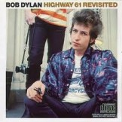
Notes:
I’ll summarize this first thesis – that we all make values-based choices in carrying out our work – by citing the great Minnesota bard from just up Highway 61, who prophetically said [on the album, Slow Train Coming], “You’re gonna have to serrrrve some-body.” I would add, “All our choices do.”
&&&

Slide 11
Thesis #2
The field of evaluation limits its usefulness with the choices it encourages among its practitioners.
Evaluation can play a more useful role in advancing change
Notes:
Here’s my second thesis: The field of evaluation limits its value or usefulness with the choices it encourages among its practitioners [repeat]. And its corollary: Evaluation and evaluators can play a more useful role in advancing change…
In the interest of time, I’ll expand on the second part. I’ll try to get there with this bridge.
&&&

Slide 12
Thousands of studies…
Tobacco
Is it harmful? Under what circumstances? What can be done?
School systems, job markets, etc
Are they harmful? Under what circumstances? What can be done?
Notes:
Why did it take a thousand studies before the powers-that-be decided to treat tobacco like a dangerous drug, even long after the evidence was pretty conclusive.
Why did it take so long to make the changes to the policies that govern the marketing of tobacco products?
In the same vein, there are already perhaps a thousand studies showing disparate harm from the performance of all our public systems and private markets.
These disparities show up everywhere, and have since records were kept. I once compiled an inventory, and found consistent measured disparities in Education; Income and Wealth Development; Housing, Infrastructure, and Amenities; Health; Justice; Dignity and Respect, and Civic Participation – and dozens of subcategories all critical to the viability of genuine democracy in this country.
In fact, our markets and systems are dangerous places for whole populations of non-Whites. Yet there’s considerable resistance to changing the rules of these marketplaces to make them more equitable. Much of society even refuses to believe all this disparities stuff, despite all the evidence (preferring to believe in theories of “just desserts” and personal exceptionalism).
The problem is that, despite the evidence, society has not yet decided to do the policy change work -- and attitude change work, and behavior change work -- that’s needed to eliminate these unfair practices.
We haven’t reached the kind of tipping point that we did finally with tobacco.
&&&

Slide 13
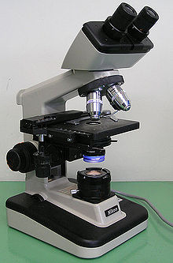
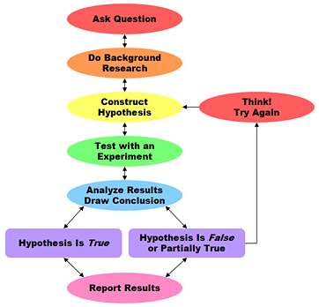
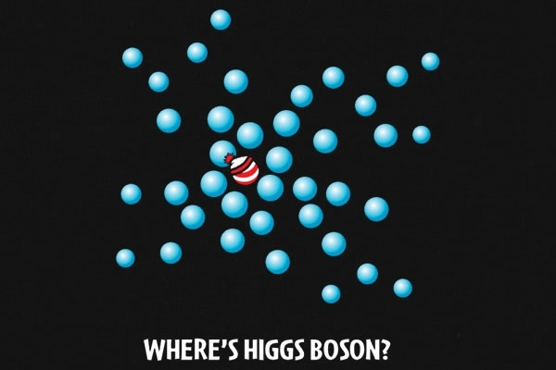
The long slow road of science
Notes:
Let me back up a bit and come at this from a different angle. Evaluation as a field grew out of the sciences, for the most part, and the sciences have favored the long, slow road of knowledge development ..over the more applied or activist role of working immediately for the public good, …even though most scientists would probably like to think that they’re ultimately serving the public good.
I’m in favor of moving “ultimately” to a closer horizon.
I’ll say it more forcefully by asking, So what are we pussy-footing around for? How can we let stand such a huge litany of disparities, shown by compelling evidence in every walk of life?
Where’s the outrage? Why are we ducking behind precepts of detached objectivity when our inner Superman, or Clara Barton, or Harriet Tubman wants us to be of help - now?
How many of us (let’s see hands) are frustrated even a little that our painstaking work seems so often disregarded or under-utilized? …
[Did I say “utilized” instead of “used”? Is Patton in the room? I’ve been giving him guff over that word for decades, though I guess it’s hard to argue with four highly successful editions. I will say that Michael’s focus on utilization was the first serious big step to put evaluation practice into the realms of Relevance, Responsibility, and Relationship – three key concepts in Rodney Hopson’s Presidential Plenary on Wednesday].
&&&

Slide 14
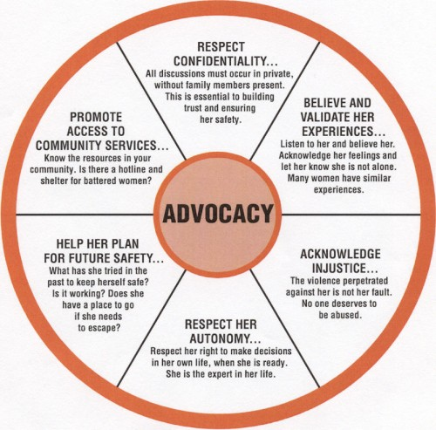
“Partisan?”
Notes:
Pressing on, I’ll call the question: Are we scientists or are we partisans? Can we be both? This is not an entirely new question -- there has certainly been discussion of this question over the years, but most of it has been moralistic; that is, should we or shouldn’t we be partisans for justice? There’s less discussion of how to do it.
Before I go further, let me make perfectly clear that by partisan I don’t mean inherently Democrat or Republican; I’m not talking campaigning in support of or against a political party or a candidate for elective office.
And unfortunately, my online dictionary puts the word “shamelessly” in front “partisan” as if “shamelessly partisan “ were one word. So I certainly don’t mean we should shamelessly exhibit blind, prejudiced, and unreasoning allegiance to, …well, anything.
By partisan, I mean that I care about the long term success of an effort I’ve chosen to evaluate, even though I may have to tell the managers the honest truth about how they’re falling way short as I read the evidence so far.
By partisan, I mean that I want to help the effort I’m working with to prevail and succeed, and that part of the evaluation work is to help them figure out how best to get there. I bring the evaluation skills, they bring the other stuff, and together we try to find the most effective way forward.
And maybe “partisan” isn’t the right word; maybe it’s “appreciative development,” or “constructive co-discovery” or “champion.” Champion has become a fairly mainstream word perhaps useful in this context.

Slide 15
OK, How to be more useful
First, two criticisms…
Aren’t there limits to evaluation?
Times change...
Won’t we sacrifice rigor?
Become more skillful in designing evaluations to be more responsive to opportunities.
Notes:
Back on track, having sanitized the concept of partisan or champion, let me get on to How to be more usefully partisan, and still regard ourselves as evaluators.
I’ve looked at AEA’s Guiding Principles for Evaluators and see only a sense of permission for advancing on this front. There’s lots of room for developing our craft in this direction.
But let me first deflect two criticisms:
One, some say there are limits to what evaluation can do .. Why do they say that? Who says there are limits to what evaluation can do? Actually, all we have to do is expand the boundaries of what’s called evaluation. In fact this boundary-expansion happens all the time, if not by formal promulgation of new rules, then by adapting to changes in the larger culture and in the evaluation marketplace. That’s how change always happens, right?
For example, it used to be that writing recommendations into an evaluation report was practically forbidden, or at least highly frowned upon. Evaluators are supposed to be in the discovery business, right, not the organizational development business, not the system or market remediation business. What we do is assess the results of introduced innovations; managers and funders take it from there.
But times have changed; our own personal theories of how the world works change as we .. mature, as does our own sense of our own proper role in that world – individually and professionally.
I’ll bet the proportion of AEA members saying “Yes, it’s appropriate to make such recommendations” is higher now than it was 10, 20, or 30 years ago. Does writing stronger recommendations put us against AEA principles? I don’t think so. We can make this choice …
Second, in proposing a stronger championing role for evaluation, I’m not suggesting we abandon our preferences for rigor, or that we begin a project pretending to know the findings in advance .. or favoring a particular set of recommendations we may be itching to make.
I am suggesting that we apply our training in rigor to become more skillful in designing our evaluations to be more responsive to opportunities to advance more effective programming, to advance more equitable policy, to make skillful common cause in promoting a more just society, and to advance, dare I say, a more effective evaluation profession.
&&&

Slide 16
Three proposals
More thoroughly informed consultation
More meaningful choice of measures
More forceful recommendations
Notes:
OK, onward. I have three proposals for developing our craft in more assertive ways, which I’ll elaborate a bit on:
More thoroughly informed consultation with client organizations;
More meaningful choice of measures for evaluating progress;
More forceful recommendations for achieving even greater effectiveness and progress.

Slide 17
Informed consultation
What’s at stake?
Implications of methods and findings?
What roles support upgrades?
Notes:
You know that dance we evaluators do with new clients, called focusing the evaluation? Where they tell us what they think they want and we figure out how best to serve them while at the same time we help them try on different lenses, see more promising and useful alternatives, and ultimately get to a place where the most best interests get served? We can do that better, referencing and protecting a wider circle of stakeholder interests, and, I submit, gain rigor in the process.
We can help our client (and us) get a better fix on the context of the evaluation request, a better fix on what’s at stake for the organization, for its clients, and for its communities of stakeholders (even its funders) – and to design an evaluation that’s more responsive to the larger set of opportunities (given the threats) faced by the program.
We can help our client (and us) get a better fix on the implications of the kinds of findings that different approaches and measures could yield – implications for strengthening the hand of the organization, of its more marginal or vulnerable stakeholder populations, even its funders, while building on the strengths of the organization -- and to design a more responsive evaluation.
We can help our client understand its own role better – as an institution, as staff, or board – and to design a more supportive culture for internal organizational learning and taking next steps.
&&&

Slide 18
Meaningful measures
Legitimize purpose and progress
Informs multiple interests
Inform action
Notes:
Where the rubber really meets the road in designing an evaluation is in the choice of measures, the yardsticks or metrics or categories of evidence by which a program’s efforts are judged. As I said in the introduction, those choices are very culture-bound, context-bound, and values-laden.
Having helped along a more informed and revealing consultation with the client at the outset, we as evaluators are in a good position to make those more meaningful choices,
In the criminal justice situation alluded to a few slides back, measuring recidivism achieves nothing good – it speaks only to dysfunction and failure -- whereas measuring successful return to community (reuniting fathers to family, developing employable skills, contributing to the household and to the community economy) does lots of good (I’m saying just the choice of measures does some good).
Measuring successful return to community…
…legitimizes these purposes and progress;
…it gives clients, programs, and funders something to shoot for and build on.
…it informs funders of more productive avenues of success and innovation;
…it informs a more productive theory of action, connecting positive behavior to positive change;
In short, in choosing measures, we should promote proactive, asset-based measures that speak fairly directly to the kinds of programmatic or policy changes that hasten improvement and greater fairness.
&&&

Slide 19
Recommendations for internal consumption
Recos that support organizational learning and development.
Recos that support upgrades to the organization’s approach to the problem and its management and governance.
Recos that strengthen the organization’s case for access to resources.
Notes:
Last, writing stronger recommendations might seem kind of rinky-dink or lame to some, but that might simply reflect how lame and rinky-dink our present recommendations are.
We can become better advocates for constructive change if we learn to beef up our recommendations so they have a better chance to influence more constructive activity downstream of the evaluation report itself. I think there’s room to stretch in that direction. I suggest:
Recommendations that support a culture of organizational learning and development. I see it as part of the evaluator’s role to support such a culture. It’s amazing how few recommendations, even warranted ones, get acted on. I want to sponsor a competition to answer the question, Where do good recommendations go to die? Something has to be done about that, or we’re all working for nothing. Evidence-based organization-development.
recommendations to upgrade to the client’s theory of action. And not just the theory of action but the management of action, the staffing of action, and the governance or oversight of action. Evidence-based programmatic upgrades.
recommendations that strengthen the organization’s case for resource development.
Better messages ought to flow from findings, if the measures are meaningful. (and if the program is less than stellar, the messages should get it some help. Evidence-based resource development, if you will.
&&&

Slide 20
Recommendations for external consumption
Recos that support networks that provide momentum and people power to adoption of good ideas.
Recos that focus on societal levers of change – improvements to public and private sector policies.
Recos that fast-track the search for solutions.
Notes:
And because a troublesome social indicator isn’t going to be moved by the work of one organization acting in isolation, no matter how good it is, we can create recos that go beyond the boundaries of our client organization.
Recommendations that help grow the stronger networks needed to lean against those rusty levers of change that can move the needle and achieve collective impact. Evidence-based network development.
Recommendations to fix the governmental or private sector policies that have been problematic and maintain the troublesome societal situation that our client organization is working with
Say you’ve been working in an area of housing or health or education or economic development or any of the areas in which disparities are found (i.e., all areas).
Chances are, if you look hard (at the water around you) you’ve learned something about injustice and how it’s manifest in the program, inadvertently or not, and chances are you’ve gotten some insight into the dysfunctional policies way upstream and then just upstream from your program.
If you’re working with an organization that services the victims of such policy, then it’s appropriate and useful to recommend changes to the very policies that are producing those victims. Evidence-based policy recommendations.
Finally, recommendations for a sequence of inquiry or study that expeditiously goes for solutions. ?You know how many studies end with, “More studies are needed.” Well no doubt that’s true, so we can, as evaluators, propose a study agenda that goes somewhere, a sequence of studies that follows a short path of discovery and can surface the kinds of evidence not just clarify the problem, but even more important, clarifies the solution.
&&&

Slide 21
Notes:
I’ll end here. As I’ve said I’ve looked at AEA’s Guiding Principles for Evaluators and see only a sense of permission for advancing on this front. There’s lots of room for developing our craft in this direction.
&&&
Jpg credit: http://www.mergersandinquisitions.com/wp-content/uploads/2010/05/myth_career_path.jpg

Slide 22
Four Big Discussion Questions
1. What do you (in the audience) think of a more partisan role for evaluation in the challenge to improve conditions in society? Would you embrace it or oppose it?
2. Should considerations of racial or any other ‘injustice’ influence your approach to practice? Why or Why not?
3. What experiences have you (in the audience) had in pursuing more far-reaching recommendations, such as in the realm of policy?
4. What ethical principles govern the choices you make in your professional practice and how do they align with AEA’s?
Notes:
I would now like to turn back to friend and colleague Ricardo to help this appreciative audience noodle a bit on my presentation and particularly on the four questions we posed earlier.
###

