Slide 1
Evaluating Individual & Collective Efficacy, and Leadership skills Lessons from project Pahel, India Supported by: David and Lucile Packard Foundation
Authors:
Ms. Madhu Joshi, Senior Advisor, Gender and Governance, CEDPA India Dr. Manju Katoch, Manager, Monitoring and Evaluation, CEDPA India
Dr. Aparajita Gogoi, Executive Director, CEDPA India

Slide 2
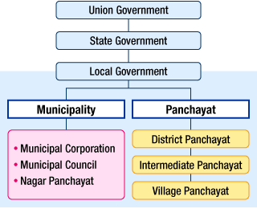
About local governance in India
Source: Council of Local Authorities for International Relations (2007) "Local Government in India"

Slide 3
Landmark Legislation
1992 – 73rd amendment to Indian Constitution
Resources and decision making powers to grassroot leaders at three tiers of local governance – village, block and district (Panchayati Raj Institutions, PRI)
Reservation of 33% seats for women in three tiers
A million women in local governance

Slide 4
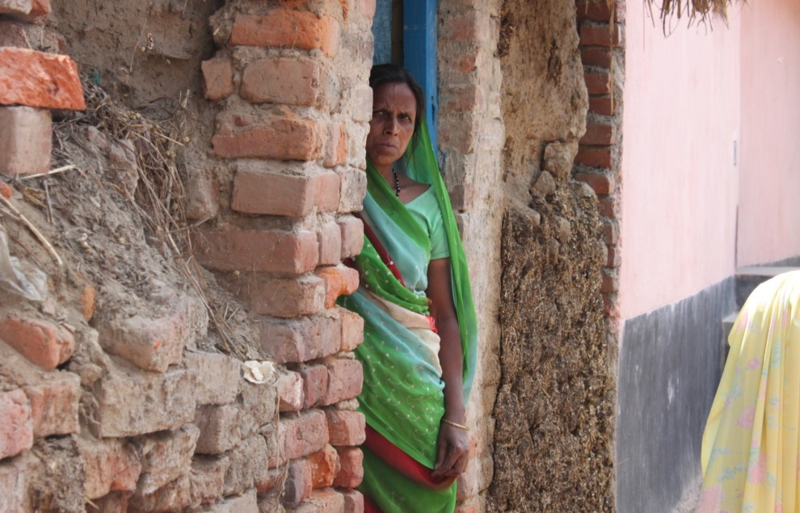
Challenges women face in India
Discrimination – Gender, caste, class, religion, ethnicity
Threat of violence – within the home and outside
Perceived as incapable of taking autonomous decisions
Restricted mobility
Burden of household chores and childrearing

Slide 5
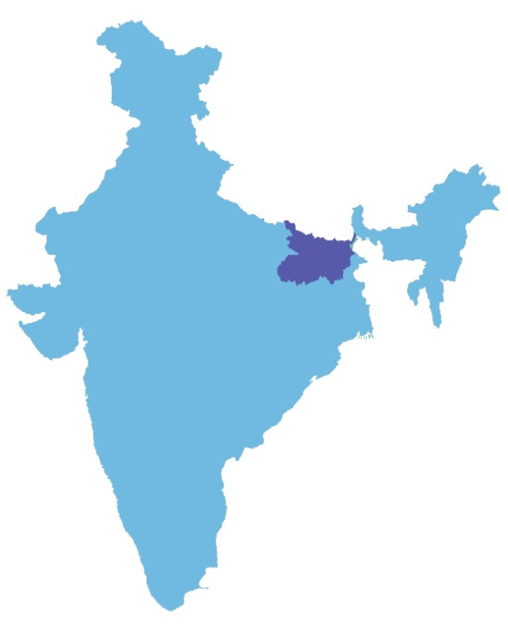
Status of women in Bihar, India
Low female literacy - 33.6%, (male literacy - 60.3%]
Highest rate of child marriage (64%) nearly two underage brides among every three women
High maternal mortality rate (178)
Highest rate of physical and sexual violence against women in India
Government of Bihar has demonstrated political commitment to promote gender equality schemes and institutional changes.

Slide 6
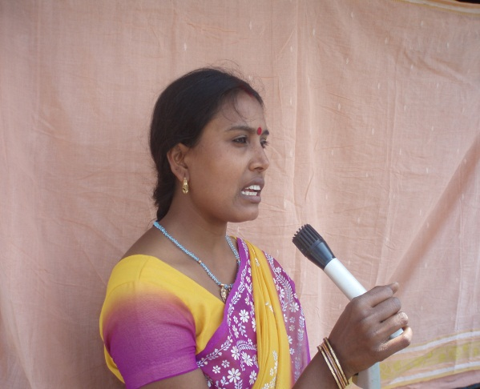
Project Pahel : towards empowering women
Building leadership skills in elected women representatives (EWRs) from local governments, so that they:
Participate effectively in meetings
Take actions to improve reproductive health services
Address development issues in their constituencies
Pahel currently works with 1200 out of the 120,000 EWRs in Bihar.

Slide 7
Who is Pahel reaching

Slide 8
Project activities
Women representatives:
Received Training – political system, gender and SRH services
Meet quarterly to learn and share
Are supported to participate in meetings and interface with officials
Use checklists to monitor health services in their areas and raise findings at PRI meetings
Exposure visits

Slide 9
Initial results
Significant increase from baseline:
67% EWRs are attending at least one meeting in each quarter
EWRs working with health workers to ensure equipment, supplies and finding solutions
Mobilising community women to access SRH services

Slide 10
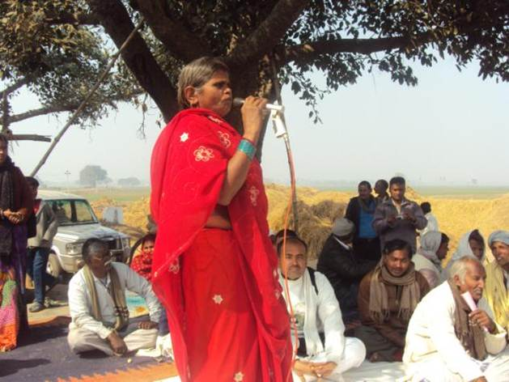
More results: EWRs taking action in other areas beyond the project mandate
Other social issues
Girls’ education,
Child marriage
Entitlements under various
government schemes
Functioning of the PRI Regularity of meetings Transparency Accountability of officials Usage/disbursal of funds.

Slide 11
Project M&E framework
Quantitative Baseline – control and intervention
Tracking of individual women’s participation at meetings and engagement on issues
Analysis of accountability checklists
Need for qualitative methods to measure change and better understand the drivers of change

Slide 12
Methodology
Most Significant Change
Contribution analysis
Reference to control areas
Cross reference with quantitative monitoring (Tracking Sheets)

Slide 13
MSC - Six steps
Establishing the domains of change
Reference group
Story collection method – story guide and FGD guide
Training of field investigators
Review of MSC stories
Secondary analysis

Slide 14
Domains of change
knowledge and awareness,
personal development,
attitude and behavior,
participation in development and political activities
Within each domain - personal and professional

Slide 15
Reference Group
Key Informants | Intervention | Control
Elected women | 30 | 18
Family members | 12 | 3
Male colleagues | 12 | 6
Health workers | 6 | 6
Community members | 3 | 3
FGD with project field team personnel

Slide 16
Story guides
Lifestyle, balancing work and domestic responsibilities, and relationship with family members.
Attitude toward women’s role in household decisions
Views on girls education, child marriage and dowry
Journey since their election - motivation to work, changes they have been able to make in their area
Relationship with male colleagues and officials
Managing the barriers (patriarchy, low literacy, lack of exposure to the external world)

Slide 17
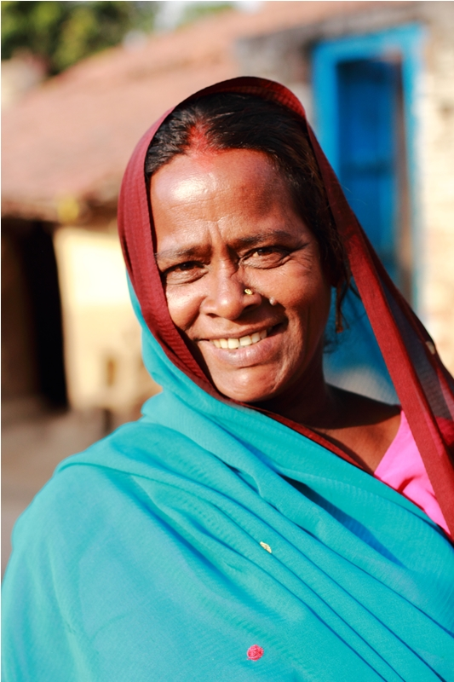
Analysis: Women share change

Slide 18
1. Knowledge and awareness
Meena Devi, Village Council member
I tell people , ‘your work will be done. I will get it done’
Having information about the political structure, health services and gender issues, makes me feel confident
“Pahel has made me a ‘star’ among my friends, I want to be the Mukhiya (Village Council Head) in the next elections”.

Slide 19
2. Personal Development
Prabha Devi , Village Council member:
“I did not want to be labeled as someone’s wife or someone’s mother”.
“Now people refer to my sons as the member’s sons, which is something unusual in our society” .
“In this man’s world educated people like the Block Development Officer and other officials would not notice me. Now I can ask them to do their work”

Slide 20
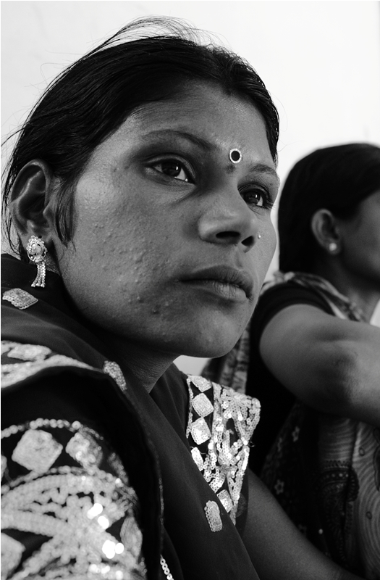
3. Attitude and behavior
“I have overcome my fears and am not scared of talking to people”
“In the initial days I felt lost without my husband supporting me and representing me in meetings”
“Now I prefer going alone to the meetings and my husband drops me to the venue”

Slide 21
4. Participation
I have ensured electricity in my ward, construction of a day care center, toilets, a bridge and a motorable road
I have stopped an early marriage
I call for informal meetings of women’s groups, we work together

Slide 22
4. Participation – cross reference with quantitative data
*Monthly tracking of women leaders over a period of 24 months

Slide 23
Participation:Cross referencing with quantitative data
*Monthly tracking of women leaders over a period of 24 months

Slide 24
5. Self-efficacy and perception
Women interviewed were:
Visibly confident, inspired and proud of their achievements both as individuals and as a collective
They attributed these changes to being a part of the Pahel initiative, communication materials, monthly meetings and exposure visit
They perceive that they are now more valued by their children and other family members as well as members of the community, their male counterparts and government officials
My brother in law says that the family is proud of me!

Slide 25
What did the others say
Husband: she has begun voicing her opinion on everything and is very well informed
Male colleagues: if there were no reservations women would have been invisible in politics, the Pahel women actively participate in meetings
Health workers: because of Pahel, these women leaders are taking up health issues
Local Project staff: It is so different now, earlier we had to persuade the husbands to allow their wives to come for the training

Slide 26
Women in control locations
I sign wherever my son asks me to sign
Have accepted their personal reality as proxy candidates for their male relatives
Rarely go for meetings
Low mobility
No information about their roles and responsibilities as elected members

Slide 27
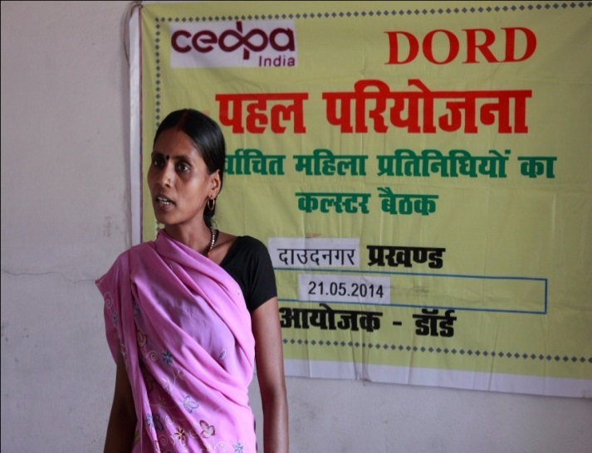
Change: what, why, how
What – mobility, decision making, cognitive skills, participation, attitudes and beliefs
Why – wanted to work for development, wanted to be valued by family, wanted respect in the community
How –access to information, training, solidarity platform, exposure to new ideas, new places
Pahel helped them believe that change is possible

Slide 28
Waiting for change
However, most of the women said
After all, my husband is the head of the family and must have a greater say
His work is important, how can he help in housework
How can we not give and take dowry, it is our tradition

Slide 29
In conclusion: qualitative methodology
Assessment team must have advanced capabilities for analytical thinking (developing and administering the story guides)
Significant implications for time and budgets.
Validation through other stakeholders
Availability of quantitative information to supplement the outcome of MSC
Feed back into programme implementation

Slide 30
In Conclusion: programme learning
Women leaders need both - information about their work AND support to negotiate patriarchal structures
Intense handhold support and mentoring over a long period
Training sessions offer a window of opportunity for women leaders to know about what they have the power to do and are capable of on their own.
Women’s solidarity platforms like Mahila Sabhas gives them the confidence to engage, challenge and change
When women leaders have the tools for effecting change on one issue, they are able to address many other issues

Slide 31
For further information contact:
mjoshi@cedpaindia.org

