Slide 1
Integrating Technology into Evaluation Business Meeting
Nathan Balasubramanian
(nathanbala@gmail.com )
(Paul Lorton, Jr.)
(lorton@usfca.edu)

Slide 2
Tentative Agenda
Presentation: Integrating Technology into Evaluation to Produce Truth: Past, Present & Future
http://comm.eval.org/viewdocument/lorton-gunn-integrating-technolog
Proposed Survey of Members
Call for Nominations
Other Business and Concerns

Slide 3
Integrating Technology into Evaluation to Produce Truth: Past, Present & Future
Paul Lorton, Jr.
Moira A Gunn
University of San Francisco

Slide 4
One Purpose is to Focus the TIG
What do we mean to be
How do we achieve that being

Slide 5
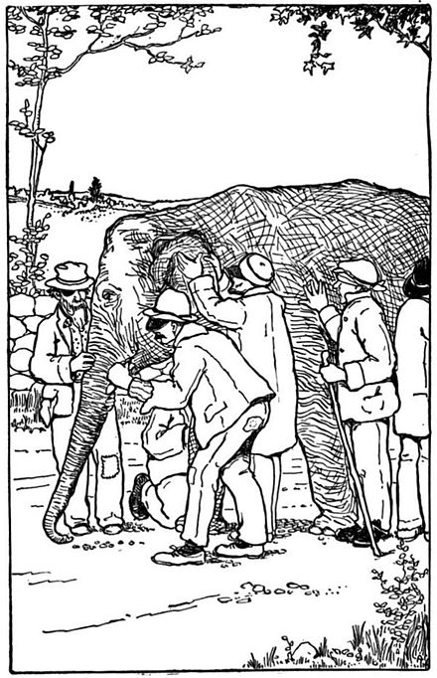
The Blind Men and an Elephant

Slide 6
https://en.wikipedia.org/wiki/Blind_men_and_an_elephant
A group of blind men heard that a strange animal, called an elephant, had been brought to the town, but none of them were aware of its shape and form. Out of curiosity, they said: "We must inspect and know it by touch, of which we are capable". So, they sought it out, and when they found it they groped about it. In the case of the first person, whose hand landed on the trunk, said "This being is like a thick snake". For another one whose hand reached its ear, it seemed like a kind of fan. As for another person, whose hand was upon its leg, said, the elephant is a pillar like a tree-trunk. The blind man who placed his hand upon its side said, "elephant is a wall". Another who felt its tail, described it as a rope. The last felt its tusk, stating the elephant is that which is hard, smooth and like a spear.

Slide 7
Our Plan for this Discussion
Define the target – Truth and how to report it.
Technology’s Role in Truth Seeking
ITE’s role in Past, Present and Future
The chief concerns for ITE’s future (which will fit nicely with AEA’s theme for 2019)

Slide 8
Truth
Truth (noun)
1.the quality of being true, genuine, actual, or factual: the truth of his statement was attested
2.something that is true as opposed to false: you did not tell me the truth
3.a proven or verified principle or statement; fact: the truths of astronomy
(from: truth. (n.d.). Collins English Dictionary - Complete & Unabridged 10th Edition. Retrieved March 14, 2018 from Dictionary.com website http://www.dictionary.com/browse/truth )

Slide 9
Technology's Role
Get the error prone human away from the numbers to produce accurate, reliable results.
Charles Babbage is our poster child in this effort

Slide 10
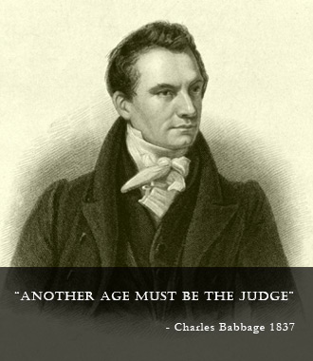
Charles Babbage 1792-1871
Professor of Mathematics at Cambridge from 1828 to 1839. He became interested in the construction of a calculating engines in 1822, investigating calculators built on the Continent. He started building his own which he did not complete.

Slide 11
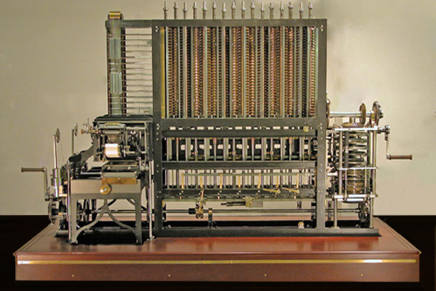
Difference Engine at the Computer History Museum

Slide 12
What’s the Problem?
Information for most of our history was recorded on finite media with a controllable physical presence and in a universally understandable form.
At the beginning of 1889, Herman Hollerith was granted a patent (US395782):
“its object to simplify and thereby facilitate the compilation of statistics wherein each of the statistical items to be recorded represents or is the product of one or more of the separate items or characteristics appertaining to each of the individuals or things respecting which the compilation is to be made”

Slide 13
The Transistor from the site www.pbs.org/transistor/index.html
In 1906, the eccentric American inventor Lee De Forest developed a triode in a vacuum tube. It was a device that could amplify signals, including, it was hoped, signals on telephone lines as they were transferred across the country from one switch box to another

Slide 14
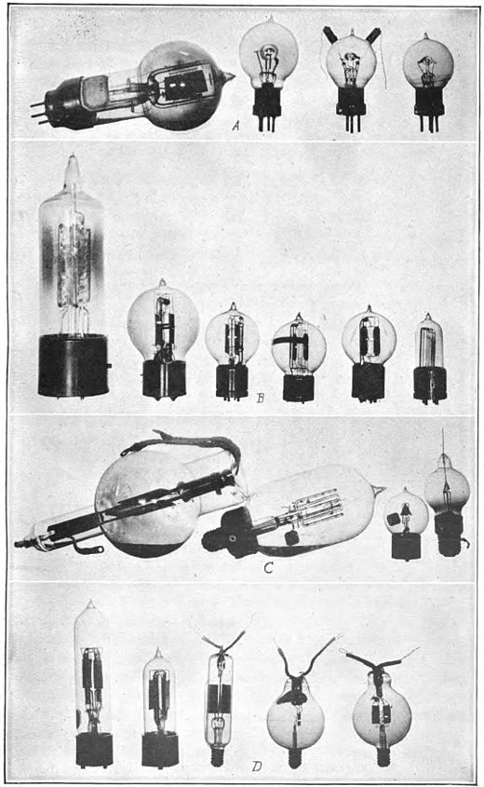
The Triode (Audion)
https://en.wikipedia.org/wiki/Audion

Slide 15
semiconductors
In the 1930s, Bell Lab's director of research, Mervin Kelly, recognized that a better device was needed for the telephone business to continue to grow. He felt that the answer might lie in a strange class of materials called semiconductors.

Slide 16
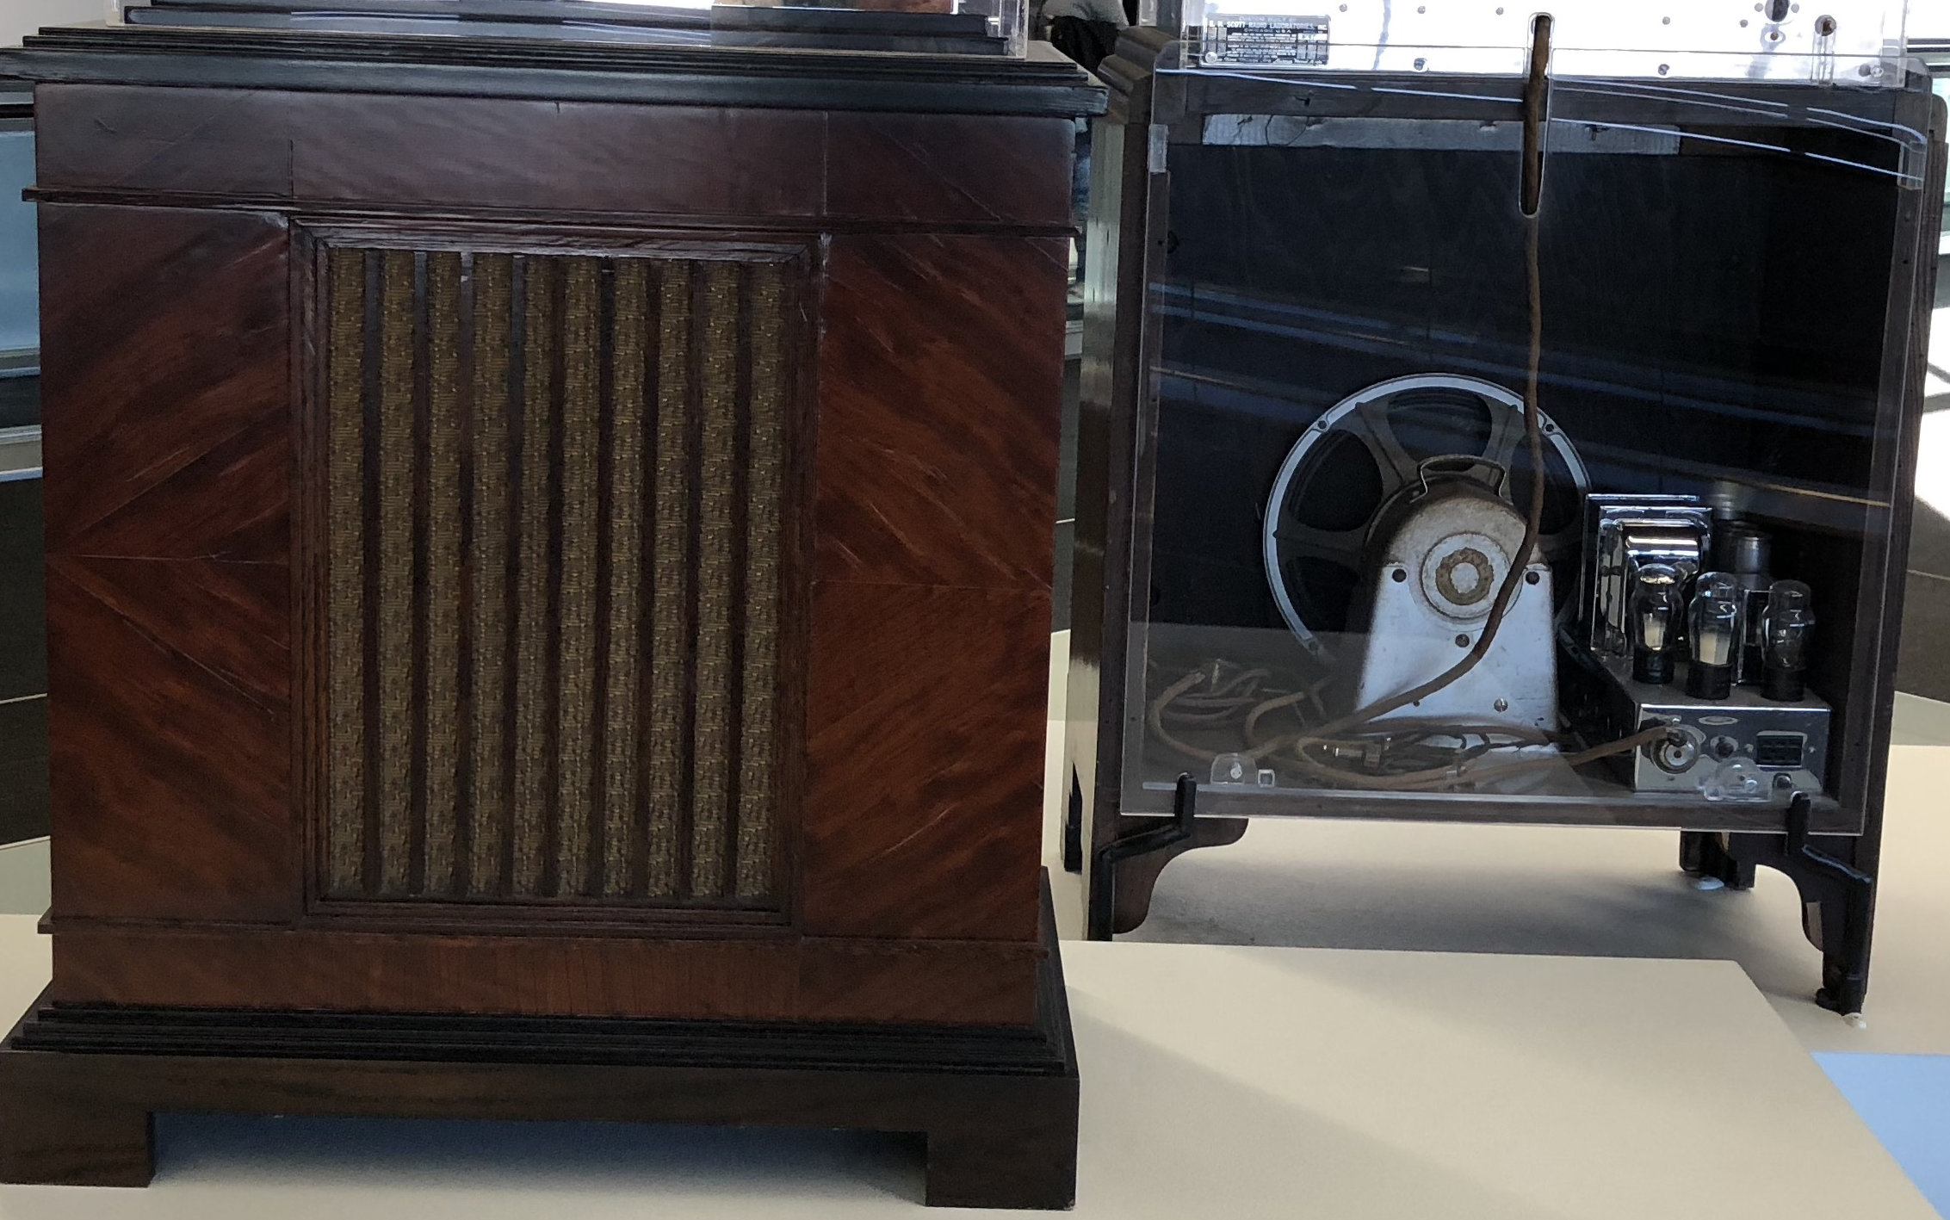
1930’s Era Radio’s

Slide 17
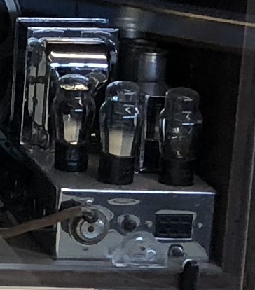
What made them work

Slide 18
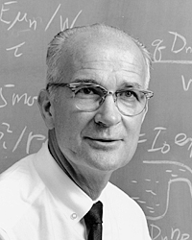
William Bradford Shockley Jr
(February 13, 1910 – August 12, 1989) was an American physicist and inventor. Along with John Bardeen and Walter Houser Brattain, Shockley co-invented the transistor, for which all three were awarded the 1956 Nobel Prize in Physics
http://en.wikipedia.org/wiki/William_Shockley

Slide 19
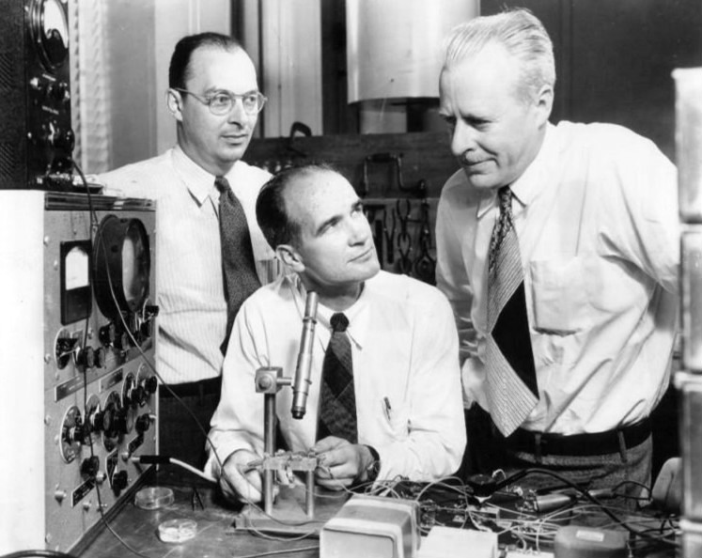
The Team

Slide 20
The birth
Bell Labs decided to unveil the invention on June 30, 1948. With the help of engineer John Pierce, who wrote science fiction in his spare time, Bell Labs settled on the name "transistor"-- combining the ideas of "trans-resistance" with the names of other devices like thermistors. The invention got little attention at the time, either in the popular press or in industry. But Shockley saw its potential.

Slide 21
Shockley starts…
He left Bell Labs to found Shockley Semiconductor in Palo Alto, California. He hired superb engineers and physicists, but, according to physical chemist Harry Sello, Shockley's personality drove out eight of his best and brightest.

Slide 22
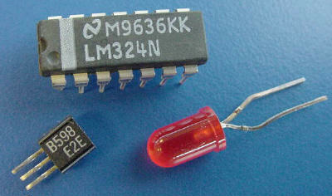
Semiconductors
Originally priced at $100 each

Slide 23
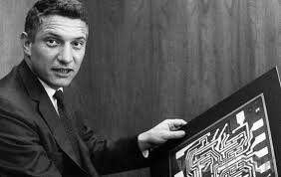
Traitorous eight
Those "traitorous eight" founded a new company called Fairchild Semiconductor. Bob Noyce and Gordon Moore, two of the eight, went on to form Intel Corporation.

Slide 24
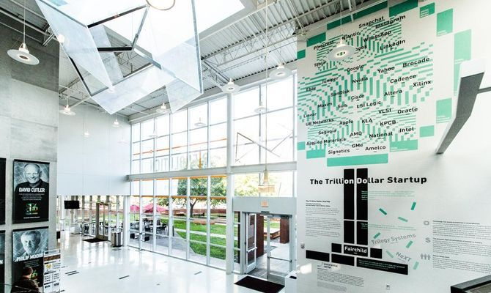
Fairchild Semiconductor
As of 2014, the 92 public companies that can be traced to Fairchild are now worth about $2.1 trillion, which is more than the annual GDP of Canada, India, or Spain.

Slide 25
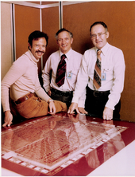
Noyce, Moore & Grove

Slide 26
Integrated Circuits
Noyce at Intel (and Kirby at Texas Instruments) co-invented the integrated circuit. Today, Intel produces billions of transistors daily on its integrated circuits, yet Bardeen, Brattain, and Shockley earned very little money from their research. Nonetheless, Shockley's company was the beginning of Silicon Valley.

Slide 27
Nobel Prize in 2000
Jack Kirby filed a patent for "Miniaturized Electronic Circuits", the first integrated circuit, on February 6, 1959. Along with Robert Noyce who independently made a similar circuit a few months later), Kilby is generally credited as co-inventor of the integrated circuit.

Slide 28
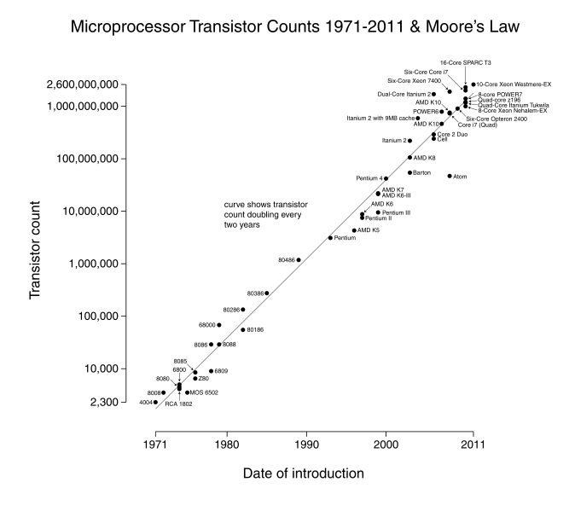
Intel’s progress & Moore’s Law

Slide 29
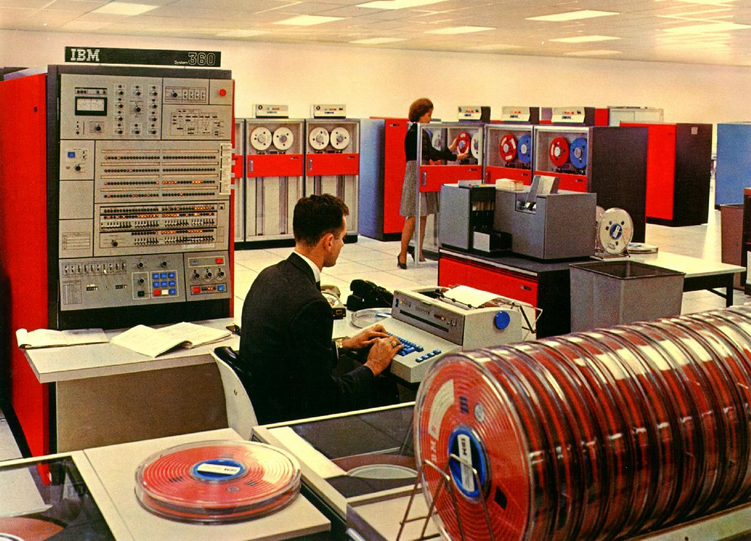
IBM 360

Slide 30
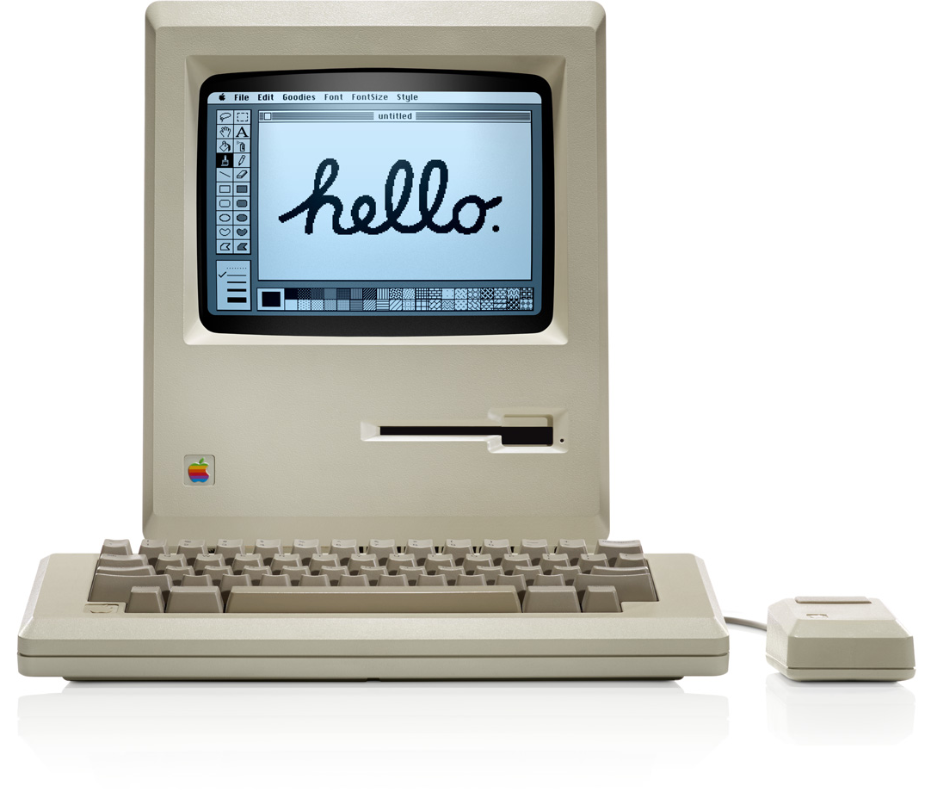
Apple 1984 128K RAM/400K Floppy

Slide 31
AEA starts in 1986
The transistor was 30 years into doubling the devices on a chip.
The 128K Macintosh and its graphical user interface were around
Microsoft’s GUI OS (Windows95) was still a decade away

Slide 32
ITE (Computer Uses) – Past
Computer Uses in Evaluation until 2003
Integrating Technology begins in 2004
Uses are largely on “mainframe” computers with data entry, database management system to contriol the data and mainframe analysis programs (SPSS, SAS) to distill the information

Slide 33
ITE – Present
Refining and improving on earlier efforts with the increasing addition of microcomputer applications
In addition Mobile/Real-Time data collection, Social Networking, Cloud Storage and use, are appearing.

Slide 34
ITE - Future
Social Media
The Cloud
Big data/Analytics
Internet of Things

Slide 35
Expectation
The next ten years will bring us incredible tools that will massively increase the degree to which we can provide accurate, reliable and increasingly valid information distilled from the data technology will collect and process.

Slide 36
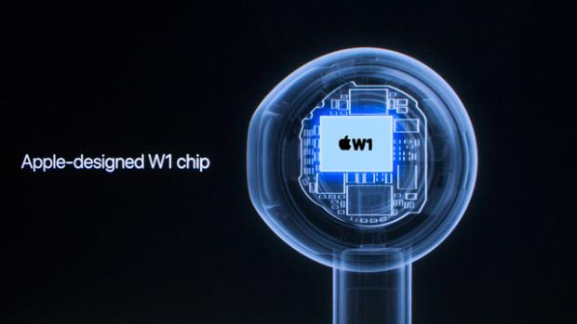
AirBud Chip
Announced Tuesday, Apple A12x has 10 billion transistors

Slide 37
Epilogue
“We must trust our good sense to provide the care of the potential in using the burgeoning Internet of Things to enhance our evaluation efforts and avoid using the powerful monitoring tools for purposes unrestrained by our good judgment.”
The social and political pitfalls must be taken into account even more than the simple application of technology to our evaluation needs.

Slide 38
Thank You
Discussion

Slide 39
Survey of Members
Briefly describe your interest in Integrating Technology into Evaluation TIG
What technologies have you used in evaluation in the past? (check all that apply)
Mark Sense (e.g. Scantron)
Smart Phones and other connected devices
On-line instruments (e.g. Survey Monkey)
IoT devices (e.g. Smart Watches)
Social Media (e.g., Facebook, Snapchat)
Other ______________

Slide 40
Survey of Members (cont)
What technologies are you using in evaluation at present?
Mark Sense (e.g. Scantron)
Smart Phones and other connected devices
On-line instruments (e.g. Survey Monkey)
IoT devices (e.g. Smart Watches)
Social Media (e.g., Facebook, Snapchat)
Other ______________
What technologies do you hope to use in evaluation in the future?
Mark Sense (e.g. Scantron)
Smart Phones and other connected devices
On-line instruments (e.g. Survey Monkey)
IoT devices (e.g. Smart Watches)
Social Media (e.g., Facebook, Snapchat)
Other ______________

Slide 41
Survey of Members (cont)
Which sorts of presentation would you like to see at future AEA conferences from this TIG
Reports of use/case studies
Demonstrations of technology use
Hands on workshops with technology
Discussion of developing technologies
Other ___________
What topics would you like the TIG to address?
Are you interested in a more formal role in the TIG? If so, indicate your preference
Co-chair
Co-Program Chair
Webmaster
Other _______________

Slide 42
Survey of Members Reaction to Fact sheet
Provides a forum for exchanging ideas and experiences in the employment of digital technology to facilitate and enhance evaluation efforts
From this TIG’s roots in Computer Uses in Evaluation (through 2003), Integrating Technology in Evaluation has sought to provide an exchange of information in how to integrate digital technologies to hone the evaluation effort increasing the precision and scope of those efforts.

Slide 43
Nominations & Volunteer Opportunities
TIG leadership positions, program development and all aspects of communication efforts (Website, AEA365, etc.) of the TIG have and seek volunteers. (Contact any of the team members listed above for information)

Slide 44
Thank You All
And prepare for an interesting year and a fine conference in Minneapolis

